Slide 1
Related works about QA&RC
Jian Fu

Slide 2
Datasets
TREC QA & WikiQA
SQuAD & CNN/DailyMail
WikiTableQuestions

Slide 3
Keys
similarity
attention
multi-hop, memory
RL
……

Slide 4
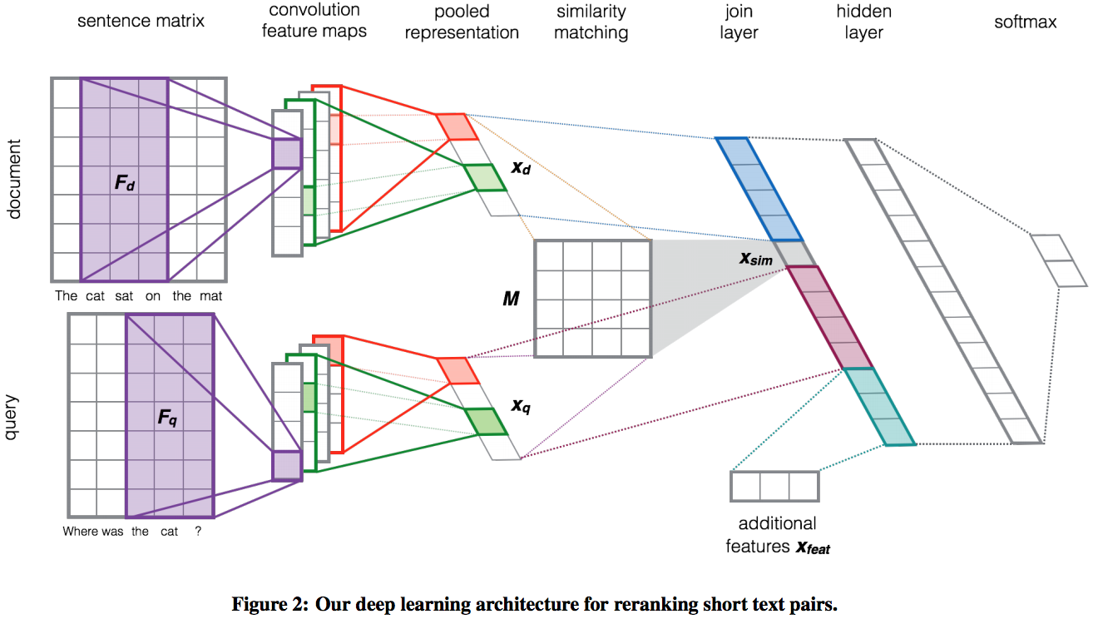

Learning to Rank Short Text Pairs with Convolutional Deep Neural Networks
Similarity

Slide 5
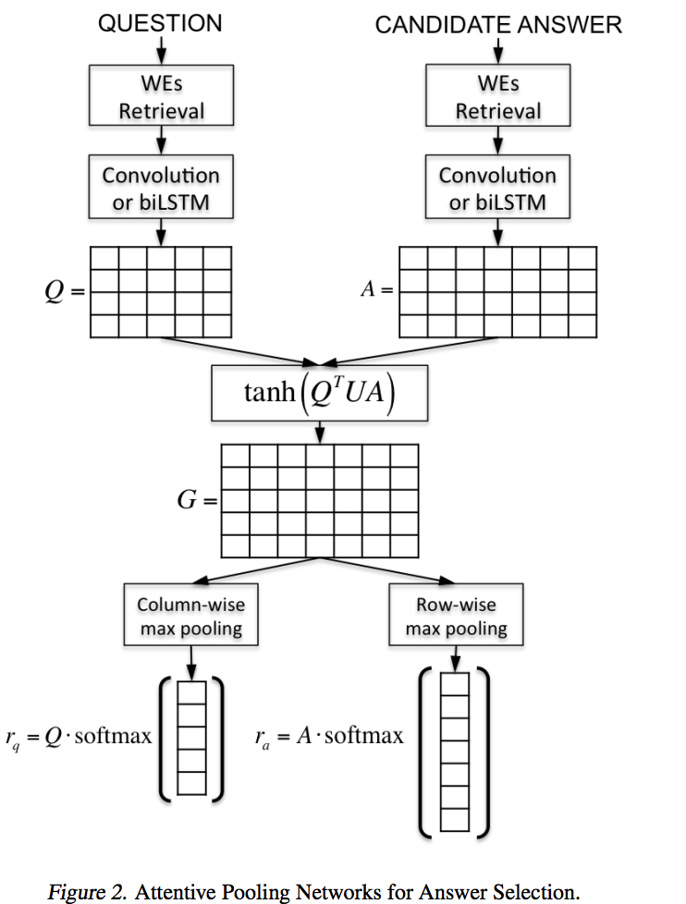

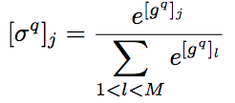

Attentive Pooling Networks
compute the matrix G
apply column-wise and row-wise max-poolings
apply the softmax function, dot product

Slide 6
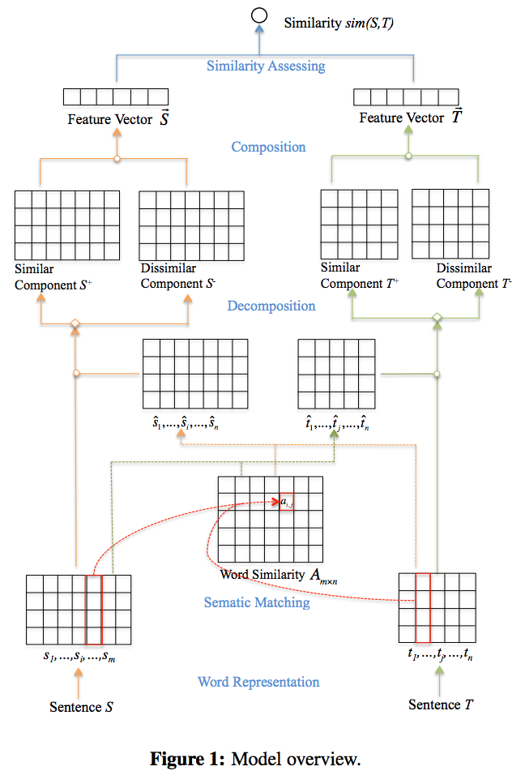

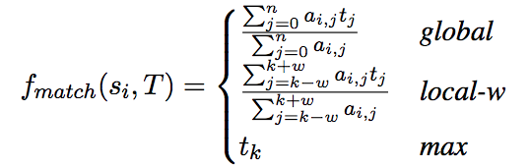
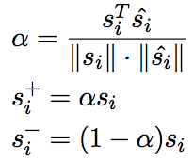
Sentence Similarity Learning by Lexical Decomposition and Composition
similarity matrix
semantic matching functions
decomposition

Slide 7
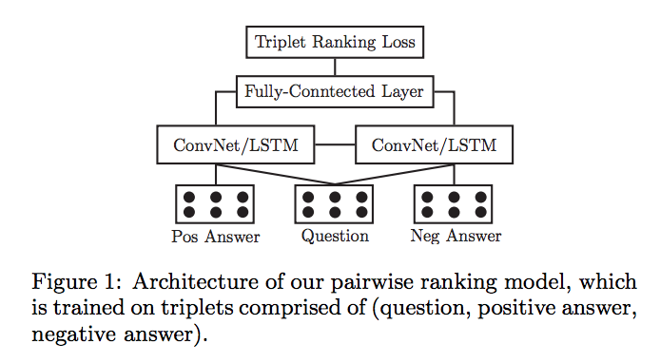

Noise-Contrastive Estimation for Answer Selection with Deep Neural Networks
Parameters of the two base models are shared during training
Sampling Strategy
Random Sampling
Max Sampling
Mix Sampling

Slide 8
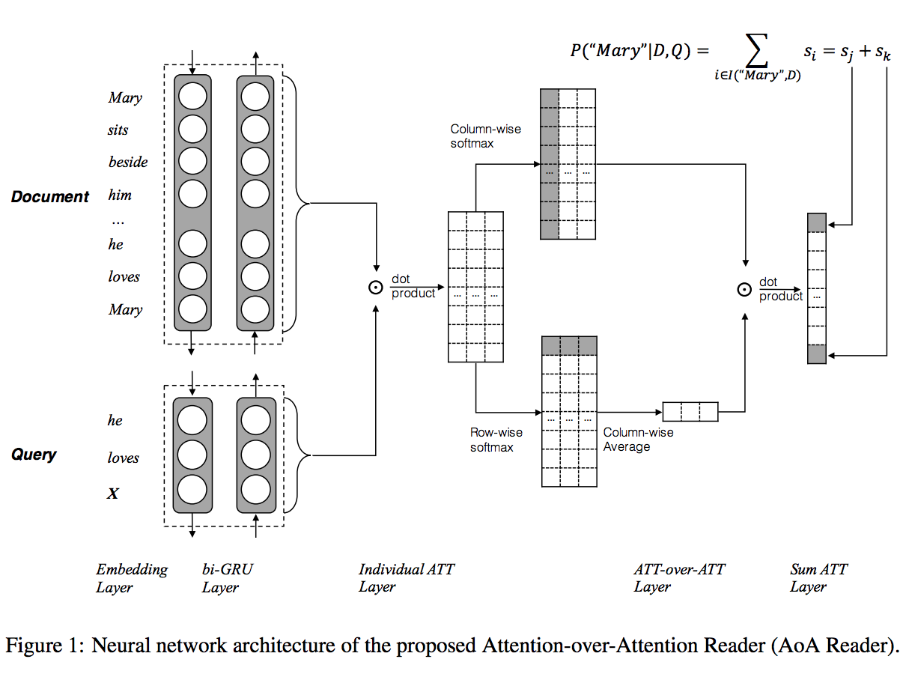




Attention-over-Attention Neural Networks for Reading Comprehension
Pair-wise Matching Score
Individual Attentions
Attention-over-Attention

Slide 9
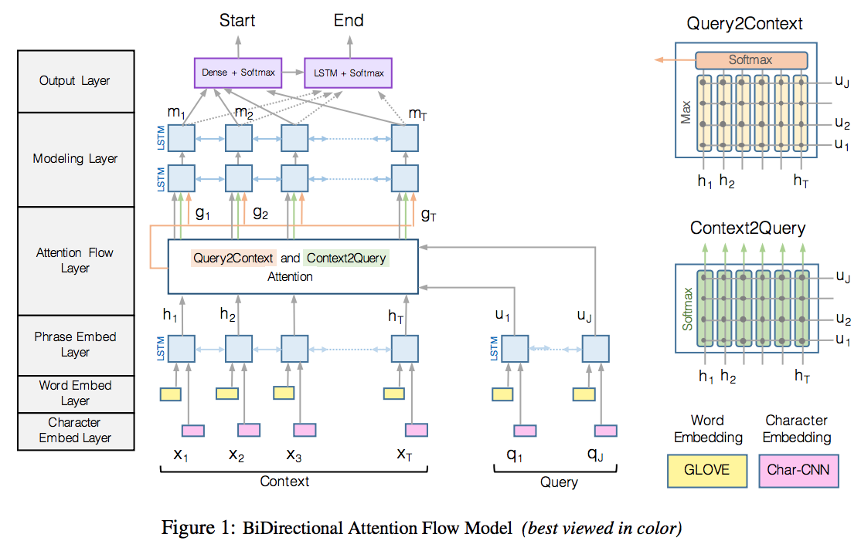



Bidirectional Attention Flow for Machine Comprehension
similarity matrix
Context-to-query Attention
Query-to-context Attention
define define G

Slide 10
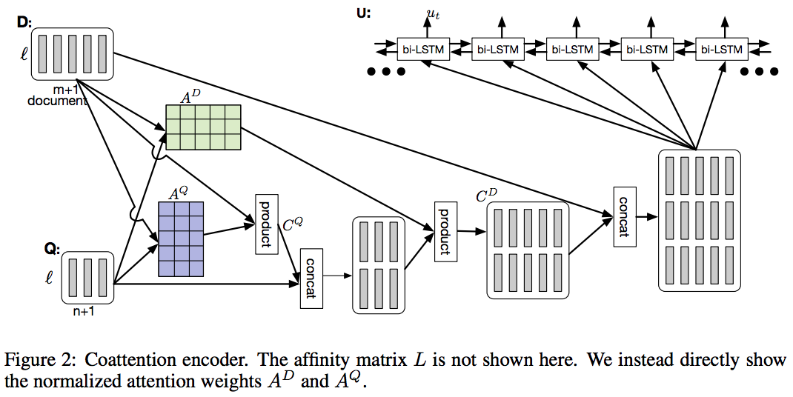


Dynamic Coattention Networks For Question Answering
the affinity matrix
row-wise to produce the attention weights
compute the summaries
similarly

Slide 11
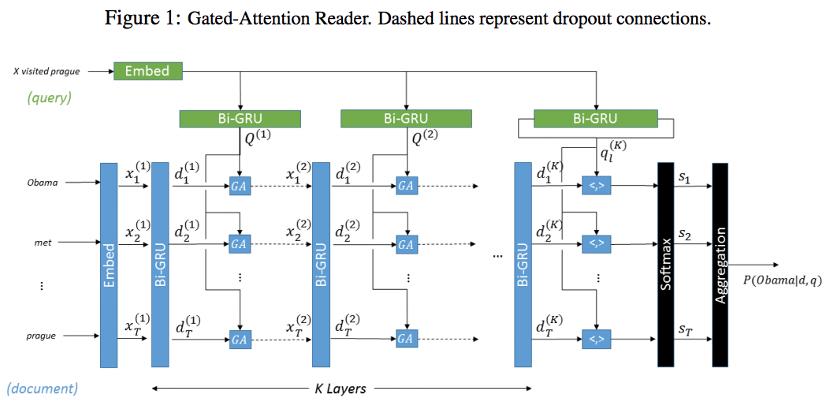
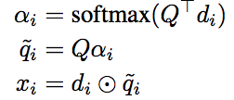
Gated-Attention Readers for Text Comprehension
GATED-ATTENTION MODULE

Slide 12
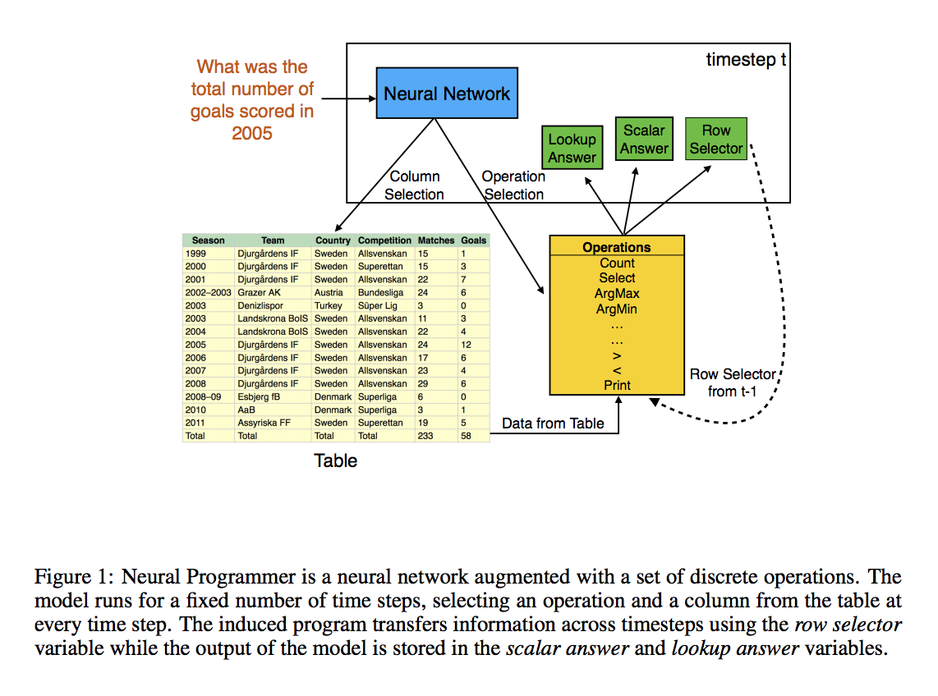
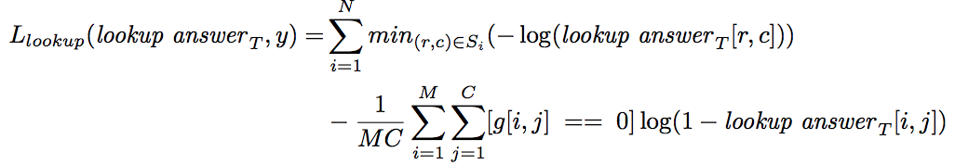
Learning a Natural Language Interface with Neural Programmer
four modules:Question RNN , A list of discrete operations, A selector module that induces two probability distributions ,History RNN
OUTPUT AND ROW SELECTOR
TRAINING OBJECTIVE

Slide 13
References
Learning to Rank Short Text Pairs with Convolutional Deep Neural Networks
Attentive Pooling Networks
Sentence Similarity Learning by Lexical Decomposition and Composition
Noise-Contrastive Estimation for Answer Selection with Deep Neural Networks
Attention-over-attention
Bidirectional Attention Flow for Machine Comprehension
Dynamic Coattention Networks For Question Answering
Gated-Attention Readers for Text Comprehension
Learning a Natural Language Interface with Neural Programmer

