Slide 1
Outline
Group Normalization
On the importance of single directions for generalization, ICLR 2018
Universal Sentence Encoder
Supervised Learning of Universal Sentence Representations from Natural Language Inference Data, EMNLP 2017
Learned in Translation: Contextualized Word Vectors, NIPS 2017

Slide 2
Group Normalization
Yuxin Wu, Kaiming He
Facebook AI Research (FAIR)
Notes:
2 figures. 原理： 经典的feature

Slide 3
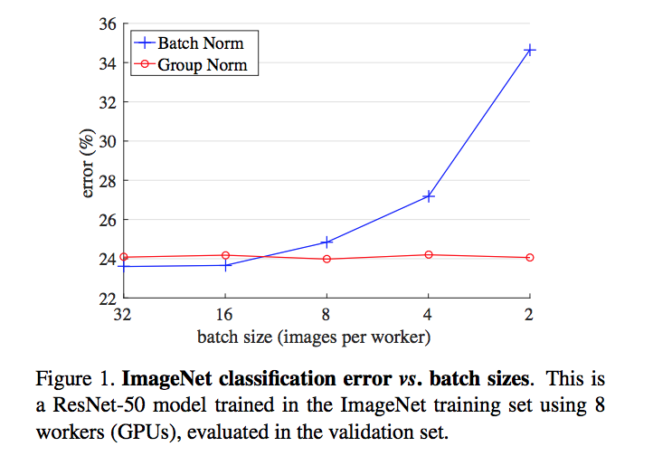
Group Normalization

Slide 4
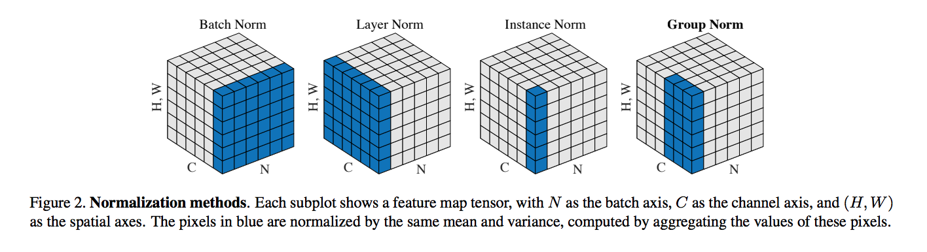
Group Normalization

Slide 5
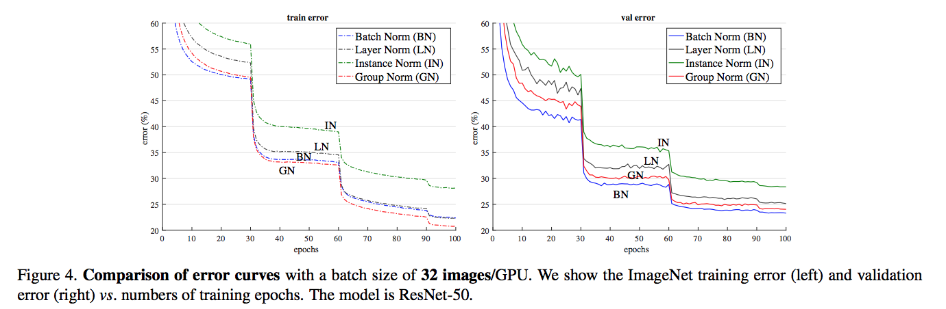
Image Classification in ImageNet

Slide 6
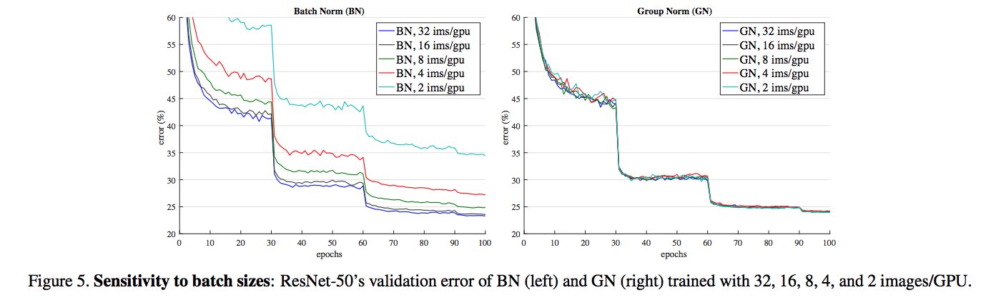
Image Classification in ImageNet

Slide 7
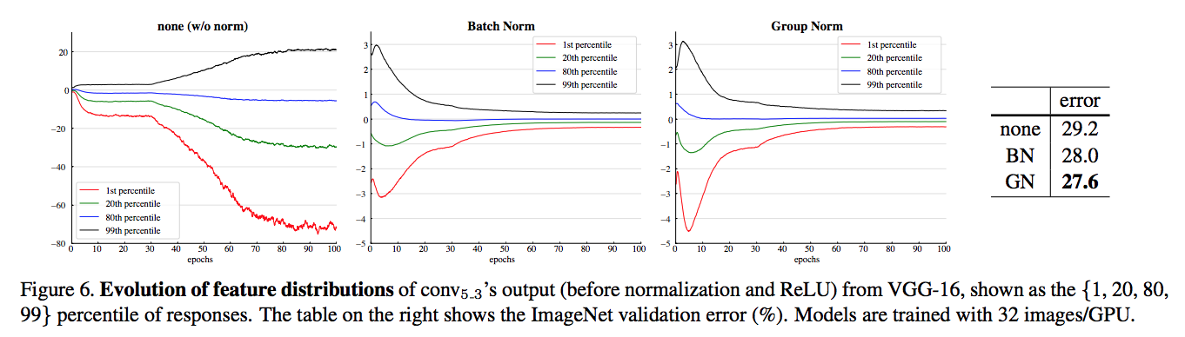
Image Classification in ImageNet

Slide 8
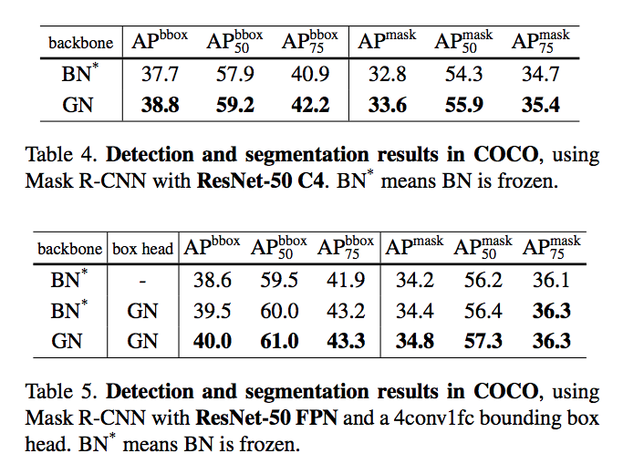
Object Detection and Segmentation in COCO

Slide 9
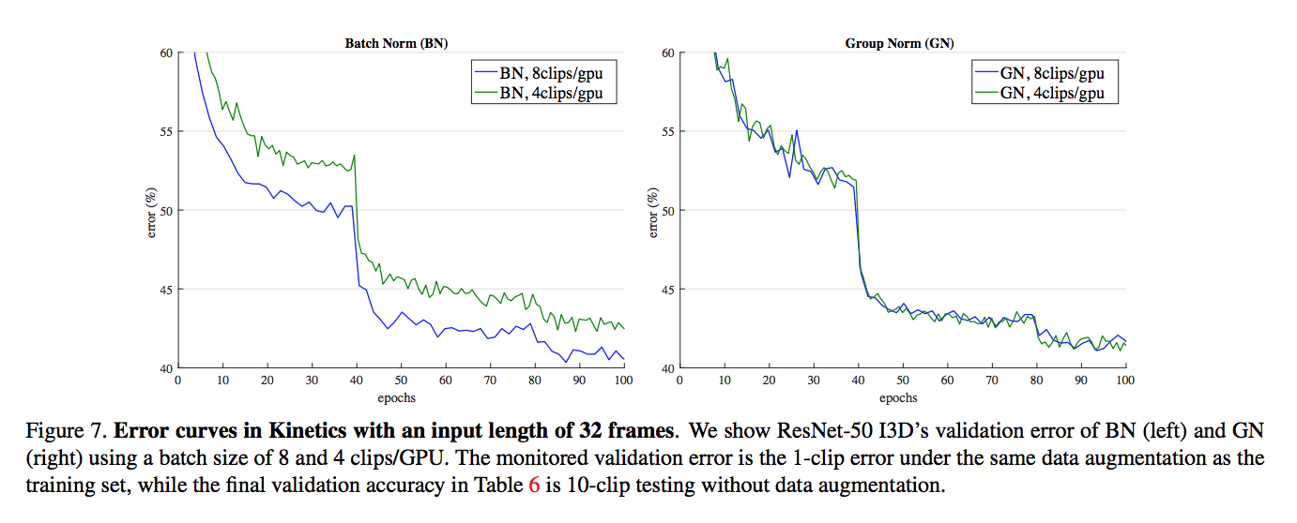
Video Classification in Kinetics

Slide 10
On the importance of single directions for generalization
Ari S. Morcos1 , David G.T. Barrett, Neil C. Rabinowitz, & Matthew Botvinick
DeepMind
ICLR, 2018
Notes:
Rethinking generalization, corrupted labels, class selectivity is a poor predictor

Slide 11

On the importance of single directions for generalization
Quantify class selectivity:

Slide 12
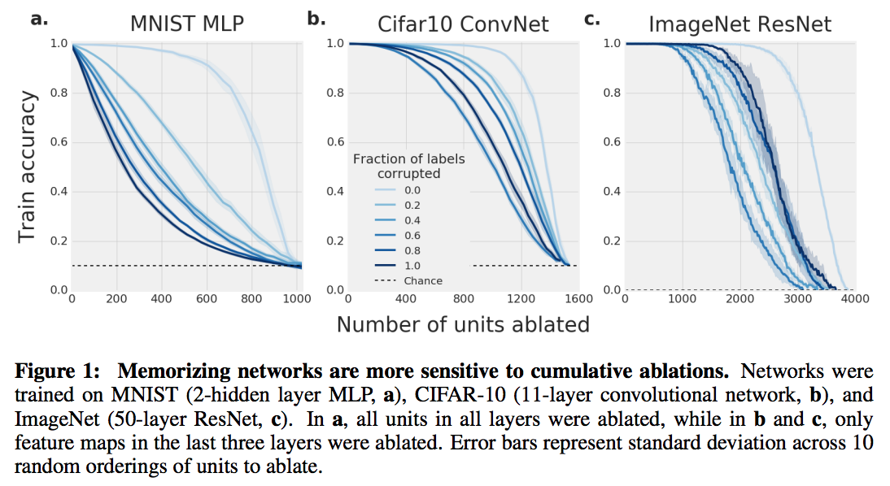
GENERALIZATION

Slide 13
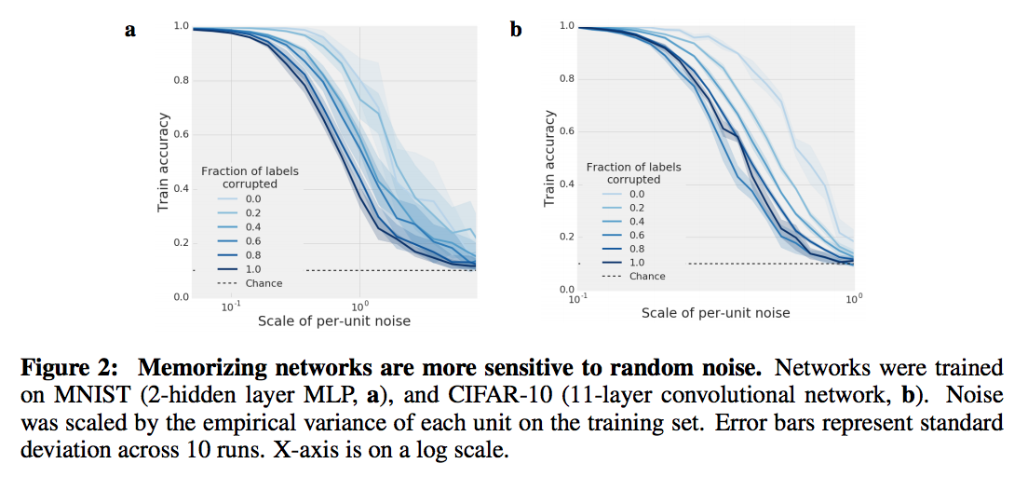
GENERALIZATION

Slide 14
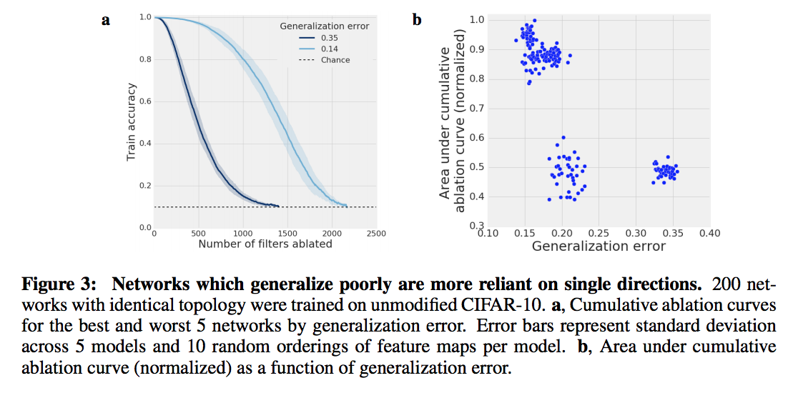
GENERALIZATION

Slide 15
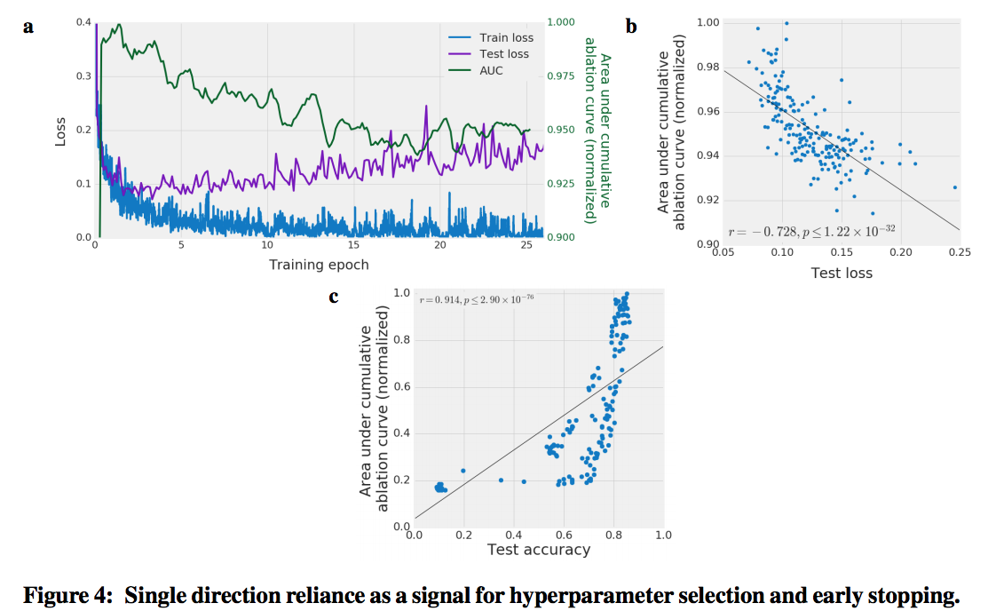
RELIANCE ON SINGLE DIRECTIONS AS A SIGNAL FOR MODEL SELECTION

Slide 16
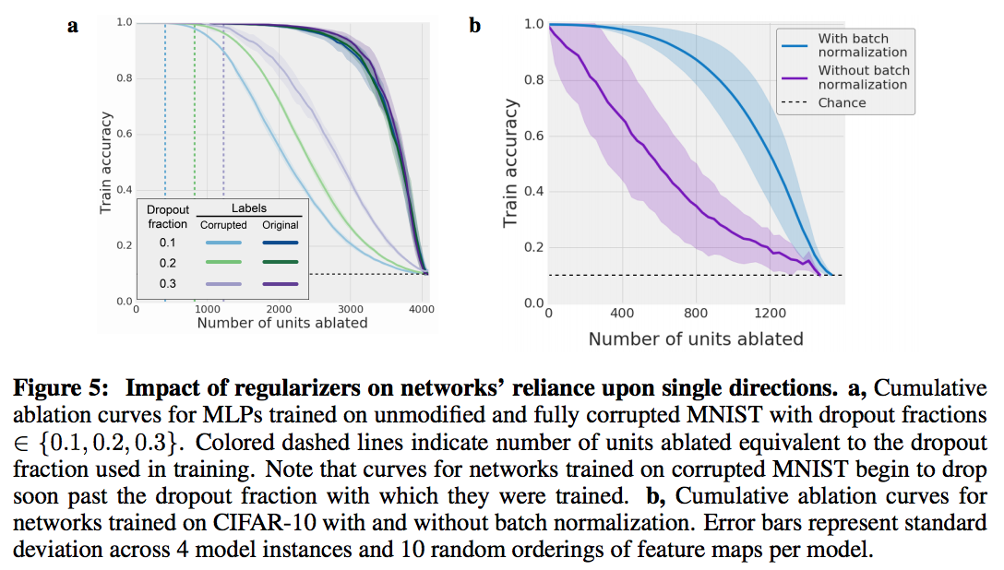
RELATIONSHIP TO DROPOUT AND BATCH NORMALIZATION

Slide 17
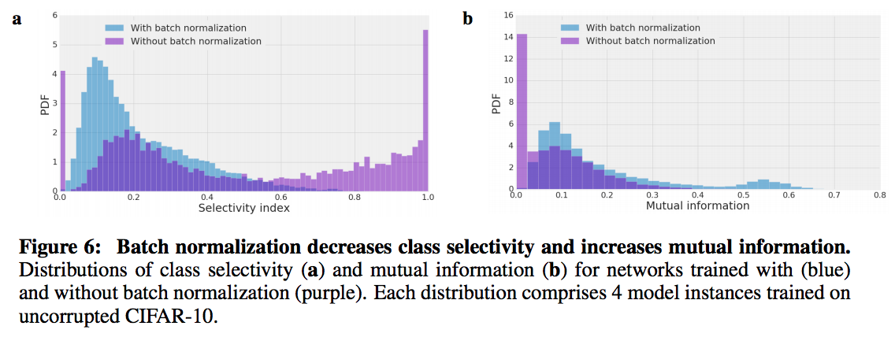
RELATIONSHIP BETWEEN CLASS SELECTIVITY AND IMPORTANCE

Slide 18
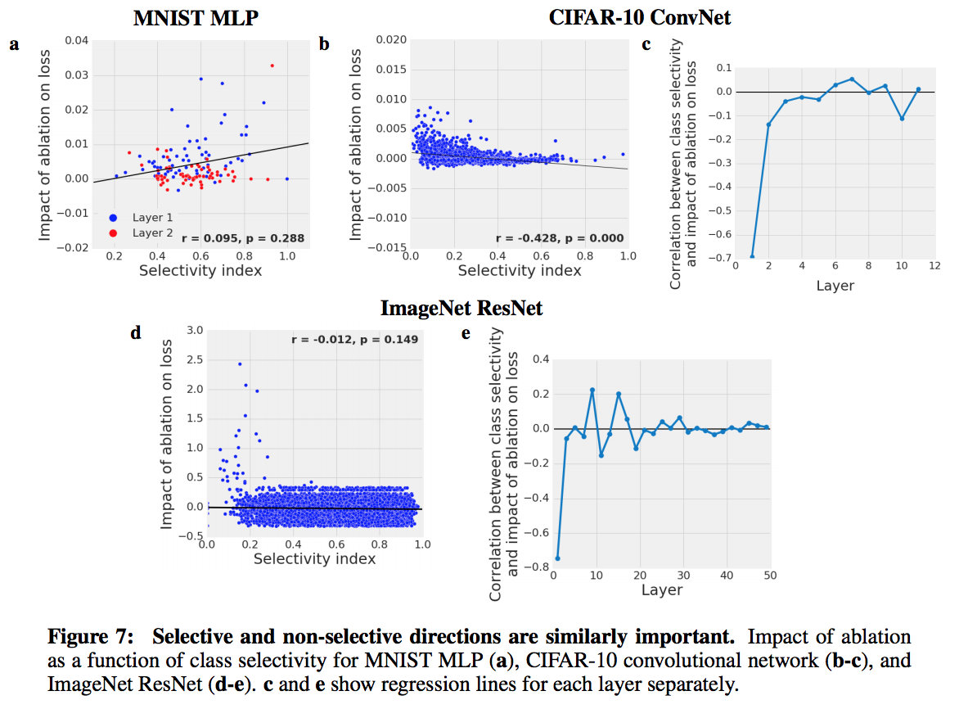
RELATIONSHIP BETWEEN CLASS SELECTIVITY AND IMPORTANCE

Slide 19
Universal Sentence Encoder
Daniel Cer, Yinfei Yang, Sheng-yi Kong, Nan Hua, Nicole Limtiaco, Rhomni St. Johna …
Google Research

Slide 20
Encoders
Transformer
Deep Averaging Network (DAN)

Slide 21
Encoder Training Data
Unsupervised
Wikipedia, web news, web question-answer pages and discussion forums
Supervised
Stanford Natural Language Inference (SNLI) corpus

Slide 22
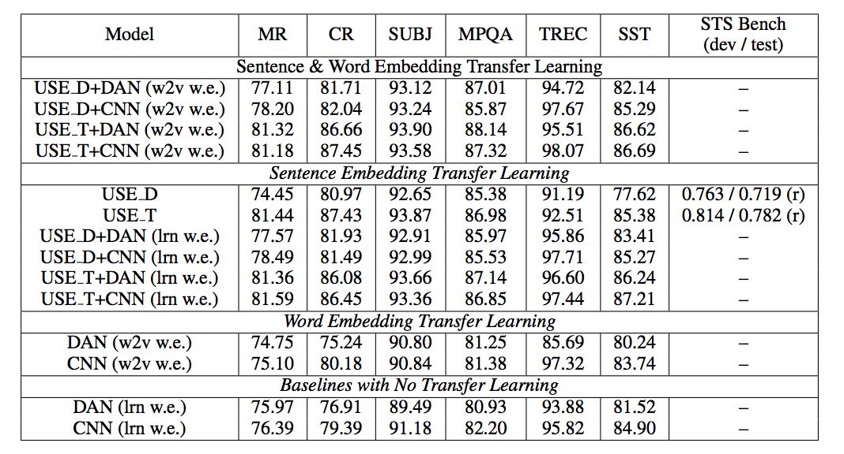
Experiments

Slide 23
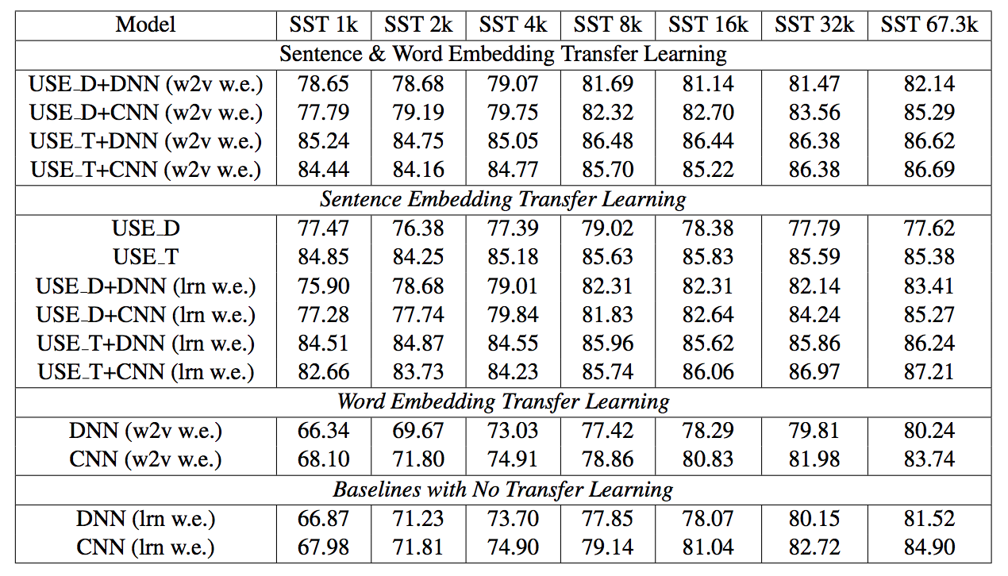
Experiments

Slide 24
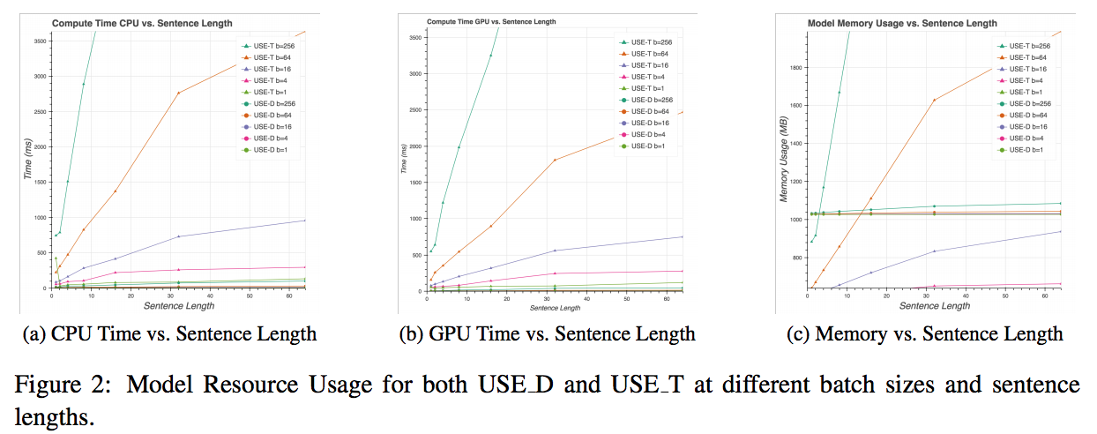
Experiments

Slide 25
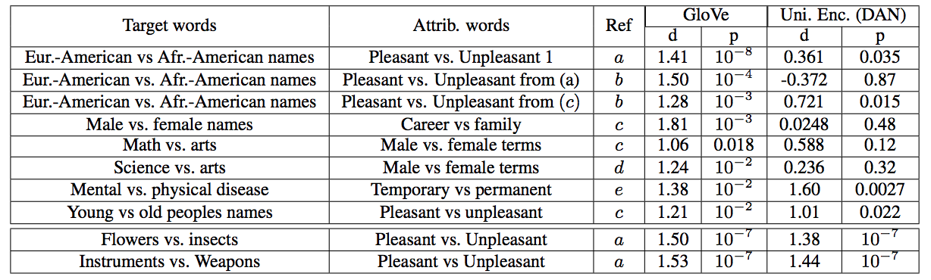
Experiments

Slide 26
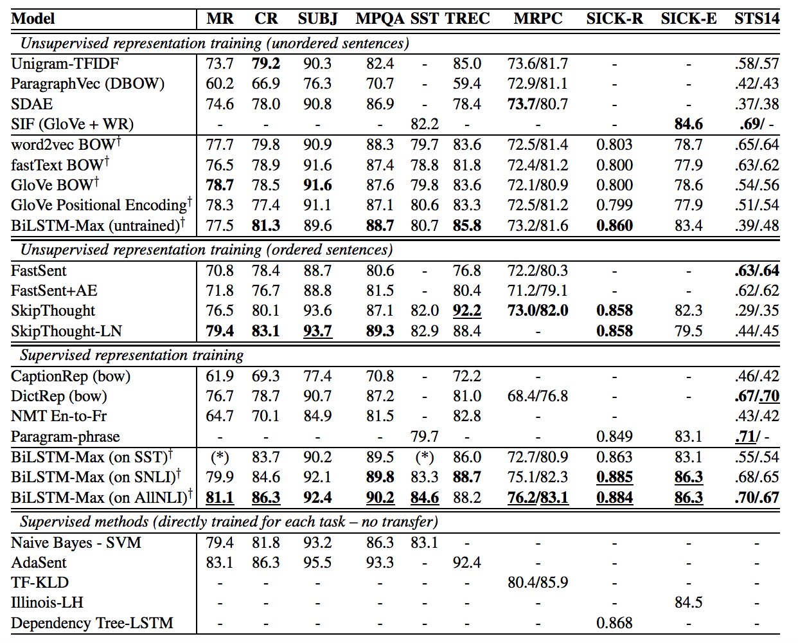
Supervised Learning of Universal Sentence Representations from Natural Language Inference Data

Slide 27
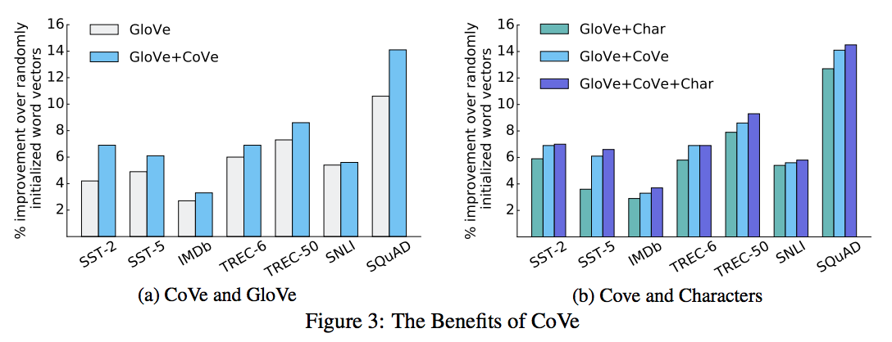
Learned in Translation: Contextualized Word Vectors

Slide 28
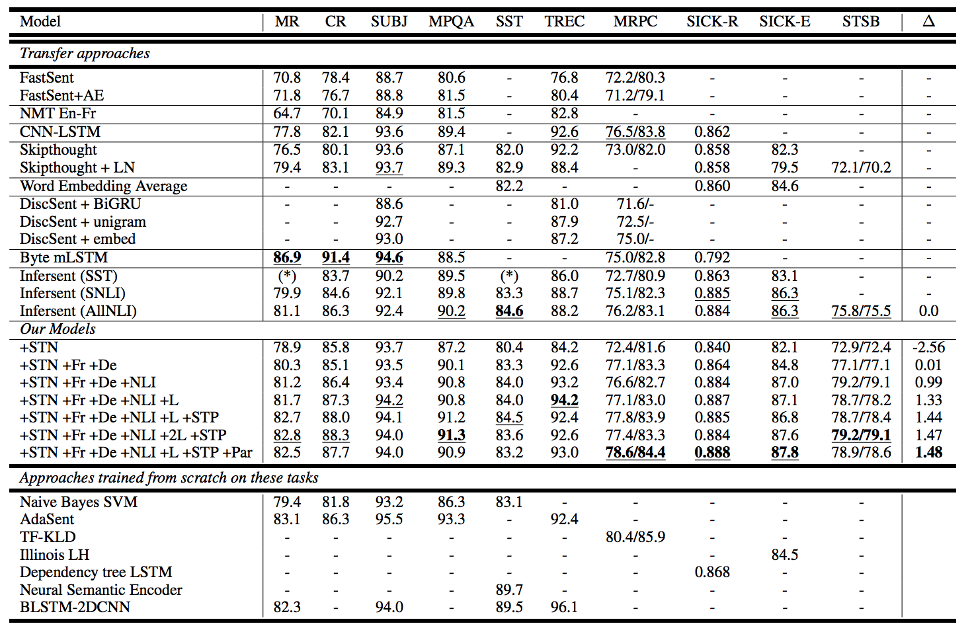
Learning General Purpose Distributed Sentence Representations via Large Scale Multi-task Learning
Notes:
Also : word embedding(benchmark), sentence embedding(certain characristic)

Slide 29
Thank you

