Slide 1
Averaging Weights Leads to Wider Optima and Better Generalization
Pavel Izmailov, Dmitrii Podoprikhin, Timur Garipov, Dmitry Vetrov, Andrew Gordon Wilson
Cornell University, Moscow State University, Higher School of Economics

Slide 2
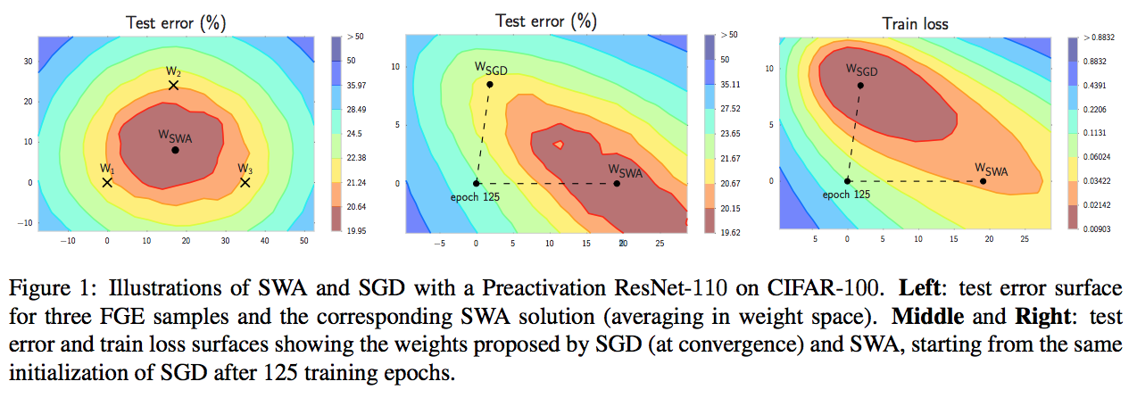
Stochastic Weight Averaging

Slide 3
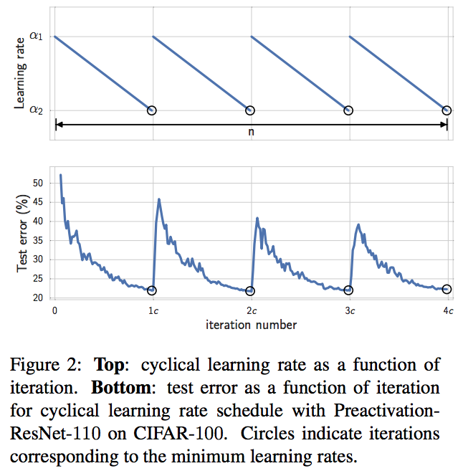
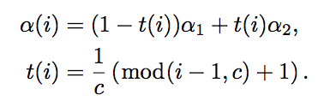

Analysis of SGD Trajectories
In each cycle we linearly decrease the learning rate from α₁ to α₂. The formula for the learning rate at iteration $i$ is given by

Slide 4
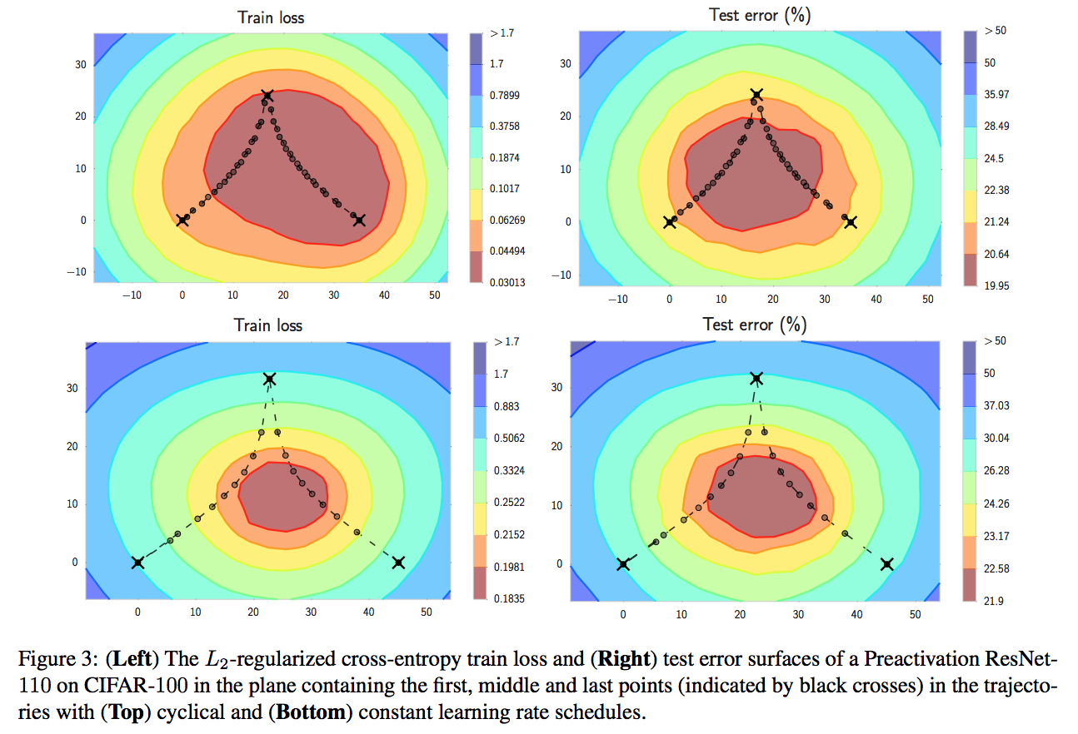
Analysis of SGD Trajectories

Slide 5
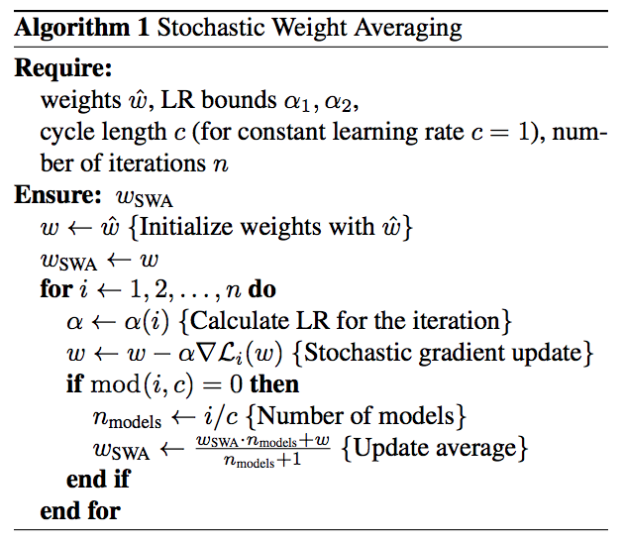
SWA Algorithm & Computational Complexity

Slide 6


Optima Width
Let $w$_{SWA} and $w$_{SGD} denote the weights of DNNs trained using SWA and conventional SGD, respectively. Consider the rays

Slide 7
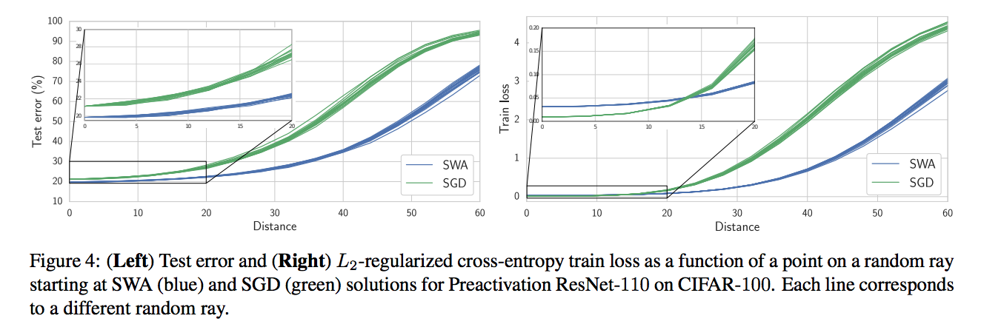
Optima Width

Slide 8
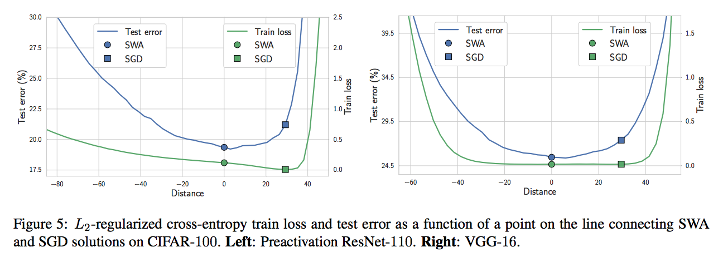
Optima Width

Slide 9
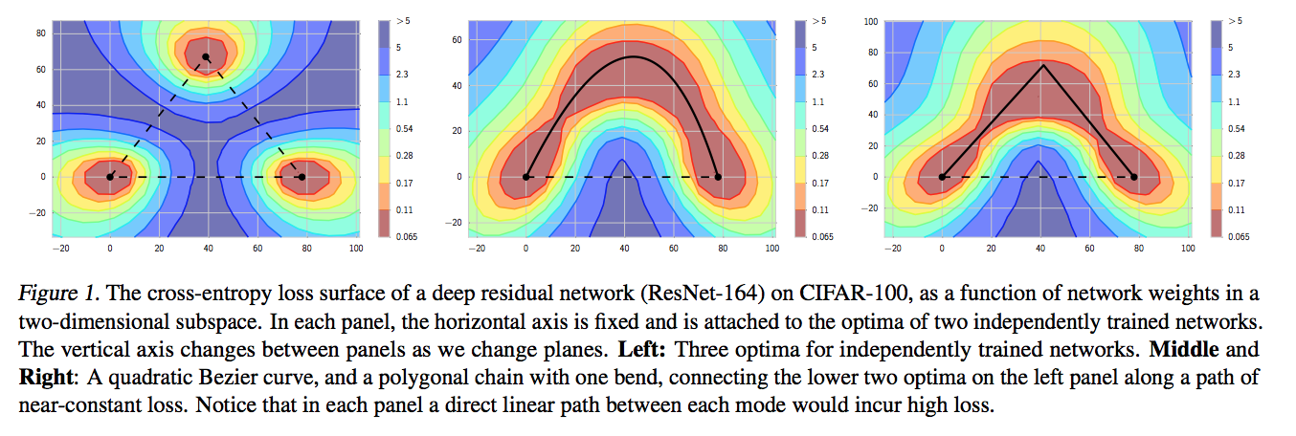
Connection to Ensembling
Loss Surfaces, Mode Connectivity, and Fast Ensembling of DNNs

Slide 10

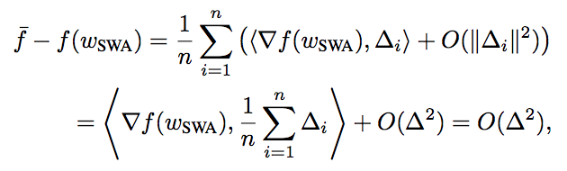

Connection to Ensembling
Ensemble
Consider the linearization of f at wSWA.

Slide 11

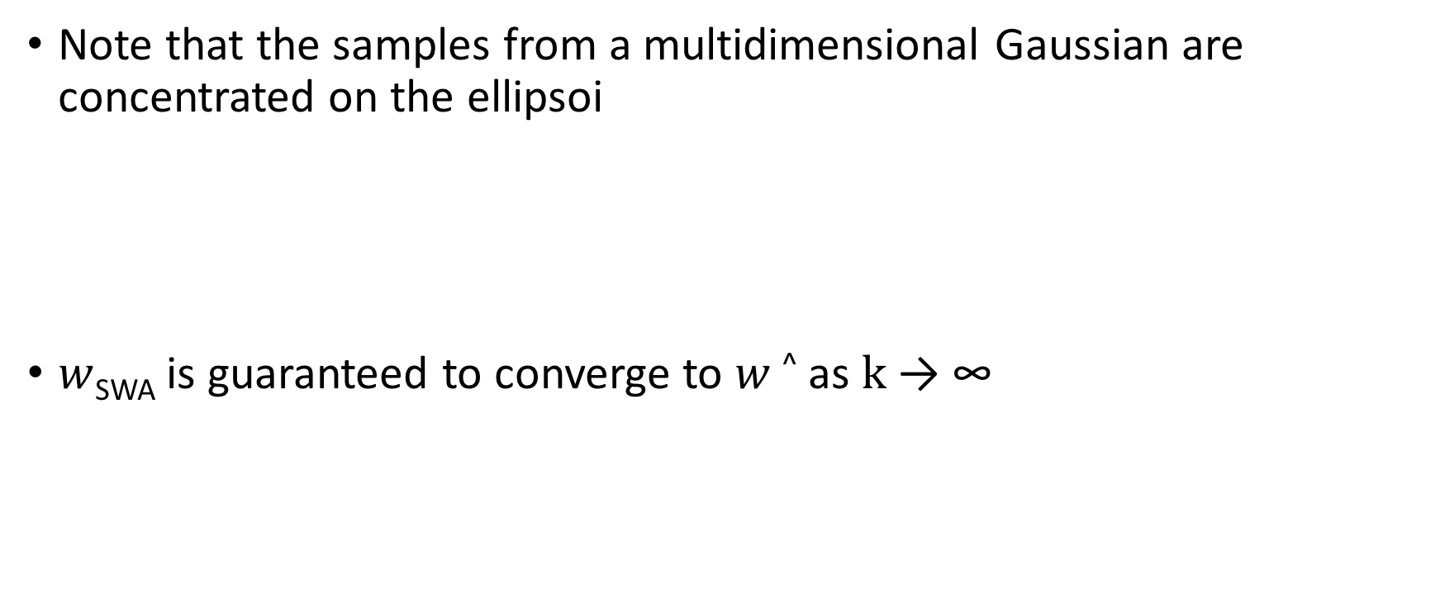
Connection to Convex Minimization
Note that the samples from a multidimensional Gaussian are concentrated on the ellipsoi
$w$_{SWA} is guaranteed to converge to $w$^ as $k$ → ∞

Slide 12
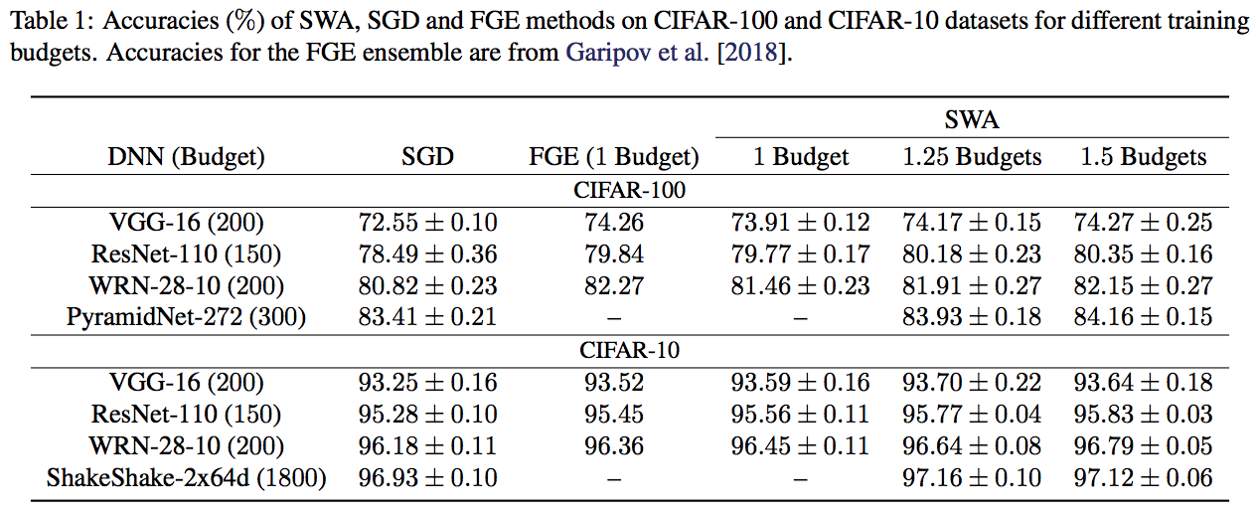
Experiments: CIFAR & ImageNet

Slide 13
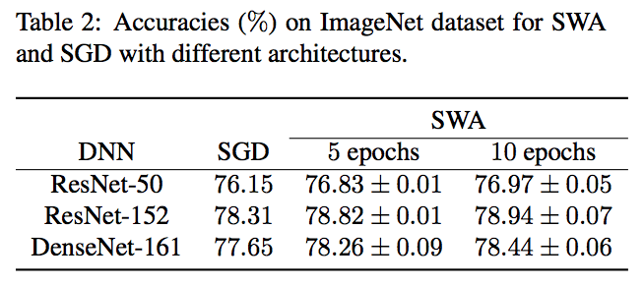
Experiments: CIFAR & ImageNet

Slide 14
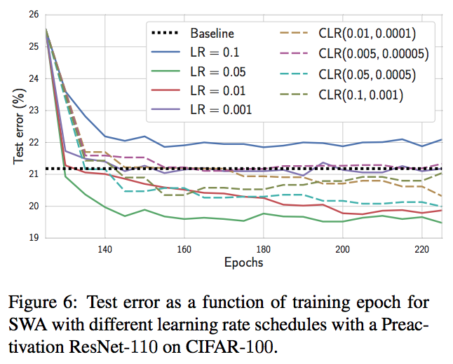
Experiments: Effect of the Learning Rate Schedule

Slide 15
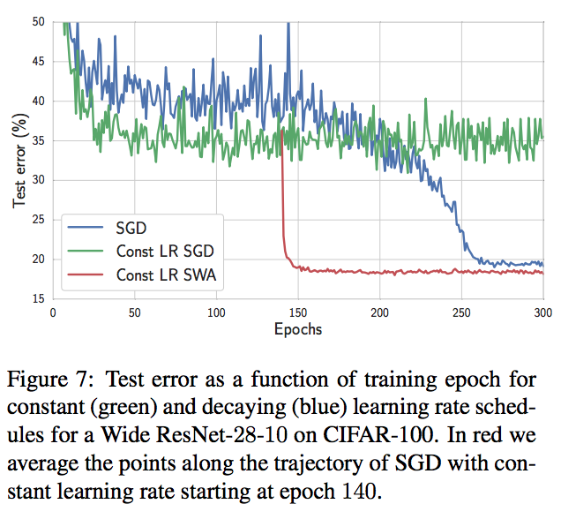
Experiments: DNN training with a fixed learning rate

Slide 16
Discussion
Furthermore, a cyclic learning rate enables SWA to explore regions of high posterior density over neural network weights. Such learning rate schedules could be developed in conjunction with stochastic MCMC approaches, to encourage exploration while still providing high quality samples.
…

Slide 17
Thank you

