Slide 2
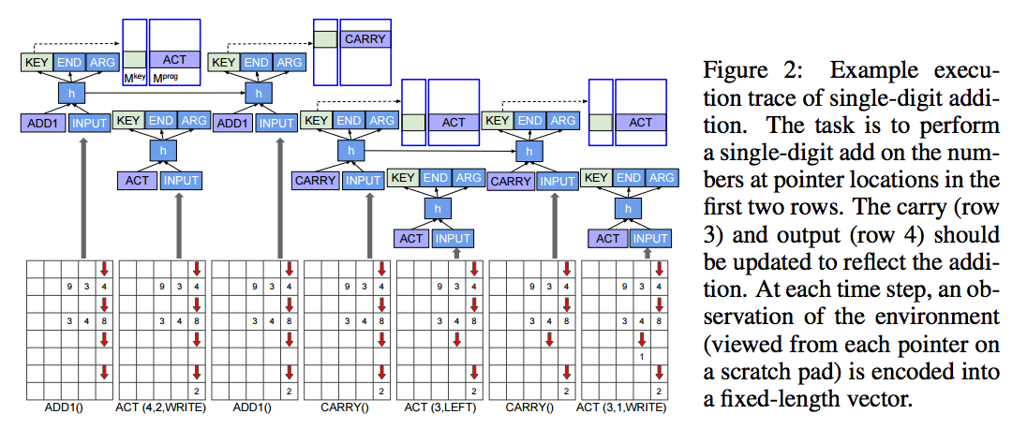
Task

Slide 3
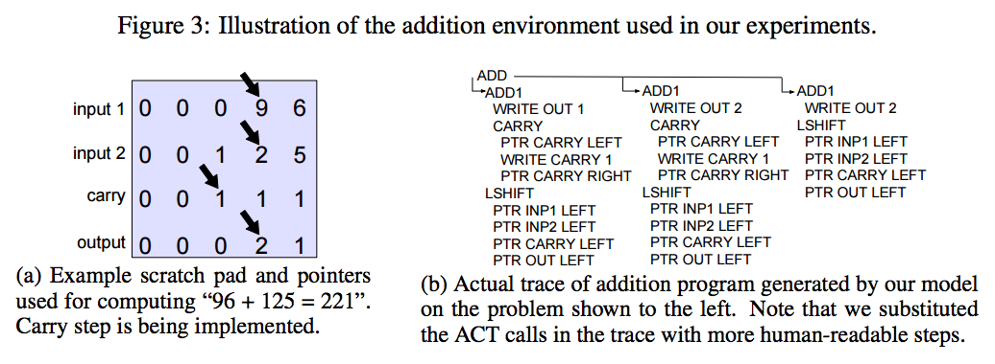
Task

Slide 4
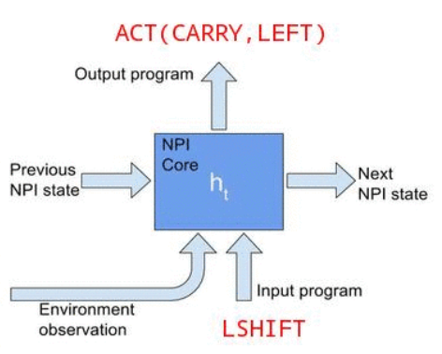
Neural Programmer-Interpreter (NPI)

Slide 5
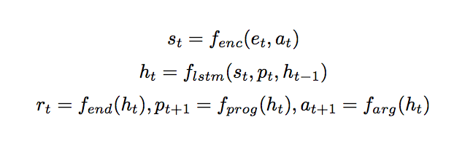
Neural Programmer-Interpreter (NPI)

Slide 6
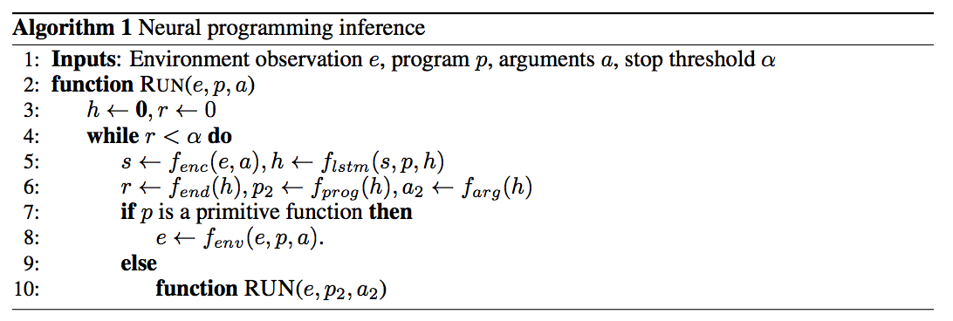
Neural Programmer-Interpreter (NPI)

Slide 7
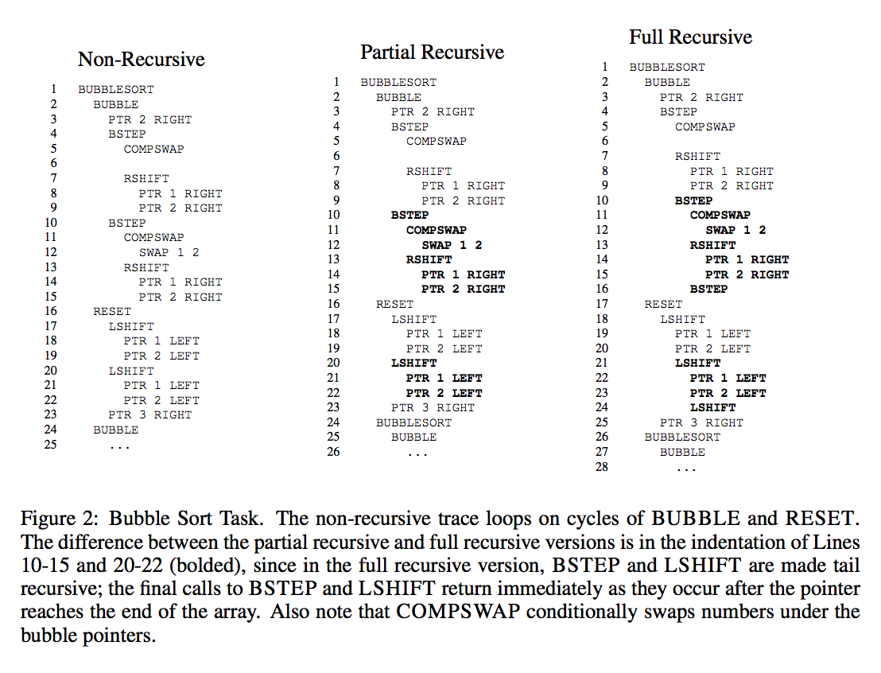
Recursive Formulations

Slide 8

Provably Perfect Generalization
Formally, verification consists of proving the following theorem:
consider the family F of addition problems：

Slide 9
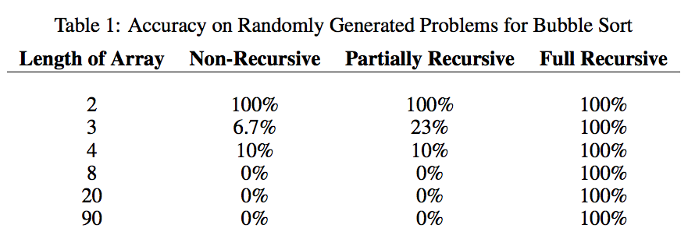
Experiments

Slide 10
Thank you

