Slide 1
Text Generation Study Based on Variational Auto-Encoder
中期考核报告
傅健 16210240008
Notes:
基于变分自编码器的文本生成研究

Slide 2
Introduction: task & baseline
Text Generation
Goal
Evaluation
Methods
Variational Auto-Encoder
Notes:
Goal, evaluation(sample, NLL, LM:Perplexity困惑度), methods(VAE, GAN, RL & their Condition-version)

Slide 3
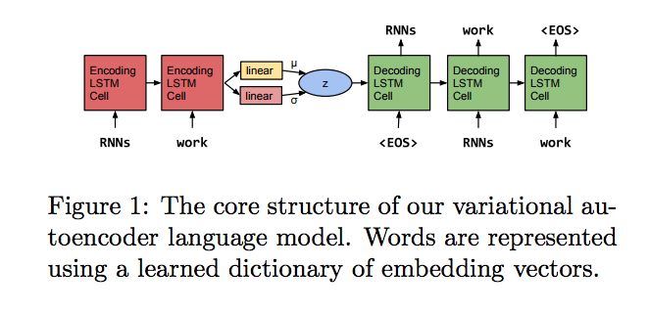
Introduction: task & baseline
Variational Auto-Encoder
cited from [1]
Notes:
Standard VS Inputless

Slide 4
Outline: ideas
Learning Vector Quantization
+ RevNet(decoder)
Low-variance Latent Model (continuous & discrete )
Act as Adaptive LR
Cyclical LR Ensemble Model
+ MCMC
Iterate by Teaching (loss + imitation)
Step back & Ensemble
Notes:
3+4： 4上面增加回退的步骤， 2+3: 使得2发挥地更好
1.学习向量量化 2.低方差隐变量 3.周期学习率融合模型 4.教学迭代

Slide 5
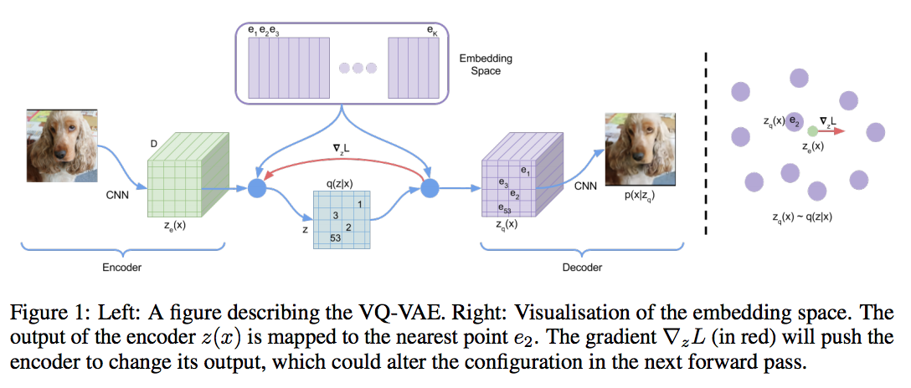
Idea: Learning Vector Quantization
VQVAE
cited from [4]

Slide 6
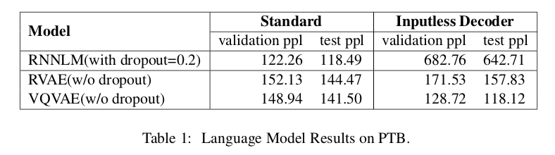
Idea: Learning Vector Quantization
VQVAE

Slide 7
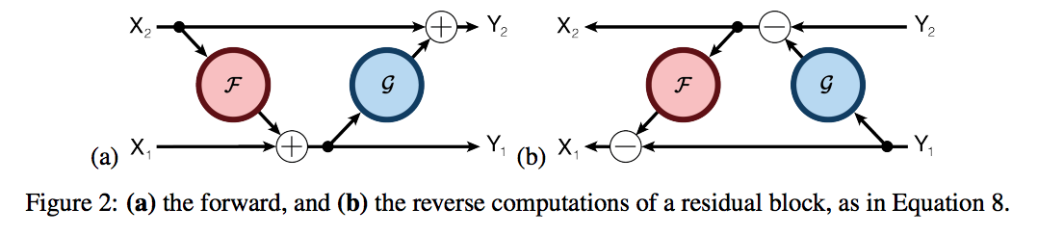
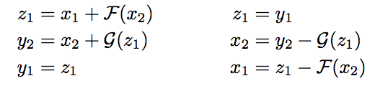
Idea: Learning Vector Quantization
RevNet(decoder)
cited from [7]

Slide 8
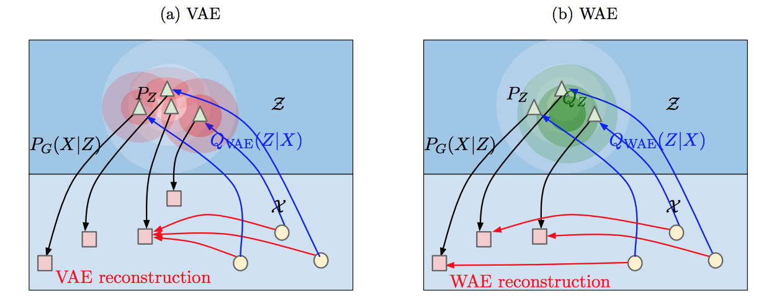
Idea: Learning Vector Quantization
VQVAE + Rev (motivation: Wasserstein Auto-Encoders)
cited from [8]
Notes:
Rev(显式做到一一对应，同时预期会更快：1步可以做2次更新)

Slide 9

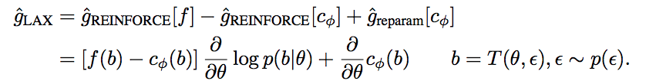
Idea: Low-variance Latent Model
Control Variates
Continuous
cited from [9]
Notes:
Problem: overfit (especially LM Task) (softmax * softmax cost!!!)

Slide 10
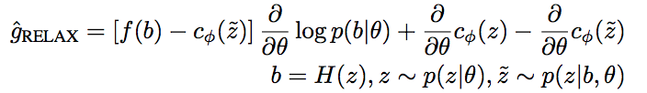
Idea: Low-variance Latent Model
Discrete
cited from [9]

Slide 11
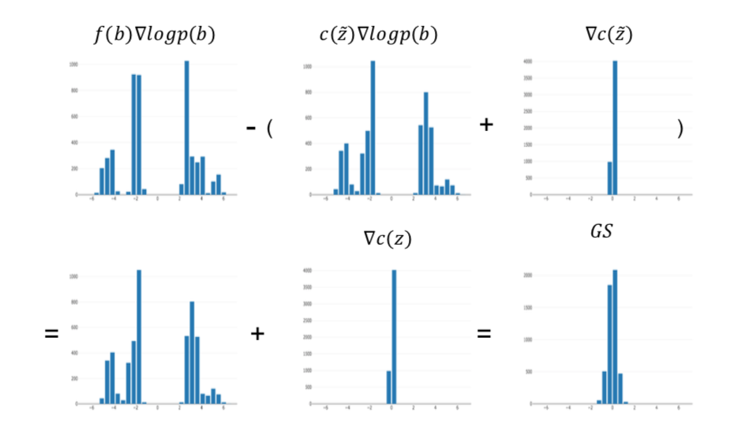
Idea: Low-variance Latent Model
Visualization: discrete

Slide 12
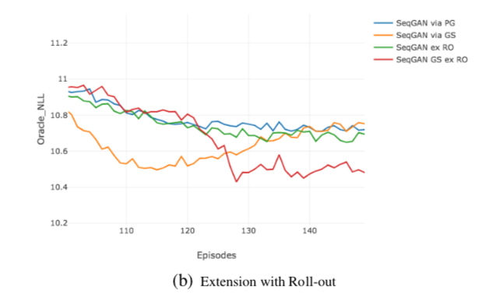
Idea: Low-variance Latent Model
Problem: overfit
Notes:
Problem: overfit (especially LM Task) (softmax * softmax cost!!!)。 Roll-out使得reward增大，会overfit，所以低方差有作用。

Slide 13
Idea: Low-variance Latent Model
Discussion
Act as LR decay (Adaptive)
Reparameterization Trick
Notes:
Adaptive LR, 重参数化(1. 已知actor-critic，增加leaky information 2.未知增加鲁棒性)

Slide 14
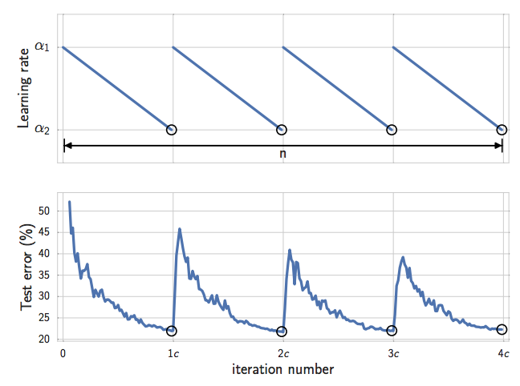
Idea: Cyclical LR Ensemble Model
LR Schedule: Cyclical
cited from [10]
Notes:
+ means: in conjunction with 结合。 MH算法：如果更高，移动过去。更低，则以一个不均匀的概率决定是否移动过去！！
MCMC: 将原问题变为一个序列采样的问题

Slide 15
Idea: Cyclical LR Ensemble Model
Ensemble: trajectory
Noise
Optimization
+ MCMC
cited from [10]
Notes:
+ means: in conjunction with 结合。 MH算法：如果更高，移动过去。更低，则以一个不均匀的概率决定是否移动过去！！
MCMC: 将原问题变为一个序列采样的问题。 路径优化。 MCMC比Roll-out快多了

Slide 16
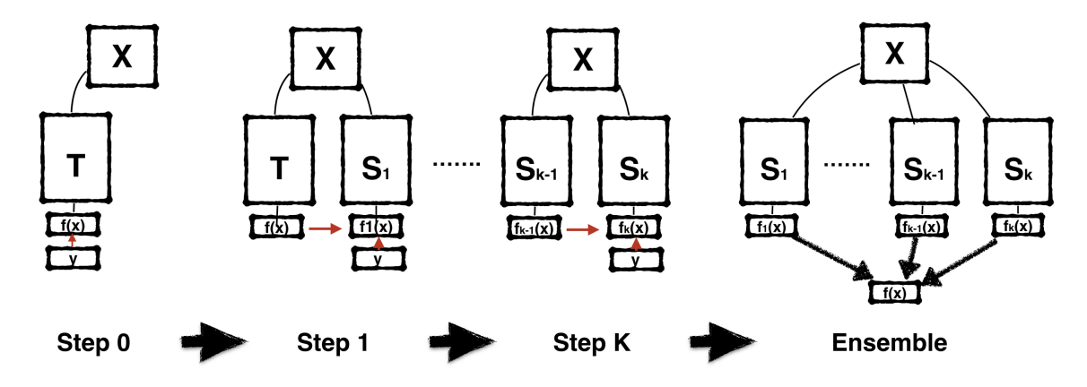
Idea: Iterate by Teaching
Teach
Loss + Imitation
cited from [11]
Notes:
Teach(different architectures!, 前面是参数层面，现在是结果f(x)层面)

Slide 17
Idea: Iterate by Teaching
Weight Space VS Predictions
Ensemble
Trajectory
Step back
cited from [11]
Notes:
Teach(different architectures!, 前面是参数层面，现在是结果f(x)层面)

Slide 18
References
Baseline
[1] Generating Sentences from a Continuous Space
[2] Improved Variational Autoencoders for Text Modeling using Dilated Convolutions
[3] Toward Controlled Generation of Text
Discrete & RevNet
[4] Neural Discrete Representation Learning
[5] Soft-to-hard vector quantization for end-to-end learned compression of images and neural networks
[6] i-REVNET: DEEP INVERTIBLE NETWORKS
[7] The Reversible Residual Network: Backpropagation Without Storing Activations
[8] Wasserstein Auto-Encoders
Low-variance Latent
[9] Low-variance, unbiased gradient estimates for discrete latent variable models
Cyclical LR Ensemble
[10] Averaging Weights Leads to Wider Optima and Better Generalization
Iterate by Teaching
[11] Born Again Neural Networks
Notes:
Attention: RELATIONSHIP between (low-variance latent) and (LR), RELATIONSHIP between (Cyclical LR) and (Teaching)

Slide 19
Thank you

