Slide 1
AMBER'S
ESSENTIAL TOUCH
AUDIENCE EXPANSION CAMPAIGN
PINole + EAST BAY / 2026
CONTENT THAT EARNS ATTENTION.
EXPERTISE THAT EARNS THE APPOINTMENT.
STRATEGY • REAL ADS • MARKET VISUALIZATION • PRODUCTION SYSTEM
Notes:
[Sources]
- User-provided Amber's Essential Touch campaign brief, 2026-08-14.

Slide 2
AMBER'S ESSENTIAL TOUCH
CAMPAIGN HIERARCHY
THE MAIN GOAL
Turn local expertise into an expanding audience—and that audience into recurring value.
01
02
03
04
05
06
07
AUDIENCE
→
ATTENTION
→
TRUST
→
LOCAL DEMAND
→
FIRST VISIT
→
RECURRING VALUE
→
PRODUCT + BRAND
Inclusion is preserved across the portfolio—not compressed into every post.
Situations, conflicts and comment triggers are executions underneath this accumulation hierarchy.
02
Notes:
[Sources]
- AMBER_ESSENTIAL_TOUCH_SOURCE_BACKED_CAMPAIGN_BRIEFS.md, Main Goal and Campaign Accumulation Hierarchy.

Slide 3
AMBER'S ESSENTIAL TOUCH
REGIONAL OPPORTUNITY
PINOLE MARKET FOUNDATION
A mature, high-income, culturally mixed local base with meaningful multilingual reach.
18,761
$127,717
44.7
41.2%
POPULATION
MEDIAN HOUSEHOLD INCOME
MEDIAN AGE
LANGUAGE OTHER THAN ENGLISH AT HOME
Build for more than one life stage and more than one cultural beauty norm—then distribute those perspectives across enough posts to remain specific.
Implication
03
Notes:
[Sources]
- Census Reporter, Pinole city, California profile: https://censusreporter.org/profiles/16000US0657288-pinole-ca/
- U.S. Census Bureau QuickFacts, Pinole city, California: https://www.census.gov/quickfacts/fact/table/pinolecitycalifornia/HSG495224

Slide 4
AMBER'S ESSENTIAL TOUCH
AGE TARGETS
THREE AGE GROUPS—NOT ONE GENERIC BEAUTY AUDIENCE.
Regional age composition informs media weight; campaign targets remain Teens 16–19, Adults 20s–30s, Mature 40s–50+.
UNDER 18
17.9%
TEENS 16–19
18–64
60.0%
ADULTS 20s–30s
65+
21.4%
MATURE 40s–50+
MEN
Cross-cutting creative within all three age groups—not a fourth age category.
04
Notes:
[Sources]
- U.S. Census Bureau QuickFacts, Pinole city, California: https://www.census.gov/quickfacts/fact/table/pinolecitycalifornia/HSG495224
- User-provided campaign brief, Three Age-Group Targets.

Slide 5
AMBER'S ESSENTIAL TOUCH
CULTURAL AUDIENCE
GEOGRAPHY SHAPES THE CREATIVE LANES.
Approximate local shares show why audience specificity must be accumulated across the campaign.
WHITE
31%
HISPANIC / LATINO
29%
ASIAN
28%
BLACK
10%
CREATIVE LANES
African / Black diaspora • Latin American / Caribbean • East, Southeast + South Asian • European / Mediterranean / MENA
05
Notes:
[Sources]
- User-provided campaign brief, Pinole demographic composition; approximate shares and source labels preserved.
- U.S. Census Bureau QuickFacts, Pinole city, California: https://www.census.gov/quickfacts/fact/table/pinolecitycalifornia/HSG495224

Slide 6
AMBER'S ESSENTIAL TOUCH
INCLUSION THROUGH QUANTITY
TWELVE AUDIENCE CELLS. ONE ACCUMULATED BRAND.
Each asset can be sharp, culturally specific and
conversion-minded because the portfolio carries
the diversity.
BLACK DIASPORA
LATIN / CARIBBEAN
ASIAN REGIONS
MED / MENA / EUROPE
TEENS 16–19
Texture + confidence
Ritual + visibility
Technique + care
Maintenance + health
ADULTS 20s–30s
Texture + confidence
Ritual + visibility
Technique + care
Maintenance + health
MATURE 40s–50+
Texture + confidence
Ritual + visibility
Technique + care
Maintenance + health
MEN APPEAR INSIDE EACH ROW WHERE THE SERVICE, skin concern and cultural context are real.
06
Notes:
[Sources]
- AMBER_ESSENTIAL_TOUCH_SOURCE_BACKED_CAMPAIGN_BRIEFS.md, Geographic Skin-Type Audience System and Inclusion Through Quantity Matrix.

Slide 7
AMBER'S ESSENTIAL TOUCH
OFFER ECONOMICS
CONTENT HAS A JOB AT EVERY STAGE.
The first creative earns the pause. The system earns the repeat visit.
01
02
03
04
05
STOP
ENGAGE
CONSIDER
CONVERT
RETAIN
3-SECOND HOOK
LIKE • COMMENT • SHARE
DM • PROFILE • OFFER
FIRST APPOINTMENT
MEMBERSHIP • PRODUCT
$150
$69
$30
$120/mo
STATED GLASS SKIN VALUE
FIRST-TIME PRICE
ILLUSTRATIVE COST / CUSTOMER
ILLUSTRATIVE MEMBERSHIP
MODEL INPUT
40% illustrative conversion—not measured campaign performance.
07
Notes:
[Sources]
- User-provided campaign brief, Offer Economics; all dollar and conversion figures are campaign model inputs, not measured results.

Slide 8
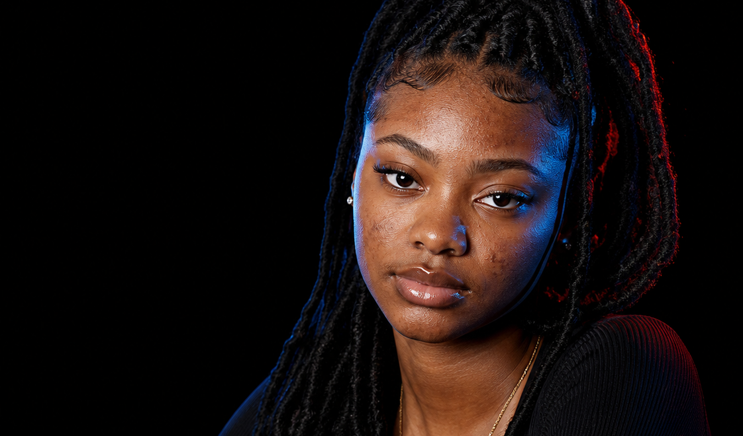
AMBER'S ESSENTIAL TOUCH
REAL AD / TEENS 16–19
YEARBOOK CONFIDENCE
MOST LIKELY TO STOP
HIDING FROM FLASH.
Portrait proof + identity language
— recognizable school ritual
— tag or share with a friend
MOST LIKELY TO STOP
HIDING FROM FLASH.
— clear-skin intake
THE YEARBOOK / CONFIDENCE + BACK-TO-SCHOOL
3-SECOND AUDIT
CLEAR SKIN INTAKE / PINOLE
Readable face • one tension • one action
08
Notes:
[Sources]
- OpenAI ImageGen, generated specifically for Amber's Essential Touch campaign, 2026-08-14.
- User-provided campaign brief and AMBER_ESSENTIAL_TOUCH_SOURCE_BACKED_CAMPAIGN_BRIEFS.md.

Slide 9
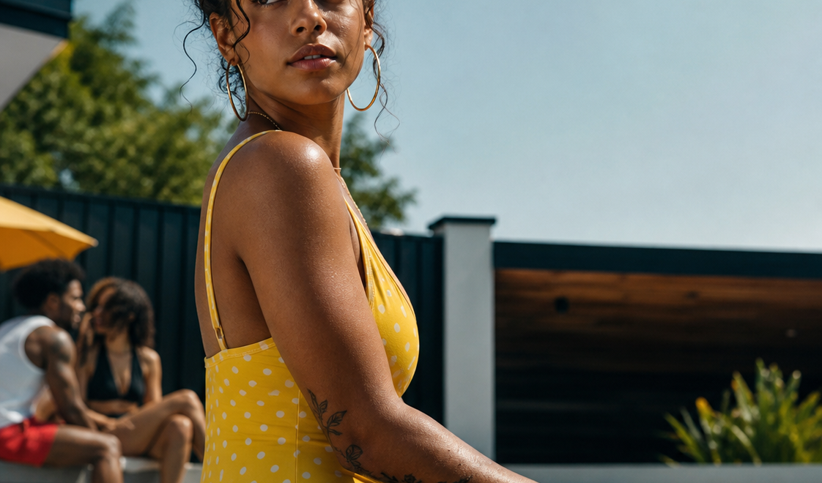
AMBER'S ESSENTIAL TOUCH
REAL AD / ADULTS 20S–30S
YELLOW POLKA DOT BIKINI
THE POOL PARTY IS
IN 6 HOURS.
Urgency without generic beauty copy
— iconic color + time pressure
— razor-versus-wax debate
THE POOL PARTY IS
IN 6 HOURS.
— appointment-ready CTA
THROW AWAY THE RAZOR.
3-SECOND AUDIT
BOOK AMBER / EAST BAY WAXING
Readable face • one tension • one action
09
Notes:
[Sources]
- OpenAI ImageGen, generated specifically for Amber's Essential Touch campaign, 2026-08-14.
- User-provided campaign brief and AMBER_ESSENTIAL_TOUCH_SOURCE_BACKED_CAMPAIGN_BRIEFS.md.

Slide 10
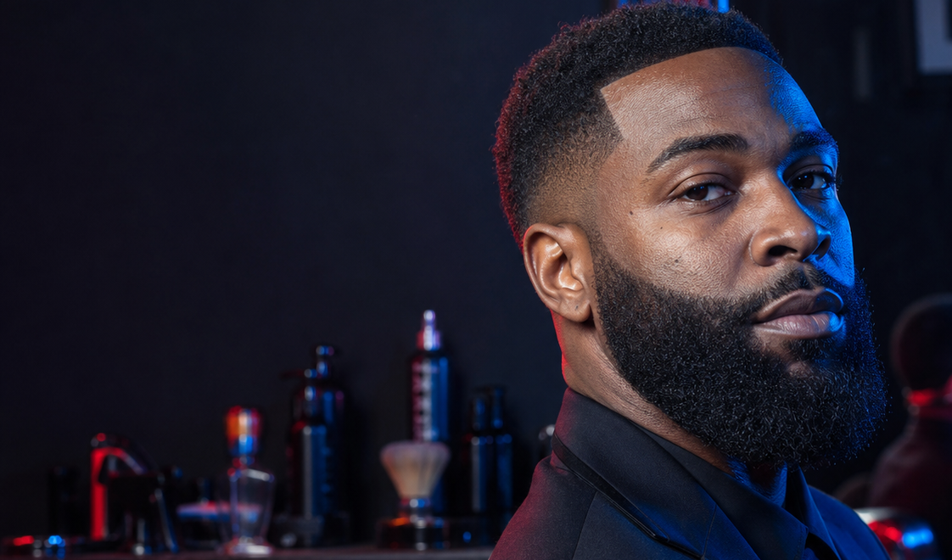
AMBER'S ESSENTIAL TOUCH
REAL AD / MEN / ADULT CROSS-CUT
EXECUTIVE RESET
YOUR BARBER CANNOT FIX WHAT
THE RAZOR KEEPS PUTTING BACK.
Health-specific maintenance positioning
— direct contradiction
— grooming norm discussion
YOUR BARBER CANNOT FIX WHAT
THE RAZOR KEEPS PUTTING BACK.
— recurring maintenance
EXECUTIVE RESET
3-SECOND AUDIT
MONTHLY MAINTENANCE / PINOLE
Readable face • one tension • one action
10
Notes:
[Sources]
- OpenAI ImageGen, generated specifically for Amber's Essential Touch campaign, 2026-08-14.
- User-provided campaign brief and AMBER_ESSENTIAL_TOUCH_SOURCE_BACKED_CAMPAIGN_BRIEFS.md.

Slide 11
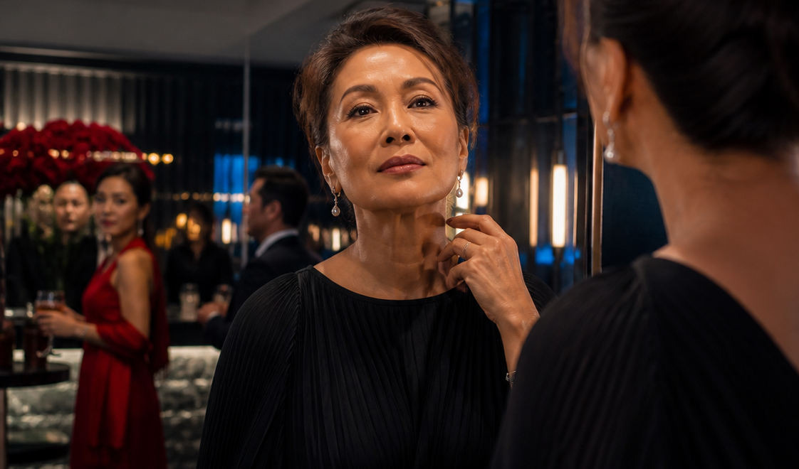
AMBER'S ESSENTIAL TOUCH
REAL AD / MATURE 40S–50+
RE-ESTABLISH THE PRIME
RE-ESTABLISH
THE PRIME.
Presence, ritual and re-entry
— elegant emotional reversal
— confidence story
RE-ESTABLISH
THE PRIME.
— consultation
THE ROOM DIDN'T CHANGE. HER RITUAL DID.
3-SECOND AUDIT
BLUEPRINT CONSULTATION
Readable face • one tension • one action
11
Notes:
[Sources]
- OpenAI ImageGen, generated specifically for Amber's Essential Touch campaign, 2026-08-14.
- User-provided campaign brief and AMBER_ESSENTIAL_TOUCH_SOURCE_BACKED_CAMPAIGN_BRIEFS.md.

Slide 12
AMBER'S ESSENTIAL TOUCH
CONTENT SYSTEM
FIVE CONTENT PILLARS DISTRIBUTE THE CAMPAIGN'S INTELLIGENCE.
The audience grid decides who. The pillar decides what the post does.
01
02
03
04
05
IDENTITY + CONFIDENCE
SKIN + HAIR EDUCATION
SERVICE PROOF
COMMUNITY ENGAGEMENT
OFFER + RETENTION
WEEKLY ACCUMULATION
4 audience-specific posts + 2 education/proof posts + 1 offer post
The result is diversity in quantity, not diluted representation inside every execution.
12
Notes:
[Sources]
- AMBER_ESSENTIAL_TOUCH_SOURCE_BACKED_CAMPAIGN_BRIEFS.md, Content Pillars and Production Accumulation Order.

Slide 13
AMBER'S ESSENTIAL TOUCH
PRODUCTION ENGINE
A REPEATABLE ENGINE—NOT FOUR ISOLATED ADS.
Create specificity at volume, learn from reaction, and amplify what earns attention.
01
02
03
04
05
CAPTURE
BATCH
TEST
AMPLIFY
RETAIN
→
→
→
→
Client B-roll
texture • ritual • result
3-second hooks
multiple audience cells
Organic posts
comments • shares • saves
Paid support
for proven winners
Membership
products • referrals
FIRST PRODUCTION WAVE
Yearbook • Bikini urgency • Executive maintenance • Mature ritual • Group chat • DMs • Dating • Health education
13
Notes:
[Sources]
- Meta Reels ads guidance: https://www.facebook.com/business/ads/facebook-instagram-reels-ads
- TikTok SMB Beauty Playbook: https://ads.tiktok.com/business/library/English_SMB_Beauty_META_Playbook_English_Final.pdf
- AMBER_ESSENTIAL_TOUCH_SOURCE_BACKED_CAMPAIGN_BRIEFS.md, Production Accumulation Order.

Slide 14
AMBER'S ESSENTIAL TOUCH
MEASUREMENT + NEXT WAVE
MEASURE EXPANSION BEFORE OPTIMIZING ONLY FOR PURCHASE.
The campaign has to grow the reachable audience while proving which specific promises create demand.
ATTENTION
ENGAGEMENT
AUDIENCE
DEMAND
VALUE
3-sec hold
thumb-stop rate
Shares
comments • saves
Profile visits
follows
DMs
bookings
Repeat visits
membership
NEXT CREATIVE WAVE
GROUP CHAT / DMs / DATING PROFILE / SUBURBAN LAWN / EDUCATIONAL MICRO-STORIES
BUILD AUDIENCE → LEARN DEMAND → EXPAND THE BRAND
14
Notes:
[Sources]
- AMBER_ESSENTIAL_TOUCH_SOURCE_BACKED_CAMPAIGN_BRIEFS.md, Measurement and Final Standard.
- Meta tailored campaign guidance: https://www.facebook.com/business/ads/automation/tailored-campaigns

