Slide 1
Team Name : Indian coder
Team ID: AANBHT05124
Problem statement ID: AANBBM001
Problem statement title: Application for Managing Shipping Warehouses

Slide 2
Abstract
A WMS is a Website used to monitor, Shipping office and control warehouse operation and material right from the point they are received into the warehouse, when they are stored and finally to when they reach customer. Almost anyone can list an item for sale on application or website, whether it’s something you’ve purchased wholesale, made yourself or simply a product you no longer want.

Slide 3
Technologies used for project
List of the technologies used in our project.
Client Side
HTML
Java Script
Css
Server Side
Php
Database
SQLlite

Slide 4
Steps taken to complete the project
The initial set up : Our first step towards the project was to provide a website that can be easily maintain the storage, packaging, and shipping work of product from one part to another, and also to the product manager/ owner.
Connections : Here the website or app directly connects the product owner with the warehouse storages, and also the packaging and shipping of products.
The output :
The website provides free marketing to the seller, as the product own by one product owner can be reached to many people in the nearby areas and can be shipped easily to them.
2. The website also reduces the stress level of buying any product, as the product will be directly shipped to owner without any transfer from one level to another, hence less costly, and easy to provide.

Slide 5
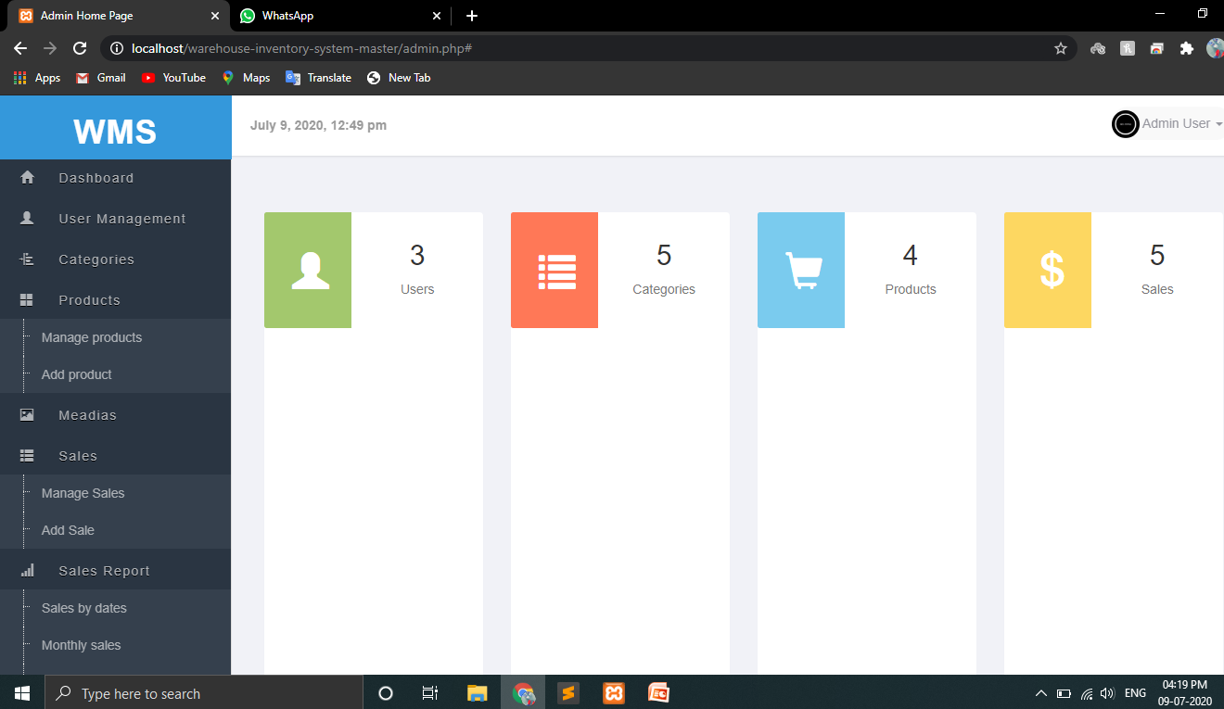
Glimpses of our project
WMS (Warehouse Management System )

