Slide 1
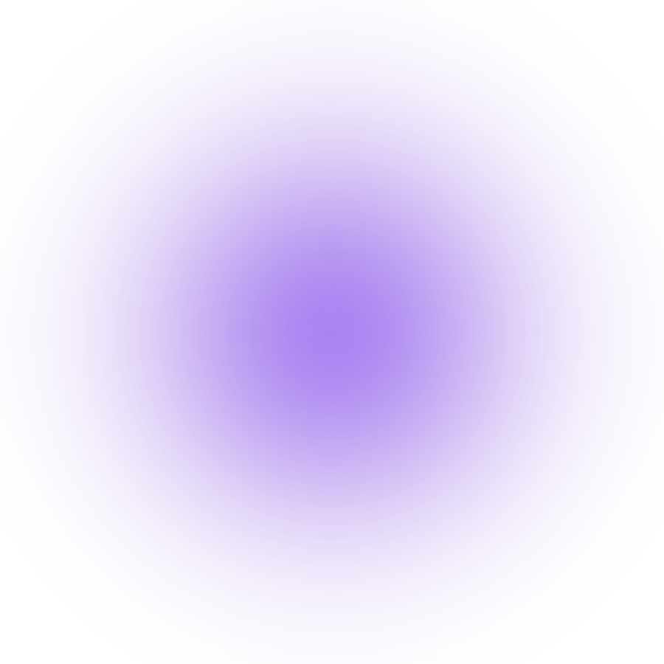

intellea
WEEK 1 · DAY 1
Python Fundamentals
From the first program to variables, data types and user input
Python Live Class · Theory and concept support
Python Fundamentals · Week 1 · Day 1
1

Slide 2
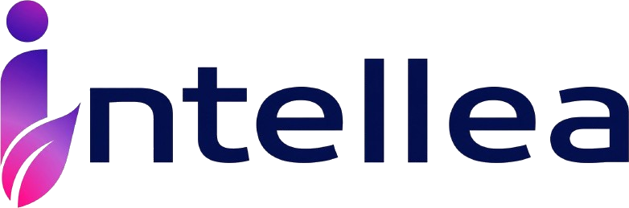



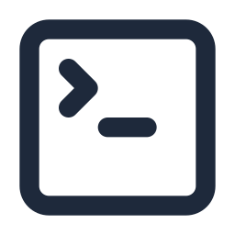
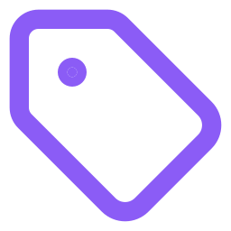

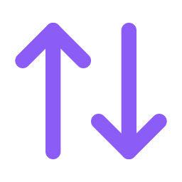
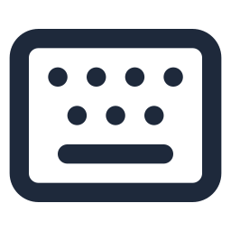
MEET RAVI
Today's Journey
Ravi wants to build his first app.
Today he learns the building blocks that every Python program is made of.
1
2
3
4
5
6
7
What is Python
Install and VS Code
First program
Variables
Data types
Type casting
User input
Python Fundamentals · Week 1 · Day 1
2

Slide 3
intellea
TOPIC 1
What Is Python?
Real time example
A recipe card gives plain steps that any cook can follow. Python works the same way: you write clear, readable steps and the computer follows them in order.
Definition
Python is a popular, beginner friendly programming language that lets you give instructions to a computer using simple, English like words.
Where it is used
Websites, data analysis, AI and machine learning, automation scripts, software testing and cloud tools. Banks, hospitals, online shops and streaming platforms all use it.
Python Fundamentals · Week 1 · Day 1
3

Slide 4



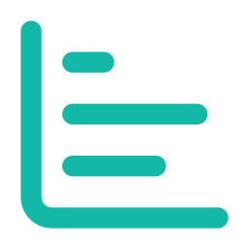



WHERE PYTHON IS USED
Python Is Used Almost Everywhere
Industries
Real time projects
Banking and Finance
fraud checks, risk reports, trading tools
Customer Chatbot
answers common questions automatically
Online Shopping
product search, recommendations, order reports
Sales Dashboard
reads data and shows charts and trends
Healthcare
patient data analysis and medical image tools
Automation Script
renames files, sends emails, fills reports
Streaming and Media
content suggestions and video data pipelines
Web Application
login, products and payments behind a website
Python Fundamentals · Week 1 · Day 1
4

Slide 5
HOW IT WORKS
How Python Runs Your Program
Write the program
Click Run
Python reads the lines from the top
Any mistake?
Output on the screen
No
Yes
fix it and run again
Python shows the error and its line number
Ravi says Python reads your program from the top, one line at a time, and tells you where it got stuck.
Python Fundamentals · Week 1 · Day 1
5

Slide 6

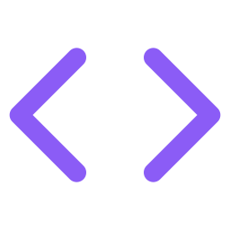
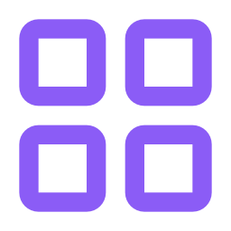
GETTING READY
Install Python and VS Code
Download Python
Install it
Install VS Code
Python extension
from python.org, the official site
tick Add Python to PATH on Windows
a free code editor from Microsoft
search Python inside VS Code and install it
All set. Now you can write a program and run it.
Ravi says Python is the language. VS Code is the notebook where you write it.
Python Fundamentals · Week 1 · Day 1
6

Slide 7

MEET YOUR EDITOR
A Quick Tour of VS Code
1
Explorer
your files and folders
EXPLORER
first.py
1
3
first.py
1
Editor
where you type the program
2
2
2
3
Run button
starts the program
3
TERMINAL
4
Terminal
shows what the program prints
Hello, World!
4
Ravi says Save the file with .py at the end, so VS Code knows it is a Python file.
Python Fundamentals · Week 1 · Day 1
7

Slide 8
intellea
TOPIC 2
Your First Program: Showing a Message
Real time example
A shop display board shows the message the shopkeeper wants every customer to read. When a program needs to talk to the user, it puts a message on the screen in the same way.
Definition
print() is a built in function that displays a message or a value on the screen.
Where it is used
Every project: showing results and messages to users, and following the progress of a script. Developers also use it to check what is happening inside a program.
Python Fundamentals · Week 1 · Day 1
8

Slide 9
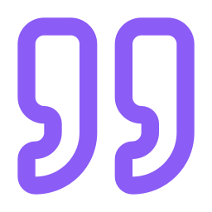
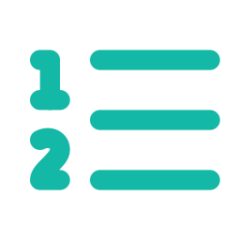

THE PRINT FUNCTION
The Message Goes In, The Screen Shows It
Hello, World!
SCREEN
your message, written in quotes
Hello, World!
print()
carries it to the screen
Quotes are not shown
One print, one new line
Numbers need no quotes
they only tell Python this is text
the next message starts below
print shows 25 as 25
Ravi says If you forget a closing bracket, Python shows a SyntaxError and points to the line.
Python Fundamentals · Week 1 · Day 1
9

Slide 10
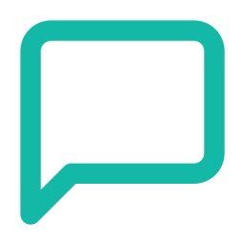

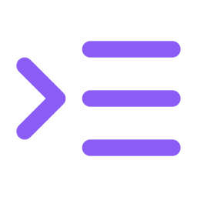
CODE BASICS
Comments, Syntax and Indentation
Comments
Syntax
Indentation
A note for humans. Python skips it completely. Teams use notes to explain why the code was written.
The grammar rules of Python. Spelling, brackets and quotes must all be correct.
Spaces at the start of a line. They show which lines belong together as one block.
Missing bracket: SyntaxError
starts with the # symbol
Wrong spelling: NameError
Extra space: IndentationError
Ravi says Python is strict about spaces, so keep every line of a block lined up.
Python Fundamentals · Week 1 · Day 1
10

Slide 11
intellea
TOPIC 3
Variables: Giving Names to Information
Real time example
In a phone, the name Mom is a label and the number saved under it is the information. You use the label and never have to remember the number.
Definition
A variable is a named place in memory that stores a value, so the program can use it or change it later.
Where it is used
Everywhere: a customer name, a cart total, a game score, a temperature reading or a salary. Every project is built on variables.
Python Fundamentals · Week 1 · Day 1
11

Slide 12
VARIABLES IN PICTURES
A Name Tag on a Box of Information
name
Ravi
age
21
price
99.5
The name on the left holds the value on the right.
age holds 21
age holds 22
Giving a variable a new value replaces the old value. The old one is gone.
new value
today
after one year
Ravi says A variable is a label on a box. The box can hold a new value any time.
Python Fundamentals · Week 1 · Day 1
12

Slide 13
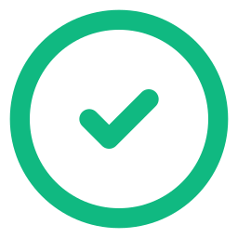

NAMING RULES
Which Names Python Accepts
VALID NAMES
INVALID NAMES
age
letters only
my name
has a space
student_name
an underscore is allowed
2marks
starts with a digit
_count
can start with an underscore
class
a reserved word
total2
digits are fine after a letter
total$
has a symbol
Ravi says age and Age are two different names, because Python notices capital letters.
Python Fundamentals · Week 1 · Day 1
13

Slide 14
intellea
TOPIC 4
Data Types: What Kind of Value Is It?
Real time example
A bank form has different fields. The name is text, the age is a whole number, the balance has decimals, and the question Is KYC done is a yes or no answer.
Definition
A data type tells Python what kind of value a variable holds: a whole number, a decimal number, text, or True and False.
Where it is used
Forms, billing, reports and databases. Choosing the right type avoids wrong totals and errors in every project.
Python Fundamentals · Week 1 · Day 1
14

Slide 15

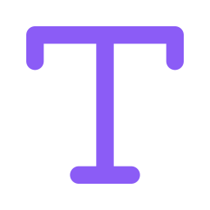
THE FOUR BASIC TYPES
Four Types You Will Use Every Day
Integer (int)
Float (float)
String (str)
Boolean (bool)
A whole number with no decimal point. Ages, counts, marks.
A number with a decimal point. Prices, heights, averages.
Text of any kind. Names, cities, messages.
Only two values: True or False. Yes or no answers.
21
99.5
Ravi
True
type() says int
type() says float
type() says str
type() says bool
Ravi says type() is a question to Python: what kind of value is this?
Python Fundamentals · Week 1 · Day 1
15

Slide 16
intellea
TOPIC 5
Type Casting: Changing One Type to Another
Real time example
A cashier receives the price typed as text on a form. Before it can be added to a bill, it must become a real number. That conversion is type casting.
Definition
Type casting means converting a value from one data type to another, using functions such as int(), float(), str() and bool().
Where it is used
Reading form data and CSV files, doing calculations on typed input, and building messages that join text with numbers.
Python Fundamentals · Week 1 · Day 1
16

Slide 17
TYPE CASTING IN ACTION
One Value In, a New Type Out
10 (text)
int()
10 (whole number)
Text that looks like a number converts well.
3.9 (decimal)
int()
3 (whole number)
The decimal part is cut off, not rounded.
7 (whole)
float()
7.0 (decimal)
A decimal point is added.
abc (text)
int()
ValueError
Letters cannot become a number.
Ravi says Cutting 3.9 gives 3, not 4. Python simply removes the decimal part.
Python Fundamentals · Week 1 · Day 1
17

Slide 18
intellea
TOPIC 6
User Input: Asking the User for Data
Real time example
At a restaurant, the waiter asks for your order and writes down exactly what you say. A program can ask a question in the same way and wait for the answer.
Definition
input() shows a question, waits for the user to type, and gives back what was typed. The answer always comes back as text (str).
Where it is used
Login screens, billing counters, quiz apps, ATM style programs and any tool that needs details from the user.
Python Fundamentals · Week 1 · Day 1
18

Slide 19


USER INPUT FLOW
From the Keyboard to Your Program
Program asks a question
User types the answer
Python receives it as text
Convert to a number if needed
Use it in the program
Typed 5 and 5, no conversion
Typed 5 and 5, converted first
Python joins the two texts. The result is 55.
Python adds the two numbers. The result is 10.
Ravi says input() always gives text, even when the user types a number.
Python Fundamentals · Week 1 · Day 1
19

Slide 20
PUTTING IT TOGETHER
Mini Project: Age Next Year
Start
Ask for the name
Ask for the age
Convert the age to a number
WHAT THE USER SEES
Ravi will be 22 next year
End
Show the message
Add 1 to the age
Ravi says Almost every program follows the same pattern: input, process, output.
Python Fundamentals · Week 1 · Day 1
20

Slide 21
PRACTICE TIME
Ravi's Practice Challenges
1
Profile Card
2
Age Next Year
3
Sum of Two Numbers
Ask for the name, age and city. Show a one line introduction.
Ask for the age. Show how old the person will be after one year.
Ask for two numbers. Show their total. Remember to convert first.
SAMPLE INPUT
SAMPLE INPUT
SAMPLE INPUT
Ravi, 21, Chennai
21
12 and 8
SAMPLE OUTPUT
SAMPLE OUTPUT
SAMPLE OUTPUT
Ravi is 21 years old and lives in Chennai
Next year you will be 22
The sum is 20
Python Fundamentals · Week 1 · Day 1
21

Slide 22
QUICK RECAP
What Ravi Learned Today
Click to reveal each one.
Python reads a program line by line, and print() shows the result
Variables hold values. The types are int, float, str and bool
input() gives text. Use int() or float() to convert it
Python Fundamentals · Week 1 · Day 1
22

Slide 23
intellea
WEEK 1 · DAY 1 COMPLETE
Great Work Today
Ravi can now run a program, store values in variables, work with data types and take input from the user.
COMING UP NEXT, DAY 2
Operators and Conditional Statements
Tomorrow, Ravi's programs learn to calculate, compare values and make decisions.
Python Fundamentals · Week 1 · Day 1
23

