Slide 1
Large Scale Volume Visualization on GPU
Submitted By:
Juhi Kumari (IIT2013153)
Sneha Jha (IIT2013174)
Tanushree Anand (IIT2013192)
Nikita Agarwal (ISM2013016)
KM Ishu (ISM2013019)
Under the Supervision of:
Prof. Anupam Agrawal

Slide 2
Introduction
Volume Visualization : is a set of techniques used to display a 2D projection of a 3D discretely sampled data sets, typically a 3D scalar field.
To deal with the ever-increasing resolution and size of volume data , it is crucial to use
1. Highly scalable visualization algorithms
2. Highly Intractable on screen

Slide 3
Problem Definition
To visualize large volume medical human data on GPU efficiently on inexpensive hardware.
It can be used to view human body in different resolutions and perspectives based on the requirements of the user, hence interactive.
This requires effective handling of large data in a structured way, keeping in mind the memory constraints.

Slide 4
MOTIVATION
Real-time out-of-core volume rendering has been performed on GPUs, performance is usually gained at the cost of image quality.
Custom server level hardware solutions have been developed to provide high-quality rendering, but the cost involved limits their widespread adoption GPU based traversal technique reduces cost for the hardware required.
Our target is to make high-quality visualization more practical in the clinic by the use of a consumer-level GPU.

Slide 5
Methodology
Our whole methodology is consists four major steps-
Preprocessing
Generating a View-Dependent Working Set
View-Dependent Sorting of the Bricks
Memory Management of the Working Set Brick Pool
Macrocell Pool
Proxy-Geometry Rasterization
Raycasting

Slide 6
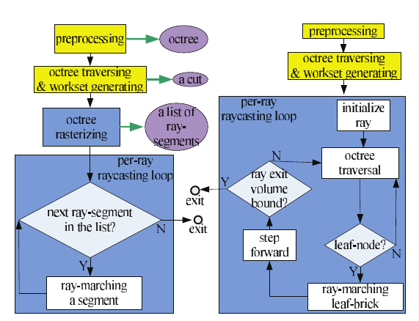
Flowchart of the methodology used
Previous Out-of-Core GPU volume Rendering algorithms
Yellow boxes: executed on the CPU, all other boxes on the GPU. Black arrows indicate control flow; green arrows indicate output of intermediate data.

Slide 7
Preprocessing
A large volume dataset is first pre-processed using blocking techniques (division of large dataset in blocks of data) and storing it in Octree.
An octree of bricks is constructed where the actual resolution data is stored in leaf nodes.
At each level or node a brick of same dimension B_{res}³ is made.
The length of the tree is kept shallow which results in courser bricks.
Inner bricks are built using down sampling of the lower level nodes like averaging filter.in this way the whole data is represented as multiresolution hierarchy which is maintained on CPU (out of core).

Slide 8
Preprocessing (contd..)
Each node of the octree points to the brick with a constant resolution that approximates the part of the volume corresponding to the octree’s node.
Bricks store extra overlapping voxels, which helps in accessing the neighbouring voxels at runtime using the tricubic interpolation and gradient computations.
The octree don’t use any transfer function for empty space culling it uses macrocells to store the min-max scalar values for the corresponding brick, for efficient brick culling.

Slide 9
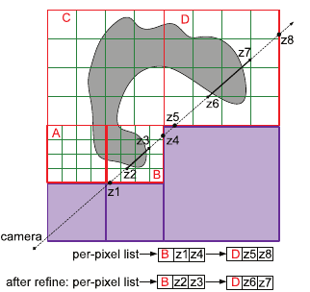
Algorithm philosophy. The octree-cut is composed of all of the active bricks (red—A, B, C, and D) at different LoDs depending on the current view. Each active brick is subdivided into macrocells (green). Empty bricks (purple) are never added to the octree-cut. We first rasterize active blocks so that the fragment shader can capture all of the active blocks that the ray penetrates (B and D) into a list in front-to-back order. Then we rasterize nonempty macrocells and refine the z-values in the list in order to get a tighter ray segment (shown as the solid black line) for each brick at the accuracy of the macrocell level.

Slide 10
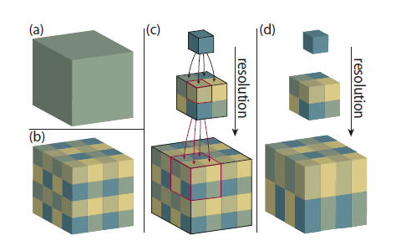
Concept of dividing large data

Slide 11
Octree Data Structure Creation and traversal
1878 slices were first constructed into a single 3D-Volume. Dimensions of each image slice is 1760 * 1024.
Brick size of every node in octree is taken as 220*128*235. Single large Volume is splitted into 512 bricks of resolution 220*128*235.
Then bricks are averaged by a factor of 8 to construct 64 bricks of same resolution which are further averaged by a factor of 8 to construct 8 bricks which are then combined to form a single root.
These bricks are then saved as nodes of an octree where root acts as parent having 8 children which are individually divided into 8 more children.

Slide 12
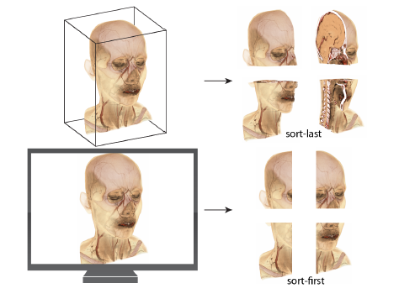
Small bricks of large data

Slide 13
Struct of the octree node is as follows -
struct node {
ifstream fp;
struct node *child[NO_CHILDREN];
struct node *parent;
int level;
int a[3];
int no_children;
int is_leaf;
string name;
};

Slide 14
Generating a View-Dependent Working Set
For viewing different frames a cut is decided out of the octree according to the required frame.
The cut includes different resolution nodes as per needed dependent on the viewing angle.
This cut is used to update the GPU brick pool for rendering.
For deciding the cut breadth first order octree traversal is used starting from the root node and is continued till the required node is found.

Slide 15
Generating a View-Dependent Working Set Cont…..
It has two parts –
View-Dependent Sorting of the Bricks
The nodes in the cut are rasterized before, hence we sort the nodes and store them in front to back fashion using a pointer list which is stored for further use.
Pointers to the traversed cut-nodes are stored in a STL list.
A traversed node is always replaced by its children in front to back order during depth-first search, this is done till a node labelled as node cut is found

Slide 16
Generating a View-Dependent Working Set (Cont…..)
It is implemented using an 8 X 8 lookup table.
Each row of the look up table encodes a possible order of the 8 octants according to the viewpoint in the octree space.
Memory Management of the Working Set
The cut represents the brick data and macrocell data of the nodes. This data is then transferred to GPU asynchronously.
The working set is loaded into two memory pools -

Slide 17
Workset Generation Algorithm
Initialize queue with root
while(queue_not_empty) {
cur = queue.front()
queue.pop()
split cur in 8 octants
if possible
for (i = 0; i < 8; i++) {
if ROI lies in octant[i]
if ROI lies completely in octant[i]
tag = 1
push in brick_pool
else
tag = 2
push in queue
else
tag = 0
}
}
copy brick_pool to cudaMemory

Slide 18
Brick Pool
It is organised as a 3D texture of specific size and dimension.
Each of the cell of this pool corresponds to a particular brick, and the cell stores the corresponding brick Id B_{ID}.
Macrocell Pool
The 3D macrocell pool is packed with the corresponding brick’s macrocell at particular brick id B_{ID}

Slide 19
Proxy-Geometry Rasterization
Proxy geometries of the whole working set of bricks is rasterized in the first pass and capture all bricks that a ray penetrates into a per-pixel list.
In second pass, we rasterize all non-empty macrocell (of all bricks) and refine per-pixel list in which each element will contain a ray-segment corresponding to the brick that the ray penetrate.
This results in skipping of empty spaces of macrocell and gives detailed process for the 2nd pass i.e. traversing the macrocells.

Slide 20
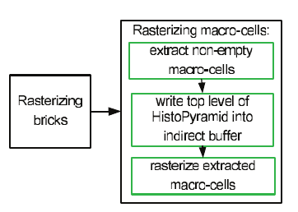
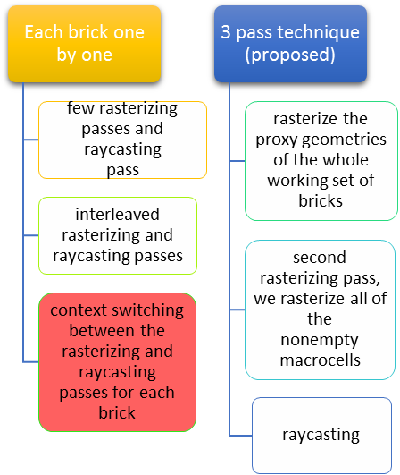
Comparison between 2 pass rasterization
Process and normal method
Flowchart of rasterization

Slide 21
Raycasting
A ray is generated for each desired image pixel.
Using a simple camera model, the ray starts at the centre of projection of the camera (usually the eye point) and passes through the image pixel on the imaginary image plane floating in between the camera and the volume to be rendered.
In the raycasting pass, depth interval is defined by the two end points of a ray-segment that performs the GPU raycasting for the corresponding brick.

Slide 22
About the DataSet
The Visual Human male dataset from the National Library of Medicine(NLM) is used for experimentation.
It is a 3.15GB .RAW file.
The data is made up of a stack of images of resolution
1760 X 1024.
The stack consists of 1878 slices. Each slice represents the body cut horizontally.

Slide 23
Hardware and Software requirements
Software Requirements
CUDA enabled system
OpenGL
Visual Studio (8+)
NLM Human Body (Male) 3.15 GB Dataset

Slide 24
Hardware Requirements
SPECIFICATIONS
GPU processor | Tesla C1060
CUDA Cores | 240
Shader clock | 1296 MHz
Memory interface | 512-bit
Memory | 5888 MB
Total available graphics memory | 4096 MB
Bus | PCI Express x16

Slide 25
Activity Time Chart
Work done till Mid-Sem |  |  |  | End-Semester
Phase 1: 10th Jan - 25th Jan | Phase 2: 25th Jan – 5th Feb | Phase 3: 5th Feb – 12th Feb | Phase 4: 12th Feb – 25th Feb | Phase V: 25th Feb – 10th Mar | Phase VI: 22nd Mar – 10th Apr | Phase VII: 10th Apr – 20th Apr | Phase VIII: 20th Apr – 4th May
Literature Survey | Data Collection and analyzing the format of the data | Environment Setup: OpenGL, CUDA | Learning OpenGL and CUDA | Visualization of small dataset | Implementation of octree data structure to manage the large volume data | Rendering small portion of octree | Visualization Pipelining and Multi – Resolution Model

Slide 26
Work Done After Mid Semester
The work that we have done after mid semester is as follows:-
Octree Implementation: As we choose octree as a data structure to store the large data for visualization. So we implement the octree and used it to handle the big data that to be visualized.
Ray-Casting : After octree implementation we start the ray-casting of the given data that we have stored in octree to start visualization of the data.
Rendering : Rendering is the major and the last step of visaulization. First we render a small portion of octree and then for the big data.It will be done using pipeline and the multiresolution model.

Slide 27
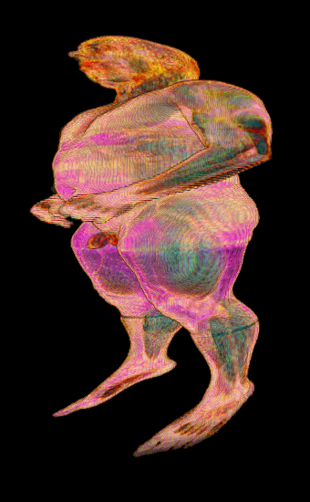
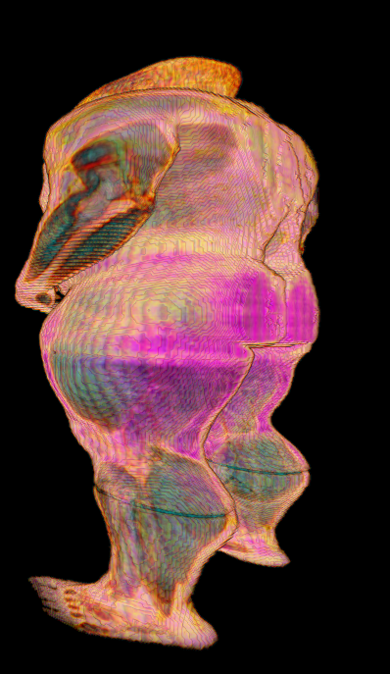
(a) | (b)
Figure 5: (a) and (b) are 2 different orientation of root node

Slide 28
References
[1] E. Gobbetti, F. Marton and A. I. Guiti ́an, "A single-pass GPU ray casting framework for interactive out-of-core rendering of massive volumetric datasets", Springer-Verlag 2008 pp: 797–806, 2008 [2] J. Beyer, M. Hadwiger and H. Pfister, "A Survey of GPU-Based Large-Scale Volume Visualization", Eurographics Conference on Visualization (EuroVis), 2014 [3] B. Liu, G. J. Clapworthy, F. Dong and E. C. Prakash "Octree Rasterization: Accelerating High-Quality Out-of-Core GPU Volume Rendering" IEEE TRANSACTIONS ON VISUALIZATION AND COMPUTER GRAPHICS, VOL. 19, NO. 10, pp. 1731-1745, OCTOBER 2013 [4] Y. Heng and L. Gu, "GPU-based Volume Rendering for Medical Image Visualization", Engineering in Medicine and Biology 27th Annual Conference, Shanghai, China, pp. 5145-5148, September 1-4, 2005 [5] C. Wang and H. Shen, "A Framework for Rendering Large Time-Varying Data Using Wavelet-Based Time-Space Partitioning (WTSP) Tree", Department of Computer and Information Science, The Ohio State University, 2004

Slide 29
[6] A. Knoll, I. Wald, S. Parker and C. Hansen, "Interactive Iso-surface Ray Tracing of Large Octree Volumes", Scientific Computing and Imaging Institute, University of Utah, Technical Report No UUSCI-2006-026, 2006
[7] S. Chen and C. Hao, "Interactive GPU-based Volume Rendering for Medical Image", Biomedical Engineering and Informatics, BMEI '09. 2nd International Conference on 17-19 Oct, 2009 [8] M. Smelyanskiy, D. Holmes, J. Chhugani, A. Larson, D. M. Carmean, D. Hanson, P. Dubey, K. Augustine, D. Kim, A. Kyker, V. W. Lee, A. D. Nguyen, L. Seiler and R. Robb, "Mapping High-Fidelity Volume Rendering for Medical Imaging to CPU, GPU and Many-Core Architectures", IEEE TRANSACTIONS ON VISUALIZATION AND COMPUTER GRAPHICS, VOL. 15, NO. 6, Nov/Dec, 2009 [9] M. Labschutz, S. Bruckner, M. E. Groller, M. Hadwiger and P. Rautek, "JiTTree: A Just-in-Time Compiled Sparse GPU Volume Data Structure", Visualization and Computer Graphics, IEEE Transactions, Vol. 22, Issue. 1, pp. 1025-1034, 2015 [10] A. Knoll, "A Survey of Octree Volume Rendering Methods", Scientific Computing and Imaging Institute University of Utah, 2006

Slide 30
[11] F. Velasco and J. C. Torres, "Cell Octrees: A New Data Structure for Volume Modeling and Visualization", VMV '01 Proceedings of the Vision Modeling and Visualization Conference, pp. 151-158, 2001 [12] I. Boada, I. Navazo and R. Scopigno, "Multi- Resolution volume visualization with a texture-based octree", Springer-Verlag, pp. 185-197, 2001
[13] A. Agrawal, J. Kohout, G. J. Clapworthy, N. J.B. McFarlane, F. D. M. Viceconti, F. Taddei and D. Testi, "Enabling the interactive display of large medical volume datasets by multiresolution bricking", Springer, pp. 3-19, 2009

Slide 31
THANK YOU

