Slide 1
NutriClass: Food Classification Using Nutritional Data
A Machine Learning Based Project

Slide 2
Project Overview
This project classifies food items into meal categories like Breakfast, Lunch, or Dinner based on nutritional values.
Machine Learning models are trained using features such as calories, protein, fat, carbs, and more.

Slide 3
Dataset Description
- Synthetic Food Nutrition Dataset
- Features: Calories, Protein, Fat, Carbs, Sugar, Fiber, Sodium, etc.
- Includes: Food Name, Meal_Type, Is_Vegan, Is_Gluten_Free
- Target: Meal_Type_Label (classification label)

Slide 4
Data Preprocessing
- Handled missing values and outliers
- Encoded categorical features
- Scaled numerical features using StandardScaler
- Applied PCA for feature reduction

Slide 5
Machine Learning Models Compared
- Logistic Regression
- Decision Tree
- Random Forest
- K-Nearest Neighbors (KNN)
- Support Vector Machine (SVM)
- XGBoost
- Gradient Boosting

Slide 6
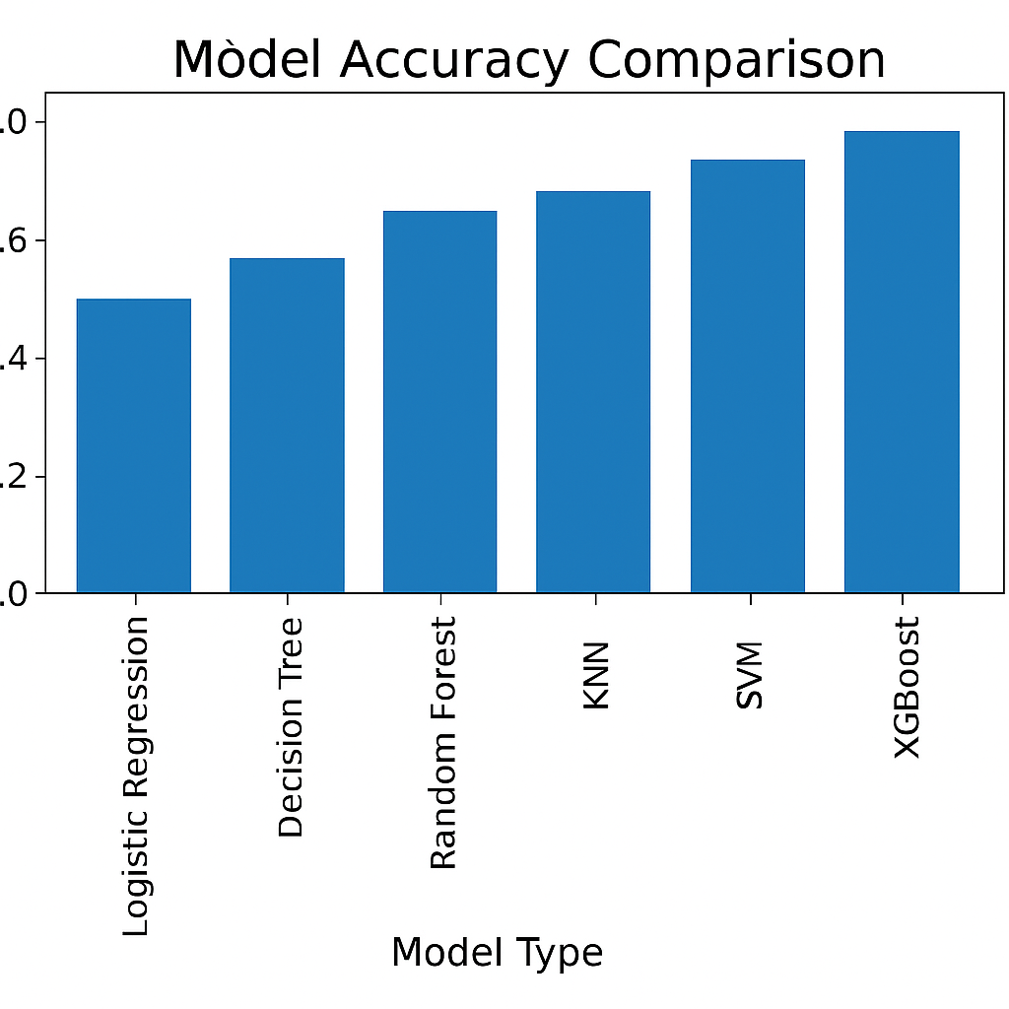
Model Accuracy Comparison

Slide 7
Evaluation Metrics
- Accuracy: % of correctly predicted samples
- Precision: How many selected items are relevant
- Recall: How many relevant items are selected
- F1-Score: Balance between Precision and Recall
- Confusion Matrix: Overall prediction performance

Slide 8
Conclusion
• Best-performing models: Random Forest & Gradient Boosting
• Valuable for nutrition-based food planning
• Future Scope: Extend to real-world food datasets
• Add recommendation engine for personalized diet plans

Slide 9
Thank You!
Questions & Discussion

