Slide 1
vulnerabilities In router firmware
Jayendra Khandare (jkhandar) Govind Mishra (shremish)

Slide 2
Index
Introduction
Previous Security Breaches
Previous researches
Faults in firmware
Design
Implementation
Limitations
Requirements
Future Scope

Slide 3
Introduction
More than a billion IOT devices are added every year.
We studied many vulnerabilities and threats faced by router and firmware.
We analyzed 7 large-scale incidents.
We also studied 2 research papers and many articles related to this problem.
Finally, we came up with security measures to constrain some of these issues.

Slide 4
Previous Security Breaches 1
Pinkslipbot - A banking malware which used infected machines to steal personal and financial data from computers.
Even after a security products removed the malware from systems, those machines were still used as the proxy devices to perform malicious activity.
This malware was using UPnP protocol to exploit routers to which systems were connected.
‘Conifeker’ malware attacked Microsoft Operating System on 9 million+ devices, using UPnP and port forwarding.

Slide 5
Previous Security Breaches 2
The OpenSSL library uses ‘heartbeats’ to transfer data to and from client to server.
‘Heartbleed bug’ caused memory leaks, and thus attackers can capture data in pieces.
CIA can implant CherryBlosom firmware on device making it ‘the flytrap’, such flytraps connect with the Cherrytree which logs their detail to the database.
Cherry tree can send missions with operator defined tasks, and these missions could include changing username and password, scanning emails, etc.
Common vulnerability called Shellshock can be exploited through the CGI scripts running on the web server by a script called BashLite which uses Busybox.

Slide 6
Previous researches
The authors of paper from Ruhr-University exploited the default username and password of the routers and also the HNAP functionalities.
They used the XSS(Cross Site Scripting) and UI Redressing.
They made the victim visit attacker’s page and sent an HTTP get/post which consisted of default username and password of router administrative interface.
Then the attackers executed JS code and modified the username and password of the device.

Slide 7
Most exploited/exploitable vulnerabilities
UPnP
OpenSSL
BusyBox
Default Settings
Firmware Upgrades and Updates

Slide 8
Faults in Router Firmware 1
UPnP
lilupnp
miniupnp
Weak and/or unchanged default passwords
Unaware of firmware update
Notes:
81 million unique IP addresses respond to UPnP discovery requests.
332 models of routers use MiniUPnPd version 1.0 which is remotely exploitable.
Study conducted by Tripwire in 2014 showed 52% - 59% routers are using outdated firmwares.

Slide 9
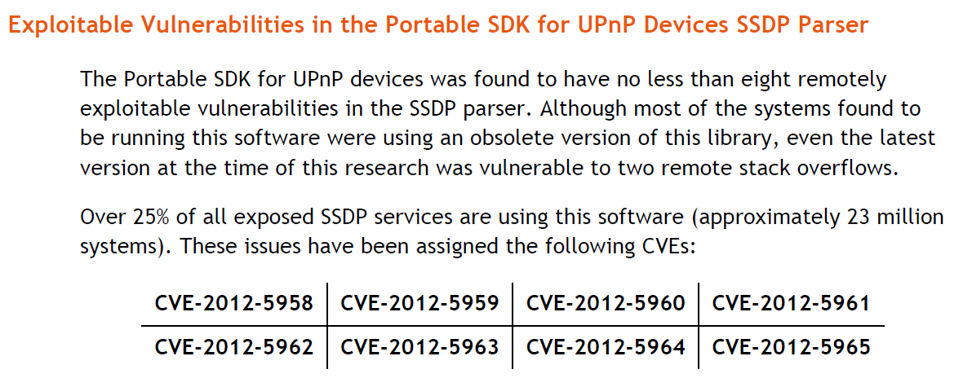
Universal Plug and Play

Slide 10
Faults in Router Firmware 1
UPnP
lilupnp
miniupnp
Weak and/or unchanged default passwords
Unaware of firmware update

Slide 11
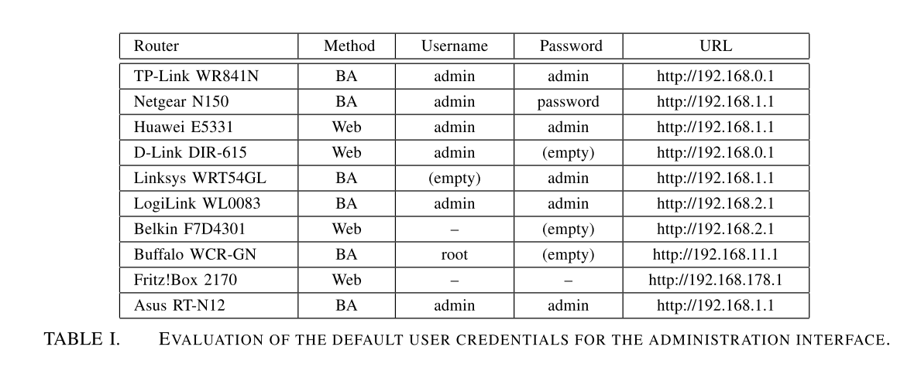
Default credentials

Slide 12
Netgear default settings file
system:configVersion 2.6
system:basicSettings t
system:basicSettings:apName netgearxxxxxx
system:basicSettings:sysMacAddress 00-00-00-00-00-00
system:basicSettings:sysVersion 1.0
system:basicSettings:sysCountryRegion 840
system:basicSettings:adminName admin
system:basicSettings:adminPasswd password
system:basicSettings:dhcpClientStatus 0
system:basicSettings:ipAddr 192.168.0.100
system:basicSettings:netmaskAddr 255.255.255.0
system:basicSettings:gatewayAddr 0.0.0.0
system:basicSettings:priDnsAddr 0.0.0.0
system:basicSettings:sndDnsAddr 0.0.0.0
system:basicSettings:spanTreeStatus 0
system:basicSettings:managementVlanID 1
system:basicSettings:untaggedVlanStatus 1
system:basicSettings:untaggedVlanID 1
system:basicSettings:networkIntegralityCheck 0
system:basicSettings:scheduledWirelessStatus 0
system:basicSettings:scheduledWirelessWeeklyStatus 0000011
system:basicSettings:radioOnTime 0700
system:basicSettings:radioOffTime 1830

Slide 13
Faults in Router Firmware 1
UPnP
lilupnp
miniupnp
Weak and/or unchanged default passwords
Unaware of firmware update
Notes:
81 million unique IP addresses respond to UPnP discovery requests.
332 models of routers use MiniUPnPd version 1.0 which is remotely exploitable.
Study conducted by Tripwire in 2014 showed 52% - 59% routers are using outdated firmwares.

Slide 14
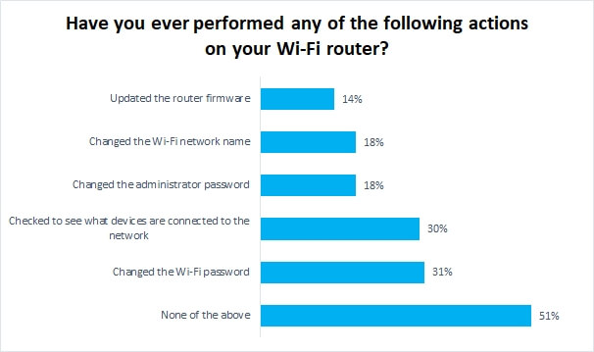
Broadband-Genie study results

Slide 15
Faults in Router Firmware 2
OpenSSL
Busy-box
Incoherency in integrated server architecture
Notes:
With previous version of OpenSSL, secret keys used for X.509 certificates, usernames and passwords, emails, instant messages ,etc. can be stolen.

Slide 16
OpenSSL
With previous version of OpenSSL following can be stolen
secret keys used for X.509 certificates
usernames
passwords
emails
instant messages
Notes:
With previous version of OpenSSL, secret keys used for X.509 certificates, usernames and passwords, emails, instant messages ,etc. can be stolen.

Slide 17
Faults in Router Firmware 2
OpenSSL
Busy-box
Incoherency in integrated server architecture
Notes:
With previous version of OpenSSL, secret keys used for X.509 certificates, usernames and passwords, emails, instant messages ,etc. can be stolen.

Slide 18
Busy-box variations
Manufacturer | Model | Busybox size (in kb)
DLink | DIR 615B | 353
DLink | DSR 150B | unknown
DLink | DSR 500N | 1126
DLink | DSR 1000N | 1126
DLink | DIR 866 | 431 + 93
DLink | DIR 866 DDWRT | 292
NetGear | JNR 1010 | 350
NetGear | MR314 | unknown
NetGear | R 6120 | 451
NetGear | R 6700 | 370
NetGear | WGT 624v4 | 398
NetGear | XR 500 | 525
NetGear | WNAP 320 | 1433
OpenWRT(default) |  | 227

Slide 19
Faults in Router Firmware 2
OpenSSL
Busy-box
Incoherency in integrated server architecture
Notes:
With previous version of OpenSSL, secret keys used for X.509 certificates, usernames and passwords, emails, instant messages ,etc. can be stolen.

Slide 20
Router Server Architecture
Maker | Model | Server | Server Tech | FS path | UPnP
Dlink | DIR 615B | ASP | /sbin/httpd | /www/ | /sbin/miniupnpd
Dlink | DSR 150B | HTML | /sslvpn/bin/httpd | /sslvpn/www/ | /bin/upnpd
Dlink | DSR 500N | HTML | /sslvpn/bin/httpd | /sslvpn/www/ | /bin/upnpd
Dlink | DSR 1000N | HTML | /sslvpn/bin/httpd | /var/www/ | /bin/upnpd
Dlink | DIR 866 | HTML | /usr/bin/httpd | /etc/www compressed | /usr/sbin/upnp
Dlink | DIR 866 DD | HTML | /usr/bin/httpd | /etc/www compressed | /usr/sbin/upnp
NetGear | JNR 1010 | PHP | /usr/sbin/mini-httpd | /usr/www/ | /sbin/miniupnpd
NetGear | MR314 | unknown | unknown | unknown | unknown
NetGear | R 6120 | HTML | /usr/sbin/mini-httpd | /www.eng/ | /usr/sbin/miniupnpd
NetGear | R 6700 | HTML | /sbin/htmlget | /www/ | /usr/sbin/upnpd
NetGear | WGT 624v4 | HTML | /usr/sbin/httpd | /www/ | /usr/sbin/upnpd
NetGear | XR 500 | HTML | /usr/sbin/uhttpd | /www/ | /usr/sbin/miniupnpd
NetGear | WNAP 320 | PHP | /sbin/lighttpd | /home/www/ | NOT FOUND
OpenWRT |  | NONE | /usr/bin/lighttpd | /var/www/ | /sbin/miniupnpd

Slide 21
Design
Extracting
firmware from the binary images using tools like binwalk, dd, fmk.
Emulating
the extracted firmware with Qemu.
Analyzing
the integrated server architecture, busybox and other components.
Suggesting
changes required to restrict the exploits and devise scripts for that.
Verifying
whether scripts resolve the issue or not.

Slide 22
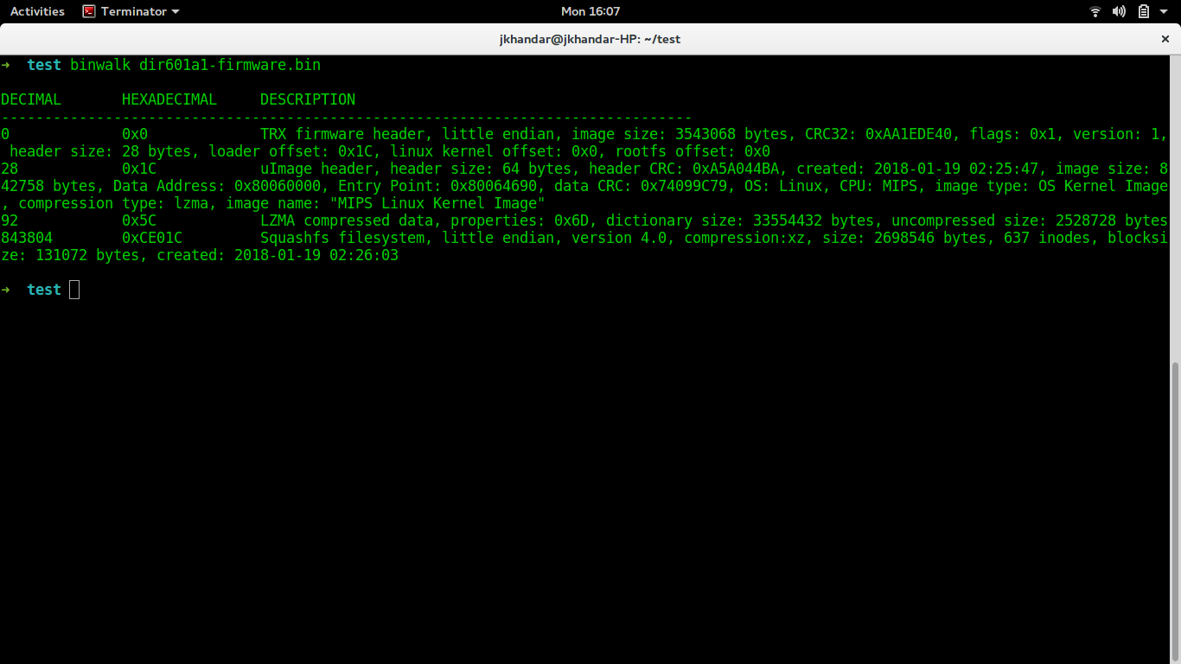
Firmware Squashfs Extraction Methodology
1. Extracting firmware from .img or .bin image file
a] binwalk XXX.bin - - extract [requires binwalk 2.0]
b] dd if=XXX.bin of=rootfs.squash bs=1 skip=843804
./unsquashfs_all.sh rootfs.squash
2. Running Qemu with default settings and default filesystem
qemu-system-mips -M malta -kernel vmlinux-3.2.0-4-4kc-malta
-hda debian_wheezy_mips_standard.qcow2 -append "root=/dev/sda1"
-redir tcp:22220::90 -redir tcp:22221::22 –nographic

Slide 23
Implementation
UPnP
1
Script sets timer till which UPnP server will be active.
OpenSSL
2
Script when executed blocks/unblocks access for remote users.
Devices connected remain unaffected.
Busybox
3
Script that creates a busybox with minimum required number of utilities.
To keep UPnP running, the script has to be run continuously.

Slide 24
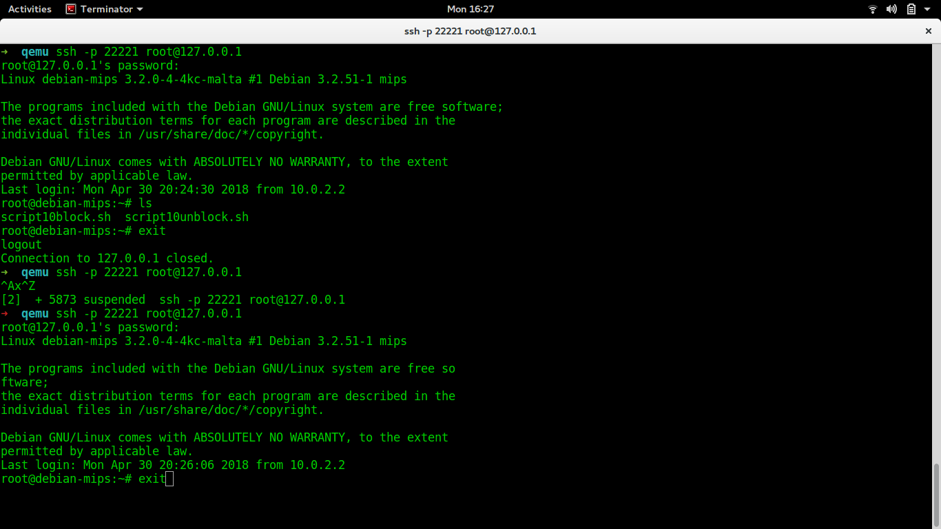
Execution of script to block OpenSSL

Slide 25
Limitations of this implementation
Emulation on Qemu is not fully functional.
Due to variations in integrated server architecture, using webpages to execute scripts is impossible.
The scripts do not detect location of various required libraries and executables now, we will provide thorough script within a few days at GitHub repo.
All scripts are run manually on the server.
Lack of any automation what-so-ever.
Not tested with real hardware.

Slide 26
Requirements to replicate this study
HP Pavilion Intel i5 @2.30GHz[64bit] [optional]
Qemu Machine Emulator 2.11.1 [some of the packages]
binwalk 2.0
Firmware-Mod-Kit [if not binwalk 2.0]
Scripts from https://github.com/jaykhandare/CSCI-B546-FinalProject

Slide 27
Future Scope
Enforced password modifications.
Initially right after setup
Then before each access request
The architecture is overwhelming to understand as of now but given enough time, the process can be automated.
Scripts can be added to integrated server architecture and can be directly used through default web - interface.
Someone could formulate a methodology to bring order in this chaos of incoherency.

Slide 28
Thanks

