Slide 1

SYSTEM ANALYSIS & DESIGN: 35359
Student Connect
ONE.IU.EDU
GROUP 3

Slide 2
SYSTEM ANALYSIS & DESIGN: 35359
Table of Contents

Slide 3
Name of the Project
Make students feel home again! (inappropriate level: 999)
Student Connect

Slide 4
Problems faced during meetings
Subbu can’t remember Xin and talks to other girls thinking they are her
It’s pronounced Shin, Jay always calls her Zin
Thrown out of East tower a couple of times due to loud noise
Discussion goes out of topic except for the Korean ‘kanya’ Juyoung who is stead fast with her book
Sophia still can’t wrap her head around difference between South and North Korea

Slide 5
Outcomes of the team project
The actual Project Plan (duh)
Got to taste Korean food
Got to taste Indian food
Got to taste Chinese ‘Duck Blood’ thing and sweets
Got to witness transformation of Sophia’s hairstyle
Got to know Korea is not a place for plus size people like Jay(who is more like ++)
Subbu couldn’t explain what he wanted to. But now, he doesn’t stop.

Slide 6
Sophia

Slide 7
Outcomes of the Interviews
Indian Student Association don’t really care about e-mails.
Everybody is trying to help in some way or the other.
By the number of students who actually show up for BISM or BWF events, we can say Indian (and other) students are interested in knowing the traditions and festivals of America

Slide 8
Outcomes of the survey
Students prefer the environment and niceties of people in America, but feel awkward initially.
Almost everybody has some extra-curricular interests, but they are not catered properly.
Academic format is not explained properly.
Most of the SOIC students don’t even know till this date(i.e. around 10 months) that they have access to Linux systems like Shark, the Hulk, Odin, etc.
Cultural barrier should be transformed into a fantong (that means useless in Chinese)

Slide 9
SYSTEM ANALYSIS & DESIGN: 35359
MOTIVATION FOR STUDENT CONNECT
ACADEMIC
1.Language barrier (different phrases like check/cheque, passed out/graduated, bunk/ditching classes, head nods) 2.Students are not familiar with academic format (assignments don't have any points in India/ in here, it is more research oriented) 3.University/bureaucratic procedures (getting SSN, driving license, registering for courses, selecting courses and stuff) 4.Housing information (which places will be favorable) 5.What courses to take for specialization (e.g. network admin, developer, system admin)
SOCIO CULTURAL
1.Feeling like an outsider (social alienation) 2.Cultural misunderstandings (strangers smiling at you, asking about your day) 3.Suppressed intrapersonal intelligence (out of touch with personal hobbies and extracurricular skills like art, music, sports, fashion) 4.No friends to begin with, later communication (finding fellow students with common interests/tastes) 5.Movie discussion and sports discussion groups 6.Problems with understanding healthcare system (insurance deals and stuff (ISO, Aetna)
EMOTIONAL
1.Being far from support network (emotionally wrecked/home-sick) 2.FOMO (fear of missing out with the scenarios (political, social) back in your country) 3.Financial burden (help to find part time jobs/letting students know where to go apply) 4.The food crisis

Slide 10
SYSTEM ANALYSIS & DESIGN: 35359
1. Planning
Project Initiation
Project Name Project Manager | Connected Student Jayendra Khandare
Customer Project Sponsor Project Start/End | Office of International Services (OIS) Indiana University Bloomington & Indiana University Bloomington Students Carol Choksy 2/13/2017 to 4/24/2017
Project Overview | The basic idea of the project is to create an applet on the "one.iu.edu" which will be accessible to every student of IU. The purpose of this applet is to provide a place of communications among the students, with this applet students will feel more connected.
Objectives | Provide categorized information. Modify database as per requirement. Provide a place of communication. Provide personalized updates.

Slide 11
SYSTEM ANALYSIS & DESIGN: 35359
1. Planning
Project Initiation
Key Assumptions | Students will feel more connected. All the information needed by students will be at a single place with interactive interface. Students will get to know what Indiana University can offer. Students with peculiar interests won’t feel left out.
Stakeholders | Roles | Responsibility | Signature
OIS Staff | OIS Staff | Project Survey, Resources
Chinese Student Org | Chinese Student Org | Project Survey, Resources
Indiana Student Org | Indiana Student Org | Project Survey, Resource
Shanmugavel Subramarian | Project Leader | Assign Tasks
Jayendra Khandare | Project Manager | Planning, Monitoring and Initiating Project

Slide 12
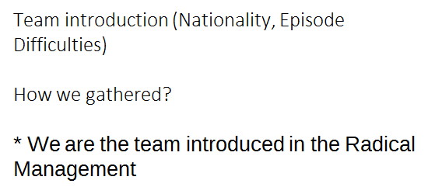
SYSTEM ANALYSIS & DESIGN: 35359
1. Planning
Project Initiation
1) Establishing the Project Initiation Team
D: Type of team, characteristics of team, type of leader,

Slide 13
SYSTEM ANALYSIS & DESIGN: 35359
Introduction
1. Planning
5. Maintenance
2. Analysis
Heart of system development
= Radical Management
“Client-centered Iteration”
Iteration each new semester
4. Implementation
3. Design
Notes:
Fig. 1-9
Overall, we followed traditional steps of System Analysis and Design, but in terms of structuring team, communication, and iteration, we selected radical management way. In addition, we adopted object oriented model to make some deliverables and assign tasks to team members.
Using of CASE tools.
We tried to make deliverables with considering different targets, Customers, team members, developers
We took much of time in planning & Analsysis part.

Slide 14
SYSTEM ANALYSIS & DESIGN: 35359
1. Planning
1.1. Project Identification & Selection
Corporate Strategic Planning
Organization Mission Statement
Bloomington is the flagship residential, doctoral-extensive campus of Indiana University. Its mission is to create, disseminate, preserve, and apply knowledge.
Statement of Objectives
commitments to cutting-edge research, scholarship, arts, and creative activity
commitments to challenging and inspired undergraduate, graduate, professional, and lifelong education
commitments to culturally diverse and international educational programs and communities
commitments to first-rate library and museum collections
commitments to economic development in the state and region
commitments to meaningful experiences outside the classroom
Notes:
First of all, to identify and select the project we investigated the mission Statement and objectives of the organization, Indiana University.

Slide 15
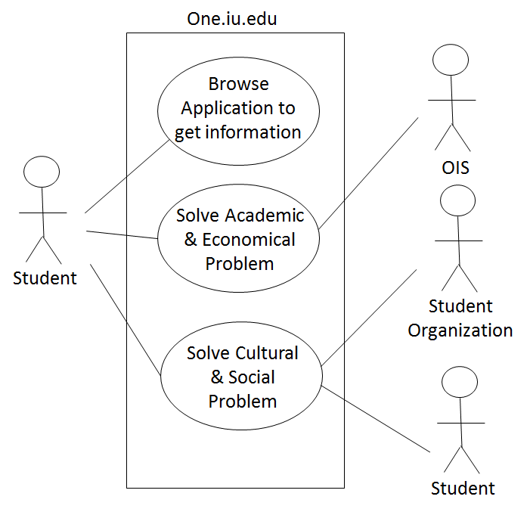
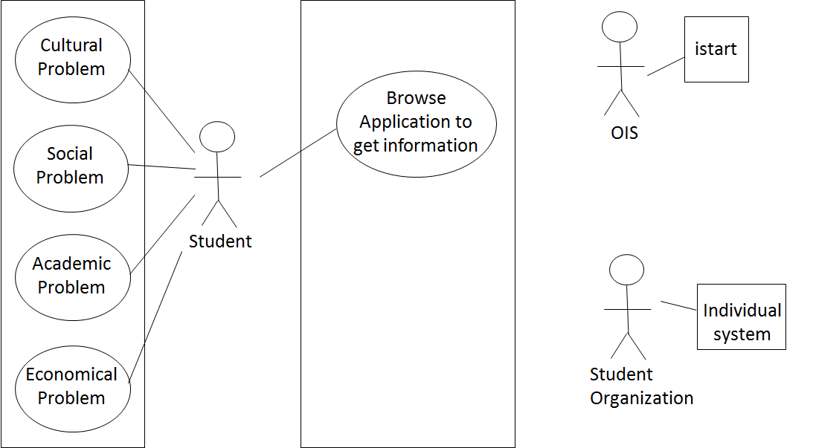
SYSTEM ANALYSIS & DESIGN: 35359
1. Planning
1.1. Project Identification & Selection
2) Information Systems Planning
1. Organizational Mission, Objectives, and Strategy 2. Informational Inventory: Use Case diagram (Now, Future)
Notes:
Organizational mission and objectives are introduced before and
Information Inventory provides a summary of the various business processes, functions, data entities, and information needs of the enterprise. The inventory will view both current and future needs.
Use case diagram is for communicating with customers

Slide 16
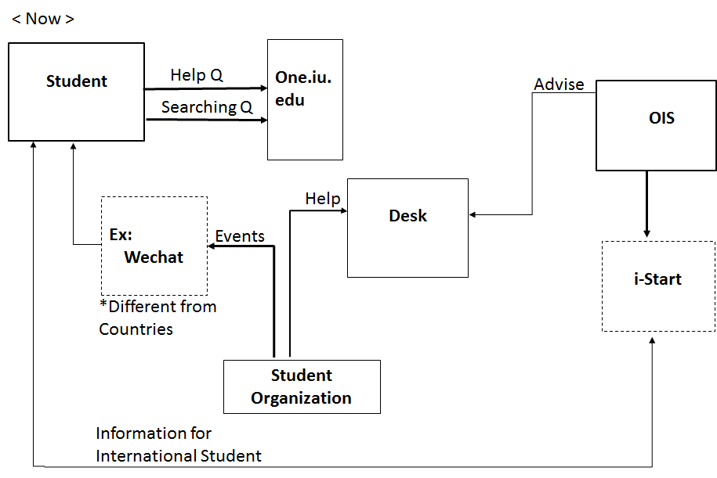
SYSTEM ANALYSIS & DESIGN: 35359
1. Planning
1.1. Project Identification & Selection
2) Information Systems Planning
2. Informational Inventory
:Context Data Flow diagram
(now)
Notes:
we built context Data Flow diagram for now to identify overall current problem of the system.

Slide 17
SYSTEM ANALYSIS & DESIGN: 35359
1. Planning
1.1. Project Identification & Selection
2) Information Systems Planning
Academics | 111 | HR&Benefits | 26
Accounts | 29 | Internatonal | 19
Administrative | 211 | IT Services | 78
Admissions | 15 | Libraries | 13
CampusLife | 50 | Orientation | 19
Careers | 20 | Payroll&Taxes | 19
Enrollment | 35 | Personal Information | 16
Faculty Services | 56 | Research | 109
Finances | 61 | Training | 37
Housing&Dining | 34 | Transportation | 20
3. Mission and Objectives of IS
Search, Click, Done
4. Constraints on IS Development
Dizzy interface
- Most Popular/ Highest Rated
- each panel consists of Image, rating, Name and corresponding campus
- 623 applications in Bloomington campus
Notes:
Organizational mission and objectives are introduced before and
Information Inventory provides a summary of the various business processes, functions, data entities, and information needs of the enterprise. The inventory will view both current and future needs.

Slide 18
SYSTEM ANALYSIS & DESIGN: 35359
1. Planning
1.1. Project Identification & Selection
2) Information Systems Planning : Project Scope Statement
SP17-BL-ILS-Z 556 SYSTEM ANALYSIS & DESIGN Prepared by: GROUP 3 Project Scope Statement Date: February 21, 2017
General Project Information Project Name: Student Connect Sponsor : Carol Choksy Project Manager: Subramanian Shanmugavel
Problem/Opportunity Statement: As international students, we have identified a number of academic, sociocultural, and emotional problems faced by students adjusting to life at IU and find it difficult to utilize the resources available to us due to the scattered nature of one.iu.edu. This is also an opportunity to create a resource to connect international students with each other and national students to share knowledge and form communities that we miss from home and organize all of the resources available to help international students in one place.
Project Objectives: Contribute to make Bloomington campus committed to full diversity, academic freedom, and creating meaningful experiences outside the classroom for international and national students
Notes:
Organizational mission and objectives are introduced before and
Information Inventory provides a summary of the various business processes, functions, data entities, and information needs of the enterprise. The inventory will view both current and future needs.

Slide 19
SYSTEM ANALYSIS & DESIGN: 35359
1. Planning
1.1. Project Identification & Selection
2) Information Systems Planning : Project Scope Statement (Cont.)
Project Description: An applet will be created on one.iu.edu that will be accessible to all students of IU. The applet will allow students to fill in and create a profile based on hobbies, interests, learnings, place of origin, cultural aspects, sports interest, etc, and then connect students with similar profiles. This applet will also act as a portal to connect international students with all resources to help them with the logistics of bureaucratic procedures.
Business Benefits: Improve utilization of IU resources Make students feel connected to IU community Improved understanding of students about what IU has to offer
Project Deliverables: Initial applet structure providing categorization of 632 IUB applications in One.iu.edu prototype (user interface) Communication space based on hobbies, interests, leanings, place of origin, cultural aspects, sports interest, etc.
Estimated Project Duration: 5 months
Notes:
Organizational mission and objectives are introduced before and
Information Inventory provides a summary of the various business processes, functions, data entities, and information needs of the enterprise. The inventory will view both current and future needs.

Slide 20
SYSTEM ANALYSIS & DESIGN: 35359
1. Planning
1.1. Project Identification & Selection
2) Information Systems Planning
Survey Academic
When deciding on courses to take for your degree, you might have had some help from seniors or professors. Is it possible to get that kind of help through One.iu?
Which specialization do you have in mind?
Were you able to understand your professors correctly? If not, what helped you?
Is the school work harder or easier compare to what they do back home?
Did you know the academic format before arriving at IU? If not, how did you find out about that?
Once you got the university ID card, how long did it take for you to know all the ways you can use it for or it will be required for?
How long did it take you to know various facilities provided by IU like Burrow account/Shark account?
Socio-cultural / link to the cultural/national organizations
Do you get information about IU/Bloomington community from One.iu?
Have you contacted any student on campus about school process through One.iu?
What hobbies do you have?(sports,art,etc) If you have, are you using One.iu to do the activities on hobbies?
What are the biggest differences you see between the university experience here and in your home country? Is One.IU helpful to understand the differences?
Has you experience here helped you gain an ability to communicate effectively within and among diverse cultural groups? If so, how?
Have you joined any student organizations? If so, which ones?
Have you ever tried to get help on socio-cultural and emotional aspect through one.iu.edu?
What platforms do you use to reconnect with your country? Are they sufficient?
What places have you visited around campus like museums, auditoriums,etc?
Emotional
Do you think One.IU help you when you have feelings of homesickness? If so, what applications you are using?
Everybody has experienced some sort of cultural shock, when they first arrived in USA. What was it for you? What kind of cultural element you were not familiar with?
How long did it take you to make acquaintances with fellow students?
What do you do on weekends for fun? (sports/IMU late-night/clubs)
Living
Do you get travel information from One.iu?
Can you get information about housing through One.iu?
Have you applied or going to apply for driving license or SSN? If so, did you use One.iu to do that?
Is it hard for you to get food you prefer? Can you get the information about food joints through One.iu or student organizations?
How important was it for you to secure a student job?
What kind of student jobs you were interested in? Which job were you able to secure finally? Did you use any IU resources for securing the student job? If yes, please specify them.
How well do you understand the United states health care insurance plan? Which one have chosen? Can you get information needed to understand through One.iu?
What do you like most about living in the United States? What was the hardest thing for you to adjust to?
Which restaurants do you prefer which serve your regional food?
Bloomington International Student Ministries(BISM) can help you get some free furniture or can arrange free rides for pickup from Indy airport. Do you know about that?
How did you come to know about Bloomington International Student Ministries(BISM)?
Notes:
Organizational mission and objectives are introduced before and
Information Inventory provides a summary of the various business processes, functions, data entities, and information needs of the enterprise. The inventory will view both current and future needs.

Slide 21
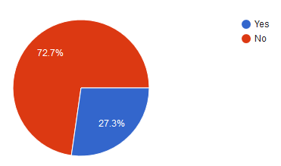
SYSTEM ANALYSIS & DESIGN: 35359
1. Planning
1.1. Project Identification & Selection
2) Information Systems Planning
Academic
When deciding on courses to take for your degree, you might have had some help from seniors or professors. Is it possible to get that kind of help through One.iu?
Notes:
Organizational mission and objectives are introduced before and
Information Inventory provides a summary of the various business processes, functions, data entities, and information needs of the enterprise. The inventory will view both current and future needs.

Slide 22
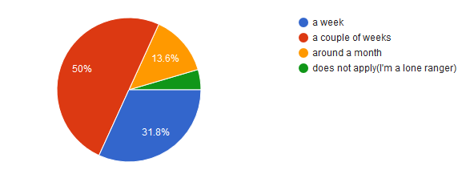
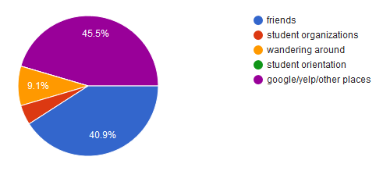
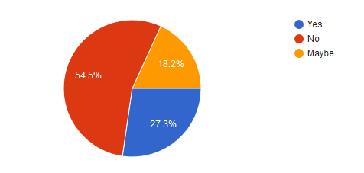
SYSTEM ANALYSIS & DESIGN: 35359
1. Planning
1.1. Project Identification & Selection
2) Information Systems Planning
Socio-cultural
Notes:
Organizational mission and objectives are introduced before and
Information Inventory provides a summary of the various business processes, functions, data entities, and information needs of the enterprise. The inventory will view both current and future needs.

Slide 23
SYSTEM ANALYSIS & DESIGN: 35359
1. Planning
1.1. Project Identification & Selection
2) Information Systems Planning
Survey result - Emotional
What do you like most about living in USA? What was the hardest thing for you to adjust to?
new environment / taxes
You have choices to achieve your goals. Culture and etiquette are the hardest things to adjust.
Large living area. No furniture.
The nature envitnment here is much better than my hometown in China. I think culture barriar is the hardest thing I had to counter.
Culture
comfortable；transportation
Nothing, people
The people here are nice. Life style.
Living
Good weather condition; Food
Good Education.Making New Friends
culture difference
finding food from home land
Language
Cheap; not a much difference so no adjustment actually.
I like the culture and the environment of the US. Hard thing to adjust is cultural shock.
Notes:
Organizational mission and objectives are introduced before and
Information Inventory provides a summary of the various business processes, functions, data entities, and information needs of the enterprise. The inventory will view both current and future needs.

Slide 24
SYSTEM ANALYSIS & DESIGN: 35359
1. Planning
1.1. Project Identification & Selection
2) Information Systems Planning
Survey result - Emotional
Everybody has experienced some sort of cultural shock, when they first arrived in USA. What was it for you? What kind of cultural element you were not familiar with?
Sample of Responses:
"How are you?"Always greeting first.
The food here is chill and cold. I could not find hot water in the building.
People's ignorance
It was okay for me. Maybe lifestyle?
language
partying and clubs
Food, life style
Open up myself to talk to others
Notes:
Organizational mission and objectives are introduced before and
Information Inventory provides a summary of the various business processes, functions, data entities, and information needs of the enterprise. The inventory will view both current and future needs.

Slide 25
SYSTEM ANALYSIS & DESIGN: 35359
1. Planning
1.1. Project Identification & Selection
2) Information Systems Planning
Survey result - Emotional
What do you do on weekends for fun? (sports/IMU late-night/clubs)
Sports and card games.
Computer games.
Not anywhere near campus
Bars
Watching films
Sports, Clubs
Sports
IMU late night
clubs
TV shows
League of Legends; Pub
Bars, video games and travelings
Notes:
Organizational mission and objectives are introduced before and
Information Inventory provides a summary of the various business processes, functions, data entities, and information needs of the enterprise. The inventory will view both current and future needs.

Slide 26
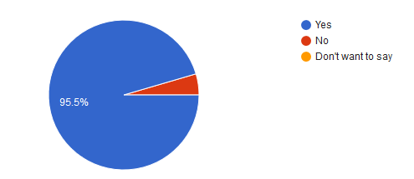
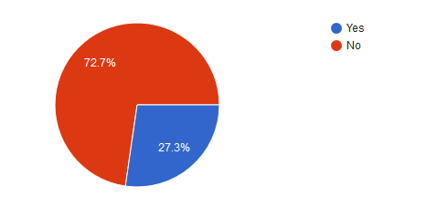
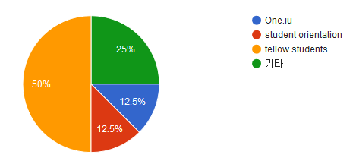
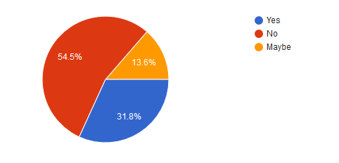
SYSTEM ANALYSIS & DESIGN: 35359
1. Planning
1.1. Project Identification & Selection
2) Information Systems Planning
Living
etc
Notes:
Organizational mission and objectives are introduced before and
Information Inventory provides a summary of the various business processes, functions, data entities, and information needs of the enterprise. The inventory will view both current and future needs.

Slide 27
SYSTEM ANALYSIS & DESIGN: 35359
1. Planning
1.1. Project Identification & Selection
2) Information Systems Planning
Interview
Notes:
Organizational mission and objectives are introduced before and
Information Inventory provides a summary of the various business processes, functions, data entities, and information needs of the enterprise. The inventory will view both current and future needs.

Slide 28
SYSTEM ANALYSIS & DESIGN: 35359
1. Planning
What sort of problems do students come to you with? (administrative, cultural, academic, etc)
What systems/resources do you use to solve those problems?
In your opinion, are the available resources on one.iu.edu for helping students adequate?
What kind of events you guys hold to make students from your community/country feel home?(cultural/social/etc) How do you advertise the events?
How do you contact the students from your community/country? OR How do they contact you?
Do you mostly have students from the same country come to your events or many different nationalities? Is it fine if someone of different nationality wants to join?
Do you help or guide students while deciding for which courses to take for specialization? If so, how?
What services do you provide for students, for example, picking up students from airport or lost and found?
Do you take help from any local group or community to coordinate events/outreach?
What would make helping your students easier?
1.1. Project Identification & Selection
2) Information Systems Planning
Interview result - OIS, CSA, BISM
Notes:
Organizational mission and objectives are introduced before and
Information Inventory provides a summary of the various business processes, functions, data entities, and information needs of the enterprise. The inventory will view both current and future needs.

Slide 29
SYSTEM ANALYSIS & DESIGN: 35359
1. Planning
1.1. Project Identification & Selection
2) Information Systems Planning
5. Overall Systems Needs and Long-Range IS Strategies
Reflect dynamic information needs/ cultural diversity through data mining
6. The Short-term Plan
http://auiproject.com/prj/view.html?i=MTEwNDQ0MTM5OTc1NTE5MTk1NzI0LDM3OTksZW4=
7. Conclusions
Notes:
ACADEMIC 1.Language barrier (different phrases like check/cheque, passed out/graduated, bunk/ditching classes, head nods) 2.Students are not familiar with academic format (assignments don't have any points in India/ in here, it is more research oriented) 3.University/bureaucratic procedures (getting SSN, driving license, registering for courses, selecting courses and stuff) 4.Housing information (which places will be favorable) 5.What courses to take for specialization (e.g. network admin, developer, system admin)
SOCIO CULTURAL 1.Feeling like an outsider (social alienation) 2.Cultural misunderstandings (strangers smiling at you, asking about your day) 3.Suppresed intrapersonal intelligence (out of touch with personal hobbies and extracurricular skills like art, music, sports, fashion) 4.No friends to begin with, later communication (finding fellow students with common interests/tastes) 5.Movie discussion and sports discussion groups 6.Problems with understanding healthcare system (insurance deals and stuff (ISO, Aetna) EMOTIONAL 1.Being far from support network (emotionally wrecked/home-sick) 2.FOMO (fear of missing out with the scenarios (political, social) back in your country) 3.Financial burden (help to find part time jobs/letting students know where to go apply) 4.The food crisis
AFTER CONDUCTING THE PROJECT 1. Students will feel more connected. 2. All the information needed by students will be at a single place with interactive interface. 3. Students will get to know what IU can offer. 4. Students with peculiar interests won’t feel left out.

Slide 30
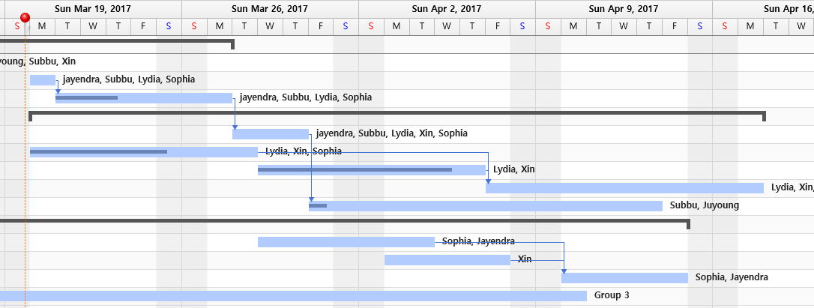
SYSTEM ANALYSIS & DESIGN: 35359
1. Planning
1.1. Project Identification & Selection
Information Systems Planning
Corporate Strategic Planning
Current Situation:
hard to find virtual space to communicate with other students
cannot relieve FOMO (fear of missing out with the scenarios (political, social) back in your country) through ONE.IU.EDU
hard to solve living problems through ONE.IU.EDU
seperated channel to meet other students
Current Enterprise
Future Enterprise
Future Situation:
1. students feel more connected.
2. everything at a single place (all the information).
3. reflecting cultural difference (words, body language, etc)
4. students with similar interests can meet up.
Schedule of Projects:
Strategic Plan

Slide 31
SYSTEM ANALYSIS & DESIGN: 35359
1. Planning
1.2. Project Initiation
1) Establishing the Project Initiation Team
2) Establishing a Relationship with the Customers
Who is our customers?
Students, OIS, Student Organizations

Slide 32
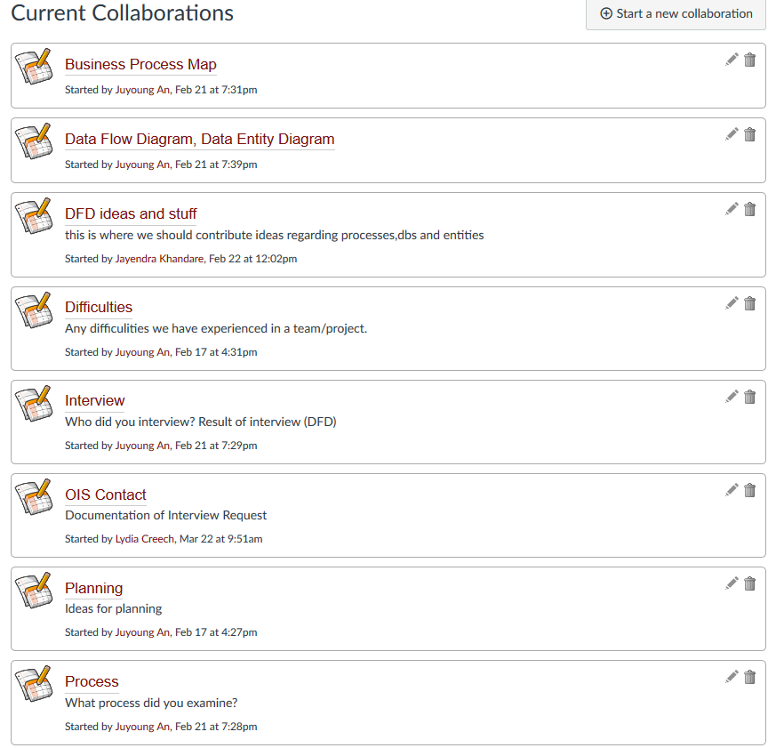
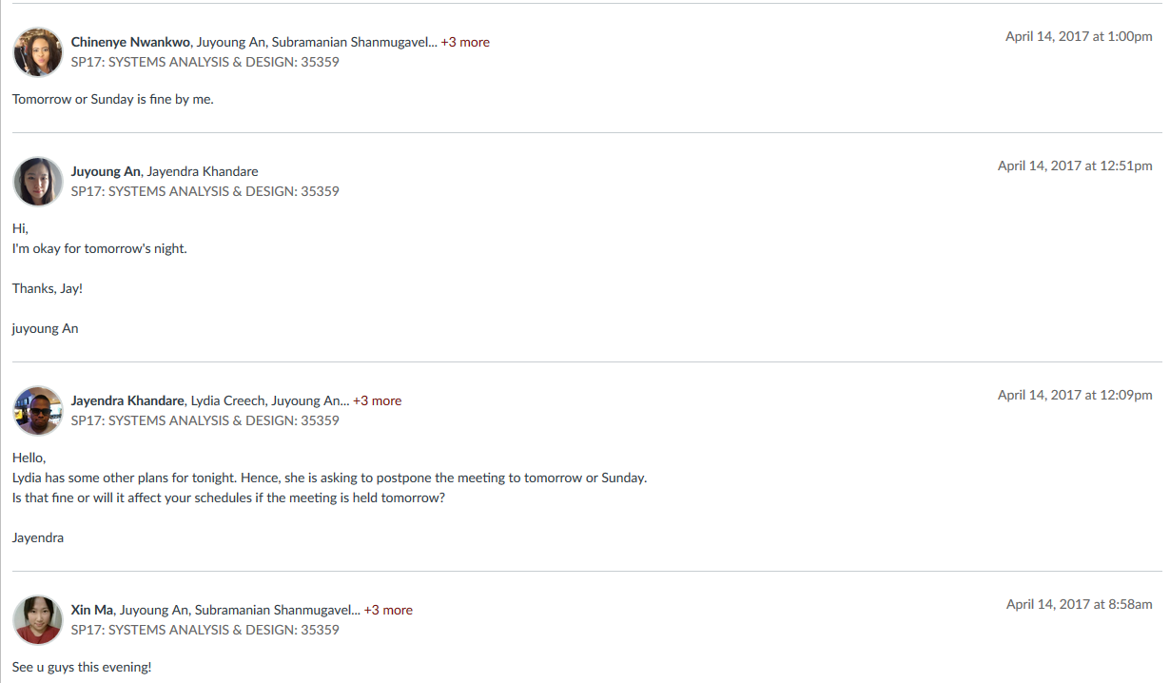
SYSTEM ANALYSIS & DESIGN: 35359
1. Planning
1.2. Project Initiation
3) Establishing the project initiation plan
4) Establishing management procedures
5) Establishing the project management environment and project workbook
: Collaboration pages of Canvas, Google docs, e-mail, Shared Gantt chart

Slide 33
SYSTEM ANALYSIS & DESIGN: 35359
1. Planning
1.3. Project Planning
1) Describing Project Scope, Alternatives, and Feasibility
The basic idea of the project is to create an applet on the "one.iu.edu" which will be accessible to every student of IU.
The initial set-up (data entry) will be done for each student by himself/herself. he/she will be provided with a questionnaire which will ask them about their hobbies, interests, learnings, place of origin, cultural aspects, sports interest, etc. This can be supplemented by providing SOPs. All the info. collected from this stage will be stored in databases and the students interested in that will be categorized and what they prefer will be stored.
Once the initial data entry is done, they will have various sub-options to choose from about what they need to know. These options will include stuff like airport protocols, ticket booking procedures and regulations, information about which places to visit for regional food, sports (cricket, shogi, mahjong, etc.) and many other things. There are some sports organizations and cultural associations like Chinese and Indian associations which can help. The project is selected by students of IUB as user department and our team members will help users to identify their requests.

Slide 34
SYSTEM ANALYSIS & DESIGN: 35359
1. Planning
1.3. Project Planning
2) Dividing the Project into Manageable Tasks
Design survey.
Define the sample population of the surveyed students.
(i) Question students about their problems and how did they overcome them(Survey).
Interviewing the student organizations like ISA, CSSA, OIS, KSA, etc. regarding what kind of help they can provide.
Interview UITS regarding process of building an applet
Visually analyzing the result of Interviews (WFD, DFD)
Research the available resources (specifically the resources already available through “One.iu.edu”).
Statistically analyzing the survey for implementation.
(i)Develop the database of student information.
(i)Design the user interface. (Will be decided After interviewing UITS)
(i)Usability testing
Creating deliverables
Communication and management
1, 2 - Subbu & Lydia
3 - Together (Through Communication)
4, 5 - Lydia & Xin WFD, DFD (help from Juyoung An)
6, 7, 8 - Juyoung An and Subbu
9 - Sophia
10- Xin CSS
11 - Sophia
12, 13 - Jay (Project manager)
cf. Providing instructions on cultural differences (Relationship b/t Professors & Students, Costumes, Volunteer, Non-verbal language, Mandatory things (engaging sports, exclusive group)

Slide 35
SYSTEM ANALYSIS & DESIGN: 35359
1. Planning
1.3. Project Planning
3) Estimating Resources and Creating a Resource Plan
Lydia & Xin: survey methodology, interviewing student organizations
Xin: interviewing UITS, and One.iu, design the user interface
Juyoung An: Text mining, Devising deliverables
Jayendra Khandare : Project Management
4) Developing a Preliminary Schedule
5) Developing a Communication Plan
Morning Stand-up
Meeting once in a week

Slide 36
SYSTEM ANALYSIS & DESIGN: 35359
1. Planning
1.3. Project Planning
6) Determining Project Standards and Procedures
7) Identifying and Assessing Risk
8) Creating a Preliminary Risk
9) Developing a Project Scope Statement
https://docs.google.com/document/d/11RKcw-MnL612QghVwv8k_8aKqQdAjpYV7hzpXzP0RX8/edit?usp=sharing
10) Setting a Baseline Project Plan

Slide 37
SYSTEM ANALYSIS & DESIGN: 35359
2. Analysis
1. Planning
5. Maintenance
2. Analysis
Heart of system development
= Radical Management
“Client-centered Iteration”
Iteration each new semester
4. Implementation
3. Design

Slide 38
SYSTEM ANALYSIS & DESIGN: 35359
2. Analysis
Agile Usage-Centered Design
Continual user involvement
(p.194)
As a project team and customer, we write down the ideas come up with freely in a shared google docs. The content of google docs is used to find requirements.

Slide 39
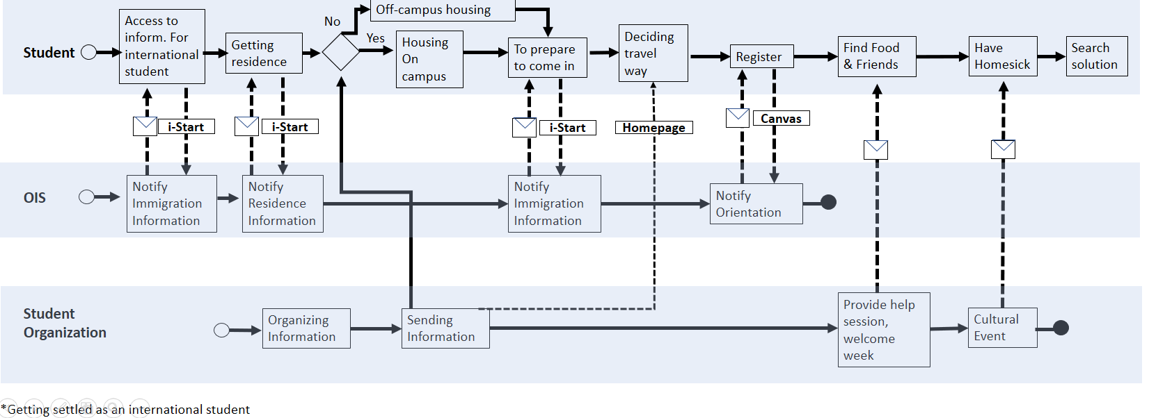
SYSTEM ANALYSIS & DESIGN: 35359
2. Analysis
2.1. Determining System Requirements
Interview & Survey Results, Sample Process : BUSINESS PROCESS MAP of Getting settled as an international student
Notes:
purpose of analysis is to determine what information and information processing services are needed to support selected objectives and functions of the organization (requirements determination).

Slide 40
SYSTEM ANALYSIS & DESIGN: 35359
2. Analysis
2.1. Determining System Requirements
2) DFD - level 0
1.0
Create Database for Student Connect
Student Chapter
Student
One.iu.edu
OIS
2.0
Accessing
Student Connect
Notes:
purpose of analysis is to determine what information and information processing services are needed to support selected objectives and functions of the organization (requirements determination).

Slide 41
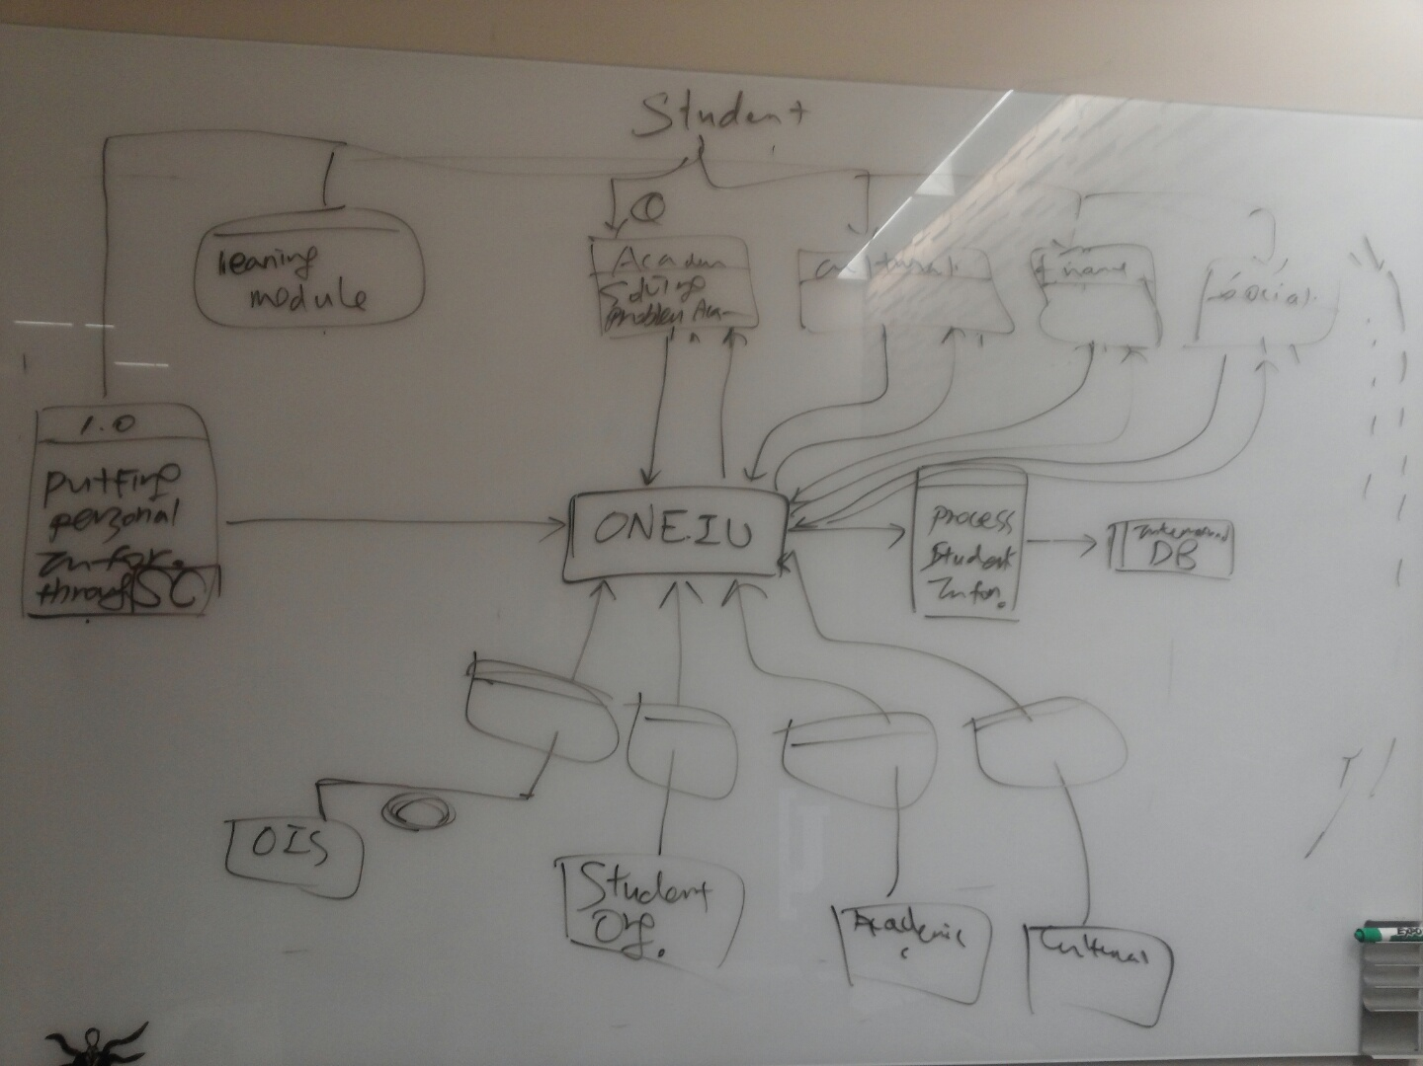
SYSTEM ANALYSIS & DESIGN: 35359
2. Analysis
2.1. Determining System Requirements
2) DFD - Process 2.0, level 1
Notes:
purpose of analysis is to determine what information and information processing services are needed to support selected objectives and functions of the organization (requirements determination).

Slide 42
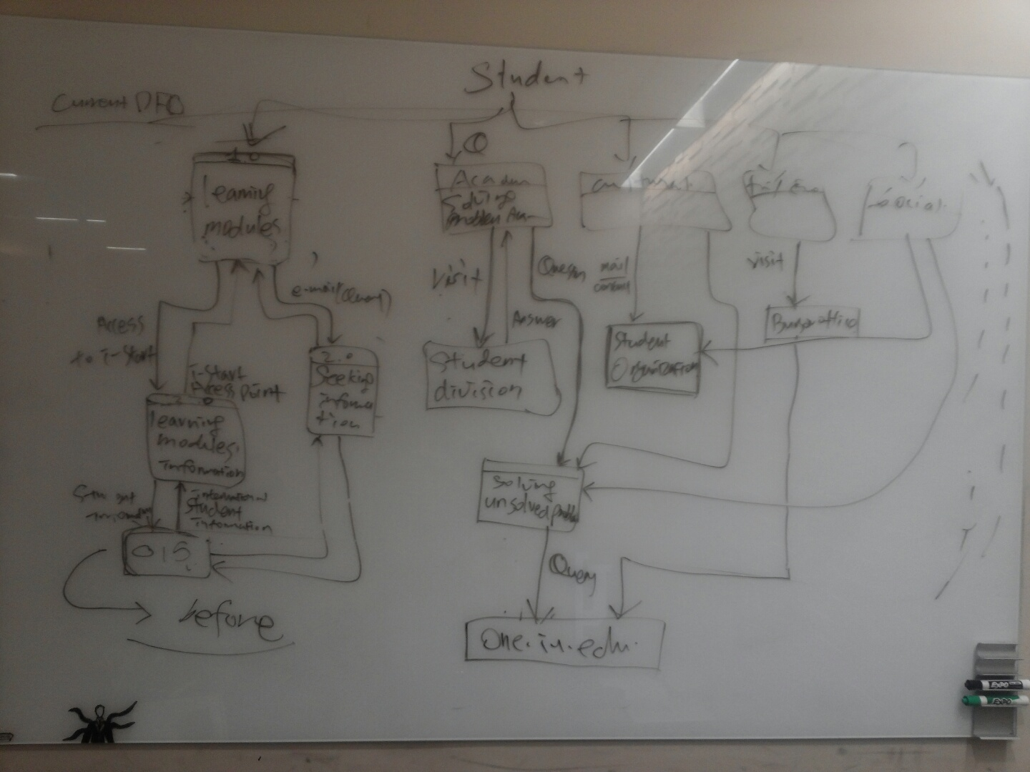
SYSTEM ANALYSIS & DESIGN: 35359
2. Analysis
2.1. Determining System Requirements
2) DFD - Process 2.0, level 1
Notes:
purpose of analysis is to determine what information and information processing services are needed to support selected objectives and functions of the organization (requirements determination).

Slide 43
SYSTEM ANALYSIS & DESIGN: 35359
2. Analysis
2.2. Structuring System Requirements
2. User diagram
Communicating/Iterating with user now/future)
Notes:
User cases are process that facilitates the development of information systems to support that process.
Use case modeling helps developers understand the functional requirments of the system without worrying about how those requirements will be implemented

Slide 44
SYSTEM ANALYSIS & DESIGN: 35359
3. Design
1. Planning
5. Maintenance
2. Analysis
Heart of system development
= Radical Management
“Client-centered Iteration”
Iteration each new semester
4. Implementation
3. Design

Slide 45
SYSTEM ANALYSIS & DESIGN: 35359
3. Design
3.1. Brainstorming, what is possible?
cf. Providing instructions on cultural differences (Relationship b/t Professors & Students, Costumes, Volunteer, Non-verbal language, Mandatory things (engaging sports, exclusive group)
SOP Text mining part for our project.
The online international orientation module is available to students before coming to USA, but some students don’t know that hence they should be reminded of that.

Slide 46
SYSTEM ANALYSIS & DESIGN: 35359
3. Design
3.2. E-R Diagram
Logical DB Design

Slide 47
SYSTEM ANALYSIS & DESIGN: 35359
3. Design
3.3. Form

Slide 48
SYSTEM ANALYSIS & DESIGN: 35359
4. Implementation
Equipment
Policies
Training
Tutorial
Enforcing
Physical DB Design
- Do we have to consider these parts, too?
Q. What is the difference between form and sample forms?
What is dialogue? Is it conversation?
Do we have to make sample interface using html things?

Slide 49
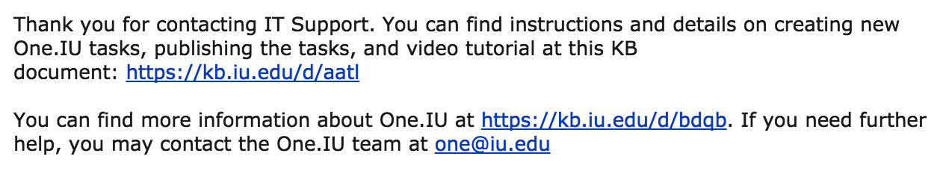
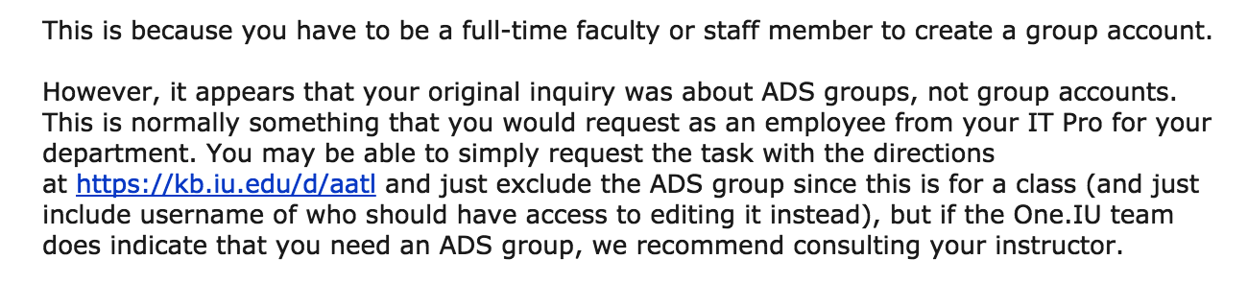
SYSTEM ANALYSIS & DESIGN: 35359
Difficulties
dsfds
Before everything, we totally have no idea about what should we do to make an applet under One.IU
We find that we need to get ADS group before ask One.IU
😒

Slide 50
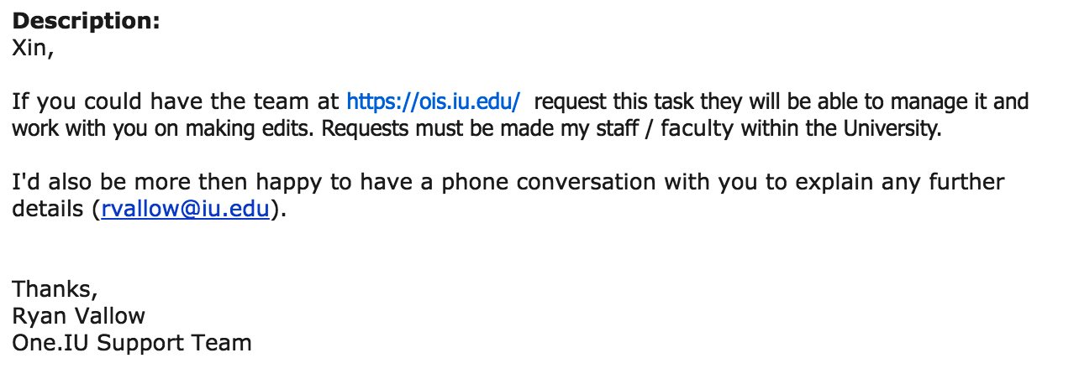
SYSTEM ANALYSIS & DESIGN: 35359
Difficulties
Reply from One.IU, ask us to contact OIS
Reply from One.IU, ask us to contact OIS

