Slide 1

A presentation on
“UBIQUITOUS NETWORKING”
Submitted to the faculty of Engineering
Dr. B. A.Technological University, Lonere
by
Khandare J.N.
20090631
under guidance of
Mrs.Geetanjali Mahamunkar
Computer Dept.
Dr. Babasaheb Ambedkar Technological University, Lonere

Slide 2
CONTENTS
Introduction
Recent Networks
Implementation(Working Parameters)
Additional Requirements
Security Issues
Applications in Workplace
Conclusion

Slide 3
INTRODUCTION
Ubiquity means which is present anywhere, anytime.
This concept dates back to the year 1966 when 1st home automation system was theoretically introduced.
The surrounding devices are used for required task.
In short the devices in the whole environment of an individual are connected to each other and to the network.
It’s said that in case of virtual reality, we enter the world of computer simulations. But in this case, the computer itself comes out of its casing to interact with user.

Slide 4
RECENT NETWORKS
There are many faults in recent networks which cause the implementation to prolong.
For connecting the whole environment of a person in a network we'll have to develop a technique to provide them necessary bandwidths they will need.
We'll need high computing power.
The networks must be modified keeping the cost factor in consideration.
Protocols needed must be modified.

Slide 5
Ubiquitous networking can be thought to be the intermediate stage between the level which we are at now and future i.e. ‘exotic networks’.
UBIQUITOUS
NETWORKING
WEB
COMPUTING
EXOTIC
NETWORKING

Slide 6
IMPLEMENTATION
Send out the Bat signal
Bats
Receivers
Central-unit
In the Zone
Information hoppers and smart posters

Slide 7
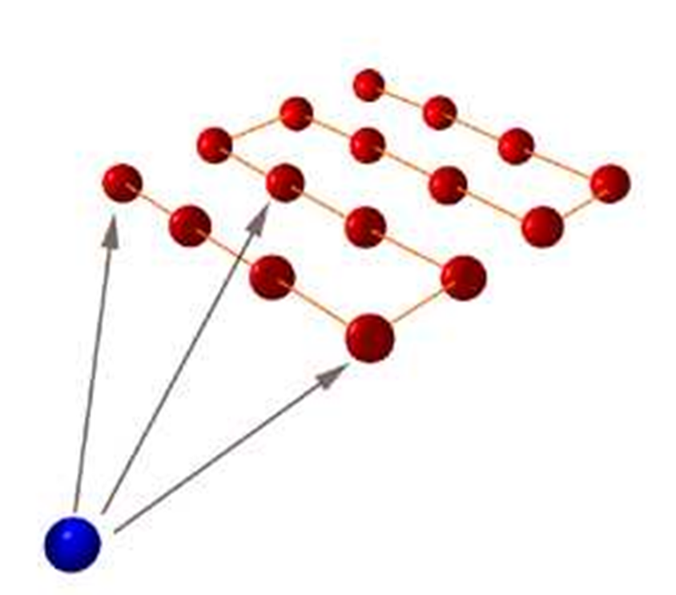
Trilateration Method of positioning

Slide 8
REQUIREMENTS
Multi-modal – at least 6 Mbps
for fixed points and portable terminals
Protocols for multi-modal – IPv6
Other network related upgrades
NTT DoCoMo’s I-mode
Bluetooth technology
Fiber-to-the-home(FTTH)
Notes:
Thanks Wrushal. I’ll continue here on…

Slide 9
REQUIREMENTS(contd.)
Balancing proactivity and Transparency
System should be properly balanced so that it is invisible.
Self-tuning should be done.
Transparency is must. The use of methods suggested by Coda File System can be done.
The system should walk the fine line between annoying proactivity and inscrutable transparency.

Slide 10
REQUIREMENTS(contd.)
Privacy and Trust
Mechanisms such as location tracking, smart spaces and surrogate monitors can be used to track user’s actions on an almost continuous basis.
It is a difficult challenge to establish the mutual trust between a system and user in a manner that is minimally intrusive and thus preserves invisibility.
More advanced systems are not really needed.

Slide 11
REQUIREMENTS(contd.)
Impact on layering
Exposure of much more information across layers.
Parnas’ principle of information hiding.
Home automation
Includes centralized control of lighting, HVAC appliances, and other systems.
Provide increased quality of life for persons who might otherwise require caregivers.

Slide 12
Ubiquitous Learning Environment
ULE is a situation of omnipresent education.
Education is happening all around the student but the student may not even be conscious of the learning process.
Students just have to be there.

Slide 13
SECURITY ISSUES
Ubiquitous computing is just a smart computer network and computer networks can be hacked.
You might get used to being monitored - ethical concerns.
Private data or behavioral patterns of the user can be leaked out.
PGP will prove useful in this field.

Slide 14
APPLICATIONS IN WORKPLACE
Nanotechnology.
Wireless computing.
Context-awareness.
Natural interaction.
offer a powerful
set of tools.

Slide 15
CONCLUSION
Simplify, minimize, and reduce human interventions.
It can be used as an alternative to recent technologies.
First of all, telecom giants have to provide higher data access at low price rates.
‘Exotic Networks’ can be realized with ‘Ubiquitous Networks’ as an intermediate stage.

Slide 16
Research centres in India –
National Ubiquitous Computing Research Centre (UCRC), Centre for Development of Advanced Computing (CDAC), India.

Slide 17
Biblography
Masayohi Ohashi, “Ubiquitous Networks”
Andrew S. Tatenbaum, “Computer Networks”
Phill Zimmermann, ”An Introduction to Cryptography”
Behrouz Forozan, “Data Communication and Networking”

Slide 18
THANK YOU

