Slide 1
History of Money

Slide 2
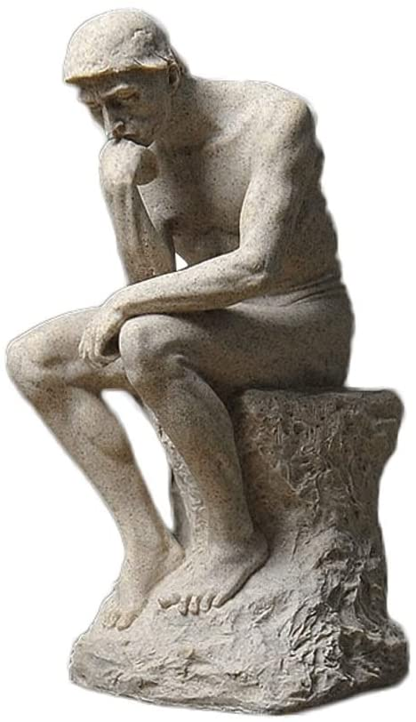
What is money ?
What is money ?
Does it really hold any value ?
How does it gets it value ?

Slide 3
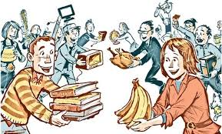
Evolution
Barter - what if it was actually happening today ?
Other systems
Shells
Rocks
Coins
Leather

Slide 4
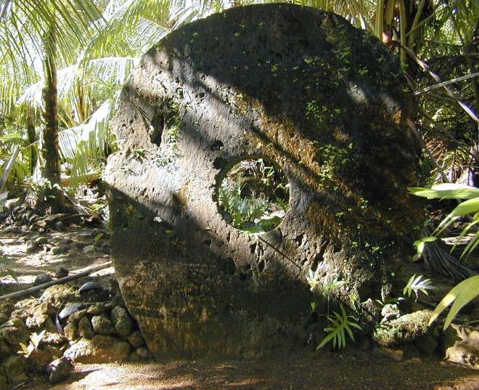
Story of YAP
How it happened ?
What these people taught world?

Slide 5
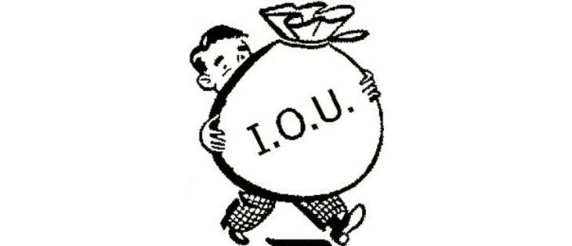
Money is IOU
What is I OWE YOU
Is this what really written
on our notes ?

Slide 6
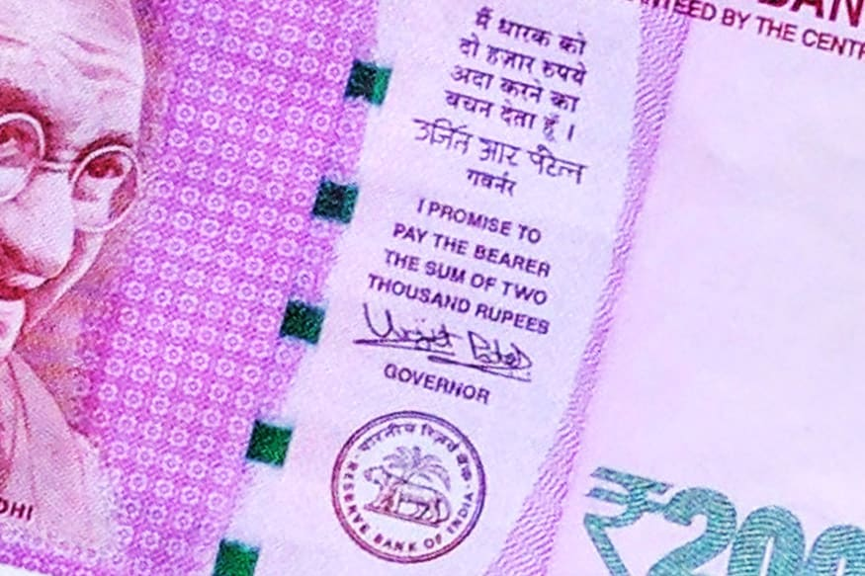
IOU

