Slide 1


Automated Meeting Room Booking System
October 2020
Team ClanOctate, DA 1 - Team 1
| Technology

Slide 2

Team members
The team for the project, named ClanOctate is composed of :-
Anuj Naresh Chetwani
Gaurav Anand
Hrushabh Hirudkar
Jaykumar Dashrathbhai Khatri
Manasi Dippak Kaamble
Nikhil Saboo
Shivani Vijay Rajmane
Simran Arun Moondra
- 45120348
- 45120322
- 45120268
- 45120246
- 45120313
- 45120202
- 45120050
- 45120142
HSBC | Technology

Slide 3
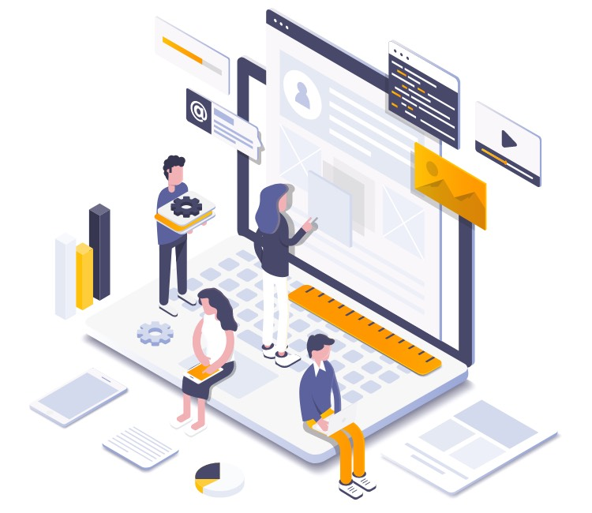
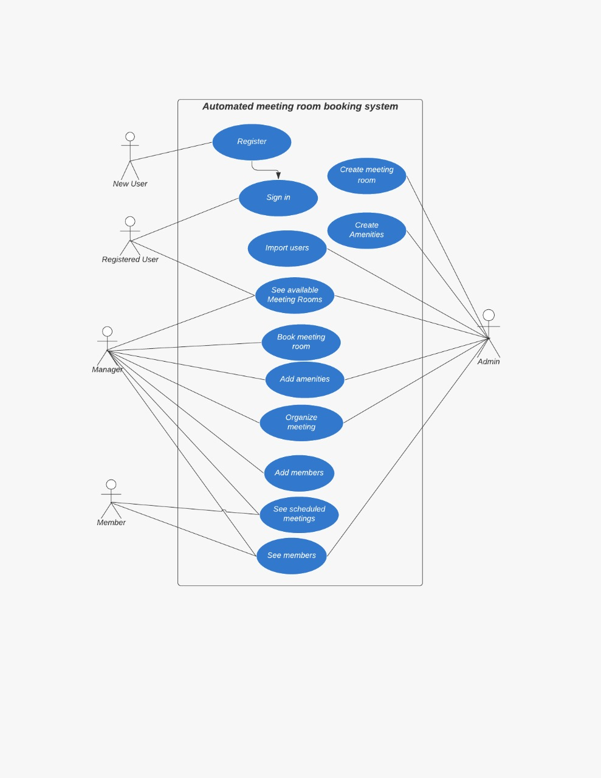
Application Features
The application designed in the project, automates the procedure of booking a meeting room in a company where employees can search and book a meeting room based on their requirements.
Depending on the role of the employee in the company, the employee can perform various functions (as shown beside) on the application.
Key points :-
The application is very simple and easy to use.
The application provides enough options to help the users easily navigate pages and thus provide a seamless experience.
The application provides a secure and reliable way to book a meeting room and keeping track of the amenities to be required for the meeting.
HSBC | Technology

Slide 4
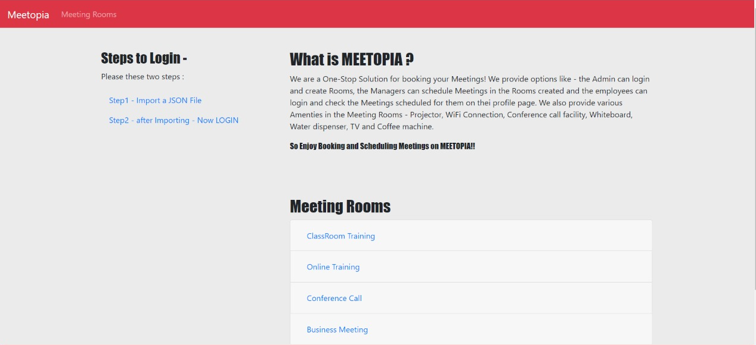
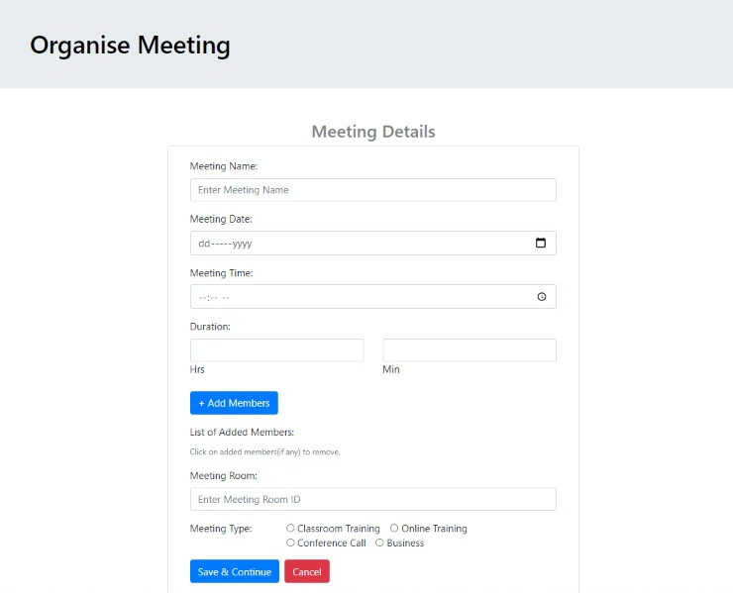
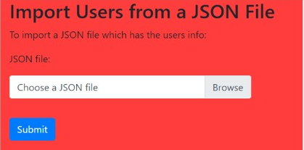
UI Snapshots
HSBC | Technology

Slide 5
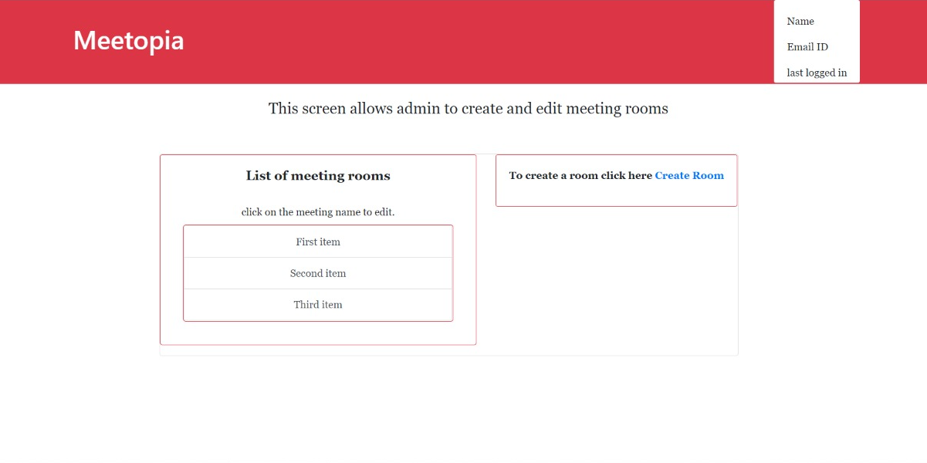
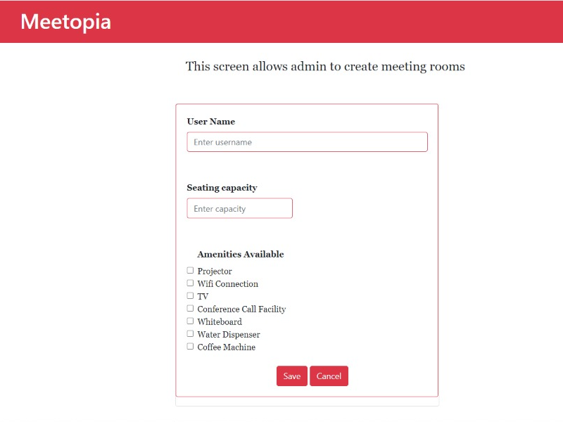
UI Snapshots continued...
HSBC | Technology

Slide 6

Learnings from the project
The modern workplace thrives on collaboration, and with collaboration comes meeting. Video meetings and conference calls can be a hassle for the modern workplace if there is no proper managed meeting room that supports the plethora of smart technologies like - laptops, wifi connection, whiteboard, TV and high-definition video conference call with several attendees, that can be booked conveniently.
While developing and designing the solution for the above problem, through our application, our team learnt a lot in the process.
Collaboration - the team learnt to plan, coordinate, control and monitor the project during entire time span of development.
Time Management - the team learnt to efficiently use time and lay emphasis on complex parts.
Technological tools & concepts - the team learnt about the following :-
proper use of layered architecture to develop the solution that is loosly coupled.
use of MVC design pattern that isolates the application logic from the user interface layer and supports separation of concerns.
use of database (MySql RDBMS server) to store the business data.
deeper knowledge of theoretical concepts through active exploration of real world problem (as specified above).
etc.
HSBC | Technology

Slide 7

“THANK YOU”
HSBC | Technology

