Slide 1
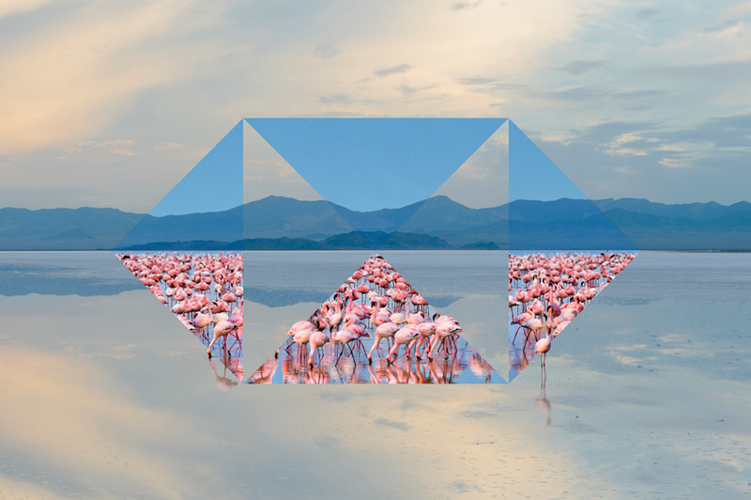

Automated Meeting Room Booking System
October 2020
Team ClanOctate, DA 1 - Team 1
| Technology

Slide 2

Team members
The team, ClanOctate is composed of :-
Anuj Naresh Chetwani
Gaurav Anand
Hrushabh Hirudkar
Jaykumar Dashrathbhai Khatri
Manasi Dippak Kaamble
Nikhil Saboo
Shivani Vijay Rajmane
Simran Arun Moondra
- 45120348
- 45120322
- 45120268
- 45120246
- 45120313
- 45120202
- 45120050
- 45120142
HSBC | Technology

Slide 3
Application Features
To add
HSBC | Technology

Slide 4
UI Snapshots
To add
HSBC | Technology

Slide 5
Learnings from the project
To add
HSBC | Technology

Slide 6

“THANK YOU”
HSBC | Technology

