Slide 1
DNS
Server
IP주소
URL
Web
brower
HTTP Request
DNS
Resolver
HTTP Request

Slide 2
DNS
Server
IP주소
URL
Web
brower
HTTP Request
DNS
Resolver
HTTP Request
Protocol
Stack
HTTP Request

Slide 3


The Nearest
DNS Server
Root Domain
DNS Server
com
DNS Server
naver
DNS Server
www
DNS Server
$$⋮$$
IP주소
www.naver.com
Client
HTTP Request

Slide 4
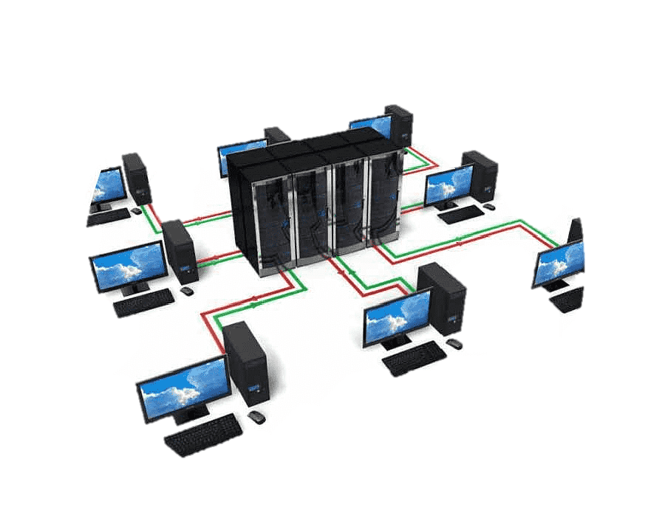
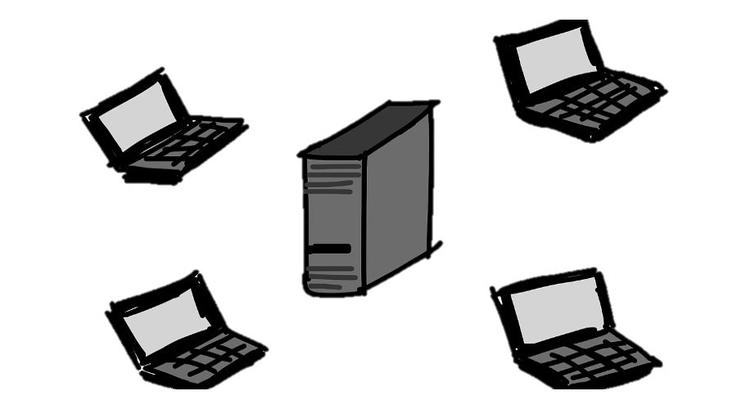

Slide 5


