Slide 1

PROJECT FINAL REVIEW
E-commerce Delivery &
Logistics Performance Analysis
Brazilian E-Commerce Public Dataset by Olist
PROJECT TEAM
Y
Yashashvi Yash
M
Meghana
J
Jaykishan
M
Madhupriya
L
Lav Kumar
Team project | Member 5: Lav Kumar — Documentation & Integration
Evidence snapshot reviewed: 05 November 2026

Slide 2
Executive summary
What the saved repository evidence supports — and what is still blocked
ORDER ROWS
1
The uploaded repository snapshot contains 99,441 unique order rows in the all-orders KPI export.
99,441
unique rows, all-orders KPI export
2
The order-status summary records 96,478 delivered orders and 625 canceled orders.
DELIVERED
96,478
orders in status summary
3
The KPI export contains 96,470 delivered-order rows; mean purchase-to-delivery duration is 12.56 days.
MEAN DURATION
12.56 days
4
The saved MySQL validation output reports a 6.77% late-delivery rate, but another saved export classifies 7,826 orders as late.
purchase to delivery
LATE RATE (MYSQL)
6.77%
5
Dashboard functionality and the final KPI sign-off remain pending because the PBIX file and live interaction evidence were not present in the uploaded archive.
saved validation output

Slide 3






Problem statement and objectives
Project scope
Understand order fulfilment and delivery performance across the Olist marketplace dataset.
Measure order status, delivery duration, on-time/late delivery, cancellations and customer review patterns.
5
Prepare a reproducible analytical layer with documented data-quality checks and KPI definitions.
project objectives
Translate validated findings into operational recommendations without claiming causation.
Descriptive, reproducible and documented — without claiming causation.
Provide a clear repository, dashboard handover and final presentation.

Slide 4



Dataset overview
Source and grain
ORDER ROWS
DELIVERED STATUS
CANCELED STATUS
KPI DELIVERED ROWS
99,441
96,478
625
96,470
kpi_orders_all.csv
Order status summary
Canceled only; unavailable is separate
kpi_orders.csv
Six source CSVs: orders, customers, order items, reviews, products and category translations.
Primary analytical grain: one row per order_id; item and review data must be aggregated before joining.
Dataset source: Brazilian E-Commerce Public Dataset by Olist (Kaggle).
The repository snapshot includes raw CSVs, MySQL SQL scripts, SQLite scripts, interim exports and exploratory reports.

Slide 5




Data preparation and quality checks
Evidence from the repository snapshot
Clean review view: 98,410 rows after deduplicating excess review_id records (814 excess rows across 789 duplicate-ID groups).
MYSQL STAGING SNAPSHOT
99,441
99,441
Saved audit output reports 99,441 order rows, 99,441 distinct order IDs and no missing order IDs.
orders
customers
112,650
99,224
The saved audit also reports 2,965 missing customer-delivery timestamps across the full order table.
order items
reviews
32,951
71
Clean-view, MySQL validation and SQLite KPI exports must be tied to the same run before final sign-off.
products
translations

Slide 6





KPI definitions
Use one documented denominator per measure
On-time delivery
Late delivery
Delivery duration
Eligible delivered orders delivered on or before the estimated calendar date ÷ eligible delivered orders.
Eligible delivered orders delivered after the estimated calendar date ÷ the same eligible delivered-order denominator.
Elapsed time from purchase timestamp to actual customer-delivery timestamp, in days.
Cancellation rate
Review distribution
Unique orders with source status exactly 'canceled' ÷ all valid unique orders. 'Unavailable' remains separate.
Available review records by score; do not assume every order has a review.
One denominator per measure

Slide 7
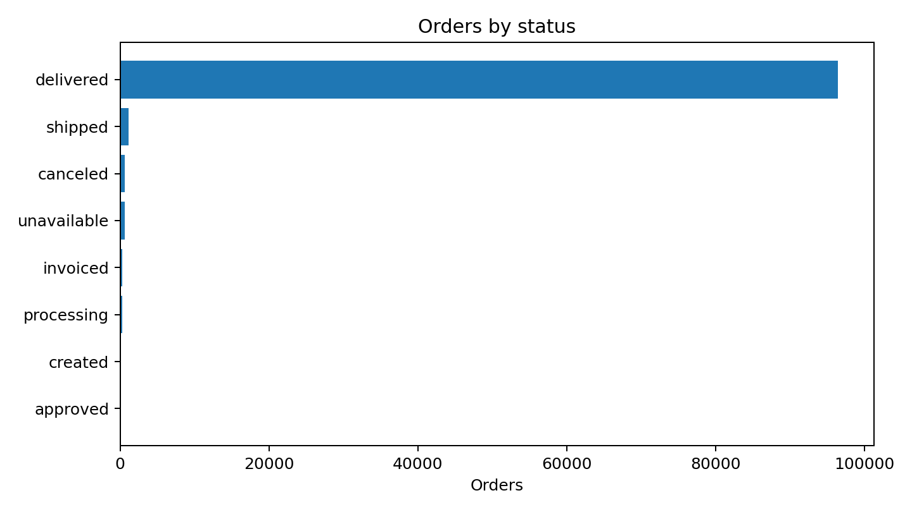
Order status distribution
Saved exploratory summary table
DELIVERED
96,478
(97.02%)
CANCELED
625
(0.63% of all orders)
UNAVAILABLE
609
Reported separately from cancellations
STATUS TABLE TOTAL
99,441
Status table totals 99,441 orders.
orders

Slide 8
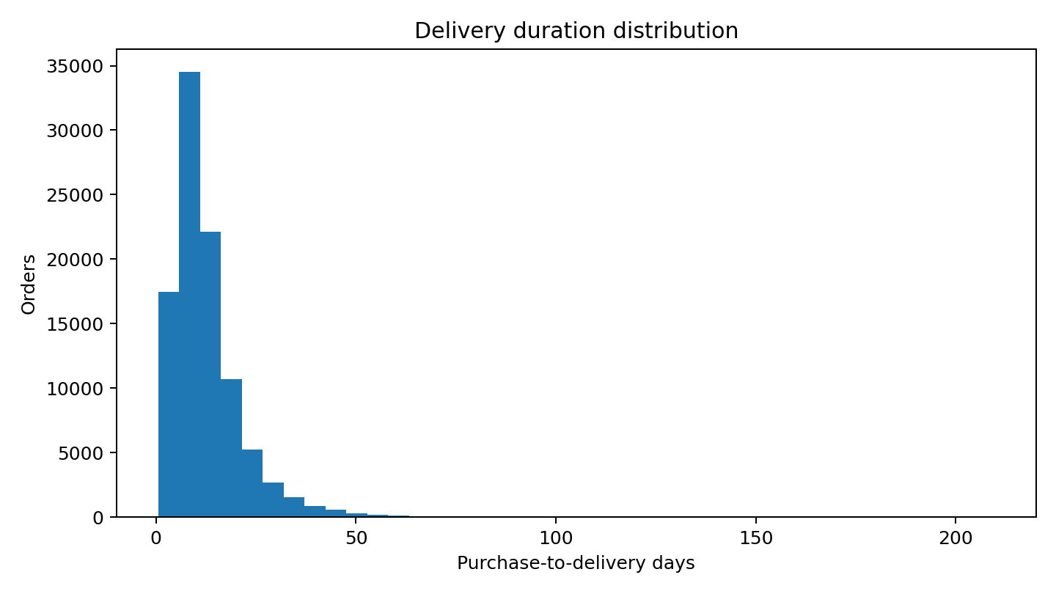
Delivery duration
Purchase timestamp to customer delivery timestamp
AVERAGE
MEDIAN
MINIMUM
MAXIMUM
12.56 days
10.22 days
0.53 days
209.63 days
From 96,470 KPI rows
From saved KPI export
From saved KPI export
Extreme duration needs review
A long right tail is visible in the saved delivery-duration distribution.
Do not remove extreme values without a documented rule.

Slide 9
Late-delivery KPI — validated result
Three saved sources, three different counts
MYSQL VALIDATION SNAPSHOT
INTERIM KPI EXPORT
DELAY-DAYS EXPORT
6,534 late
7,826 flagged late
7,820 positive
96,470 eligible delivered orders | 6.77%
is_on_time = 0 in kpi_orders.csv
delay_days > 0 in kpi_orders.csv
Independent recomputation from the original orders CSV confirms the MySQL validation result:
6,534
+
89,936
=
96,470
The saved KPI export flags 7,826 rows as late and has 7,820 positive delay_days values; those exported flags are inconsistent and must be regenerated before dashboard use.
late
on time
eligible delivered orders
Late-delivery rate: 6.77% | On-time/early rate: 93.23%

Slide 10
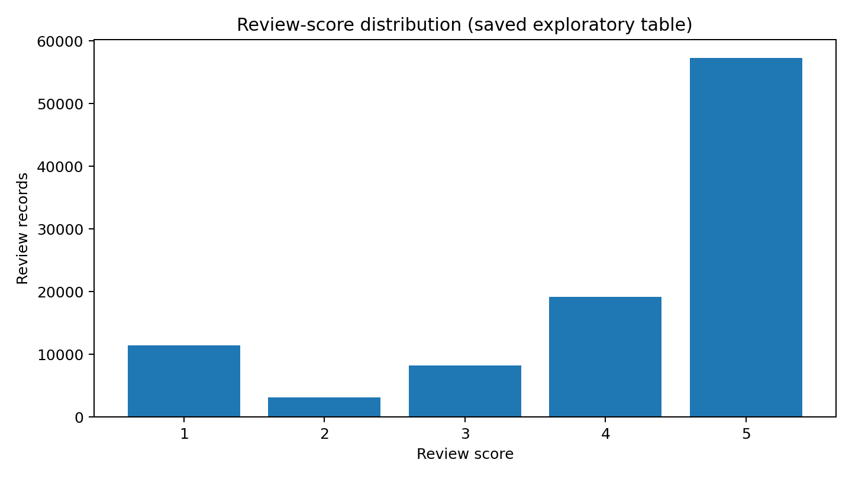
Cancellations and customer reviews
Descriptive results from saved exploratory tables
CANCELED ORDERS
0.63%
625 of 99,441
REVIEW SCORE 5
REVIEW SCORE 1
57,328
11,424
SCORE 2
SCORE 3
SCORE 4
3,151
8,179
19,142
These review totals are from a saved exploratory table; they differ from the deduplicated review clean-view counts.
Saved exploratory table

Slide 11

Regional and delivery-stage analysis
What can and cannot be concluded
Region mix in the saved KPI export (delivered orders)
The saved KPI export includes customer_state and mapped region fields for delivered orders.
The uploaded repository snapshot does not include a separately validated carrier-performance result table.
Carrier-level claims should not be made unless a valid carrier identifier and analysis output are available.
Regional comparisons should use the same eligibility rules and should report sample sizes.

Slide 12
Dashboard status and handover
Power BI verification is not complete
BEFORE SIGN-OFF
VERIFICATION PENDING
Open the PBIX in Power BI Desktop
1
The uploaded repository archive used for this review did not contain a .pbix file or dashboard screenshots.
Prior repository review indicated a PBIX file existed on origin/main; that alone does not prove the file opens or visuals work.
Dashboard user guide is therefore marked 'verification pending' in the documentation pack.
2
Refresh or confirm source state
3
Inspect every page, test slicers, check KPI cards and validate row counts
4
Capture screenshots of each dashboard page
5
Record the PBIX path, refresh date, data source and any refresh errors

Slide 13
Operational recommendations — provisional
Recommendations to validate with the final dashboard
01
Late-delivery orders
02
Delivery-duration tail
03
Cancelled vs unavailable
Prioritize investigation of late-delivery orders by region and order cohort after the late KPI is reconciled.
Inspect the long tail of delivery durations and verify extreme cases against source timestamps.
Monitor cancellation and unavailable statuses separately; they represent different outcomes.
04
Reviews and delivery
05
Weekly KPI scorecard
Track review-score distribution alongside delivery performance, but describe associations rather than causal effects.
Use a weekly KPI scorecard with fixed definitions, documented exclusions and a repeatable refresh process.
Provisional until validated with the final dashboard

Slide 14
Limitations and open risks
Explicitly disclose these in the final submission
Saved outputs originate from different stages/runs; the late-delivery count is inconsistent.
Review summaries differ between exploratory CSV tables and the deduplicated clean review view.
Missing customer-delivery timestamps exist in the full orders population; eligibility exclusions must be disclosed.
No verified carrier analysis result or PBIX interaction evidence was included in the supplied archive.
Analysis is descriptive and cannot establish that delivery delay caused a particular review score.
Disclose all five in the final submission

Slide 15
Team ownership and contribution map
As defined in the project execution handbook
YY
ME
JK
MP
LK
Yashashvi Yash
Meghana
Jaykishan
Madhupriya
Lav Kumar
SQL validation, KPI definitions and dashboard data preparation.
Power BI dashboard and DAX measures.
Carrier, regional and delivery-stage analysis.
Cancellation, customer ratings and operational recommendations.
Documentation, repository integration and final presentation.

Slide 16
Final closeout checklist
Required before the project is declared fully complete
Late KPI reconciled from original source: 6,534 late / 96,470 eligible (6.77%).
DONE
Regenerate kpi_orders.csv so exported flags match the validated calendar-date KPI.
OPEN
Reconcile review-score distribution with the clean review view.
OPEN
Open and test the PBIX; capture dashboard screenshots and refresh evidence.
OPEN
Review the pull request, merge LavKumar into main, then verify the merged files.
OPEN

Slide 17
THANK YOU
Questions & Discussion
E-commerce Delivery & Logistics Performance Analysis
Presented by: Yashashvi Yash, Meghana, Jaykishan, Madhupriya and Lav Kumar
QVETO Technologies | Team Project

