Slide 1

Robot Restaurant in LA
Telling a Story Using Data
Klarin Sprint 10

Slide 2

Introduction
We have decided to open a small robot-run cafe in LA. The project is promising but expensive, so our partnership has decided to attract investors. We’re interested in the current market conditions -— will we be able to maintain our success when the novelty of robot waiters wears off? Let's put on our analytics guru hat and prepare some market research using open-source data on restaurants in LA we have acquired.
View Online Report

Slide 3
Step 1. Download the data and prepare it for analysis
Download the data on restaurants in LA. Make sure that the data type for each column is correct and that there are no missing values or duplicates. Process them if necessary.
/datasets/rest_data_us.csv
id — unique identifier
object_name — establishment name
address — address
chain — chain establishment (True/False)
object_type — establishment type
number — number of seats
There are three records missing 'chain' data. Fixed and looking good
id | object_name | address | chain | object_type | number
18432 | STARBUCKS COFFEE | 300 WORLD WAY | TRUE | CAFE | 43
17134 | DONUT FRIEND | 5107 YORK BLVD | FALSE | FAST FOOD | 26
14968 | COLE'S | 118 E 6TH ST | FALSE | RESTAURANT | 135
12661 | TOKYO CUBE | 3173 CAHUENGA BLVD W | FALSE | RESTAURANT | 45
13489 | INT'L HOUSE OF PANCKAKES | 1880 W SLAUSON AVE | FALSE | RESTAURANT | 125

Slide 4
Step 1. Continued
For the first parts of part 2, the address fields cause difficulty aggregating the location count. We can bring them back when we need them again.
There were 9651 now there are only 8682 records. We Consolidated 969 records
object_name | chain | object_type | number | object_name
#1 CAFE | FALSE | RESTAURANT | 4 | #1 CAFE
#1 CHINESE FAST FOOD | TRUE | RESTAURANT | 6 | #1 CHINESE FAST FOOD
#1 DONUT | FALSE | FAST FOOD | 21 | #1 DONUT
#1 DONUTS | FALSE | FAST FOOD | 25 | #1 DONUTS
#2 MOON BBQ | FALSE | RESTAURANT | 109 | #2 MOON BBQ

Slide 5
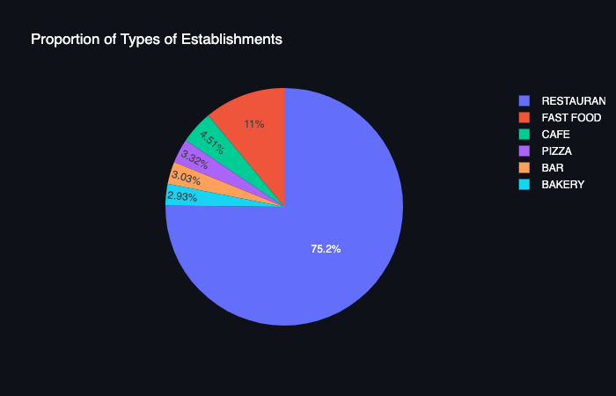
Step 2a
Investigate the proportions of the various types of establishments. Plot a graph.

Slide 6
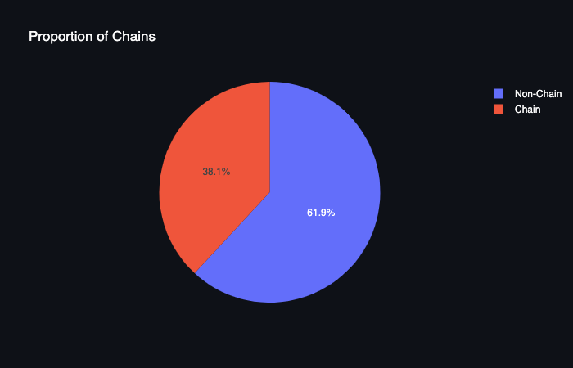
Step 2b
Investigate the proportions of the various types of chain and nonchain establishments. Plot a graph.
Conclusion: The 'Cafe' and 'Fast Food' categories are slightly more likely to be chain restaurants. The 'Bakery' category is exclusive to chain restaurants. The 'Pizza' category is evenly split. The 'Restaruant' and 'Bar' category favors non-chain restaurants 2:1 or more!

Slide 7
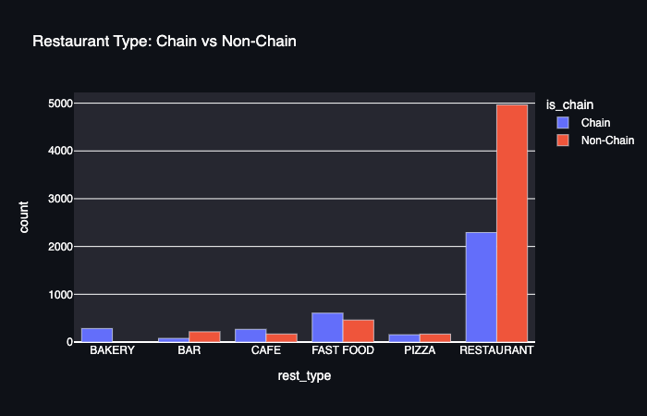
Step 2c
Which type of establishment is typically a chain? Plot a graph.
Conclusion: The 'Cafe' and 'Fast Food' categories are slightly more likely to be chain restaurants. The 'Bakery' category is exclusive to chain restaurants. The 'Pizza' category is evenly split. The 'Restaruant' and 'Bar' category favors non-chain restaurants 2:1 or more!

Slide 8
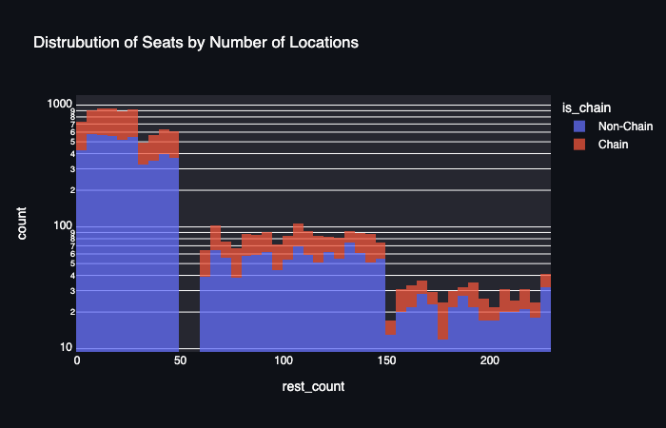
Step 2d
Which type of establishment is typically a chain? Plot a graph.
Conclusion: The average number of seats for establishment has similar distributions between chain and non-chain restaurants.
The restaurant count for chain restaurants have a much wider distribution thank non-chain restaurants and are much more likely to have multiple restaurants.

Slide 9
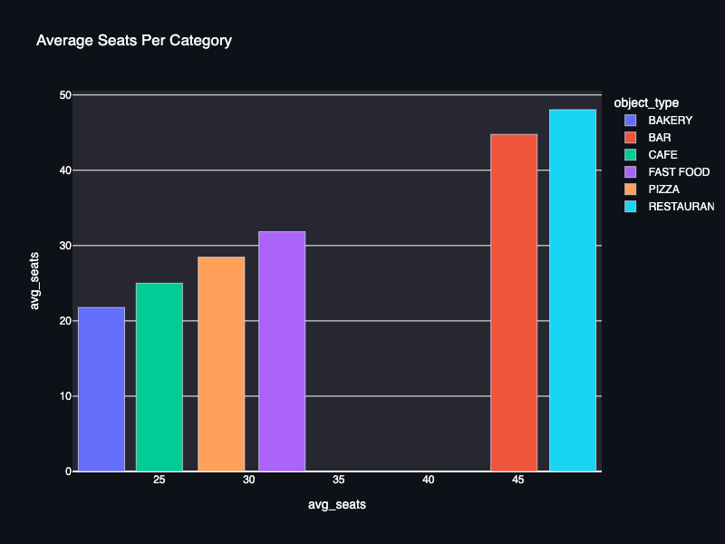
Step 2e
Determine the average number of seats for each type of restaurant. On average, which type of restaurant has the greatest number of seats? Plot graphs.
Conclusion: The 'Cafe' and 'Fast Food' categories are slightly more likely to be chain restaurants. The 'Bakery' category is exclusive to chain restaurants. The 'Pizza' category is evenly split. The 'Restaruant' and 'Bar' category favors non-chain restaurants 2:1 or more!

Slide 10
Step 2f. Put the data on street names in separate columns
id | object_name | address | chain | object_type | number | street_name | clean_address
11786 | HABITAT COFFEE SHOP | 3708 N EAGLE ROCK BLVD | false | CAFE | 26 | ROCK | 3708 ROCK, Los Angeles,USA
11787 | REILLY'S | 100 WORLD WAY # 120 | false | RESTAURANT | 9 | WORLD | 100 WORLD, Los Angeles,USA
11788 | STREET CHURROS | 6801 HOLLYWOOD BLVD # 253 | false | FAST FOOD | 20 | HOLLYWOOD | 6801 HOLLYWOOD, Los Angeles,USA
11789 | TRINITI ECHO PARK | 1814 W SUNSET BLVD | false | RESTAURANT | 22 | SUNSET | 1814 SUNSET, Los Angeles,USA

Slide 11
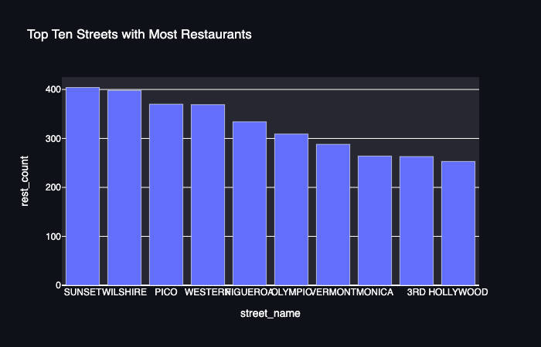
Step 2g
Plot a graph of the top ten streets by number of restaurants.

Slide 12
Step 2h
Find the number of streets that only have one restaurant.
Conclusion: There are 185 streets that have only one restaurant.

Slide 13
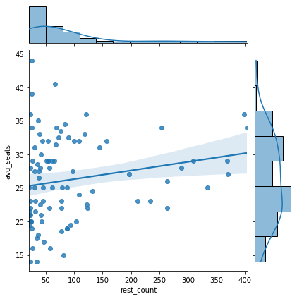
Step 2i
For streets with a lot of restaurants, look at the distribution of the number of seats. What trends can you see?

Slide 14
Overall Conclusions
Don't open a bakeries as an independent operator. The franchises will eat you alive. Open a restaurant, because more than half of them are independently owned and operated.
I don't think buying into an existing franchise with our gimmick as robots would find approval by the franchise.
Restaurants on average have just less than 50 seats each. That seems like a sweet spot and a good place to start.
The busiest streets are the best place to get the most exposure. Starting on one of the top 10 streets would bring us a lot of foot traffic. Having our sign outside would give us free advertising. Our robots would give us a big boost in the beginning for the curiosity factor alone. Hopefully from there we could run a sit-down restaurant with very few employees, so even if we have a decrease in customers a few months after our initial opening, we will have lessened our need for weight staff, and eliminate our customers need to tip.

