Slide 1
Background Noise Reduction Based on Wiener Suppression using a Priori Signal-to-Noise Ratio Estimate
Gilbey’s Jhon – Ladion
Jay Neil Gapuz

Slide 2
Background of the Study
Communication system is essential in our every life.
However, one major problem the affects the performance of a communication system is noise.

Slide 3
Background noise is a category of noise that are present in the background of an audio file. People usually perceive it as “hiss” sound. There are actually lots of studies that focuses on the reduction or suppression of background noise.

Slide 4
The study will focus on the background noise suppression using a Priori Signal-to-Noise Ratio Estimate and Wiener Suppression

Slide 5
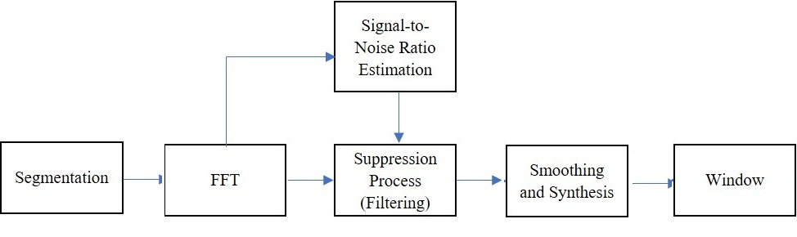
Proposed System Block Diagram

Slide 6
The system is composed of three major processes : the segmentation, suppression or the filtering and the smoothing and synthesis.

Slide 7
Segmentation
In the analysis of the signal, the FFT of the audio input is also equal to the FFT of the signal and the noise component itself. Hence, in order to remove the noise, an attenuation factor must be multiplied to reduce the level of the signal to a significant amount. For efficient analysis, segmentation of the audio is necessary to limit the number of samples to be analyse

Slide 8
Signal-to-Noise Estimation
Each segment was analyzed and an estimate value of the segment’s signal-noise ratio (SNR) was determined.
SNR = ∑ E(X,k) / ∑ N(X,k)
thresh = σ + x̅

Slide 9
Suppression
Let G₀ be the suppression value or attenuation value.
G₀ = (SNR − 1) /SNR

Slide 10
The idea is to multiply each frequency component to a suppression array generated as function of the SNR. The noise components will be suppressed to a negligible. The signal level, on the other hand, will retain it’s energy level.
G₀ was multiplied to the frequency bin being considered as noise component and a factor of 1 was multiplied to the frequency bin being considered as intelligible signal component.

Slide 11
Synthesis and Smoothing
The selection in the overlapping region was based on the average of the two points obtained from segmentation process; this creates a smoother output when compared to selecting from the points
The synthesized signal was passed to a band pass filter basing from the type of voice signal used (narrowband or wideband), then performed moving average among adjacent points in an equal length. This further eliminates low and high frequency noise present in the signal.

Slide 12
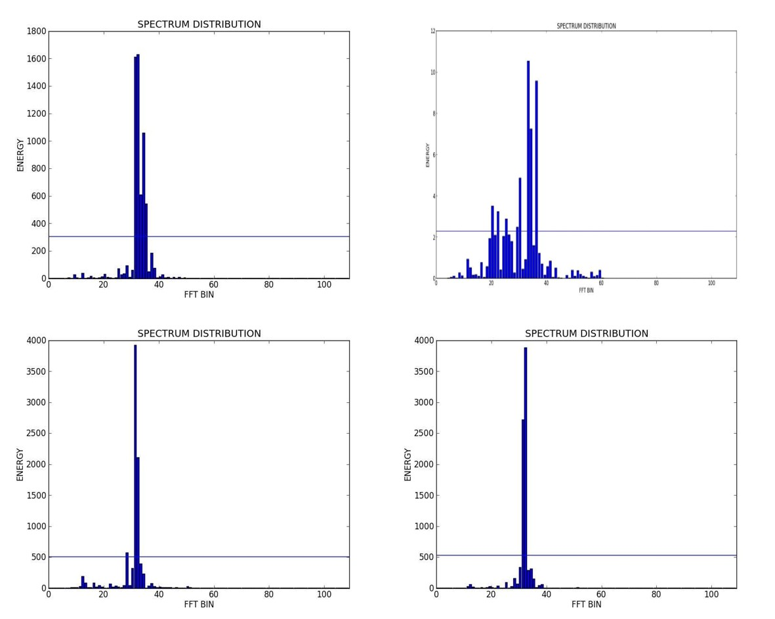
Results and Discussion

Slide 13
Sample Values of the Suppression, G₀
Segment | Suppression Value, G₀
1 | 0.702699
2 | 0.502188
3 | 0.450595
4 | 0.659492
5 | 0.791353
6 | 0.673505
7 | 0.642886

Slide 14
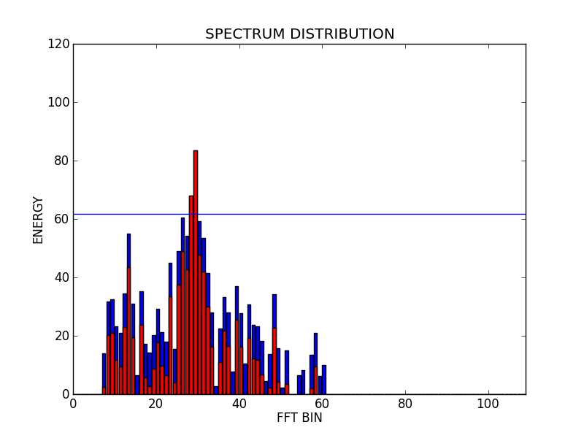
Comparison of the Input audio and Output audio

Slide 15
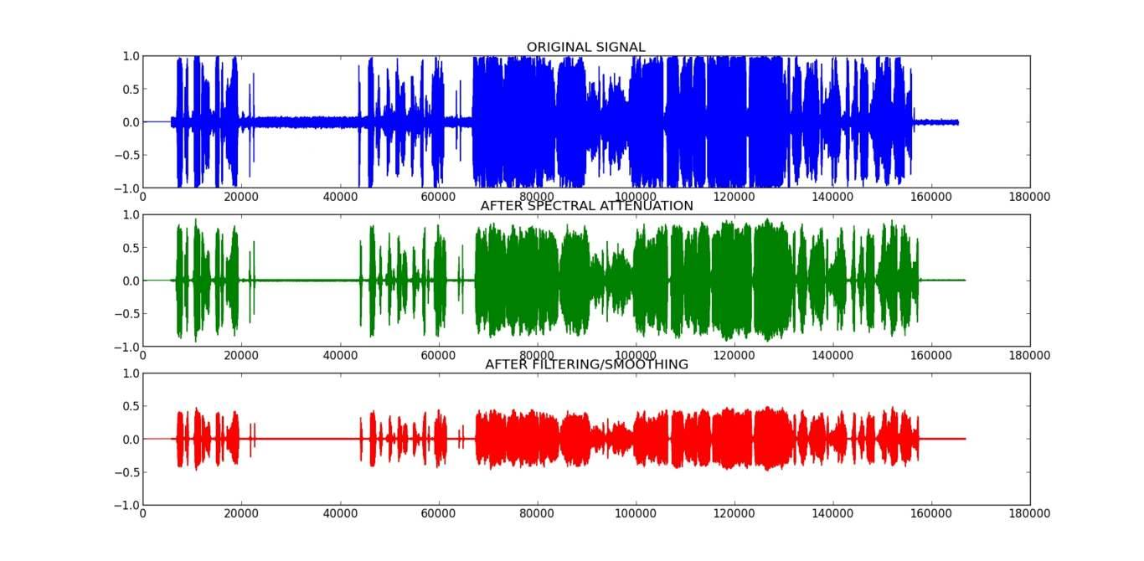
Comparison of the Input audio and Output audio

