Slide 1

Dr. AMBEDKAR INSTITUTE OF TECHNOLOGY
Near Jnana Bharathi Campus, Bengaluru-560056.
(An Autonomous Institution, Aided by Government of Karnataka)
DEPARTMENT OF ELECTRONICS AND COMMUNICATION
UG MAIN PROJECT :
“Design and Implementation of RISC-V Vector Processor for Embedded Systems”.
Submitted By:
ANJALI DEVI N 1DA19EC015
DHARMARAJ S R 1DA19EC033
GANGADHARAIAH T G 1DA19EC039
JAIKISHORE G 1DA19EC055
Guide By:
PUSHPALATHA G S
Assistant Professor
DEPARTMENT OF ELECTRONICS
AND COMMUNICATION

Slide 2
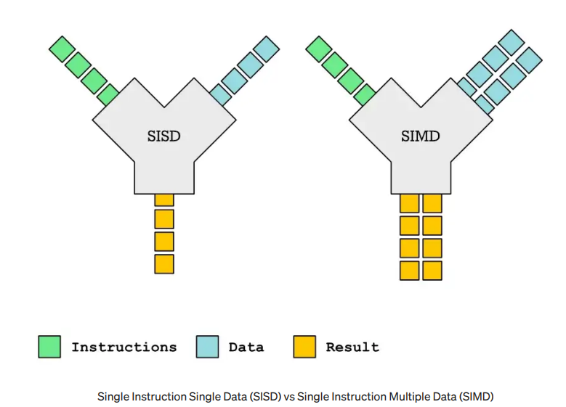
DIFFERENCE BETWEEN SCALAR AND VECTOR

Slide 3
SCALAR :
load r1, 14
add r3, r1, r2 ; r3 ← r1 + r2
3 + 4 = 7
4 * 8 = 32
VECTOR:
vload.32 v1, 14
vadd.i32 v3, v1, v2 ; v3 ← v1 + v2
[3, 2, 1,5] + [1, 2, 2,4] = [4, 4, 3,9]
[3, 2, 1,4] - [1, 2, 2,2] = [2, 0, -1,2]

Slide 4
SCALAR :
load r1, 14
add r3, r1, r2 ; r3 ← r1 + r2
3 + 4 = 7
4 * 8 = 32
VECTOR:
vload.32 v1, 14
vadd.i32 v3, v1, v2 ; v3 ← v1 + v2
[3, 2, 1,5] + [1, 2, 2,4] = [4, 4, 3,9]
[3, 2, 1,4] - [1, 2, 2,2] = [2, 0, -1,2]

Slide 5
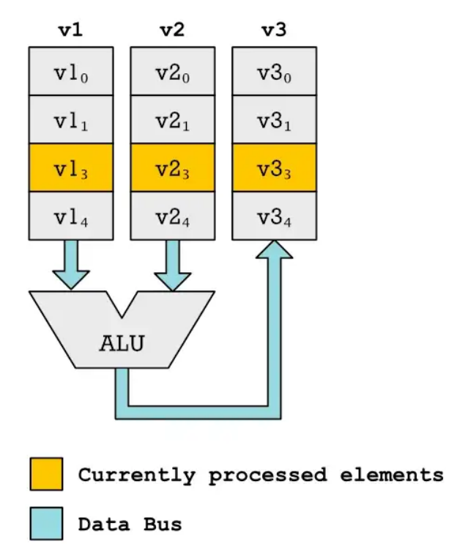
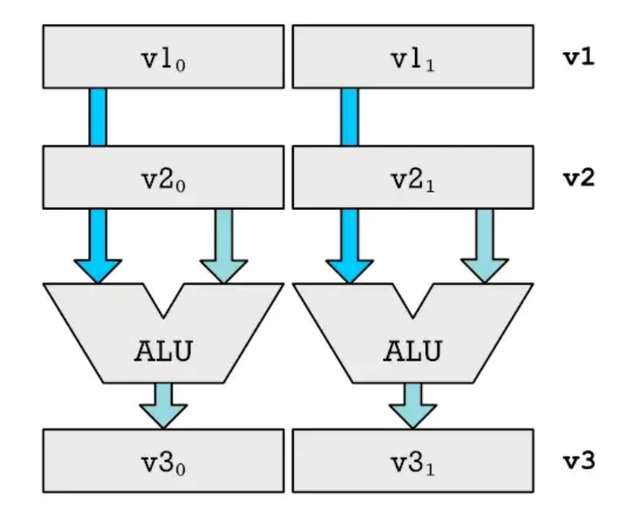
Traditional vector processing and our vector processing unit

Slide 6
Instruction format:
32 bits
Format | Fields |  |  |  |  |  | Comments
 | 6-bit [31-26] | 5-bit [21-25] | 5-bit [16-20] | 5-bit [11-15] | 5-bit [10-6] | 6-bit [5-0] | All MIPS instrunction are 32 bits
R-format | opcode | rs | rt | rd | shamt | F_Code (funct) | ALU instructions except immediate, jump Register (JR)
I-format | opcode | rs | rt | address/immediate |  |  | Load, store, Immediate ALU, beq, bne
J-format | opcode | target address |  |  |  |  | Jump (J)

Slide 7
Scalar Integer Instruction
operation | instructions
Arithmetic Instructions | add , sub , addi , subi , mult , div Ex : add rd, rs, rt subi rd , rs , k ; k=immediate const
Logical Instructions | and , or , andi , ori , xor , xori , sll , srl
Comparison | beq , bne , slt , slti
Jump Instructions | j , jr
Memory instructions | lw , sw , mfhi , mflo

Slide 8
Vector Integer Instruction
operation | instructions
Arithmetic Instructions | vadd , vsub , vaddi , vsubi , vmult , vdiv , vrem Ex : vadd vd, vs, vt vsubi vd , vs , k ; k=immediate const
Logical Instructions | vand , vor , vandi , vori , vxor , vxori , vsll , vsrl
Comparison | vslt , vslti
Memory instructions | vlw , vsw

Slide 9
Vector register file :
4 element of each 32 bit size
in each vector register.
32 vector Reg.
Register file :
32 reg with 32bit size each
r0
r1
r2
. . . .
r30
r31
v0
e0 | e1 | e2 | e3
e0 | e1 | e2 | e3
e0 | e1 | e2 | e3
. . . .
e0 | e1 | e2 | e3
e0 | e1 | e2 | e3
v1
v2
v30
v31
32-bits
MaxVL=4

Slide 10
Vector register file :
4 element of each 32 bit size
in each vector register.
32 vector Reg.
Register file :
32 reg with 32bit size each
r0
r1
r2
. . . .
r30
r31
v0
e0 | e1 | e2 | e3 | . . . . . . . . | e8 | e9
e0 | e1 | e2 | e3 | . . . . . . . . | e8 | e9
e0 | e1 | e2 | e3 | . . . . . . . . | e8 | e9
. . . . |  |  |  | . . . . | . . . . | . . . .
e0 | e1 | e2 | e3 | . . . . . . . . | e8 | e9
e0 | e1 | e2 | e3 | . . . . . . . . | e8 | e9
v1
v2
v30
v31
32-bits
MaxVL=10

Slide 11
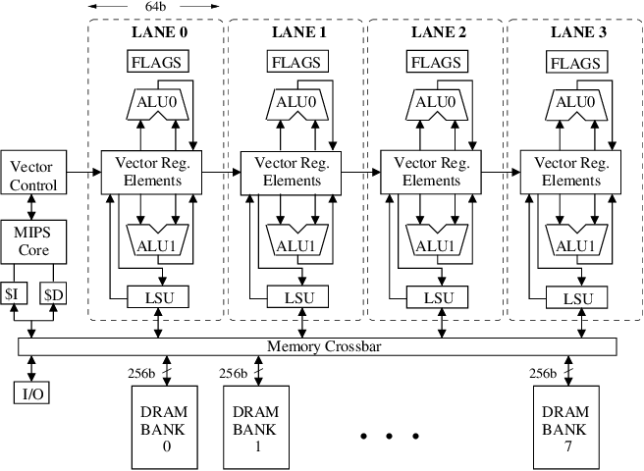
Traditional vector processing architecture:

Slide 12
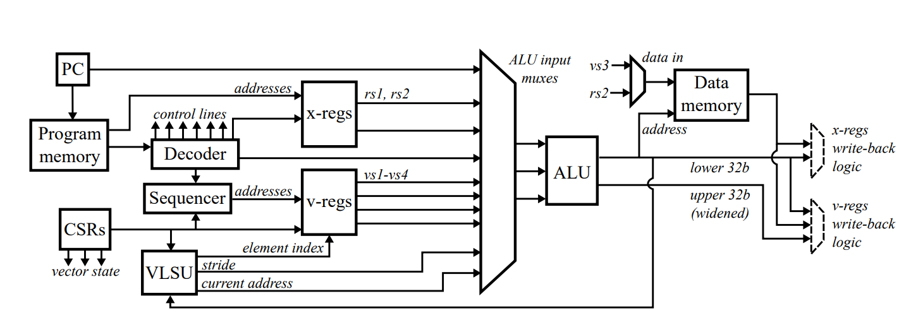
Previous Paper Block Diagram

Slide 13
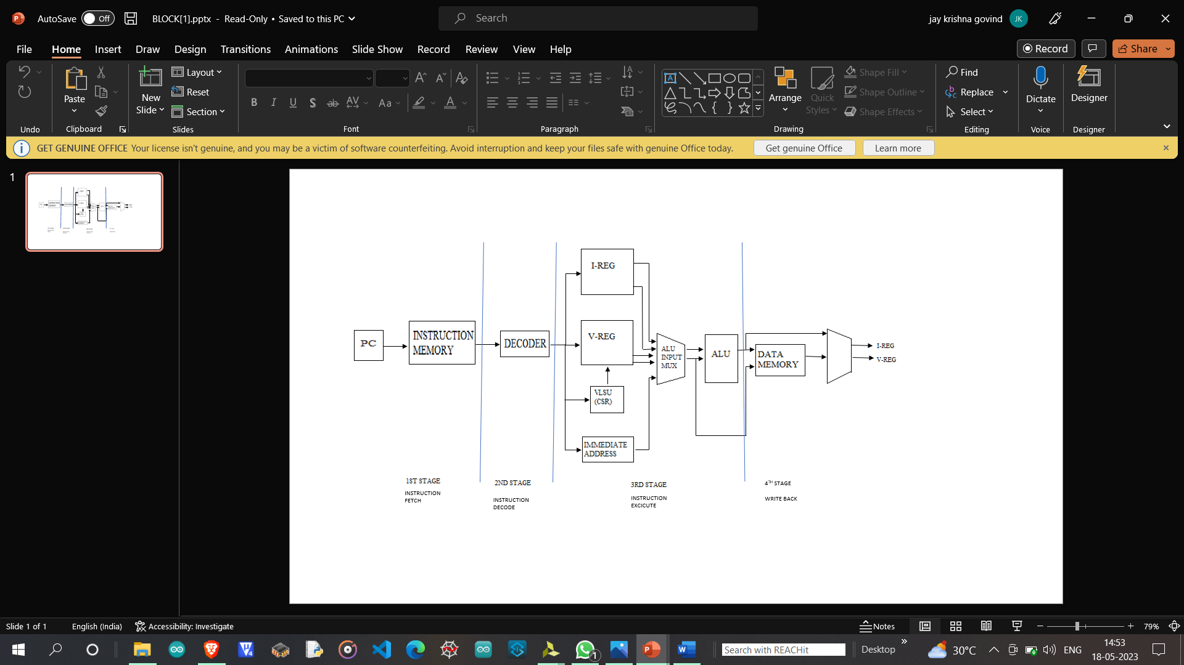
BLOCK DIAGRAM OF RISC-V

Slide 14


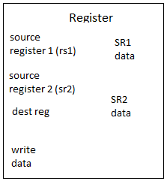

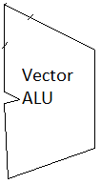
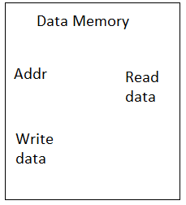
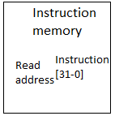
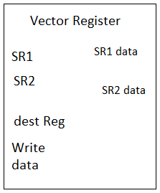




PC + Branch
PC+4
Jmp Reg
PC+4
Inst[31-26]
Control signals
jump
Inst[25-21]
Inst[20-16]
PC_select
Inst[15-10]
Next PC
opcode
Write-back Rs
alu
Inst[25-21]
rs
Inst[20-16]
Input
select
vs
Inst[15-10]
Write-back Rs
Element
index
RV_select
Write-back Vs
Write-back Vs
RV_select
16
32

Slide 15
Performance Comparison Between Scalar and Vector :
for (i=0; i <100 ; i++) // repeat 100 times
y[i] = x [i] + y[i] // assume x & y are arrays start at location 4000 and 8000.
Scalar processor | Comments | No.cycles | Vector processor | No.cycles
andi $3, $3, 0 ; andi $2, $2, 0 ; addi $2, $2, 100 ; $label: lw $15, 4000($3) ; lw $14, 8000($3) ; add $24, $15, $14 ; sw $24, 8000($3) ; addi $3, $3, 1 ; bne $3, $2, $label ; | initialize loop counter $3=0 clear register for loop bound loop bound load x(i) to R15 load y(i) to R14 x(i) + y(i) save new y(i) update address register, address= address + 1 check if loop counter=loop bound | 3 3 3 { 4 4 3 4 3 2 } * 100 | andi $3, $3, 0 ; andi $2, $2, 0 ; addi $2, $2, 10 ; Vconfig 10; $label: vlw $15, 4000($3) ; vlw $25, 8000($3) ; vadd $35, $15, $25 ; vsw $35, 8000($3) ; addi $3, $3, 1 ; bne $3, $2, $label ; | 3 3 3 2 { 2 + 10 = 12 2 +10 = 12 12 12 3 2 } *10
Scalar_total_cyc
= 2009 cyc
Vector_total_cyc
= 541 cyc

Slide 16
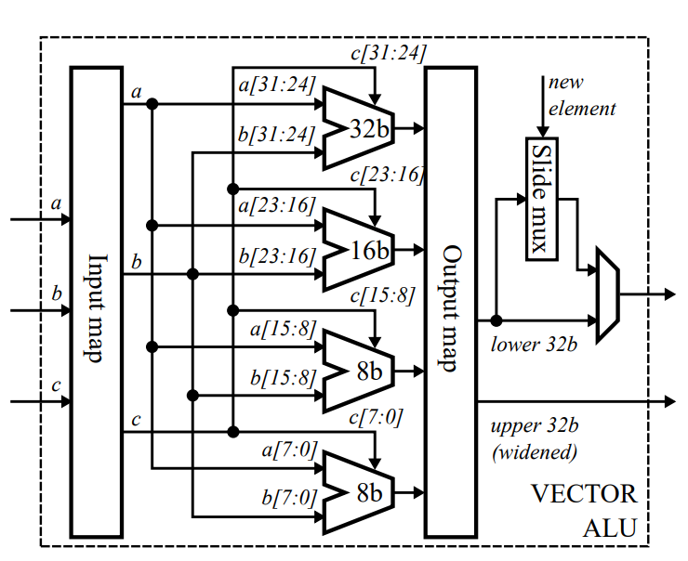
Upgrades on Previous Paper :
Previous Paper Design | Our design
It consists of 4 ALU ( 32-bit , 16-bit , and two 8-bit ), with more complex mapping Architecture. | 1.It consists of one 32bit ALU
2. VLSU was just a register which provides current element index and ALU was used to update the element index. For this operation it needed N+1 cycles. Note: N is no of elements in vector. | 2. We have updated VLSU , it consists of adder and comparator , which updates next element index by it Self. Now the N+1 cycle is reduced to N cycles.

Slide 17
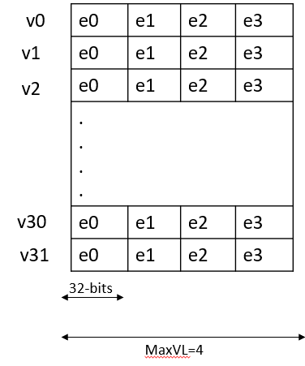
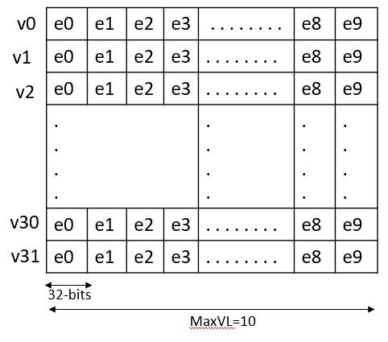
Vector register file : 4 element of each 32 bit size in each vector register. 32 vector Reg. | Vector register file : 10 element of each 32 bit size in each vector register. 32 vector Reg. Thus increases data processing capability in execution stage.

Slide 18
2 | Ara: A 1 GHz+ Scalable and Energy-Efficient RISC-V Vector Processor | IEEE on 2nd June 2019 | Implementation of high-performance energy-efficient 64-bit vector unit based on the version 0.5 draft of RISC-V’s vector extension.

