Slide 1
SYSC 5103 - Final Project
Jason BDI Agent RoboCup Team
Presented by:
Akshay Busa
Yash Patel
Jay Shirsagar
Hongbo Pangv
Guided by:
babak Esfandiari
December 10th, 2021

Slide 2
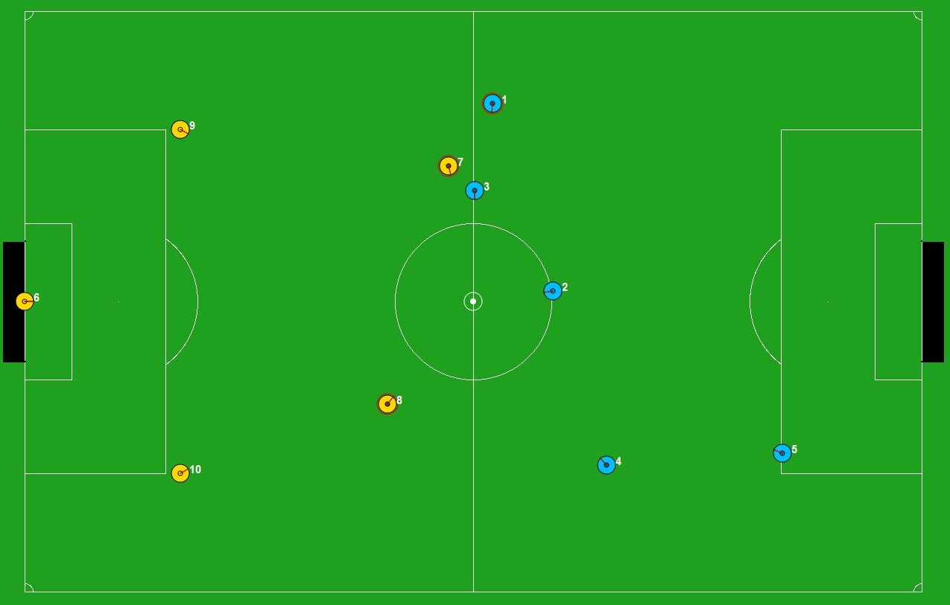
Introduction
Defender
Attacker
Goalie
Goalie
Defender
Notes:
Jon: Good evening everyone..welcome to our presentation. We have created several belief desire intention agents using the Jason AgentSpeak interpreter along with the Robocup environment. All of us are very excited to share our findings with you and give a short demonstration of our agents in action. To start, we will describe the model of our program

Slide 3
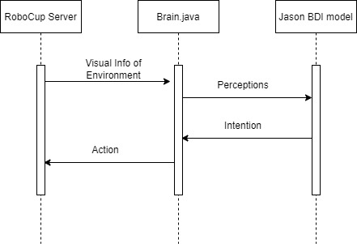
Modelling

Slide 4
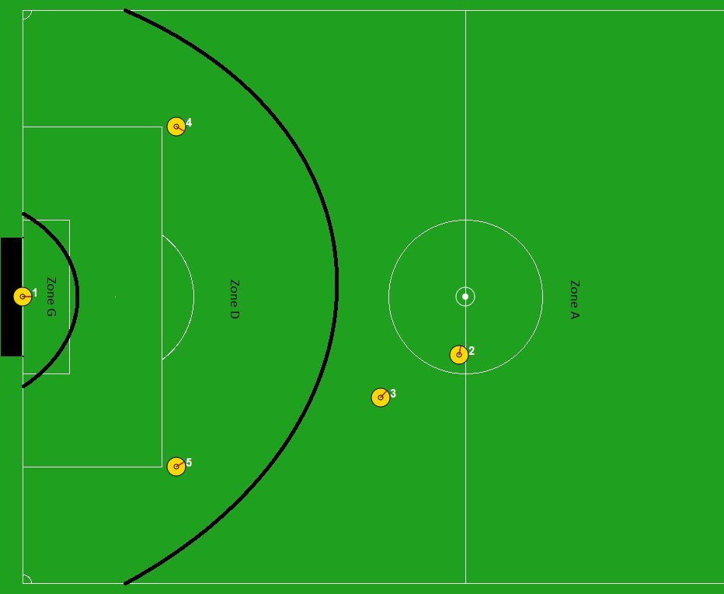
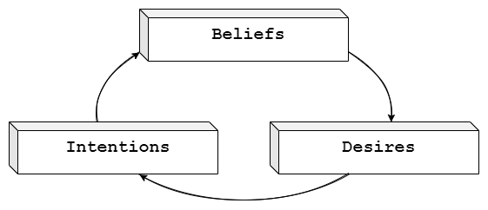
The Attacker Agent

Slide 5
The Defender Agent

Slide 6
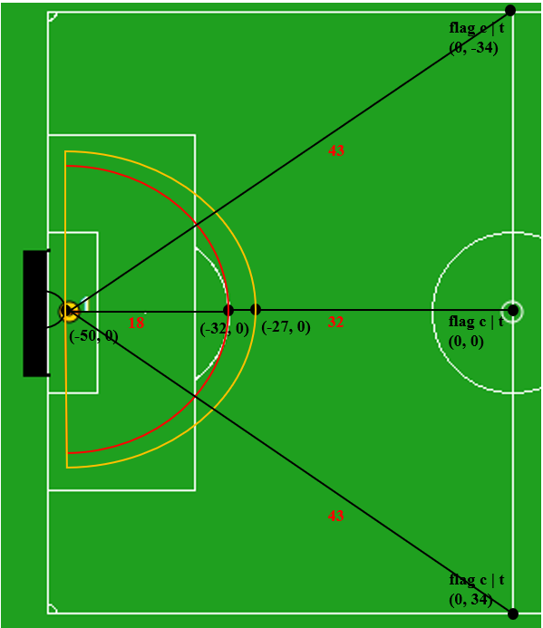
The Goalie Agent

Slide 7


Slide 8
Thank you!

