Slide 1
Spend Analytics
Poultry Farm Data

Slide 2
Objective
Analyse and classify the spend data for the procurement function of a company. This will enable the company to identify the scope for efficiency improvement and better strategic planning.
Analyse the data and identify purchasing trends and patterns
Cluster items that have similar purchasing patterns
Identify the cost saving opportunities by using the data of procurement
Make a report describing all the findings.

Slide 3
Spend Analytics - Process

Slide 4
About the data
We started with generating a report on the data
Business
How much Value spent
How many Purchase Orders
Date Spread
Technical
Volume of data
Percentage Missing values
Percentage of Zero Values
Features with single value
Tool Used - Python

Slide 5
Data Preprocessing
Filtered out data and kept only for Year 2018 and 2019
Removed 0 Gross Value Observations
Removed features with
more than 90% Null value
single value only
Imputed missing values for some features
Tool used - Python

Slide 6
EDA
We explored data to answer questions –
How much was spent ?
Who spends ?
What is bought ?
Get top N materials which are hight ticket items, contributing considerably towards the gross value.
Tool Used –
Tableau
Have used a bit of Python too

Slide 7
Clustering - 1 of 4
Important feature for Spend Analytics is –
Gross Value and Net Price
Frequency of buying the material
We summarised the data on Material Name on these information –
Sum of Gross Value
Imputed the Number of times the material is bought
We used this data for clustering

Slide 8
Clustering - 2 of 4
The purpose of clustering was to find common group of materials in terms of its Gross value and the number of times it is bought
We explored both K-means and Hierarchical clustering
We used elbow method to get the number of cluster
Also explored combination of features for kmeans
The selection criteria for the final kmean clustering was lesser inertia amongst them

Slide 9
Clustering - 3 of 4
For Hierarchical clustering, the visual of the dendogram was not clear enough to decide on the number of cluster.
Used 4 cluster for Hierarchical clustering also.
Got almost similar results as the kmeans clustering.
Finally used kmeans with 4 clusters for further analysis.

Slide 10
Clustering - 4 of 4
Also used only top 24 materials contributing towards 80% of the Gross value.
The cluster results were same as that when using all materials
Tool Used - Python

Slide 11
Price Analysis and Dashboard
The objective was to find opportunity of cost savings for the company.
Started with analysing high value , high frequency materials
Did detailed analysis for materials falling into 2 clusters
2 from each of the 2 clusters – in total 4 materials
Tool Used - Tableau

Slide 12
EDA

Slide 13
About the data (1 of 3)
Total Gross value : Rs. 2399.68 Cr.
Number of Purchase order : 42,596
No Vendor information provided
Number of Company Codes | 5
Number of Plants | 116
Number of Storage Location | 1108
Number of Material Codes | 2757
Number of Material Description | 7332
Number of Material Group | 145

Slide 14
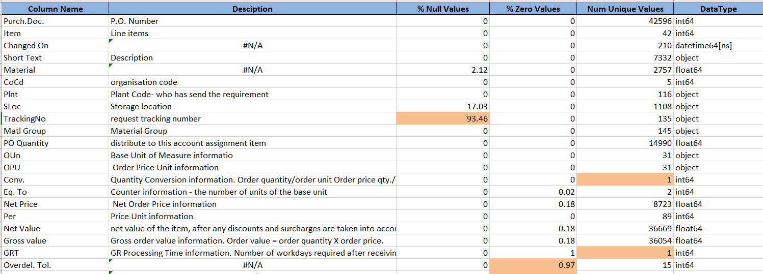
About the data – ( 2 of 3 )
65 features
75349 Observations
Columns with more than 90% Missing Values
Columns with Single Value
Columns with more than 90% 0 values

Slide 15
About the Data - (3 of 3)
The data is from 2012 (Only for July ) till April 2019.
Number of Purchase Order - year and month wise.
Very few information from year 2012 till 2018(Nov).
Continuity in Data from 2018 till April 2019(till 9th April).
 | Jan | Feb | Mar | Apr | May | Jun | July | Aug | Sept | Oct | Nov | Dec | Total
2012 | 0 | 0 | 0 | 0 | 0 | 0 | 1 | 0 | 0 | 0 | 0 | 0 | 1
2014 | 0 | 0 | 0 | 0 | 0 | 1 | 0 | 2 | 0 | 0 | 0 | 2 | 5
2015 | 0 | 1 | 0 | 0 | 0 | 0 | 0 | 0 | 0 | 0 | 0 | 0 | 1
2017 | 0 | 0 | 0 | 0 | 3 | 0 | 2 | 0 | 1 | 2 | 0 | 3 | 11
2018 | 2 | 1 | 1 | 4 | 2 | 5 | 3 | 7 | 16 | 29 | 71 | 2895 | 3034
2019 | 14931 | 12454 | 12134 | 168 | 0 | 0 | 0 | 0 | 0 | 0 | 0 | 0 | 39582
Total |  |  |  |  |  |  |  |  |  |  |  |  | 42596

Slide 16
Data Preprocessing
Removed data from year 2012 till 2017
Retained Only for year 2018 and 2019.[ 54 observations removed ]
Removed 7 features because of more than 90% null values.
Removed 17 features with only 1 unique value
Imputed Null values for these columns -
Material – Null are Services – so created a new code
Storage Location, Profit Center,Mtyp,NCM Code – Filled Null with CoCd Mode information
Price Date – Filled with Changed On Dates.
Cleaned Priority information, and mapped it with Priority(Material Required Within) and imputed its Null value.

Slide 17
1. How much is spent ?

Slide 18
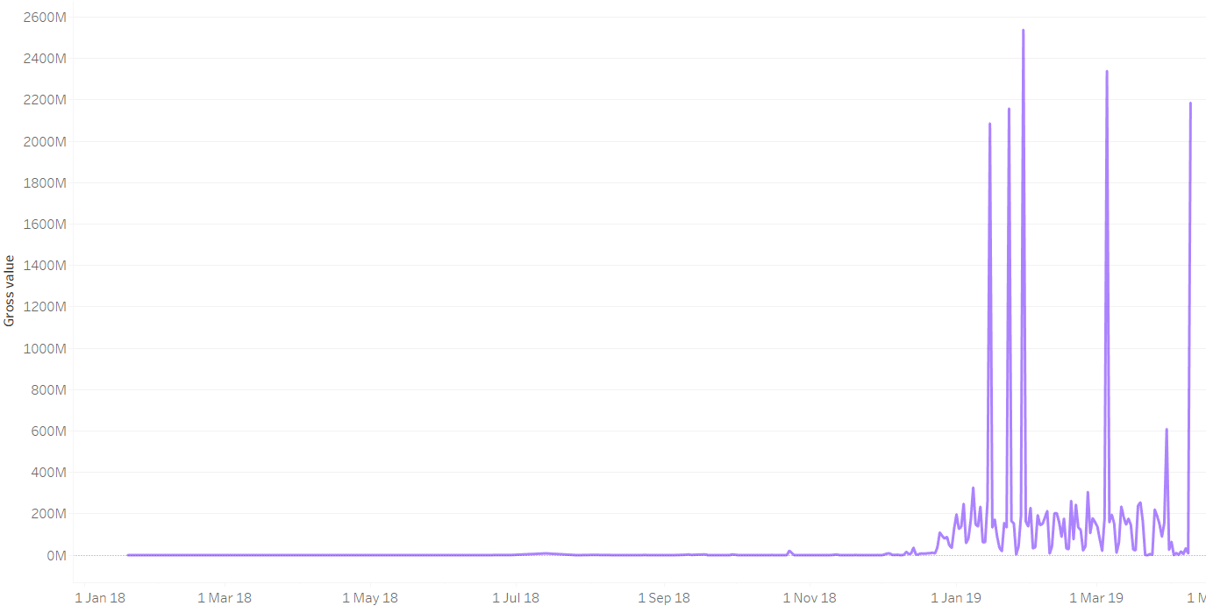
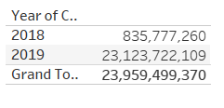
Gross Value by date
Not much of buying in 2018.
Few Days of high spending in 2019.

Slide 19
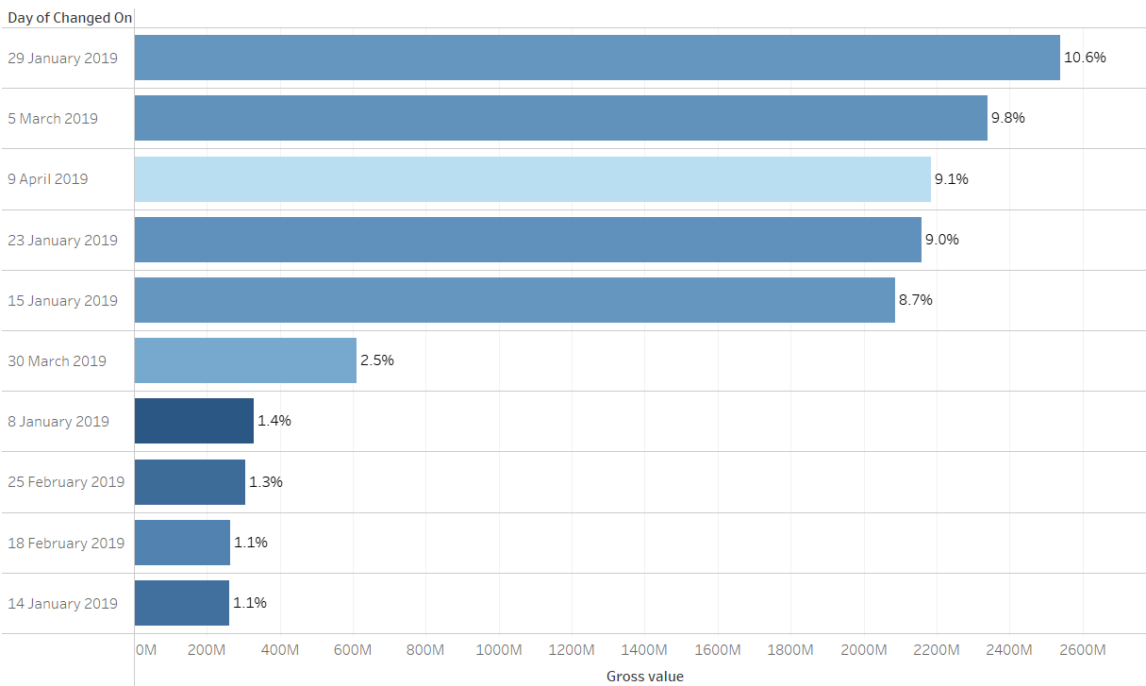
Lets Shop!
These 10 days in 2019 contribute 54.6% of all purchases (2018 and 2019) by value.
The colour shade is by number of PO issued, darker shade means more.

Slide 20
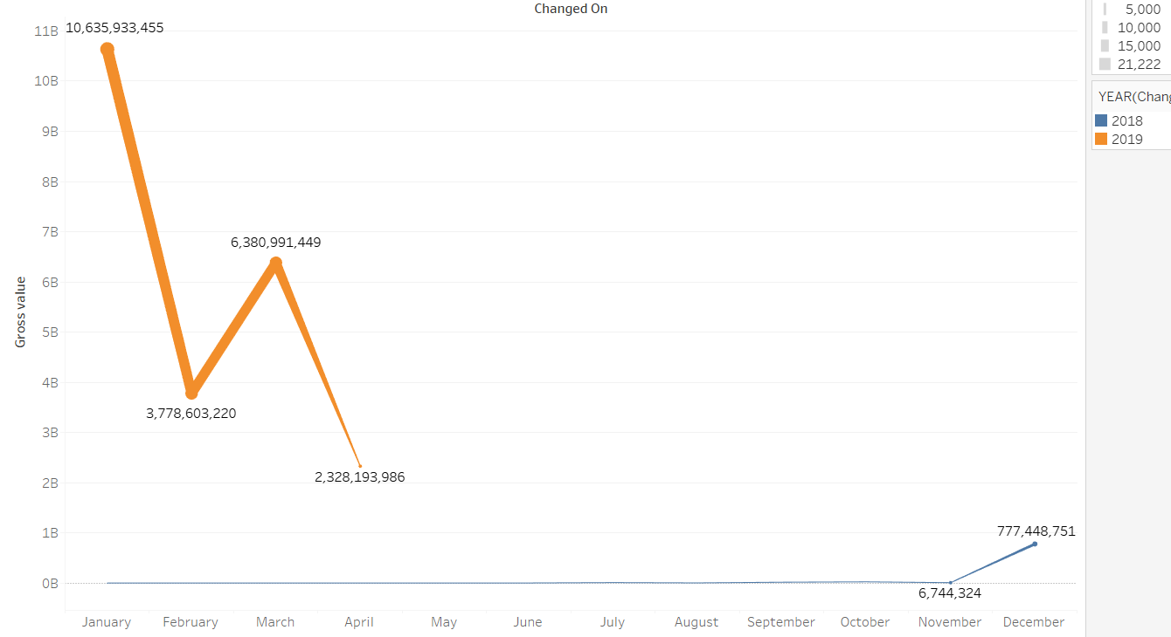
Gross Value by Year and Month
The thickness of line is based on the number of purchase order.

Slide 21
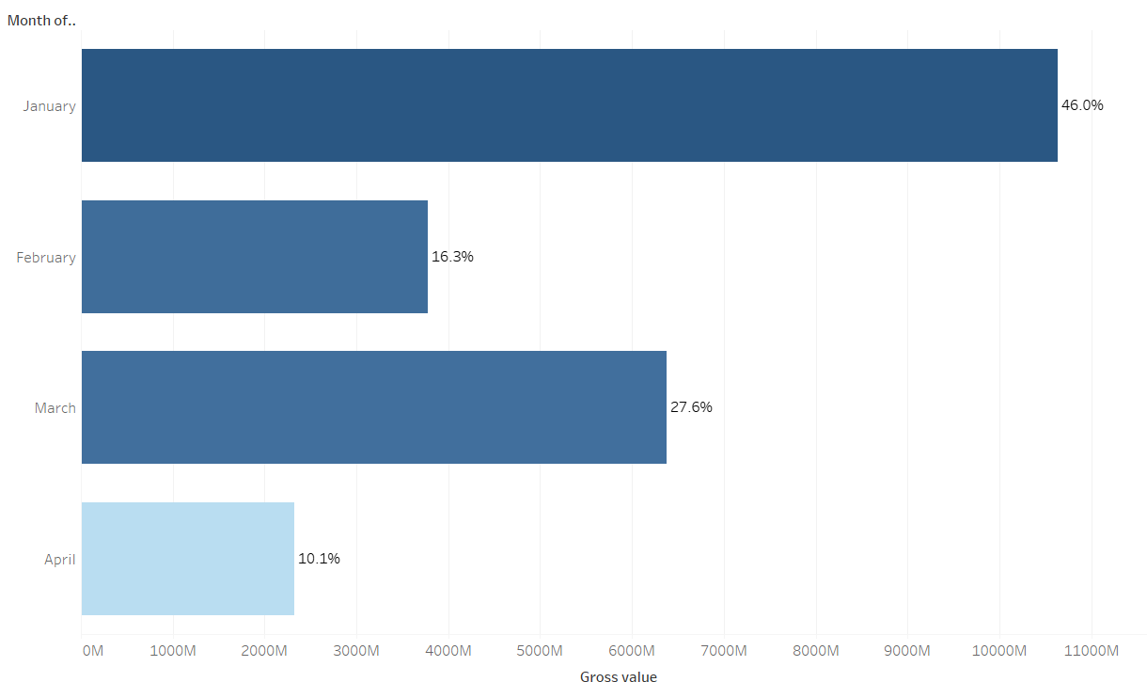
Gross Value By Month(for 2019)
January has 46% of the purchases done for 2019.
The colour shade is by number of PO issued, darker shade means more.

Slide 22
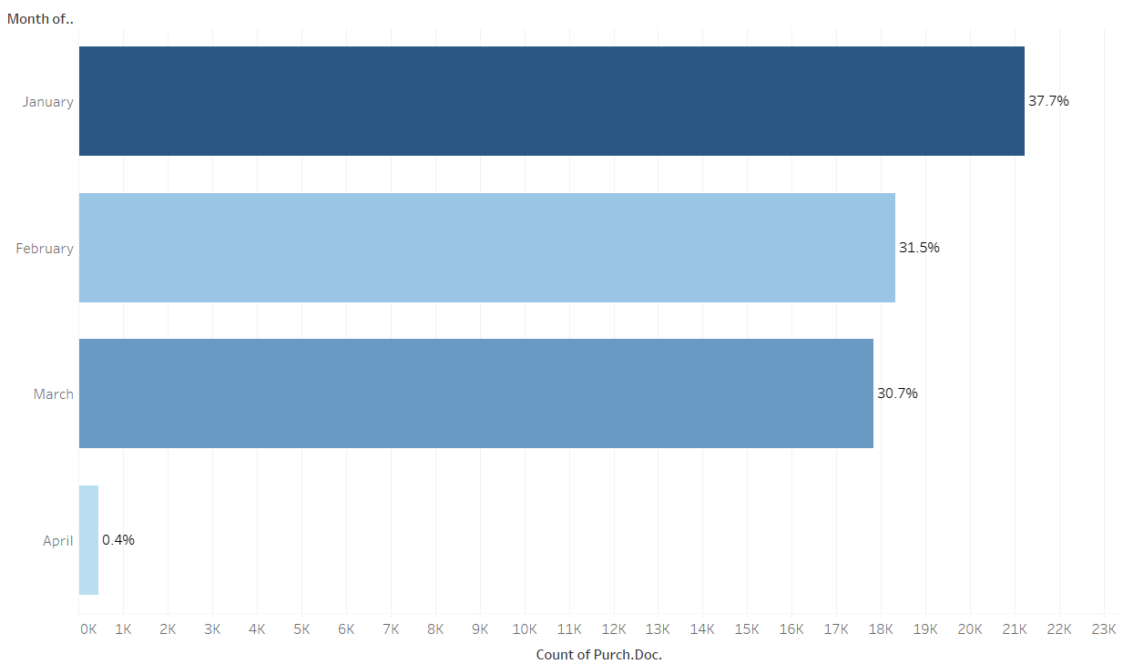
Number of Purchase Order Issued By Month(for 2019)
January has 37.7% of the po issued in 2019.
For March, the number of PO issued is less but the value is more than February.
The colour shade is by the Gross Value, darker shade means more.

Slide 23
2. Who Buys ?

Slide 24
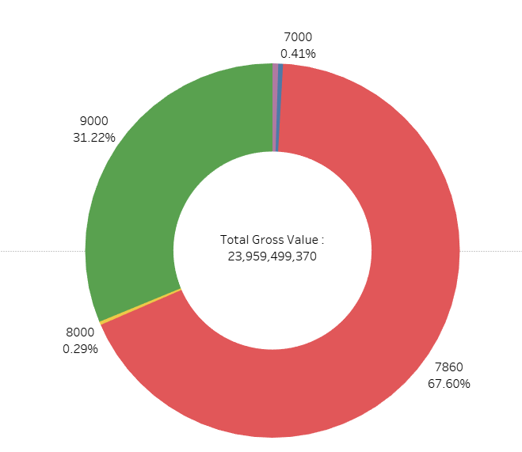
Buying by Company Code
Gross Value by Company code
Company Code 7860 has 67.6% share.
Company Code 7860 and 9000 has 98.82% share.
CoCd | Order_yr | Gross value
4500 | 2018 | 12052985.54
 | 2019 | 106330026.65
7000 | 2018 | 1306874.21
 | 2019 | 96037373.12
7860 | 2018 | 50211054.00
 | 2019 | 16145397250.33
8000 | 2019 | 68533700.00
9000 | 2018 | 772206346.61
 | 2019 | 6707423759.39

Slide 25
3. What is being Bought ?

Slide 26
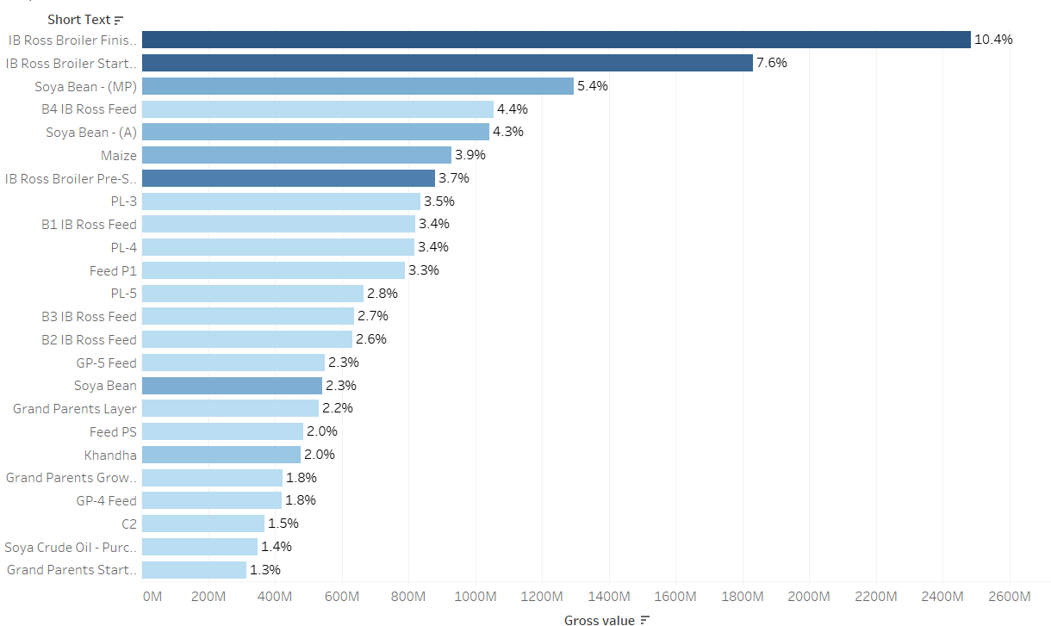
What is being bought – (1 of 2 )
Top 24 Material by Gross Value contributes 80% of the value.
The colour shade is by number of PO issued,darker is more.

Slide 27
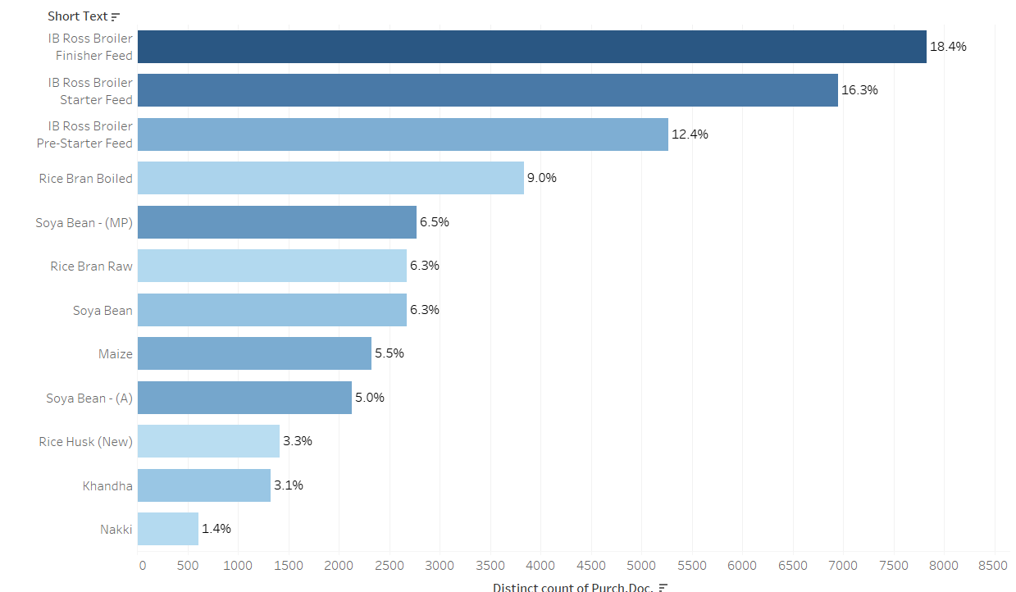
What is being bought – ( 2 of 2)
Top 12 Material by Frequency, contributes 93.5% of the PO issued.
The colour shade is by Gross Value,darker is more.

Slide 28
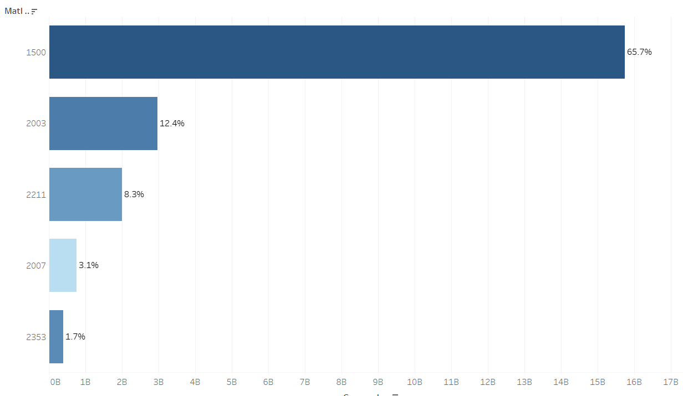
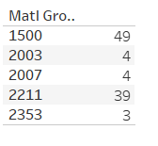
What is being bought – ( 3 of 3)
Top 5 Material Group by Gross Value,contributes 91.2% of the value.
Number of Material by Group -
The colour shade is by number of PO issued,darker is more.

Slide 29
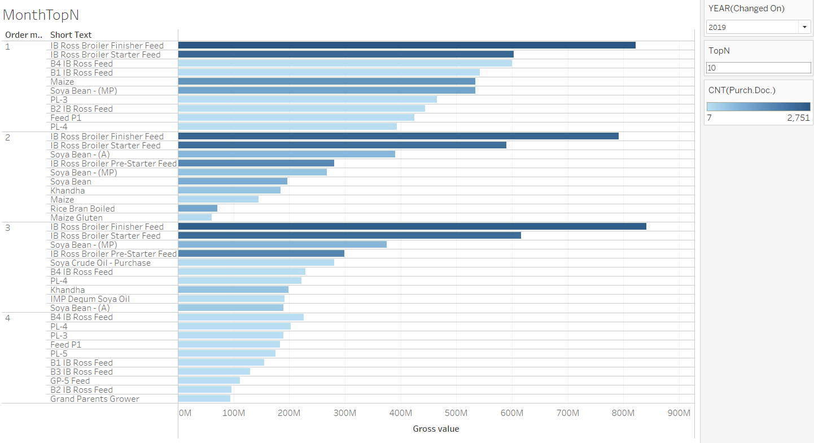
Top 10 by Gross Value – Year 2019 by Month

Slide 30
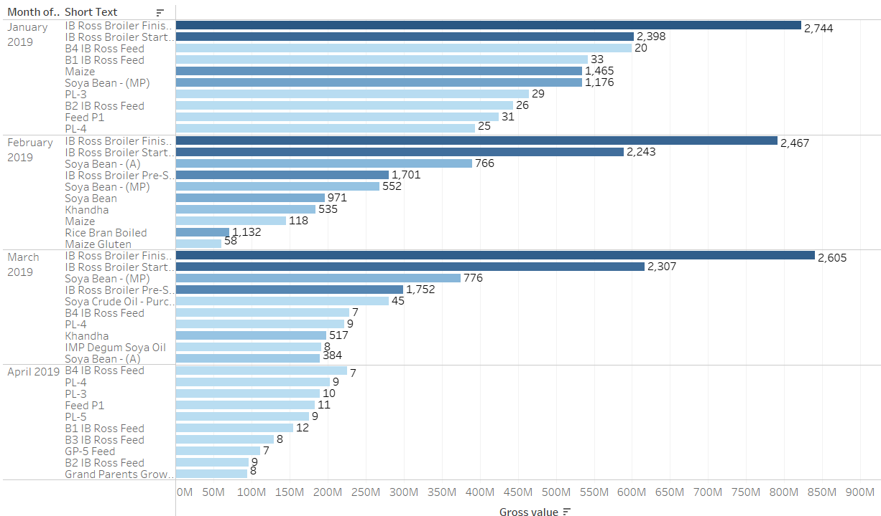
No Of PO Issued- Top 10 by Year 2019 and Month
The colour shade is by number of PO issued, darker is more.

Slide 31
Percentage of PO with single item
 | For all materials | Top 24 Materials
Number of PO Issued | 42579 | 21696
% PO with single item | 76.4% | 69.4%
% PO with more than 1 item | 23.6% | 30.6%

Slide 32
Spend Analytics - Cluster

Slide 33
Cluster
Objective - Cluster items with similar purchasing patterns
Data Used –
Removed Assets and Services Material Group
Summarised data by Material name ( Short Text )
There are 6248 unique Material name
Computed these values for the Materials -
Count number of times the item is bought
Sum Gross Value
Use this summarised data for clustering purpose.

Slide 34
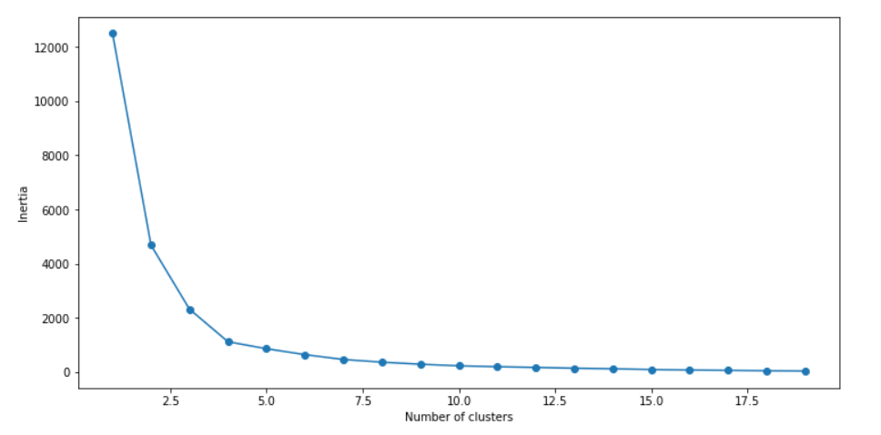
Elbow Method
Using Elbow method, get the number of clusters for kmeans.
The recommendation for number of cluster is 4.
Notes:
Get technical details on kmeans

Slide 35
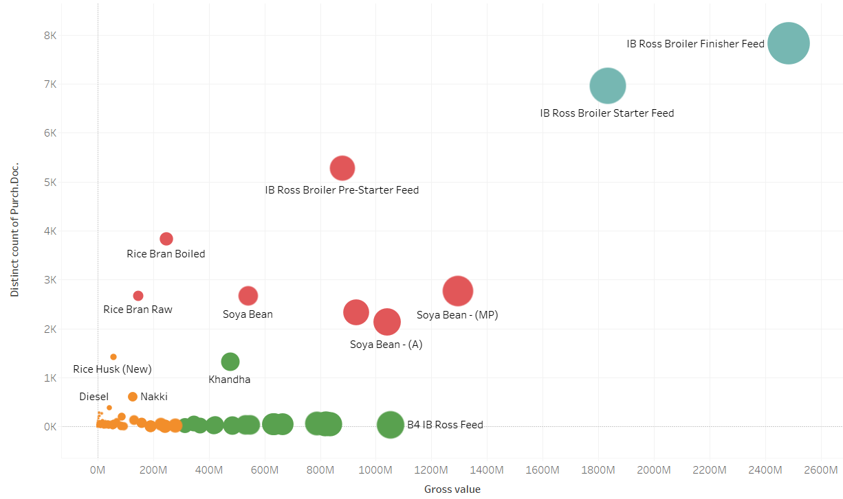
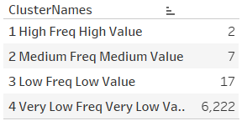
Cluster - 4 clusters
Number of Materials per clusters -

Slide 36
Cluster info
Cluster | Num Material In Cluster | Average Num Times Bought | Sum Gross Value | Average Per Unit Cost
Very Low Frequency Very Low Value | 6222 | 3.47 | 666028.51 | 7716.94
Low Frequency Low Value | 17 | 112.94 | 598180903.52 | 4166.76
Medium Frequency Medium Value | 7 | 3098.86 | 726667416.12 | 15798.82
High Frequency High Value | 2 | 7414.50 | 2158315090.94 | 29.67

Slide 37
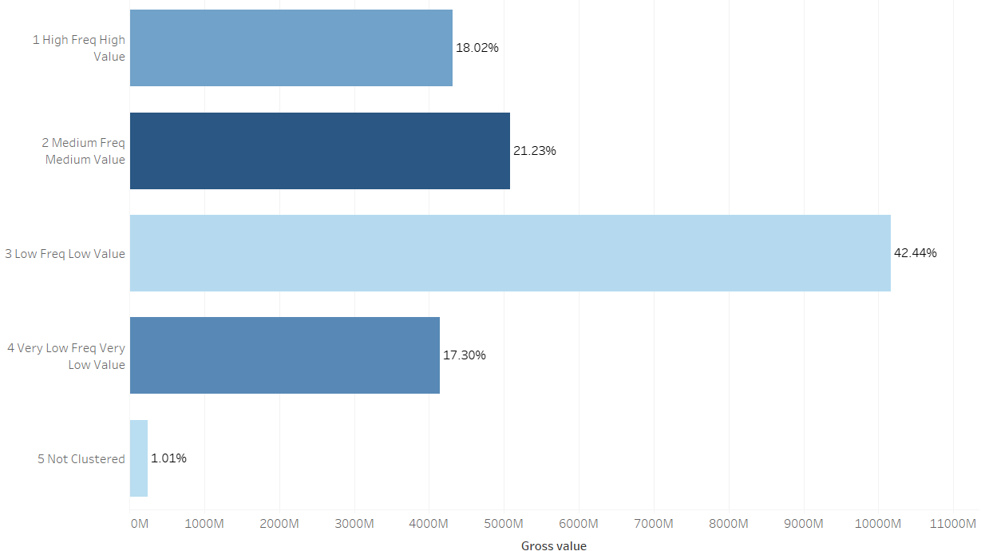
Cluster Details (1 of 4)
The three clusters contribute 81.7% and the first two 39.25% of the total Gross Value.
The colour shade is based on Number of PO Issued, lighter shade lower no of PO.

Slide 38
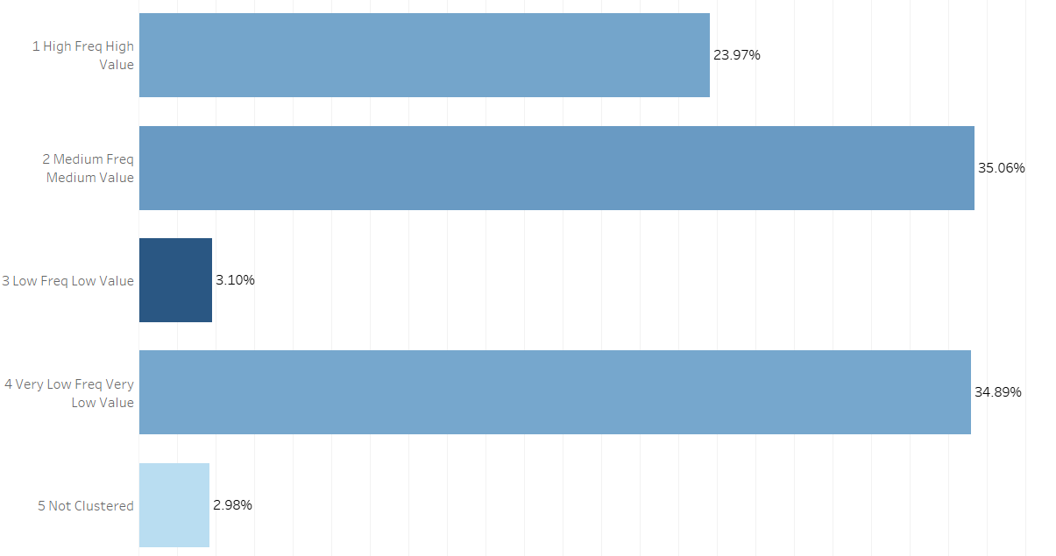
Cluster Details (2 of 4)
The three clusters contribute 62.13% and the first two 59.03 of the total PO Issued.
The colour shade is based on Gross Value, darker the higher.

Slide 39
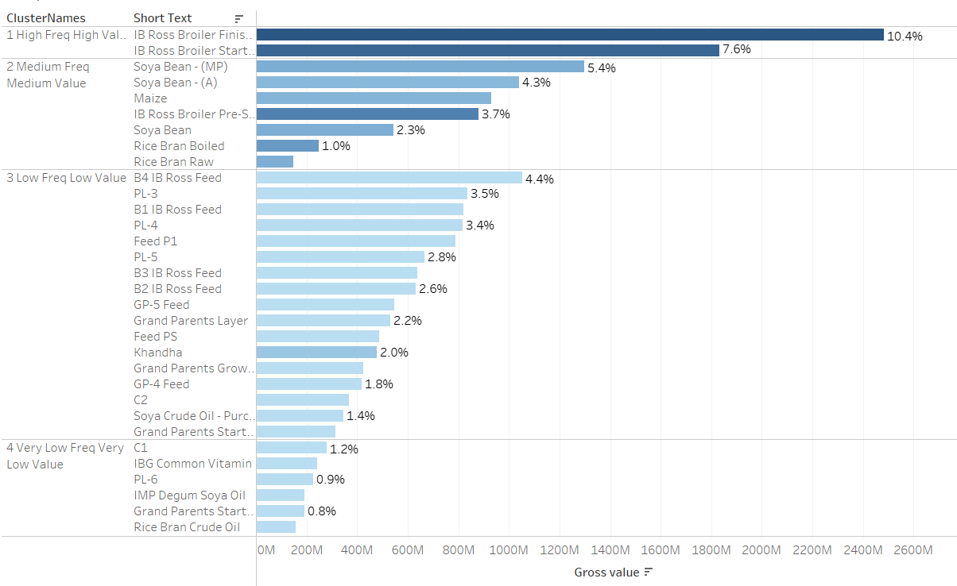
Cluster Details - 3 of 4
Top Materials per group – By Value, colour shade by PO Quantity.

Slide 40
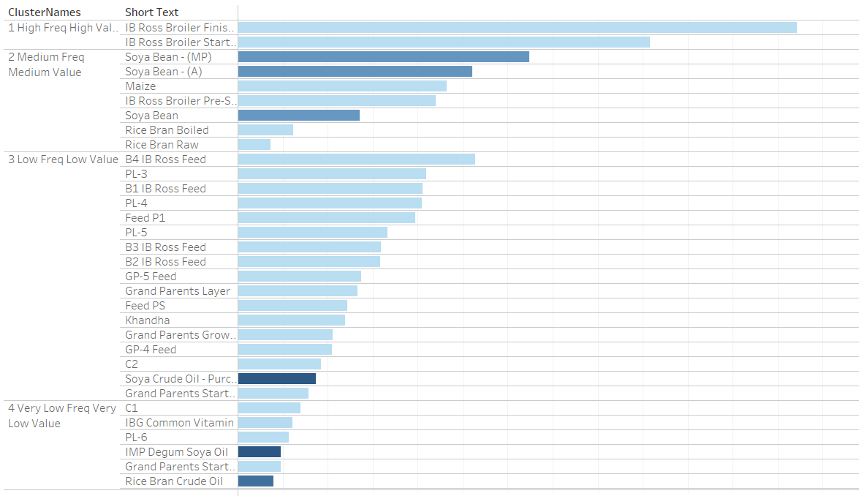
Cluster Details – 4 of 4
Top Materials per group – By Value, colour shade by Net Price.

Slide 41
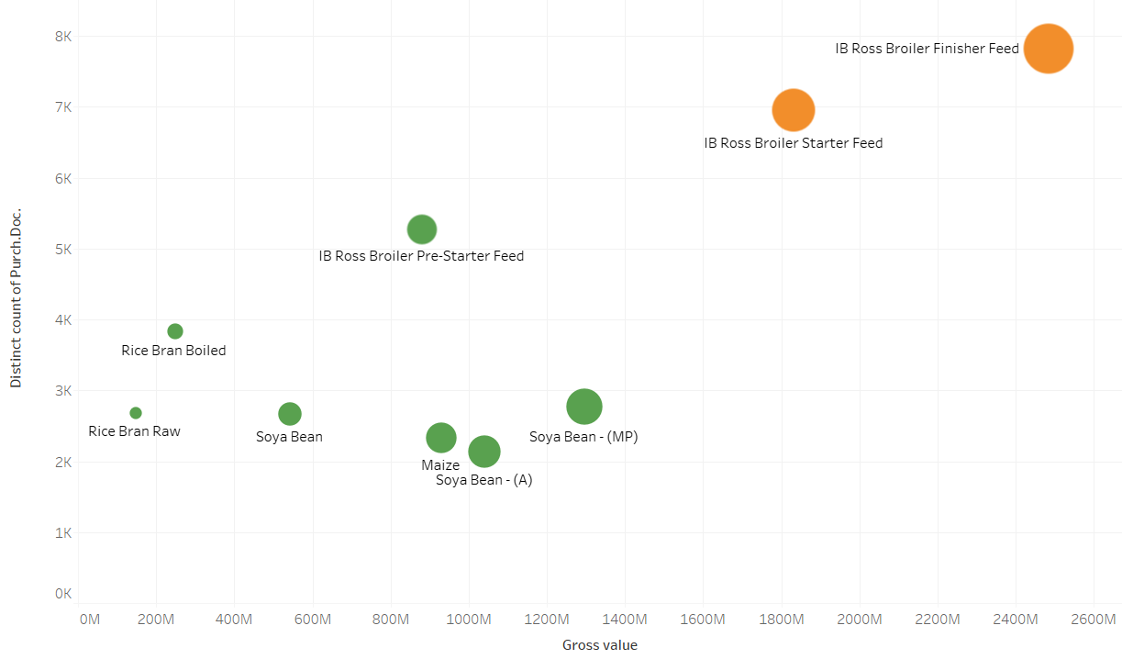
Cluster Analysis
Will ignore the low frequency low value and very low frequency and very low value group for cost saving analysis.
The two clusters have 9 materials in it.

Slide 42
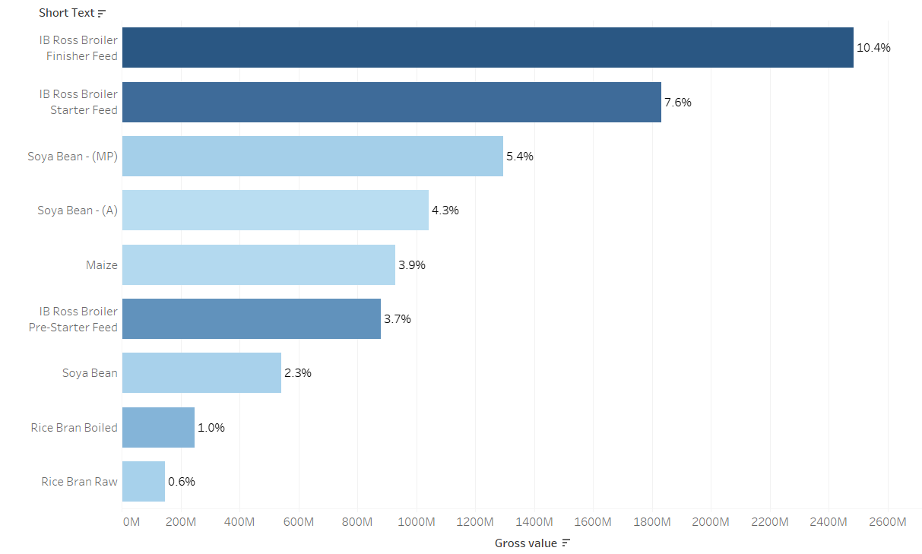
9 materials by percentage of total Gross value and colour shade by Count of PO

Slide 43
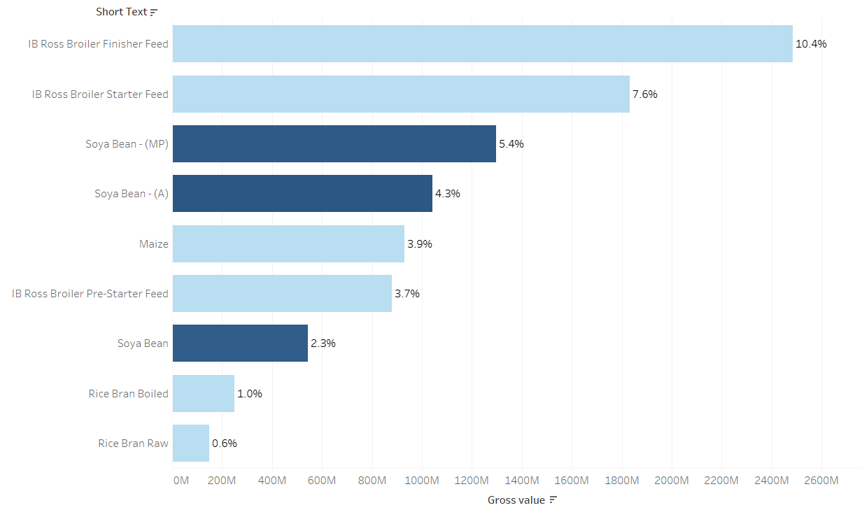
9 materials by percentage of total Gross value and colour shade by average price

Slide 44
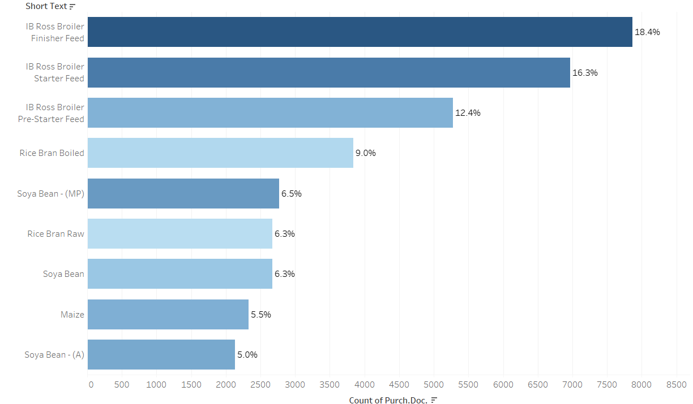
9 materials by percentage of total PO issued and colour shade by Gross value

Slide 45
Cost Saving Opportunity

Slide 46
Analysis on 2 materials per cluster
Analysing 2 material per cluster -
High Freq High Value
IB Ross Broiler Starter Feed
IB Ross Broiler Finisher Feed
Medium Freq Medium Value
Soya Bean (MP)
Maize

Slide 47
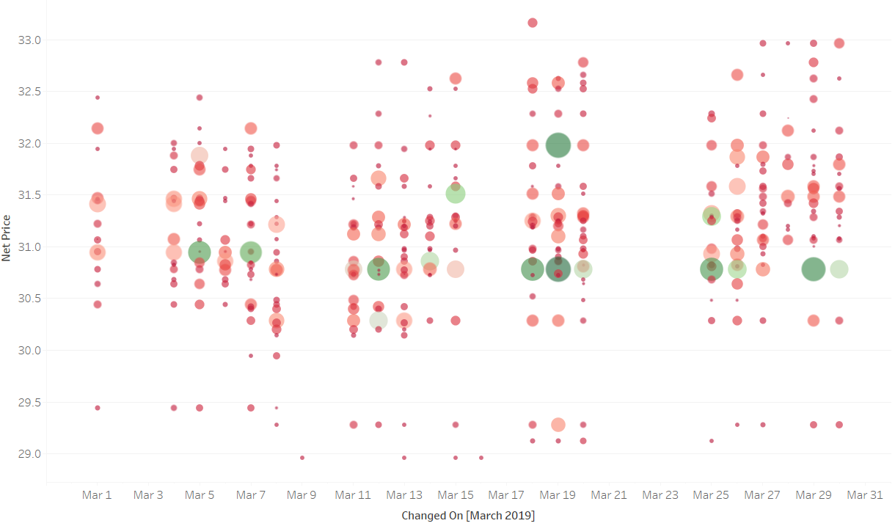
Ordering Trend – for IB Ross Broiler Starter Feed for March 2019
Ordering many times in a single day
2307 PO raised in March 2019
at various price points.
The size of the circle is based on Gross value and Colour on PO Quantity.

Slide 48
Explore Price Variation
We observe a lot of price variation on a monthly basis from the previous slide.
Will need explore price variation in more detail on –
weekly
Use Box plot to show the variation in min, max and average prices over the week.
daily
Use line chart to show the daily price variation
We do this for January 2019.

Slide 49
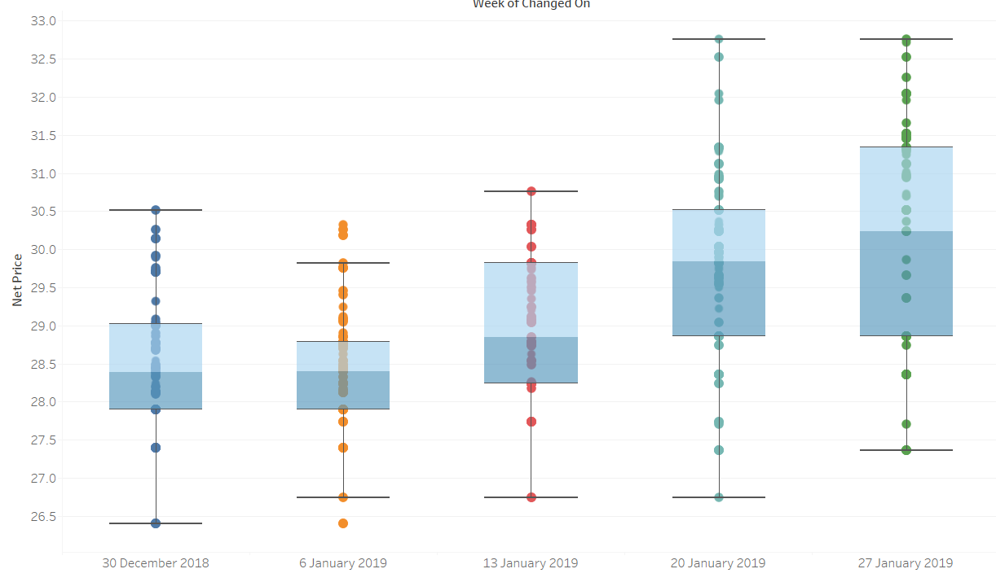
Weekly Price Variation for January 2019- (1 of 4)
IB Ross Broiler Starter Feed - observe weekly price variations.

Slide 50
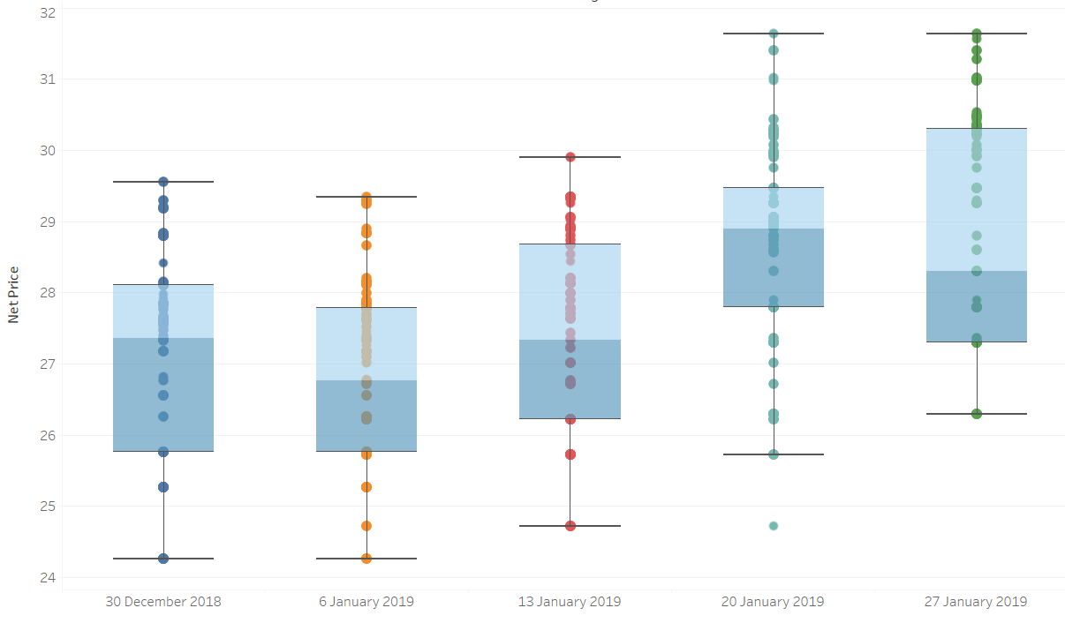
Weekly Price Variation for January 2019 – (2 of 4)
IB Ross Broiler Finisher Feed – observe weekly price variations.

Slide 51
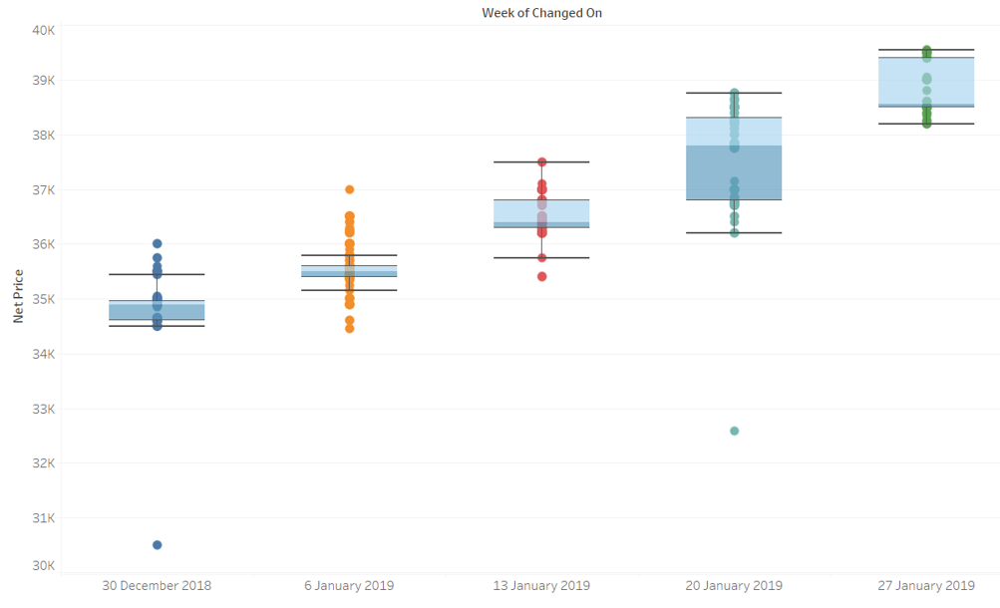
Weekly Price Variation for January 2019 - (3 of 4)
Soya Bean(MP) - observe weekly price variations.

Slide 52
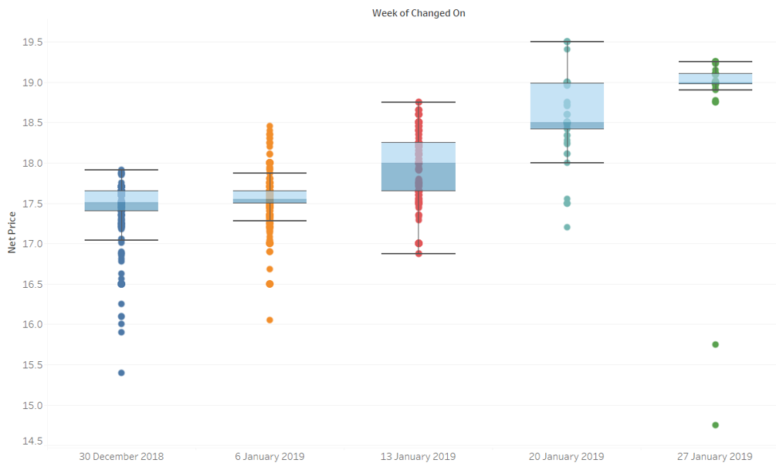
Weekly Price Variation for January 2019 – (4 of 4)
Maize - observe weekly price variations.

Slide 53
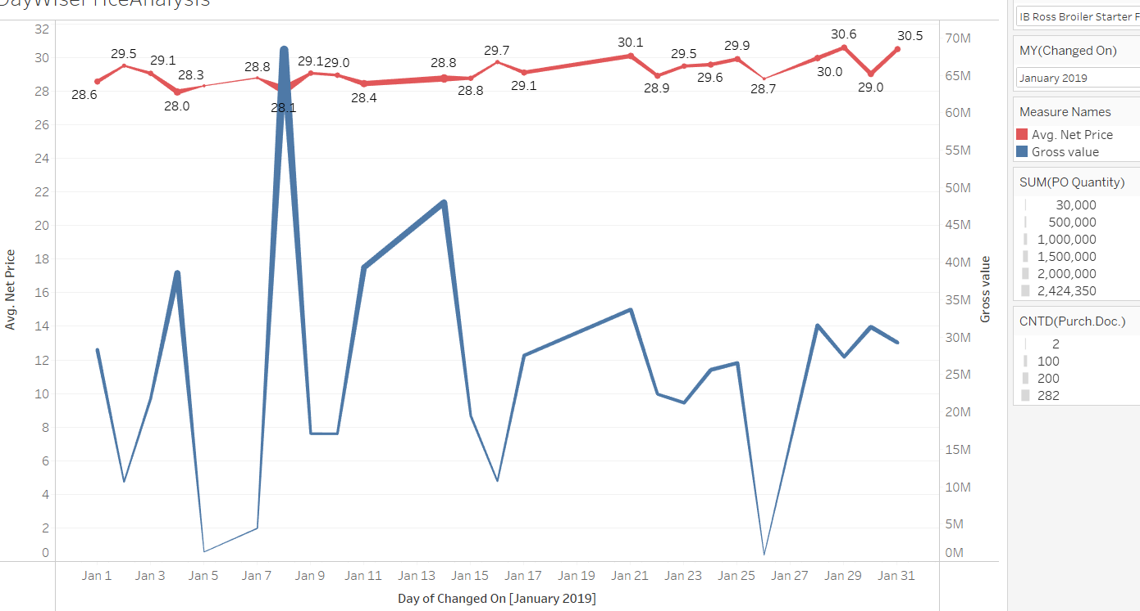
Daily Buying Trend - Jan 2019 – (1 of 4)
High Freq High Value - IB Ross Broiler Starter Feed

Slide 54
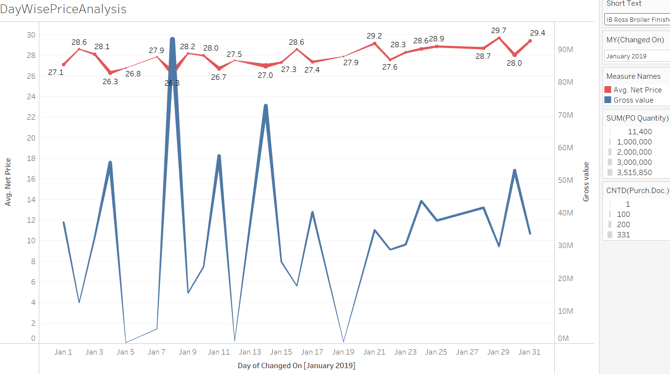
Daily Buying Trend - Jan 2019 – (2 of 4)
High Freq High Value - IB Ross Broiler Finisher Feed

Slide 55
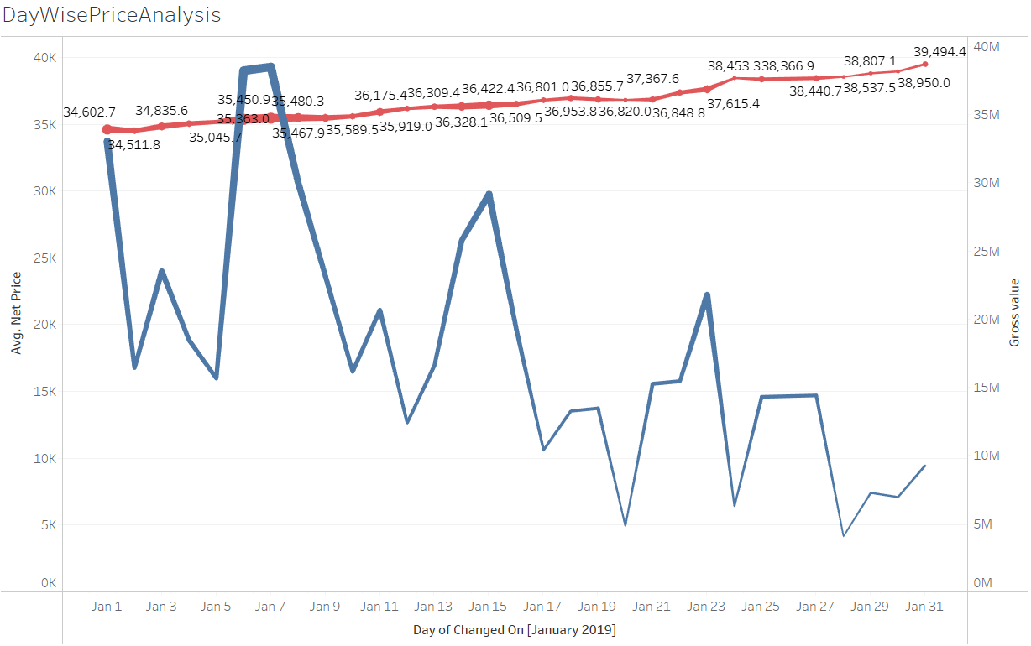
Daily Buying Trend - Jan 2019 – (3 of 4)
Medium Freq Medium Value - Soya Bean (MP)

Slide 56
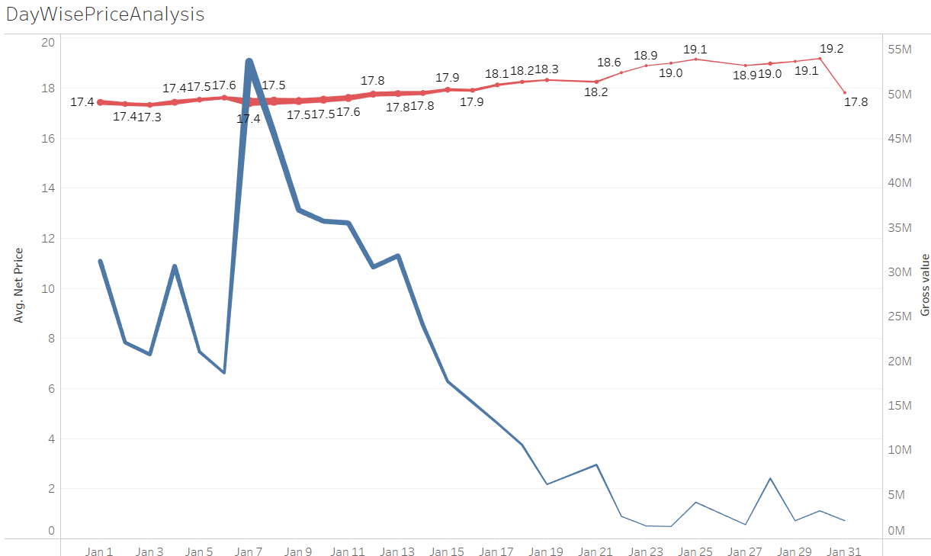
Daily Buying Trend - Jan 2019 – ( 4 of 4)
Medium Freq Medium Value - Maize

Slide 57
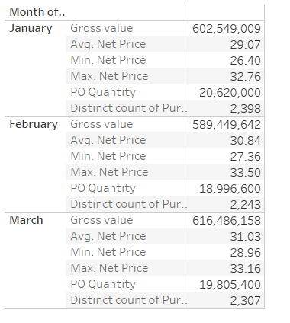
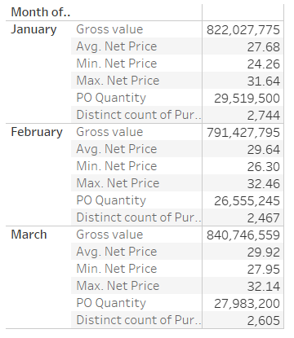
Price Variations ( 1of 2 )
IB Ross Broiler Starter Feed IB Ross Broiler Finisher Feed

Slide 58
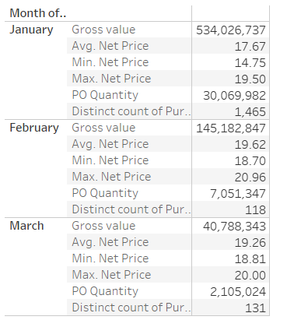
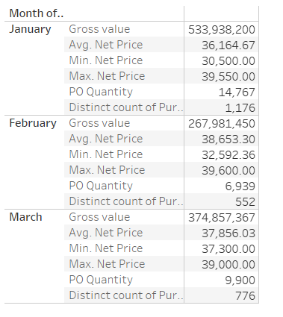
Price Variations ( 2 of 2 )
Maize Soya Bean ( MP)

Slide 59
Pricing Observations
We observe the prices of materials
Mostly going up as the month progresses.
Varies on a daily/weekly basis.

Slide 60
Cost Saving Opportunities – calculations for Jan 2019
Savings for 4 items to be bought at minimum price :
 | JANUARY 2019
 | IB Ross Broiler Starter | IB Ross Broiler Finisher | Maize | Soya Bean (MP)
Gross Value | 602549009 | 822027775 | 534026737 | 533938200
Avearge Net Price | 29.07 | 27.68 | 17.67 | 36164.67
Min Net Price | 26.4 | 24.26 | 14.75 | 30500
PO Quantity | 20620000 | 29519500 | 30069982 | 14767
Min * PO Qty | 544368000 | 716143070 | 443532235 | 450393500
Diff with Gross Val | 58181009 | 105884705 | 90494503 | 83544700
Savings % | 9.66% | 12.88% | 16.95% | 15.65%

Slide 61
Cost Saving Opportunities - Recommendations
Savings can be made if purchase is planned and materials bought in bulk at start of the month at minimum price.
Bulk purchase – Expect discounts from suppliers
Can also save on costs related to –
Logistics
Vendor Transportation

Slide 62
Dashboard

Slide 63
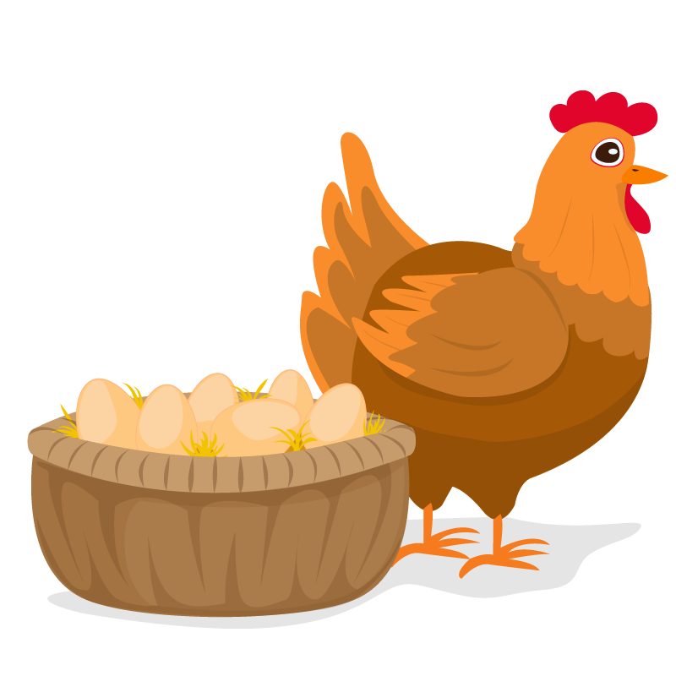
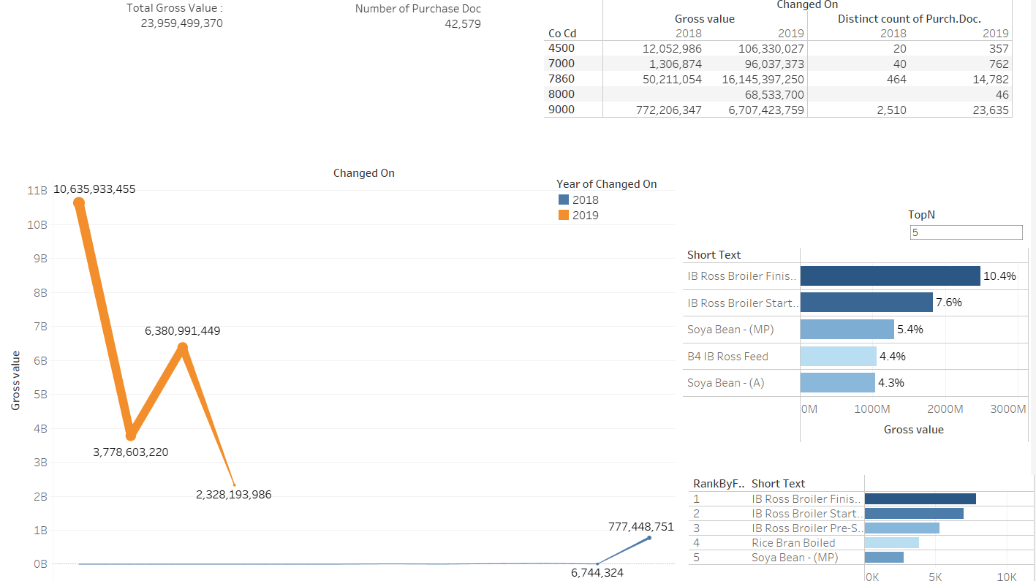
Dashboard

Slide 64
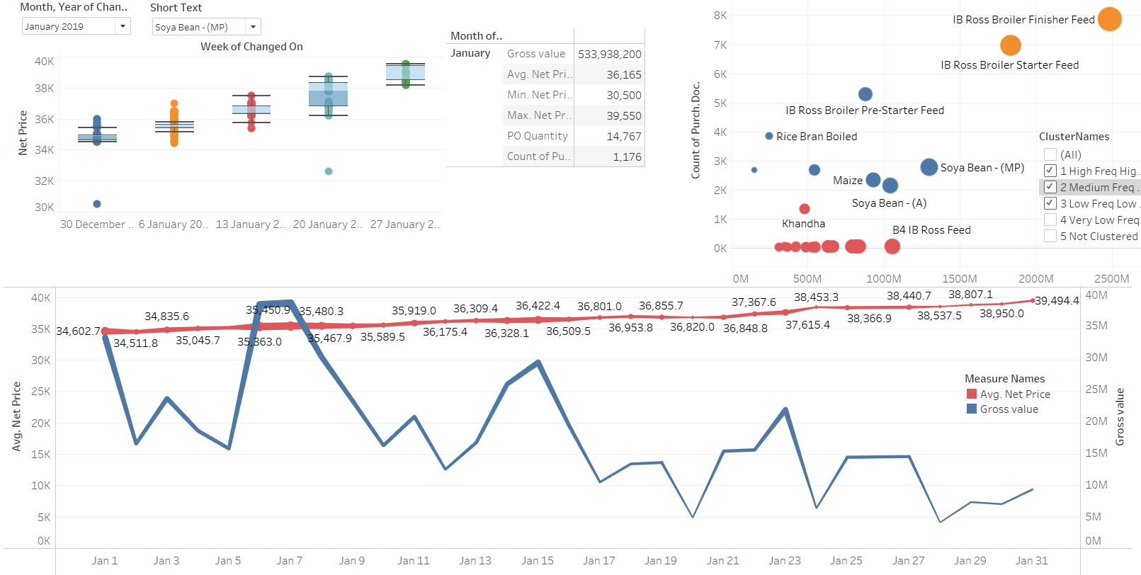
Dashboard – Price Analysis

