Slide 1
Predicting 3M Corporation’s Weekly Stock Return using Linear Regression
Jay Kwon
Metis Data Science and Engineering (flex program)
Module 2 – Linear Regression and Web Scraping
November 10, 2021

Slide 2
Goal:
Create a Linear Regression model to predict the weekly returns for 3M corporation’s stock.
1. optimize the performance of the model.
2. gain insights on how to predict stock returns, including which features are most relevant
Motivation:
insights gained would be beneficial to anyone interested in stock returns including:
investors (individuals, wealth management firms, hedge funds, pension funds)
financial news (Bloomberg, CNBC, Wall Street Journal)
ratings agencies (S&P, Moody’s, Fitch)
financial services

Slide 3
Dataset:
Target: Weekly return of 3M stock derived from historic prices scraped from https://finance.yahoo.com/quote/MMM/
Feb, 2010 to Feb, 2020 : 522 weeks
Features derived from historic price and volume: previous week’s price, weekly avg volume traded
Features from other data sources (Federal Reserve): inflation, unemployment, Fed Funds rate, and US treasury rate
Why 3M Corporation? Less volatile, easier to predict
- large, mature company with long history (founded 1902,
part of S&P 500), not as volatile as a small growing company
- Industrials sector is not as volatile as other sectors like Tech
Tools used:
Selenium, BS, Numpy, Pandas, Matplotlib, Seaborn, StatsModels, scikit-learn

Slide 4
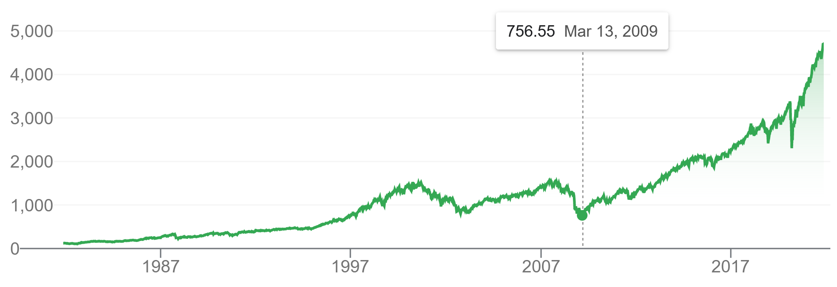
Historic Trend of Stock Market
* Standard and Poor’s 500 Index (source: Google)
period examined
(Feb 2010 – Jan 2020)
Period of our Data: Feb 2010 to Feb 2020
want to avoid extreme events that are hard to predict
after 2008 financial crisis, before 2020 Covid-19 pandemic
relatively stable bull market

Slide 5
Initial Model:
t
8 Features:
avg_volume
wk_1
wk_2_5
wk_6_17
ff_rate
Inflation
UNRATE
T_Rate
Initial model:
avg_volume
wk_1
wk_2_5
UNRATE
Significant
p-values < 0.01
Takeaways:
Recent historical returns may be more valuable predictors compared to older historical returns.
Fed Funds Rate, Inflation, and 1-yr Treasuries are not good predictors of returns

Slide 6
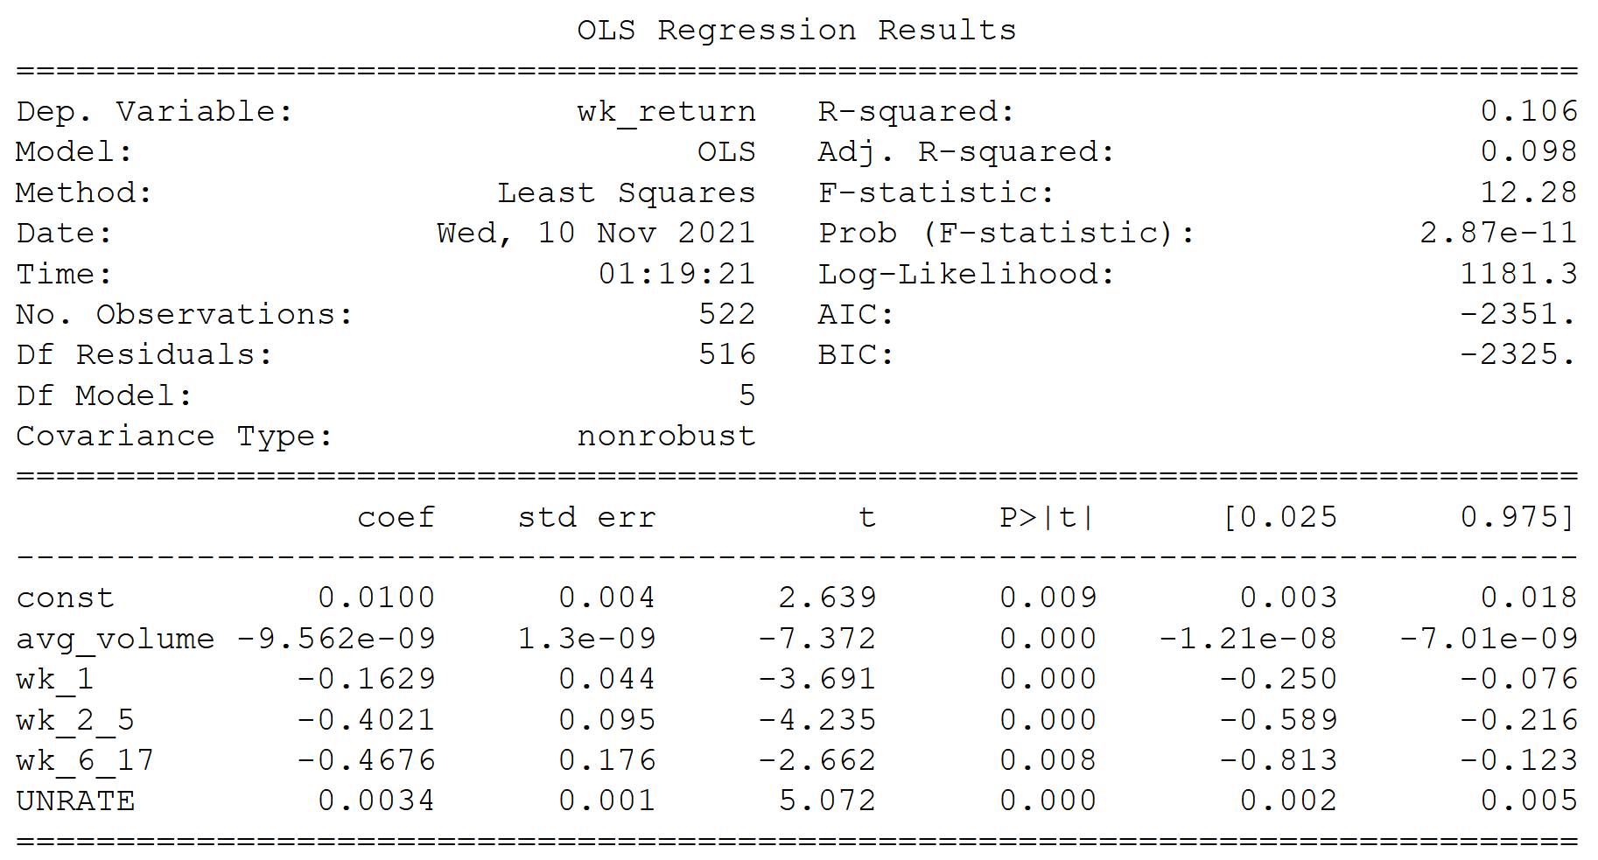
Performance and Feature Interpretation:
Adj R-squared of 0.10 means that our features explain 10% of the variance of our target
In the domain of finance, an R-squared of 0.20 is considered stellar
High condition number (not shown) suggest multicollinearity
When average volume traded was high last week, the weekly return this week will be low
When returns have been high in previous weeks, the weekly return this week will be low
When unemployment is high, the returns will be high

Slide 7
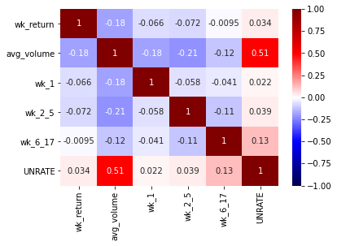
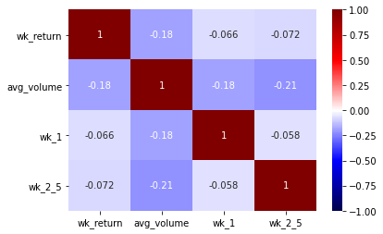
Fixing Multicollinearity
Problem: correlation between features:
Average volume and Unemployment rate
Keep Average Volume
(stronger correlation of -0.18)
Upon removing UNRATE, wk_6_17 became insignificant and had to be removed
Our final model has 3 features, with avg_volume having the strongest correlation to our target.

Slide 8
Performance on Unseen Data
- Our final model has 3 features: previous week return, -2 to -5 week average return, and previous week’s average volume (highest correlation to target, -0.18)
→ R-squared: 0.059 Adj. R-squared: 0.053
→ this is on the entire 522 rows that it was trained on
- 5-fold Cross Validation on final model
→ R-squares: 0.041, -0.16, -0.075, -0.068, -0.012
→ avg. R-square: -0.055
→ significantly smaller than 0.059 we saw above.
A negative R-squared of -0.055 means that our model is performing worse than if we were to use the simple average of the previous weekly stock returns (naïve model).
Perhaps party affected by 20% less data used to train the model
522 rows total is a limited amount of data
wide ranged in R-squared values calculated in the cross validation suggests that more of the same type of data is necessary

Slide 9
Conclusions and Recommendations:
Conclusions:
Previous week’s average volume traded may be weakly, negatively correlated with future return
Macro factors including inflation, fed funds rate, unemployment are poor predictors of future return
Previous returns are poor predictors of future return
Weekly returns may limit the amount of data too much for the features and target examined.
Recommendations:
Look for more company specific features, metrics derived from financial statements and the news such as expected and actual revenue, and earnings per share
Find a way to obtain more data to train and test the models on: e.g. use daily returns or try to predict cross sectionally across many stocks instead of longitudinally over time
Try modeling sectors or indices instead of individual stocks.

Slide 10
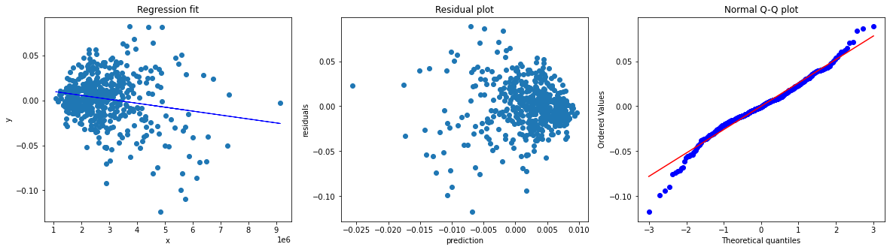
Supplemental:
Further regression assumption check on avg_volume feature:
RMSE of 5-fold cross validation of our final model:
5-fold cross validation RMSE's: [0.035 0.021 0.023 0.02 0.031]
5-fold cross validation RMSE mean: 0.026

