Slide 1
Capstone 1 An Analysis of Historic Cryptocurrency Prices
Jay Kwon
Galvanize Data Science Immersive (RPP3)
July 24, 2021

Slide 2
Goal:
perform Exploratory Data Analysis on historical prices of cryptocurrencies
filter dataset to rows and columns of interest and make insightful visualizations
identify potential relationships for deeper research and machine learning application
in particular, how do other coin prices move relative to Bitcoin (BTC)?

Slide 3
Dataset
"Cryptocurrency Historical Prices" dataset from Kaggle: https://www.kaggle.com/sudalairajkumar/cryptocurrencypricehistory
Historic Prices of top 23 Cryptocurrencies by marketcap
Date
daily Prices in USD (High, Low, Open, Close) dating back to April, 2013 (for BTC)
Volume of daily transactions
Market Capitalization
additional columns derived: daily price change, percent change, price up/down, standardized closing price
all numerical data except for the categorical variable 'Up' which represents whether the price went up or not

Slide 4
Why Bitcoin (BTC)?
Why are we interested in how other coins track with Bitcoin (BTC)?
BTC is 46% of the total cryptocurrency market cap, tracks the entire crypto market well
very first (oldest) cryptocurrency created in 2009 (most historic data for this currency)
most trusted, widely-used cryptocurrency

Slide 5
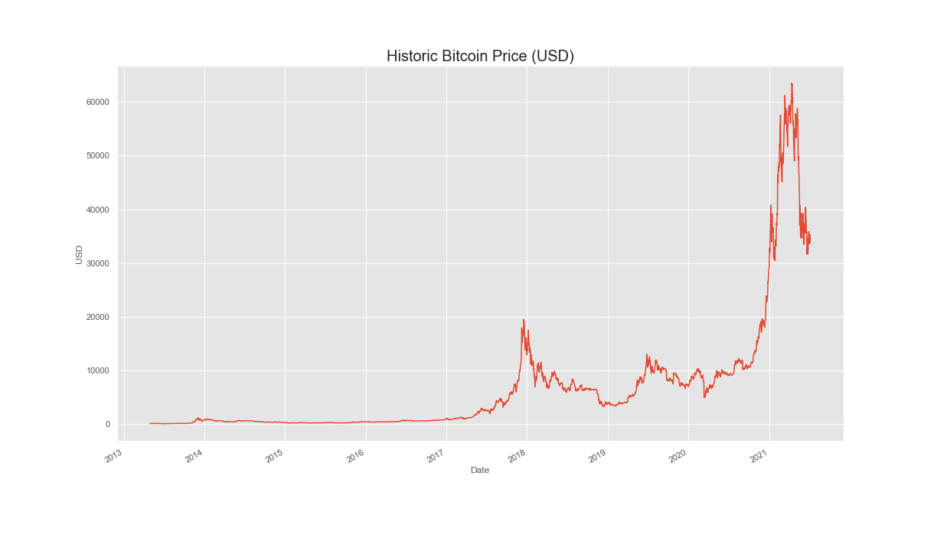
Bitcoin price (USD) over time
2 major bubbles: 2017 and 2021
note on scale: Bitcoin(BTC) in the 34,000 USD, Ethereum 2,100 USD,
Cardano 1.21 USD , Dogecoin 0.19 USD
wide range (orders of magnitude)

Slide 6
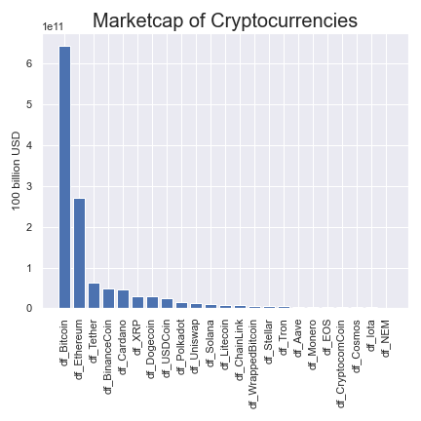
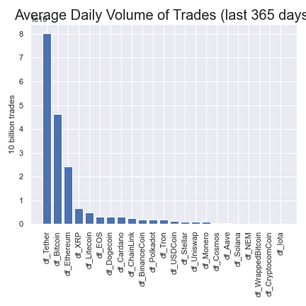
Cryptocurrencies by Marketcap and Volume
coins with the largest marketcaps: Bitcoin (46%), Ethereum (17%), Tether (4.8%), Binance Coin (4.0%), Cardano (2.9%)
largest average daily volume: Tether, Bitcoin, Ethereum, XRP, Litecoin

Slide 7
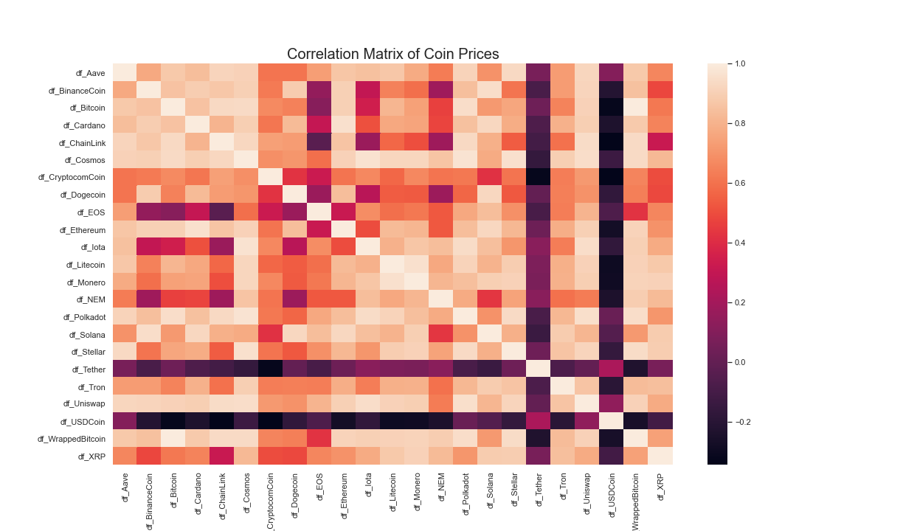
stable coins (Tether, USDCoin) are uncorrelated or negatively correlated with other coins
coins with the highest correlations: Polkadot, Uniswap, Cosmos, Ethereum (all have correlations > 0.90)

Slide 8
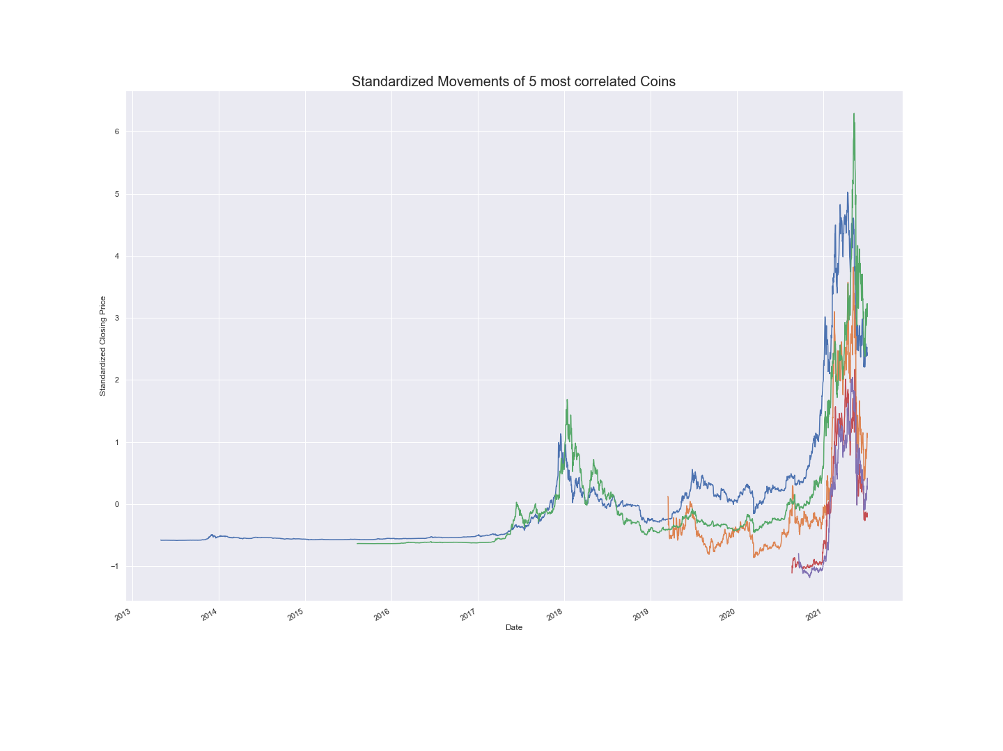
Standardized Movements of 5 most correlated Coins
Legend:
Bitcoin (2013): blue
Ethereum (2015): green
Cosmos (2019): orange
Uniswap (2020): red
Polkadot (2020): purple

Slide 9
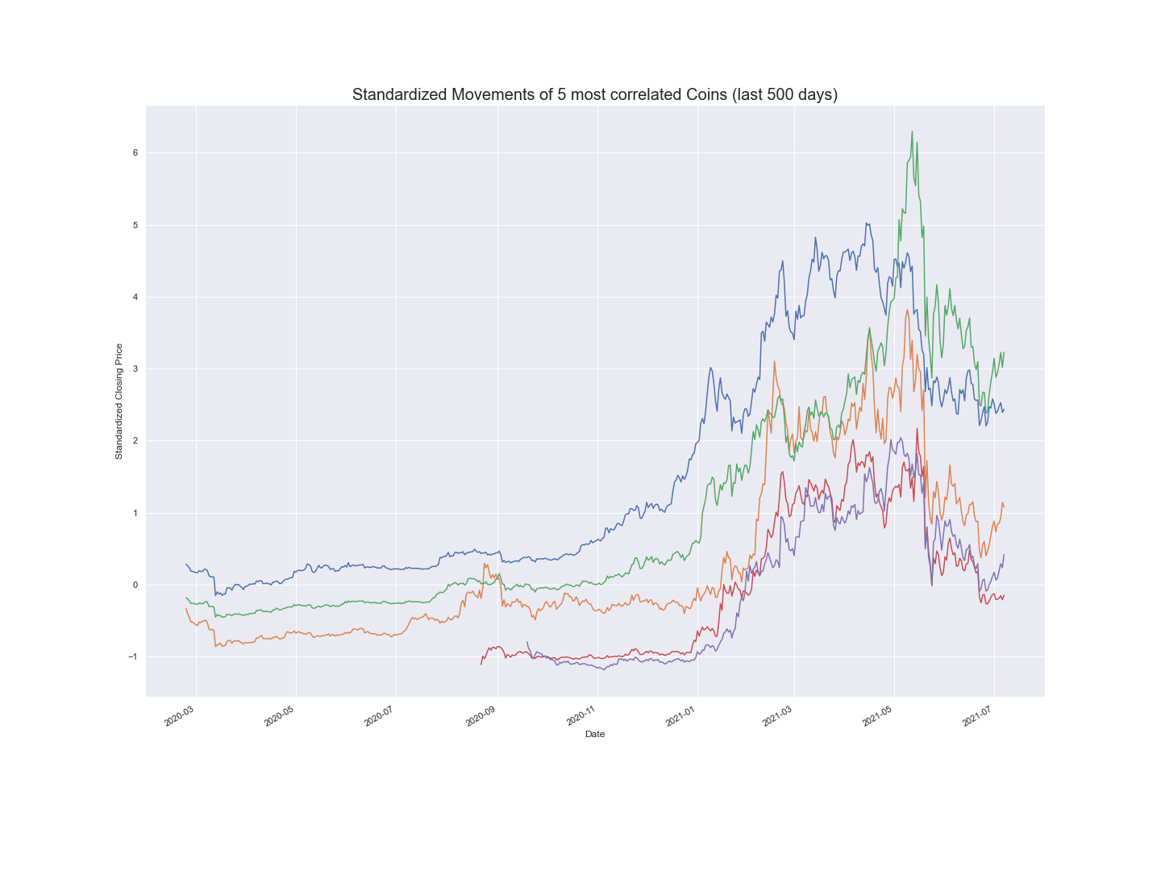
Standardized Movements of last 500 days
Legend:
Bitcoin (2013): blue
Ethereum (2015): green
Cosmos (2019): orange
Uniswap (2020): red
Polkadot (2020): purple
can visually confirm that that highly correlated coins track together

Slide 10
Future Studies:
make the time series data stationary by removing seasonality and trends
test for changes before and after big events like the onset of Covid-19 pandemic
fit predictive models with price as outcome
incorporate other financial data like interest rate, unemployment rate, and S&P 500 data as possible predictors
look at more obscure coins with small marketcaps

