Slide 1
Historical Earnings per Share (EPS) EDGAR Data Pipeline
Jay Kwon
Metis Data Science and Engineering (flex program)
Module 3 – Data Engineering
Feb 23, 2022

Slide 2
Goal:
Create a Data Pipeline for historical financial statement data (EPS) for companies in the S&P500 index.
1. obtain raw data from SEC’s EDGAR database, curate EPS data, make available on PostgreSQL server hosted on AWS
2. create interactive frontend for end users access to data/visualization
Background:
historical price and trade volume of stocks are easily available for free
historical financial statement data for companies are difficult to track, curated data not available for free
without this data ML regression models to predict returns proved to be ineffective:
R^2 of -0.055 (worse than simple average)

Slide 3
Motivation:
Serial, historical data may serve as important features for time-series ML models (e.g. predicting stock returns)
insights gained would be beneficial to anyone interested in company fundamentals including:
investors (individuals, wealth management firms, hedge funds, pension funds)
financial news (Bloomberg, CNBC, Wall Street Journal)
ratings agencies (S&P, Moody’s, Fitch)
financial services

Slide 4
Dataset
Raw JSON files obtained from SEC’s EDGAR database: https://www.sec.gov/edgar/sec-api-documentation
498 JSON files each representing a company in the SP500 index
PostgreSQL database had 1 table for EPS with 100,368 rows and 10 columns (4 categorical, 6 quantitative)
time period: 2009 to 2022
Why EPS data?
- represents a company’s profit per share
- great candidate as a feature to predict stock returns
Tools used:
Psycopg2, PostgreSQL, AWS, Pandas, Matplotlib, Streamlit

Slide 5
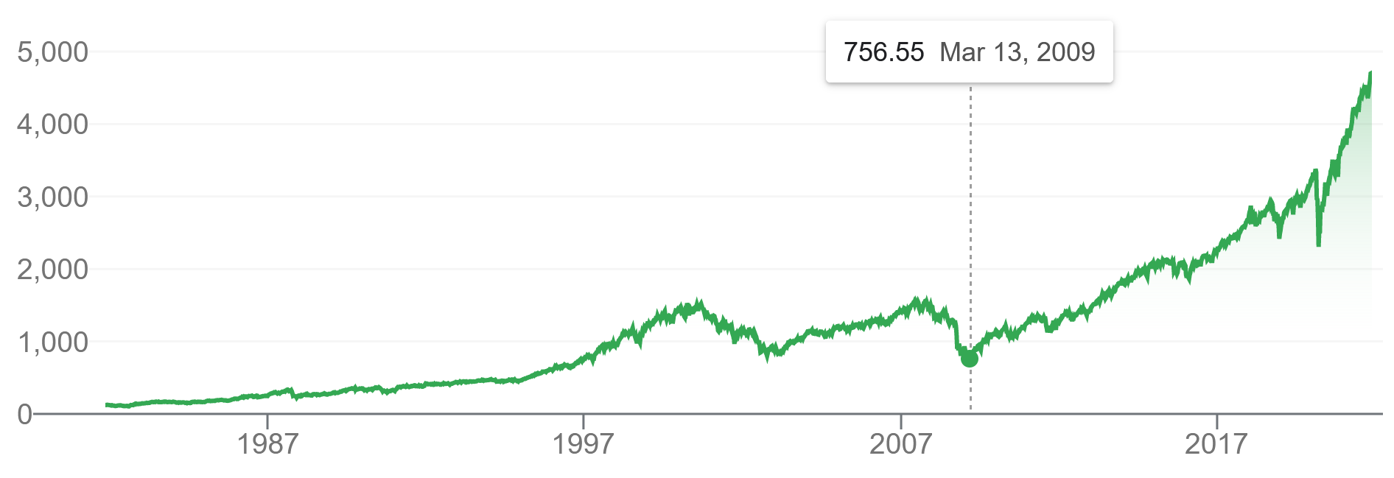
Historic Trend of Stock Market
* Standard and Poor’s 500 Index (source: Google)
period examined
(Feb 2010 – Jan 2020)
Period of our Data: Feb 2010 to Feb 2020
want to avoid extreme events that are hard to predict
after 2008 financial crisis, before 2020 Covid-19 pandemic
relatively stable bull market

Slide 6
Historical Financial Statement Data Pipeline
DATA INGESTION
Download JSON files for companies from EDGAR website
TESTING/ROBUSTNESS
check that new data was written by accessing new rows, check that values make sense (reasonable range, negative values)
DATA STORAGE
Parse JSON files and store diluted Earnings Per Share (EPS) data for SP500 companies on a PostgresSQL server hosted on AWS using Psycopg2
and SQL commands
PROCESSING
Clean/filter data into a usable format using Pandas;
Engineer features of interest
DEPLOYMENT
Frontend hosted on Streamlit with table and visualization (Matplotlib) of historical EPS data
Allow access to AWS database; Jupyter notebook and python scripts access on GitHub

Slide 7
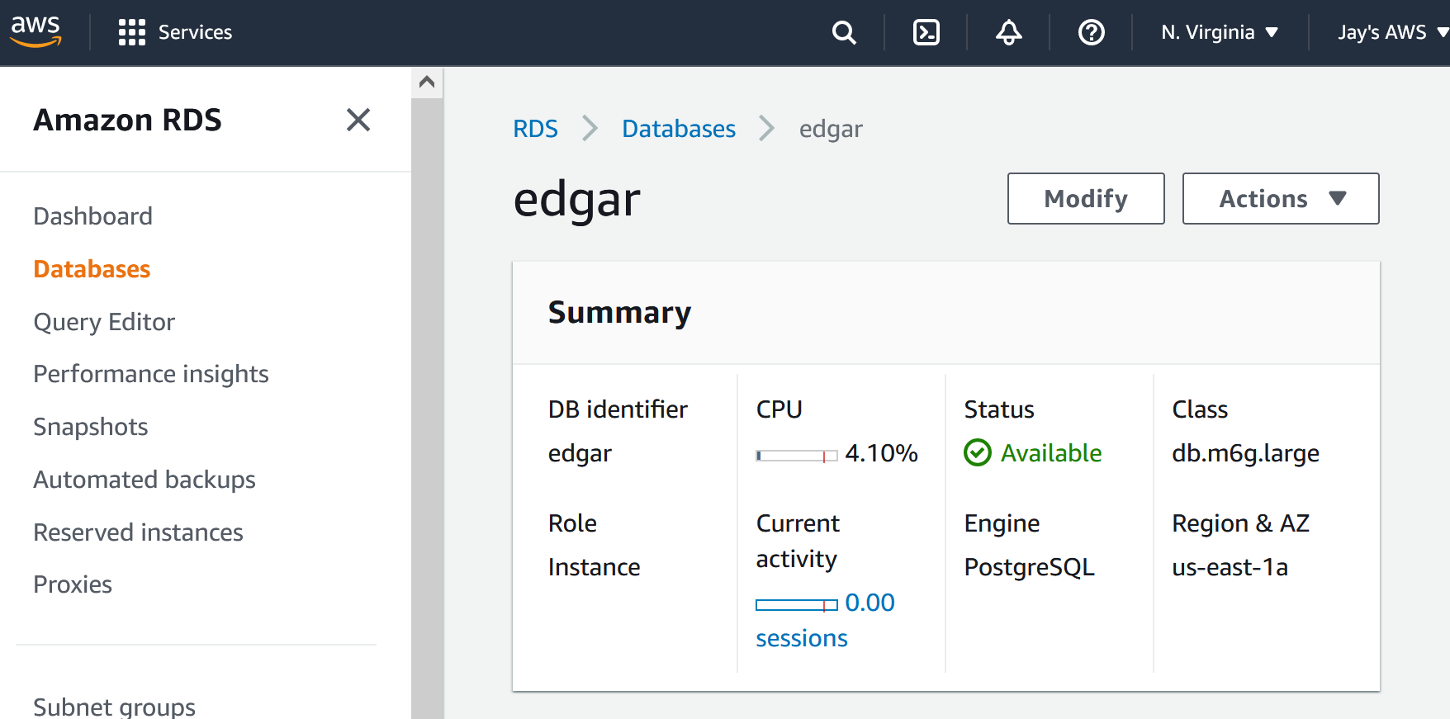
AWS
t
AWS → RDS → Databases → Instance → databases → tables

Slide 8
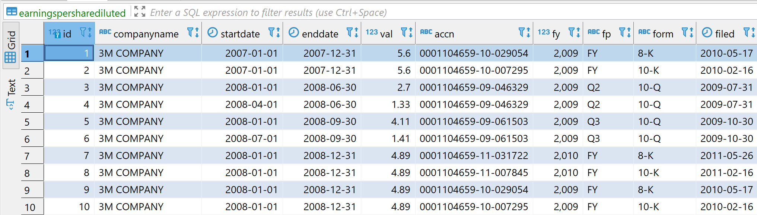
PostgreSQL
Schema:
EPS Table:
t

Slide 9
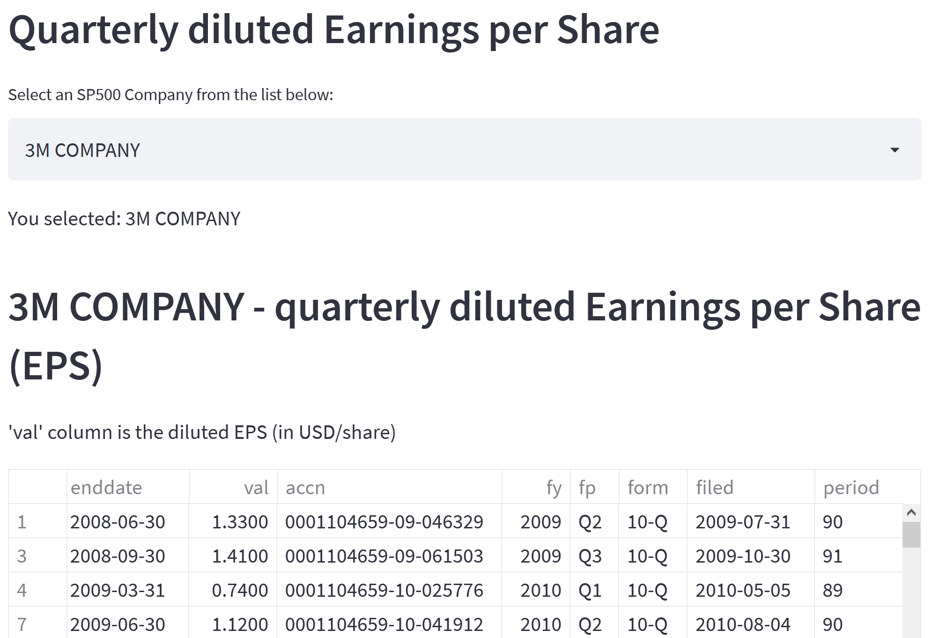
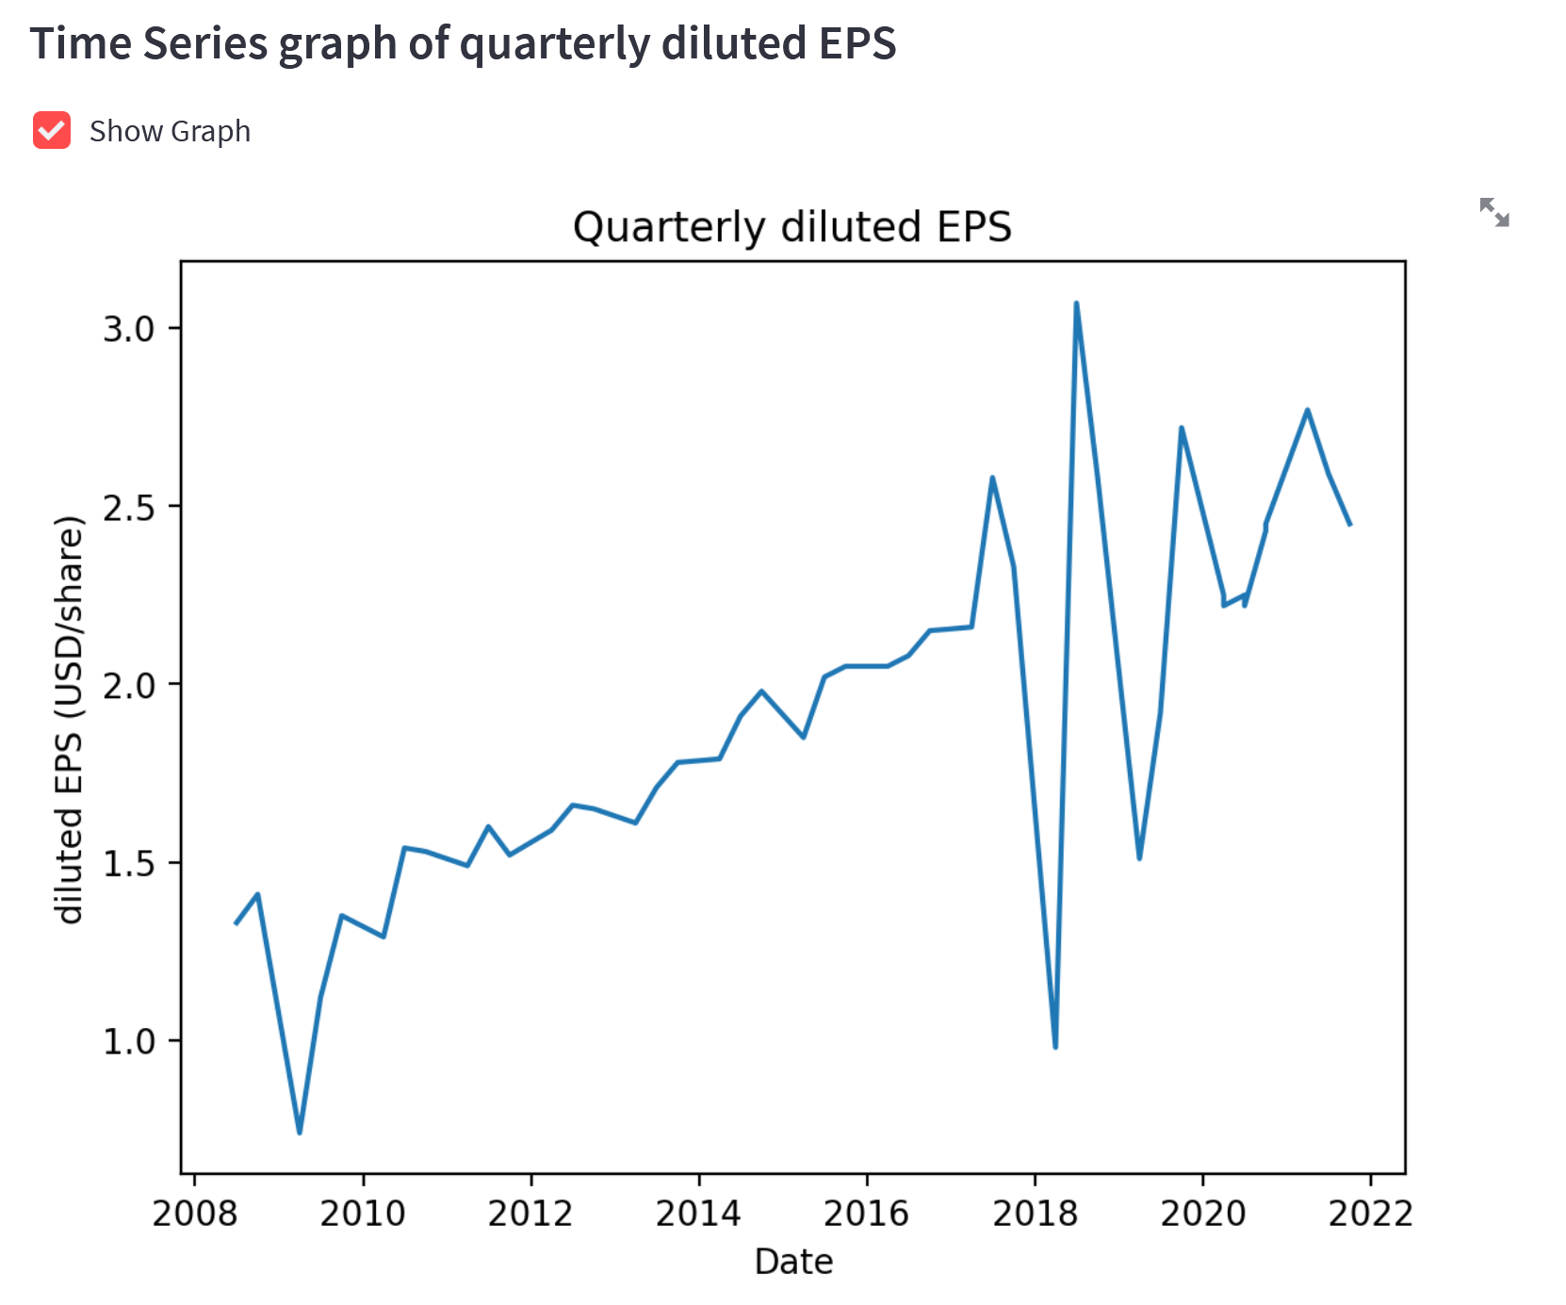
Frontend: Streamlit
User chooses one of the companies
shows EPS data and time-series graph
https://share.streamlit.io/jaykwon2/edgar-dilutedeps/main/EDGAR_streamlit_app.py

Slide 10
Conclusions and Future Projects
Conclusions:
It is possible to create one’s own data pipeline for historic financial statement data
handling financial data on local machine even only for 500 companies is inefficient
using AWS proves useful for handling big data
Future Projects:
Expand to other financial metrics: debt-to-equity, quick ratio, working capital ratio
Apply ML models on data to predict targets such as stock returns
Cron job on EC2 instance to regularly update database using API

