Slide 1
Exploratory Data Analysis (EDA) on NYC Transit Data for Optimal Advertisement
Jay Kwon
Metis Data Science and Engineering (flex program)
Module 1 - EDA
October 13, 2021

Slide 2
Motivation:
Pitching to advertising agency
I propose that I can help them make better decisions on ad placement by analyzing NYC transit data
Stations, buses, subways, and commuter rails in the Greater New York area
more effective ad placements on interior and exterior of these vehicles, walls of the stations, human street teams
Goal:
perform Exploratory Data Analysis (EDA) on NYC transit data to find insights on how to optimize ad placement
Busiest stations, busiest day of the week, seasonal trends
Event driven spikes in traffic

Slide 3
Dataset:
Turnstile entries and exits data from the Metropolitan Transportation Authority (MTA): http://web.mta.info/developers/turnstile.html
July 25, 2020 to January 29, 2021 : 27 weeks (188 days)
Turnstile count of entries and exits take every 4 hours
379 Stations, focused on Penn Station
Why this time period?
Seasonal trends. How does ridership change...
- as we move out of summer (Aug) and into the new school year (Sept)
- onto the holiday season in December, and into the new year
Tools used:
SQL, SQLAlchemy, Pandas, Numpy, Matplotlib

Slide 4
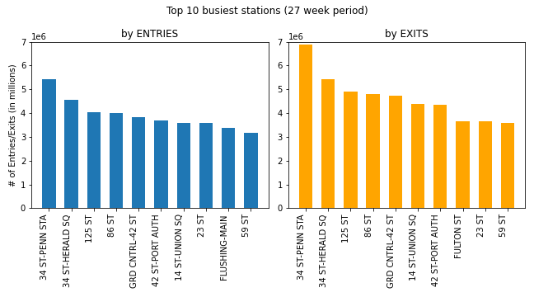
9 out of the top 10 stations by Entries is in the top 10 by Exits
more people exit the stations than enter; NOTE: also true for ALL stations combined, 3.7% that enter, exit at stations not covered by the dataset (e.g. commuter rails in other states)
Penn Station is #1 for both Entries and Exits

Slide 5
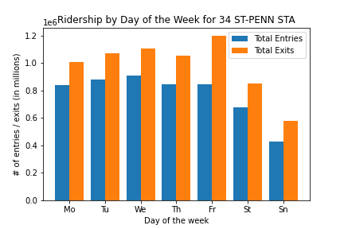
Penn Station
Weekdays are the busiest: Mo, Tu, We, Th, Fr
Weekends are less busy: St, Sn
Spike in Exits on Friday: time to party in the city after work, ride cab back home after subway closes

Slide 6
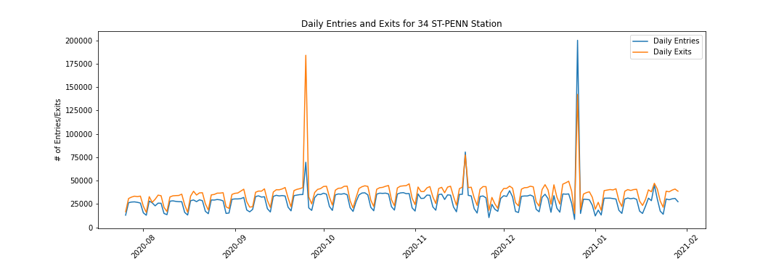
Penn Station
Weekly cyclical trend (peak during weekdays, drop on weekends)
higher exits than entries
3 unusual spikes in traffic after capping count at 200,000

Slide 7
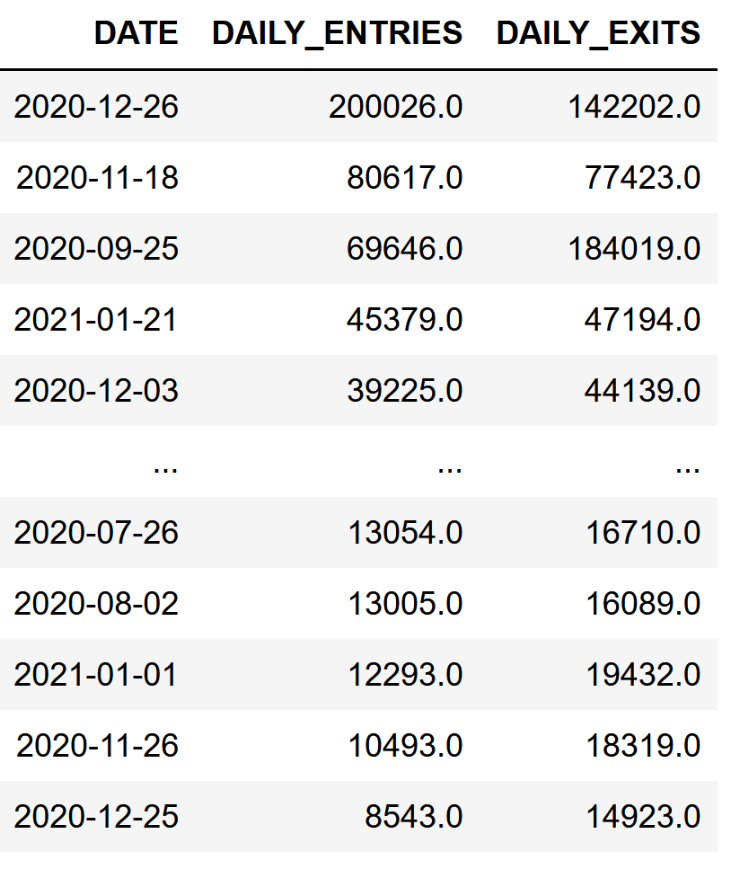
Penn Station
Day after Christmas
Top 5 and Bottom 5 daily Entries
Public holidays celebrated
in NY include:
Labor Day Mon, Sep 7, 2020
Columbus Day Mon, Oct 12, 2020
Veterans Day Wed, Nov 11, 2020
Thanksgiving Thu, Nov 26, 2020
Christmas Day Fri, Dec 25, 2020
New Year's Day Fri, Jan 1, 2021
MLK Jr. Day Mon, Jan 18, 2021
Announcement of public school shutdown due to 3% Covid test positivity rate
Error in Data Entry?
(further investigation needed)
3 Days After MLK (work/school starts to pick up)
Lowest Traffic:
Summer
New Years Day
Thanksgiving
Christmas

Slide 8
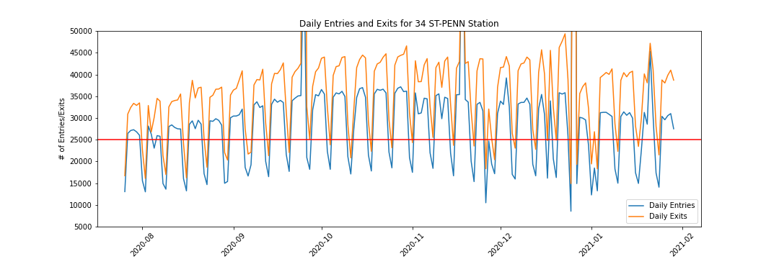
Penn Station: General Trend
Low Traffic in July and August (end of summer)
High Traffic in October and November (fall)
Medium Traffic in January

Slide 9
Recommendations:
Target the top 10 busiest station by Entries and Exits
Ad space near Exits are more valuable than those near Entries
Advertise more during Weekdays especially near Exits for Penn Station
Day after Christmas is the best day to advertise
Keep on eye on NYC Covid policies and deploy human street teams when shutdowns are announced (e.g. 3% covid test positivity rate)
Do not advertise on Thanksgiving, Christmas, and New Years day.

