Slide 1
NBA Home Team Game Outcome Classification
Jay Kwon
Metis Data Science and Engineering (flex program)
Module 4 – Classification
March 23, 2022

Slide 2
Goal:
Use classification models to predict whether the home team wins upcoming NBA games. home team wins = positive outcome = 1
1. Assess the models and optimize best model for precision
2. Interpret model – most important features; can this model be used to turn a profit by wagering on the games?
Background and Motivation:
Sports Betting: can potentially turn a profit by wagering on the outcomes of NBA games
must consistently beat the odds that the oddsmakers lay
insights gained would be beneficial to anyone interested in NBA, sports betting, making money

Slide 3
evaluation metrics
1st -- Precision:
only concerned when we actually place wagers
False Positives = lose money
True Positives = make money
maximize precision = minimize FP and maximize TP
2nd -- Recall:
must make enough wagers in a reasonable timeframe
- weather variance of binomial distribution to reduce risk-of-ruin (losing everything)
- bet sizes must be small enough relative to capital to make enough wagers
Soft Predictions:
probabilities may be used as proxy for expected value (EV) calculations
given the probability and payouts is the EV positive?
if positive bet on home team winning; else do not bet on the game

Slide 4
Dataset
Raw data with historical game outcomes and statistics: https://www.kaggle.com/nathanlauga/nba-games?select=games.csv
rolling previous 10 game averages were obtained for each game
24526 rows and 26 features (all quantitative)
time period: Oct, 2003 – Nov, 2021 (18.5 NBA seasons)
Home team advantage
- empirical probability of home team winning 59% of the time
- not a big class imbalance
Tools used:
Sklearn, Pandas, Matplotlib, Seaborn

Slide 5
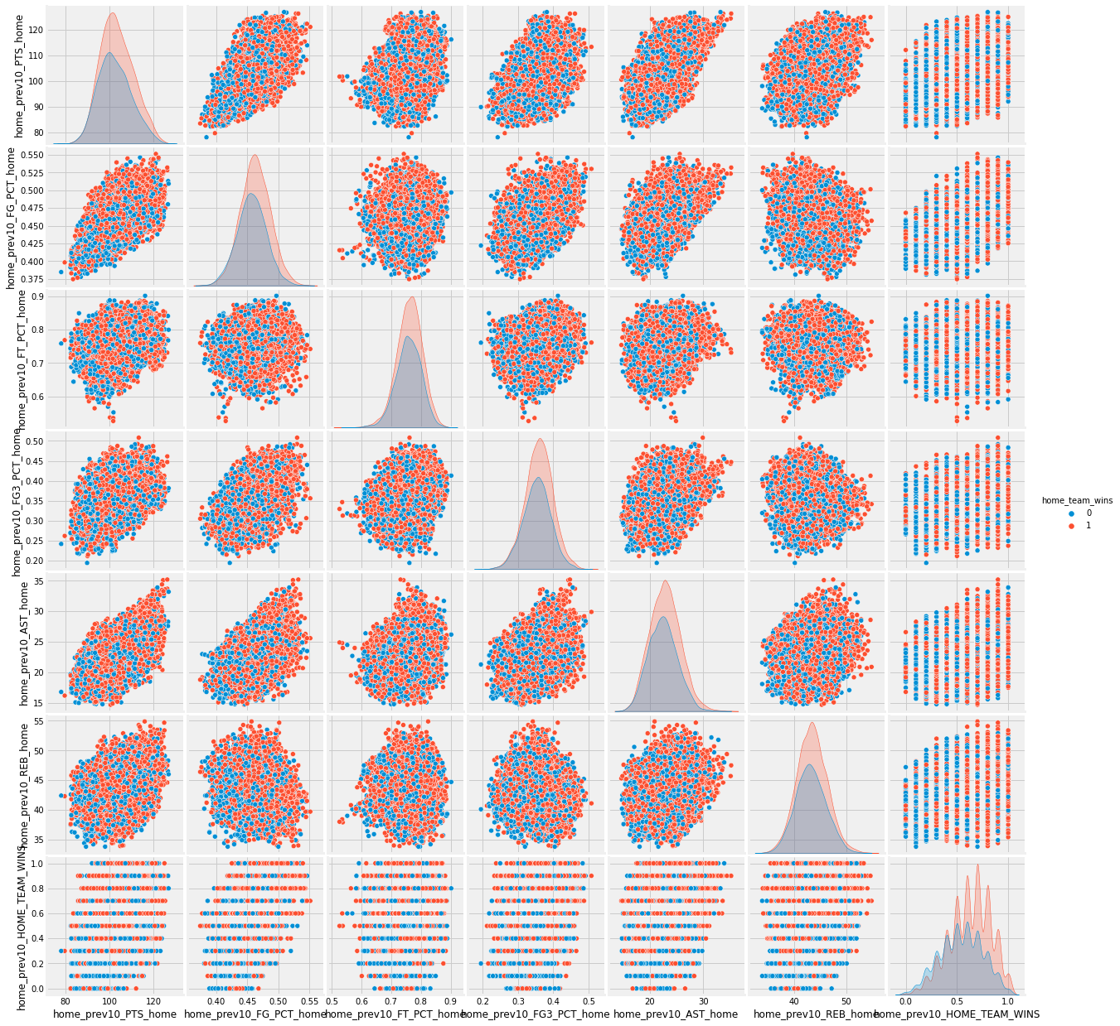
Pairplot of select features
- Home team’s previous 10 home game average statistics not too promising as classification features
previous 10 game win-rate
looks promising
separation of 0 vs 1 distributions

Slide 6
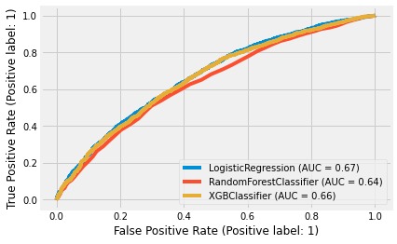
Classification Model Evaluation
Test Accuracies:
- Logistic Regression: 0.65
- Random Forest: 0.63
- Grad Boosted Trees: 0.64
* empirical probability: 0.59
ROC AUC curves
Precision:
- Logistic Regression: 0.67
- Random Forest: 0.66
Grad Boosted Trees: 0.66
* 0.5 threshold

Slide 7
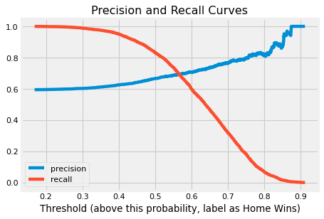
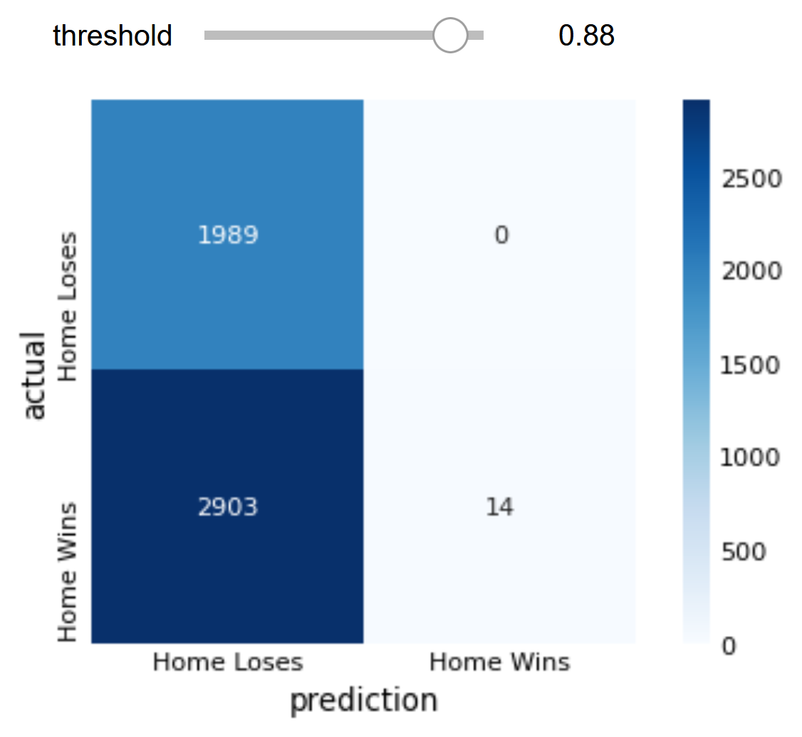
Maximizing precision for Log-reg
t
Confusion Matrix (th = 0.88)
100% precision when th = 0.88
only 14 games out of 24,000+
need higher recall
higher threshold:
higher precision but lower recall

Slide 8
Practical Application: wagering on NBA games
Breakeven Odds at 88% precision:
Expected Value = (win prob x (payout – wager)) – (lose prob x wager)
let’s say we wager $100
use soft probability threshold as proxy for real game outcome probabilities
when EV = 0, we breakeven
EV = 0 = 0.88 x (payout – wager) – 0.12 x $100
(payout – wager) = $13.63 ← breakeven point: must be laid 0.136 to 1 ; -733.68 in sports betting terms
For every $100 wagered, we must be offered a profit > $13.63 for our model to be profitable (positive EV, “beat the odds”)
Practical Problem of Time – Low Recall:
over 18.5 years, we found 14 games that had 88%+ chance of the home team winning
to decrease the probability of going broke (tail risk) we must make enough wagers to endure variance
in order to make many smaller wagers, we need more games to bet on (increase recall)

Slide 9
Conclusions and Future Projects
Conclusions:
profitable scenarios exist for deploying our model successfully
trying different ML techniques and tinkering with the hyperparameters led to similar performances
need more features with better predictive power to increase F1 score
previous 10-game win-rate is a good predictive feature
Future Projects:
find more features: injury data, offensive and defensive rankings, player specific data
obtain historic data for sports wagering odds
calculate EV for each prediction and adjust threshold and bet sizes to find profitable strategies

