Slide 1
Financial news topic Modeling and recommender
Jay Kwon
Metis Data Science and Engineering (flex program)
Module 5 – Unsupervised Learning and NLP
May 18, 2022

Slide 2
Goal:
1. Define Topics for Financial News Articles
2. Build a recommender for any given article
Motivation:
people in finance must pay close attention to the financial news
ability to categorize articles base on topics would be useful
ability to pull up similar articles
distribution of articles over topics is insightful
investors (individuals, wealth management firms, hedge funds, pension funds)
financial news (Bloomberg, CNBC, Wall Street Journal)
ratings agencies (S&P, Moody’s, Fitch)
financial services

Slide 3
Data and Method
Data:
https://www.kaggle.com/datasets/jeet2016/us-financial-news-articles?datasetId=49948
US News articles: Bloomberg.com, CNBC.com, reuters.com, wsj.com, and fortune.com
Jan to May, 2018
111747 documents
Method:
- preprocessing included lemmatization and filtering to nouns
- LDA used to define 20 topics
- cosine similarity for recommender
Tools used:
spaCy, nltk, sklearn (LDA), Pandas, Matplotlib

Slide 4
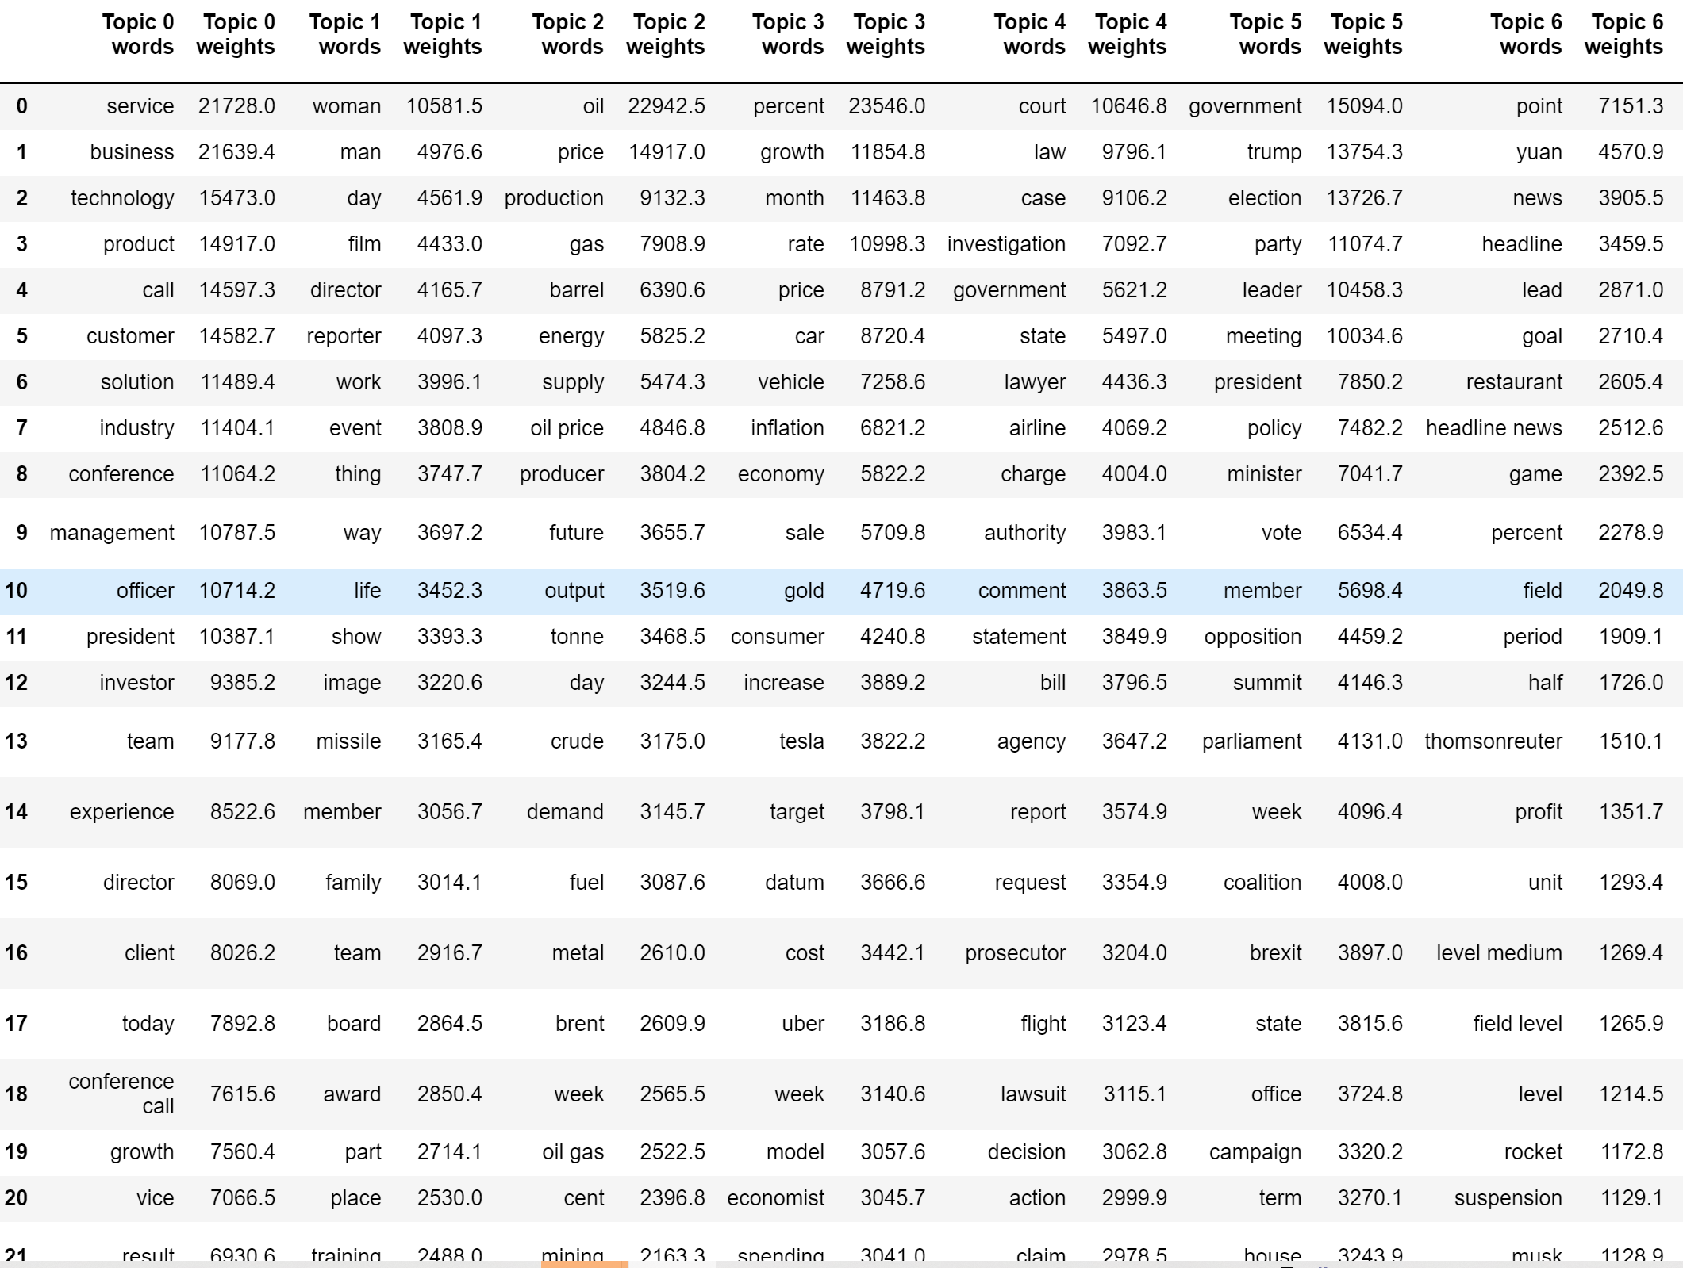
Top Words for Topics 0~6
0: Management (Tech)
2: Oil
4: Lawsuits
5: US Government

Slide 5
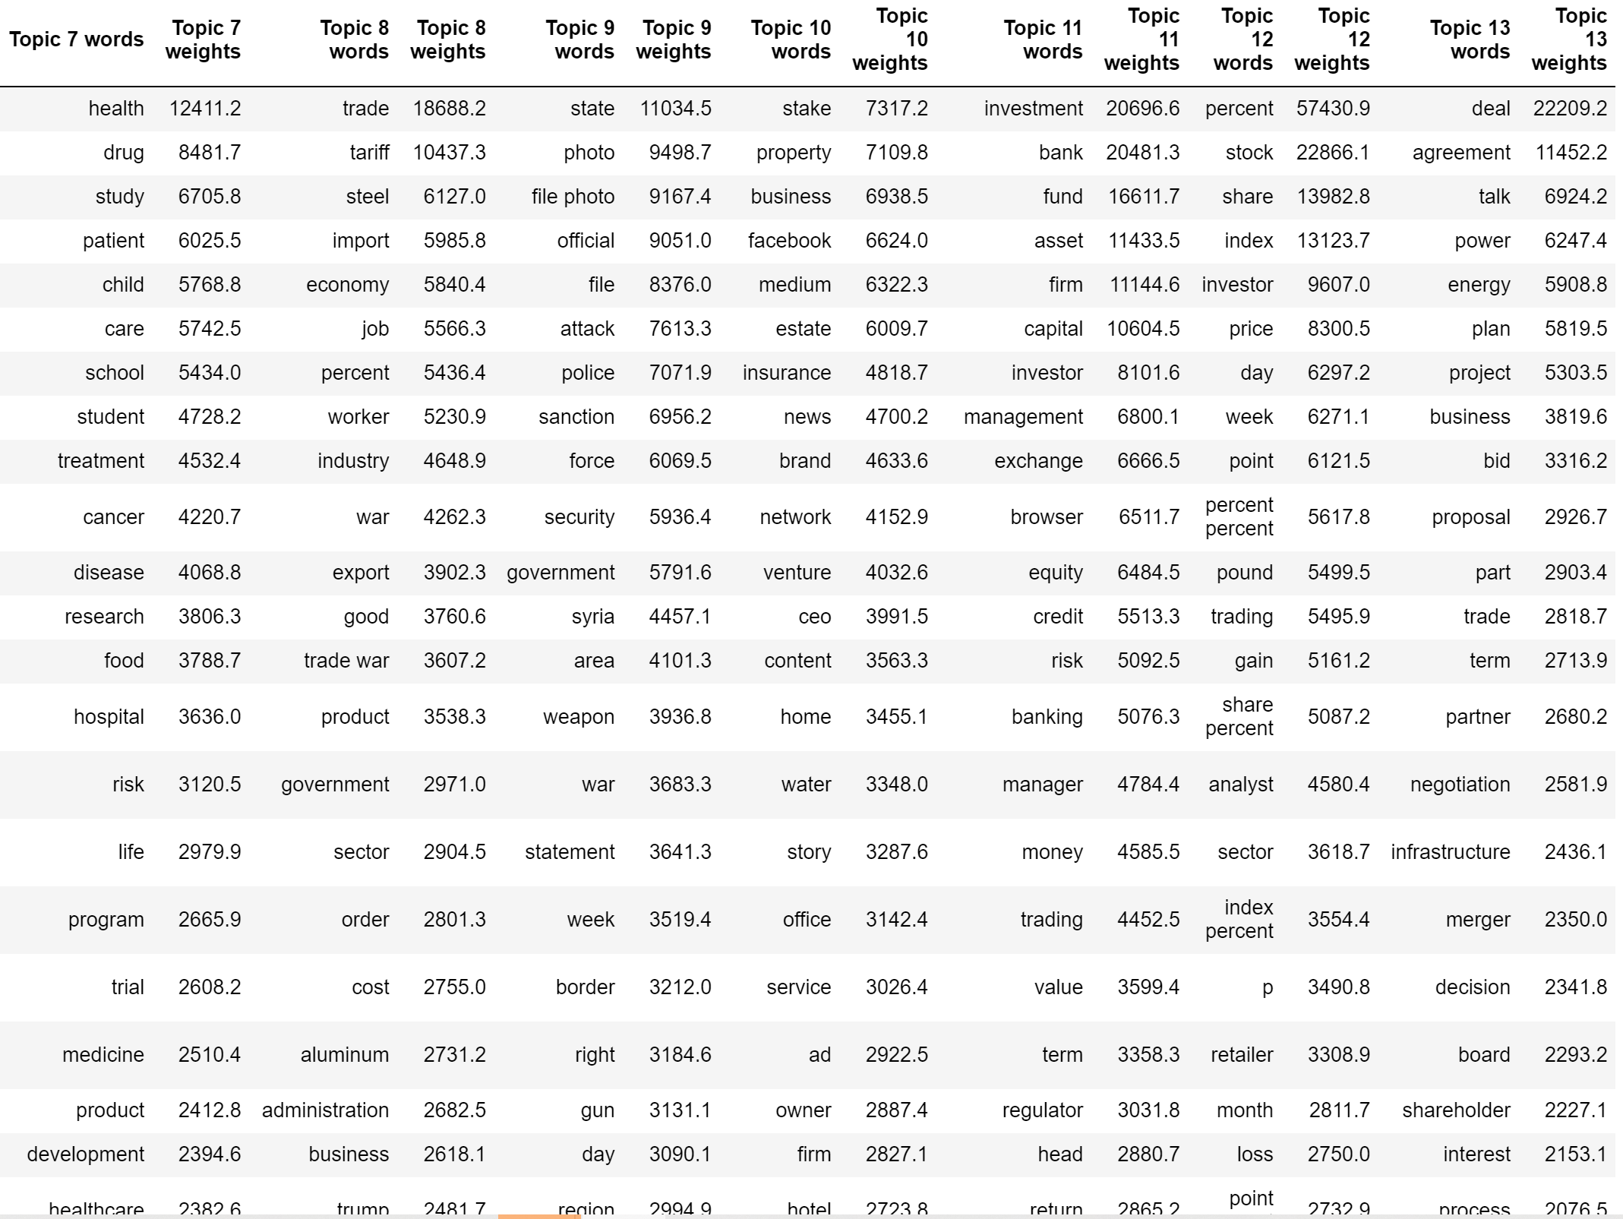
Top Words for Topics 7~13
7: Health
8: Trade (export/import)
11: Investment Management

Slide 6
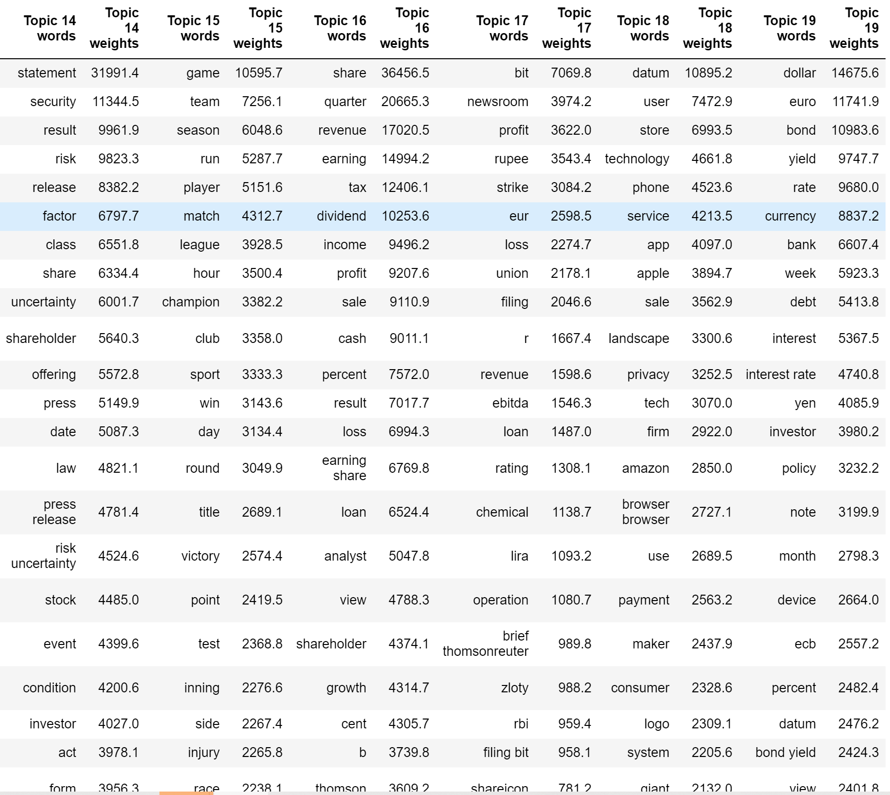
Top Words for Topics 14~19
15: Sports
16: Business performance (financial statement metrics)
Topic 18: Tech
Topic 19: Currency and Rates

Slide 7
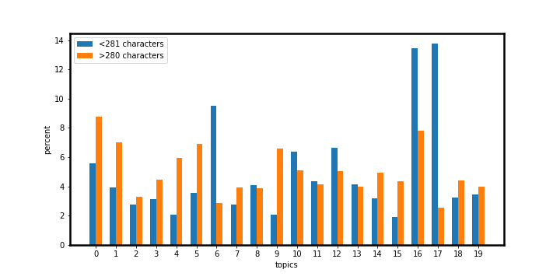
Topic Distribution by Character Count
4: Lawsuits
5: US Government
6: ?
15: Sports
16: Business performance
17: ?

Slide 8
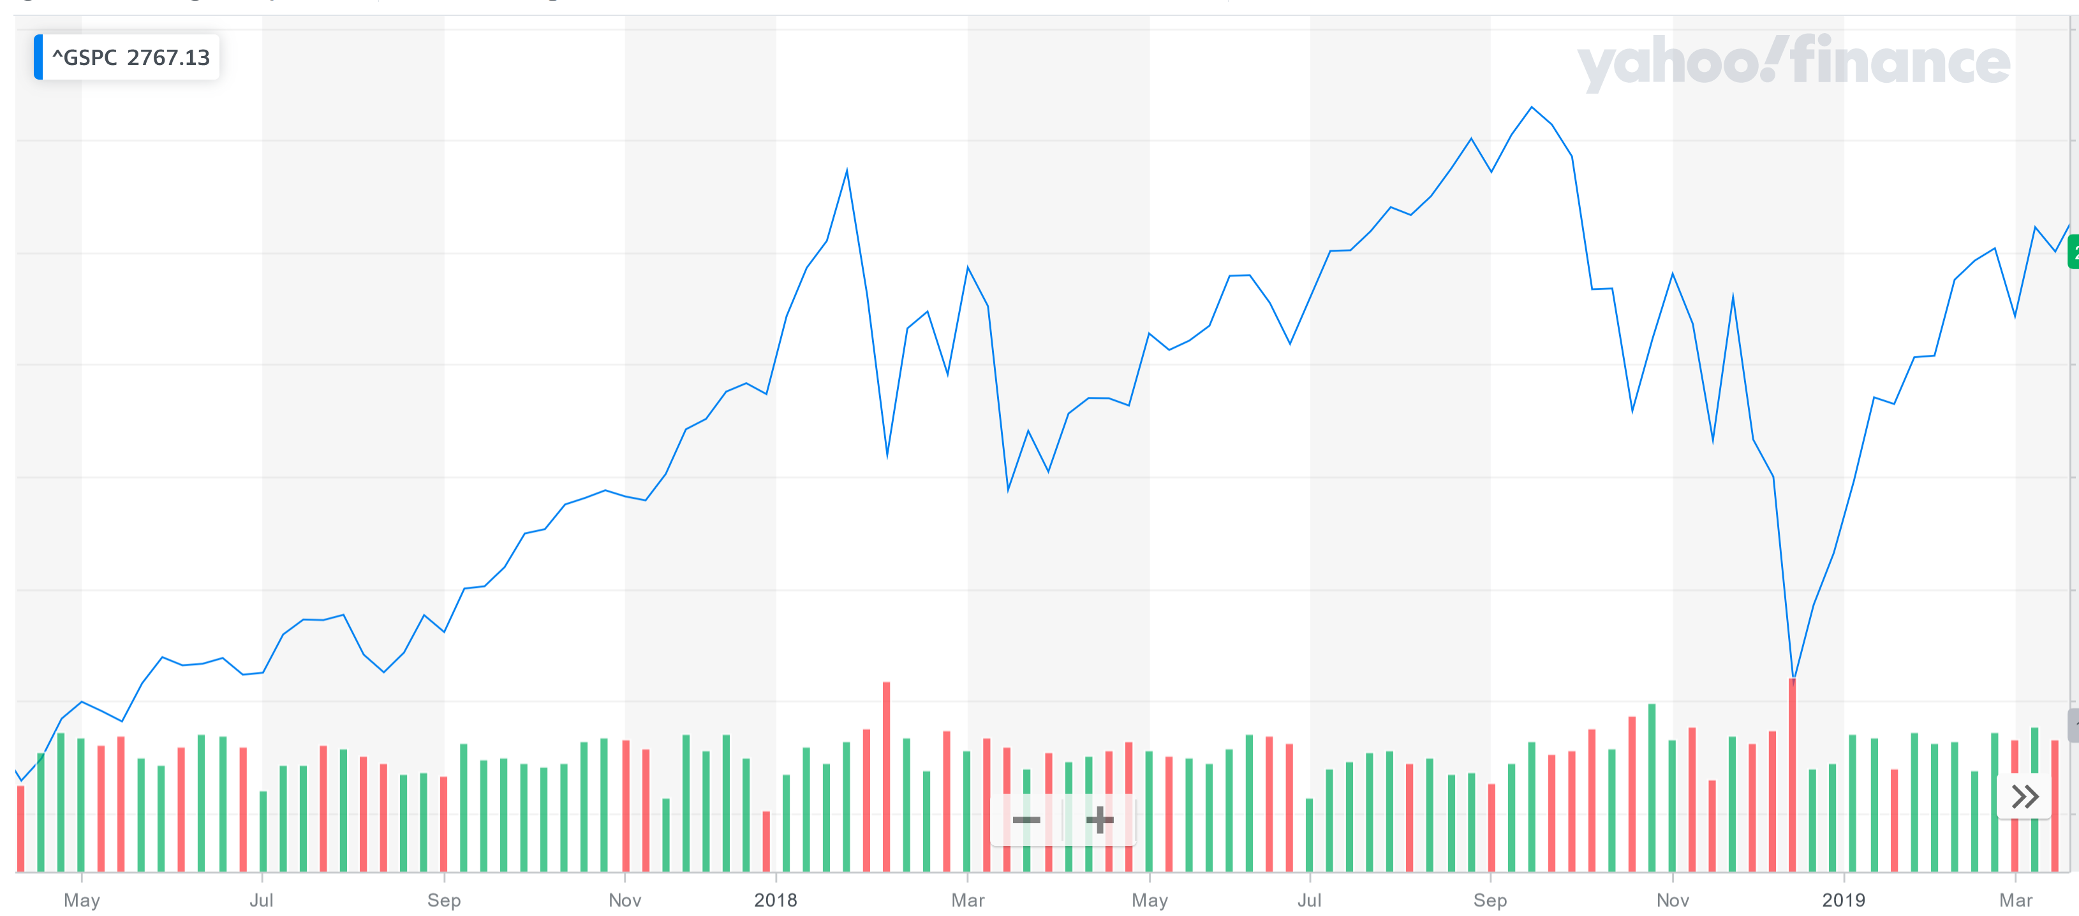
SP500
* sell-off in early Feb, 2018

Slide 9
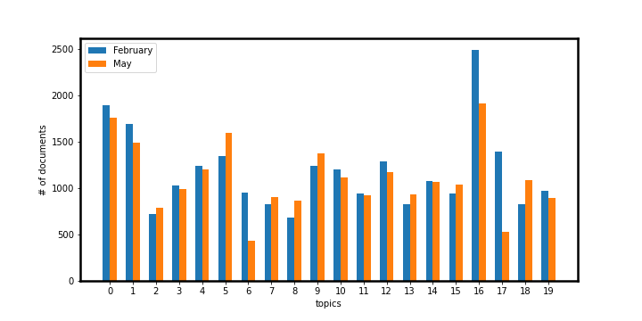
Topic Distribution by Month: February vs May
6: ?
16: Business performance
17: ?

Slide 10
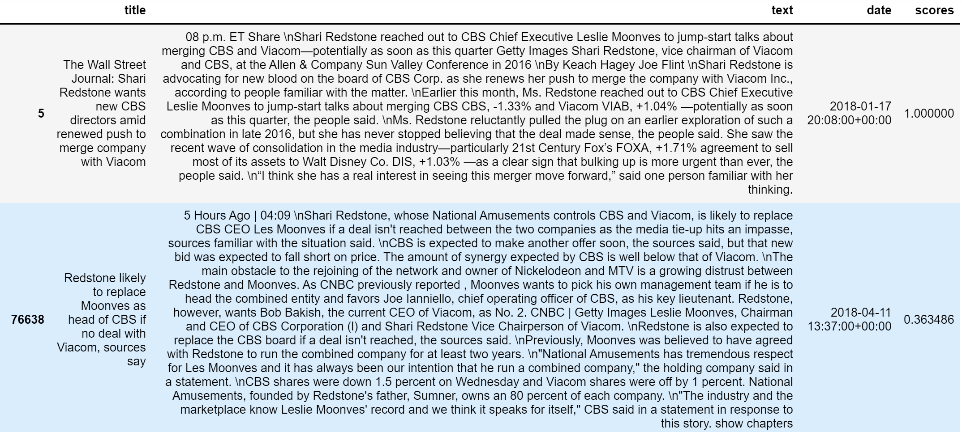
Recommender
original article
top recommendation

Slide 11
Conclusions and Future Projects
Conclusions:
LDA modeling resulted in some clearly defined topics
Readers can pull up articles based on topics
Readers can use recommender to display similar articles
some insights gained based on segmentation of data
Future Projects:
Try increasing number of topics for better resolution
Sentiment analysis

Slide 12
Supplemental

Slide 13
Supplemental

Slide 14
Supplemental

Slide 15
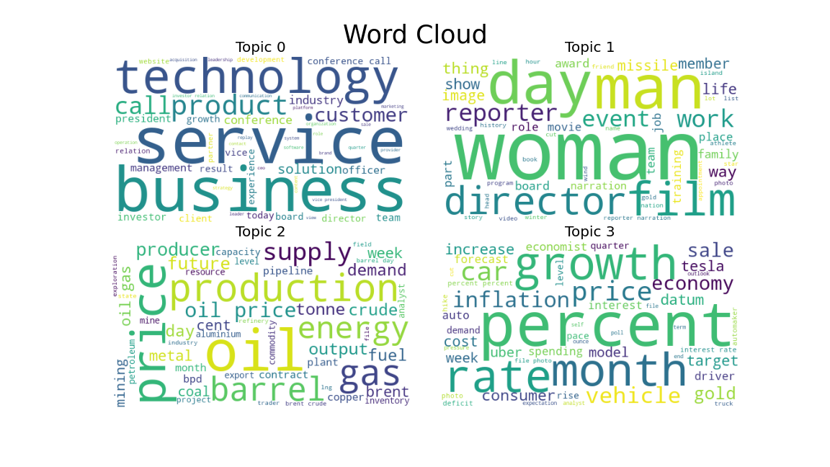
Supplemental

