Slide 1
MAGICAL: Toward Fully Automated Analog IC Layout Leveraging Human and Machine Intelligence
Biying Xu, Keren Zhu, Mingjie Liu, Yibo Lin, Shaolan Li, Xiyuan Tang, Nan Sun, and David Z. Pan
Dept. of Electrical and Computer Engineering
The University of Texas at Austin
https://www.cerc.utexas.edu/utda/
Notes:
‹#›

Slide 2
Outline
Introduction and MAGICAL Overview
MAGICAL Components
Parametric Device Generation
Analog Layout Constraint Extraction
Analog Placement
Analog Routing
MAGICAL Experimental Results
Conclusion

Slide 3





Introduction
High demand of analog/mixed-signal IC in emerging applications
Internet of Things (IOT), autonomous and electric vehicles, communication and 5G networks…
Communication
Sources: IBM
Advanced computing
Healthcare
Notes:
The advancement in communication technology, sensors, computing and healthcare is fostering an unprecedented scale of internet of things in the coming years. It is forecast by major industry players that by the mid-21st century more than hundreds of billions, or possibly trillion of devices will be connected to the internet. This devices can be whatever in our daily life… but whatever they are, they all need to fulfill two key functions, that is sensing and communicating. To support such large scale of interfacing between the real world and machines, mixed-signal circuit, such as data converters or sensor readout circuit, will be a key ingredient for our next generation electronics.
%%And, there will be a diverse application spectrum creating different feature emphases for the future mixed-signal design. For example, in the scenario of 5G communication, some designs will push for long-term reliability in order to support the massive scale machine communication in a smart city, while others will pursue ultra-high speed to support future handset.

Slide 4
Introduction
Analog IC layout design still heavily manual
Cf. digital IC layout automation
Very tedious and error-prone
Modern SoCs: 20% or less analog, but maybe over 80% design time
Follow complex design rules in advanced tech nodes
Mitigate parasitic, noise, and layout-dependent effects
Handle manufacturability, reliability and yield issues
Notes:
A majority of the AMS IC layout efforts are still handled manually, which is time consuming and error prone.
Relies heavily on the use of high gain op-amps to guarantee precision and linearity.
Prior work is not end to end

Slide 5
Prior Art of Analog Layout
Placement: [Lampaert+, JSSC’95], [Strasser+, ICCAD’08], [Lin+, TCAD’09], [Ma+, TCAD’11], [Wu+, ICCAD’12], [Lin+, TCAD’16]
Routing: [Ozdal+, ICCAD’12], [Ou+, DAC’13], [Ou+, TCAD’16]
Constraint extraction: [Malavasi+, TCAD’99], [Massier+, TCAD’08]
Flows/Tools:
Approaches | Optimization-based | Template-based | Standard cell-based
Prior Art | ILAC, LAYLA, KOAN/ANAGRAM II, Malavasi+, GELSA, Strasser+ | IPRAIL, ALG, Zhang+, Liu+, LAYGEN, LAYGEN II | Waters+, Weaver+, Deng+, Liu+
Pros | (+) Flexible (+) Optimize towards different objectives | (+) Runs fast (+) Suitable to layout retargeting | (+) Leverages digital APR tools (+) Runs fast
Cons | (-) Usually runs slow | (-) Lack of flexibility | (-) Requires new circuit design (-) Performance still not in line with state-of-the-art

Slide 6
Limitations of Prior Art and Our Goal
Why previously works are not widely used in industry
Only capture limited design intents
Efficiency and scalability issues
Limited capability to transfer to different technology nodes
Not easily accessible for trial and use
Our Goal to address the DARPA IDEA mission
End-to-end analog layout automation, leveraging recent AI and machine learning advancement
🡺 Machine-generated analog IC layout (MAGICAL) system
Notes:
A lot of previous layout tools used SA and evolutionary algorithms.

Slide 7
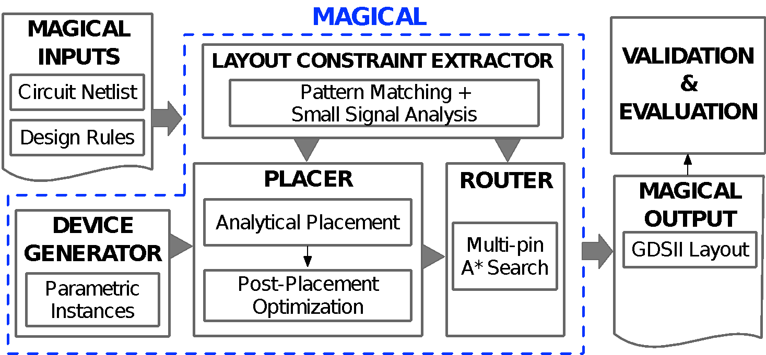
MAGICAL Layout System Framework
Input: unannotated netlist
Output: GDSII Layout
Key Components:
Device Generation
Constraint Extraction
Analog Placement
Analog Routing
Fully-automated (no-human-in-the-loop)
Guided by analytical, heuristic, and machine learning algorithms
Obtained promising initial results
Open-sourced on GitHub: https://github.com/magical-eda/MAGICAL
Notes:
Disclaimer: still very early on in the project. A bit over months. Prototype.
40nm TSMC at this time.

Slide 8
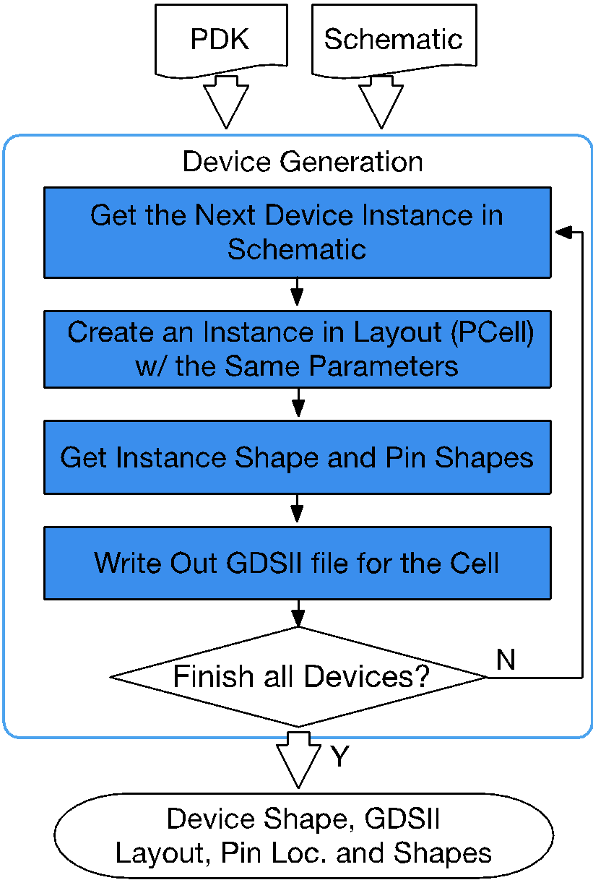
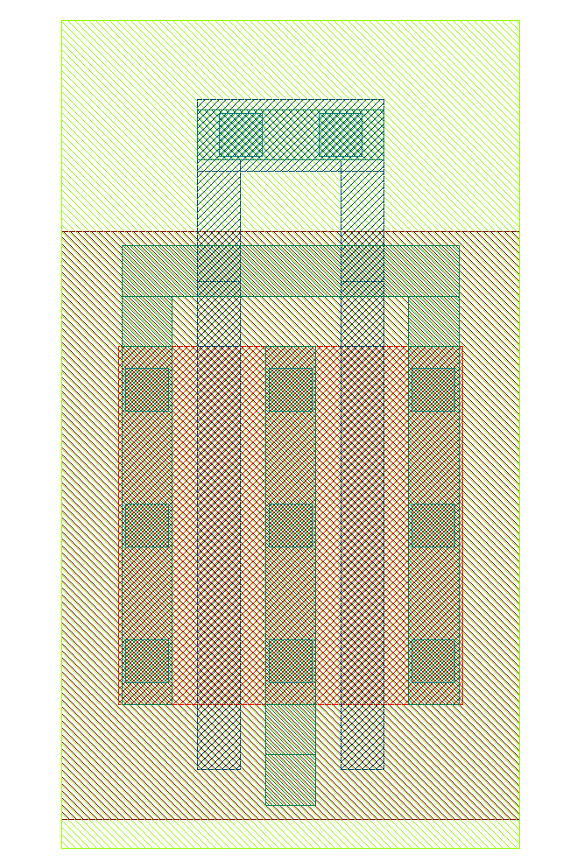
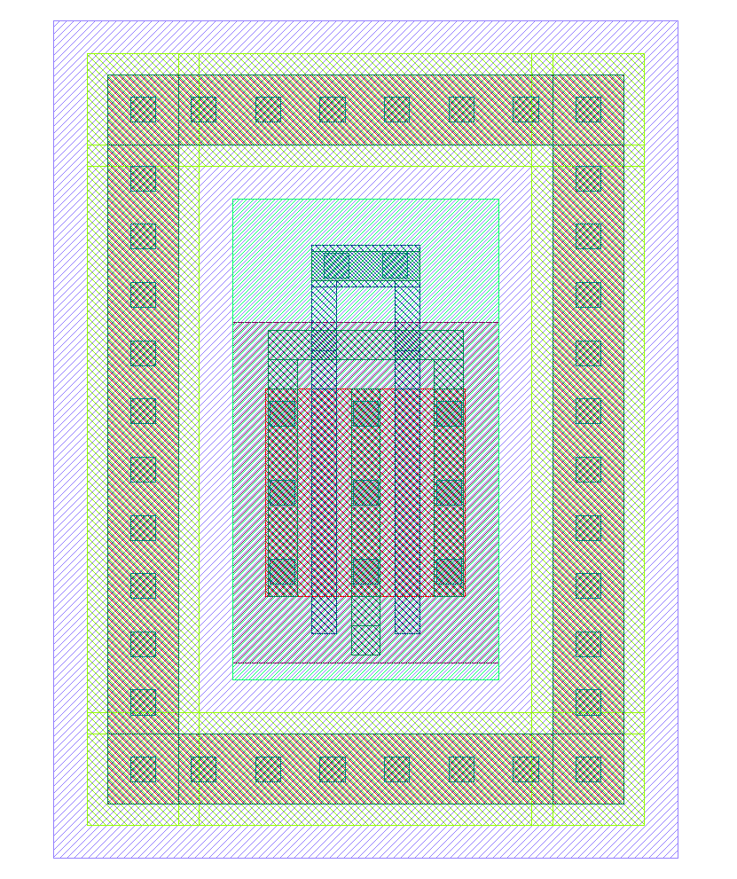
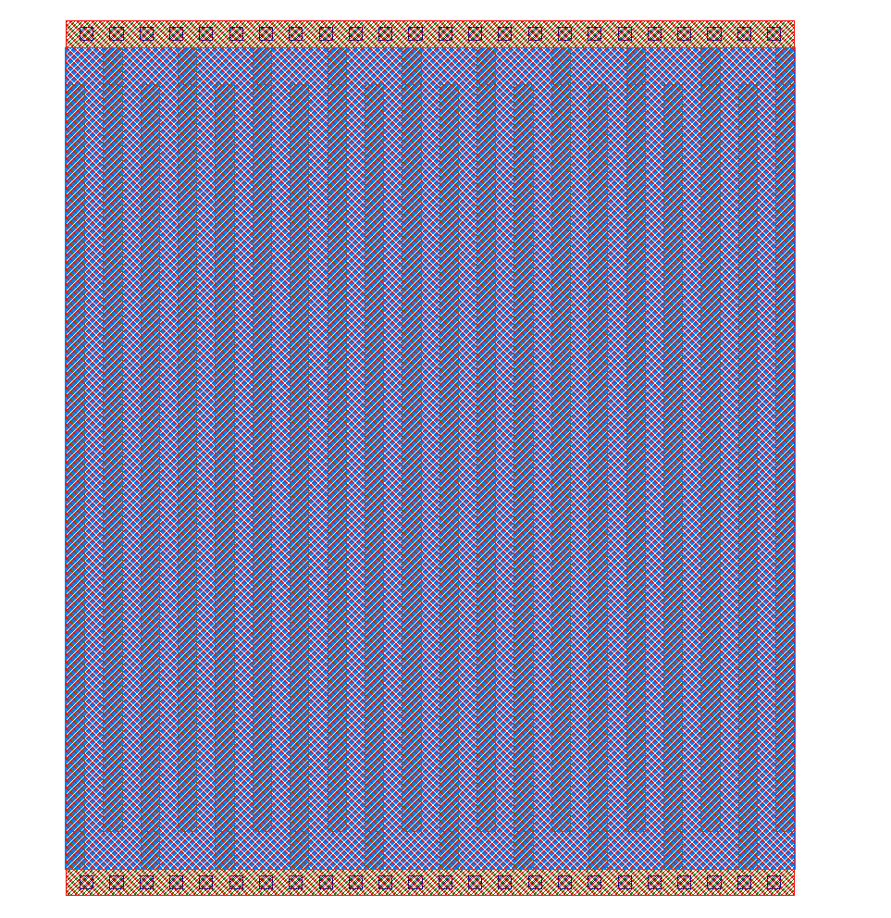
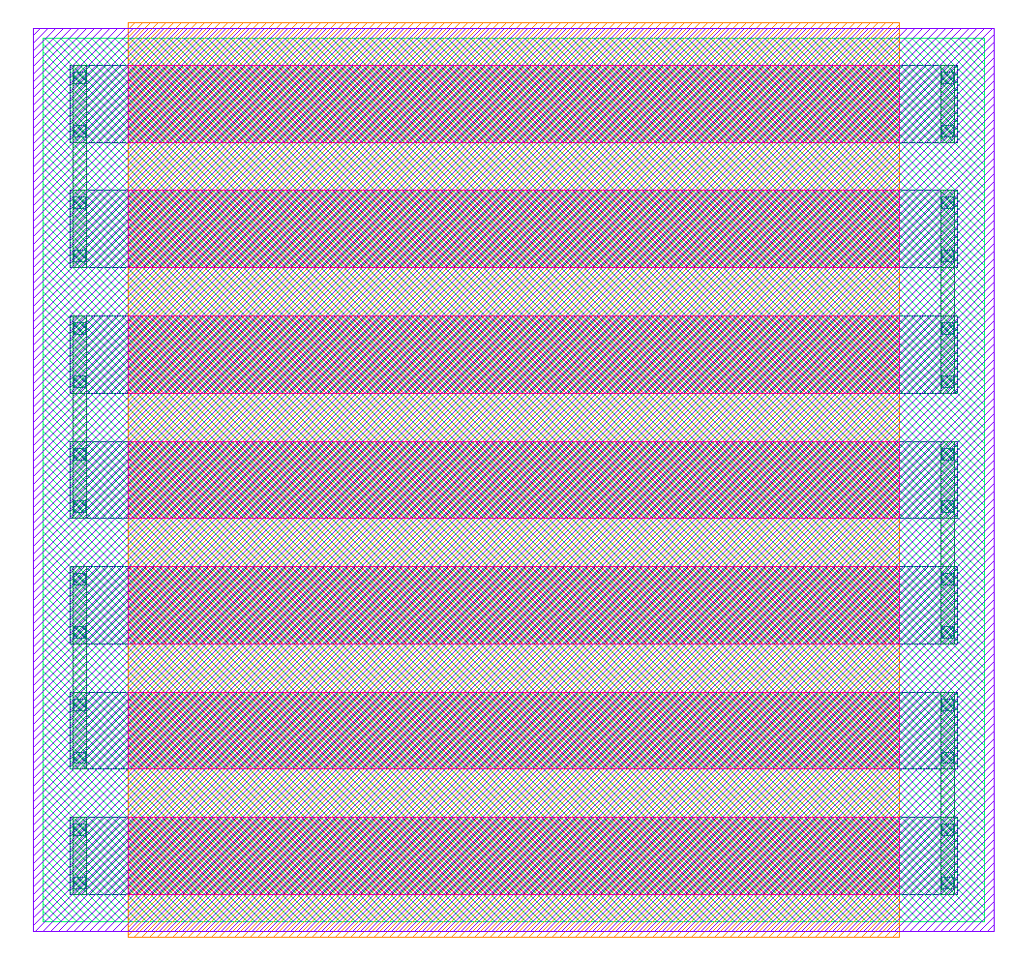
Parametric Device Generation
Inputs: circuit netlist, design rules
Outputs: device GDSII layout, bounding box, pins, etc.
Developed parametric device generation kernel in Python
Correct by construction:
DRC and LVS cleaned
NMOS
PMOS w/ guard ring
MOM capacitor
Poly resistor

Slide 9
Analog Layout Constraint Extraction
Input:
Unannotated circuit netlist (spice/spectre)
Outputs:
Symmetric constraints for placement and routing, including symmetric device groups and symmetric nets
Methods:
Graph abstraction
Seed pattern detection based on pattern matching
Graph traversal based on small signal flow analysis
Constraints post-processing

Slide 10
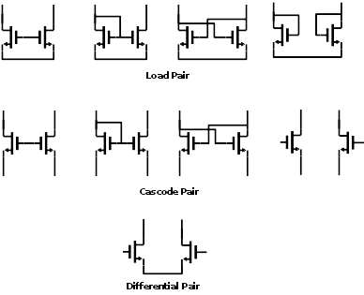
Analog Layout Constraint Extraction
Graph abstraction of the circuit netlist
Abstract circuit netlist into graph representation
Represent devices, pins, and nets as nodes
Constraint extraction is performed based on the graph representation
Seed pattern detection
Transistor pairs from pattern library as seed patterns (start/end points for graph traversal)
Pair-wise pattern matching instead of expensive graph isomorphism algorithms
Ambiguity resolving for mixed-signal circuits
Sample Pattern Library

Slide 11
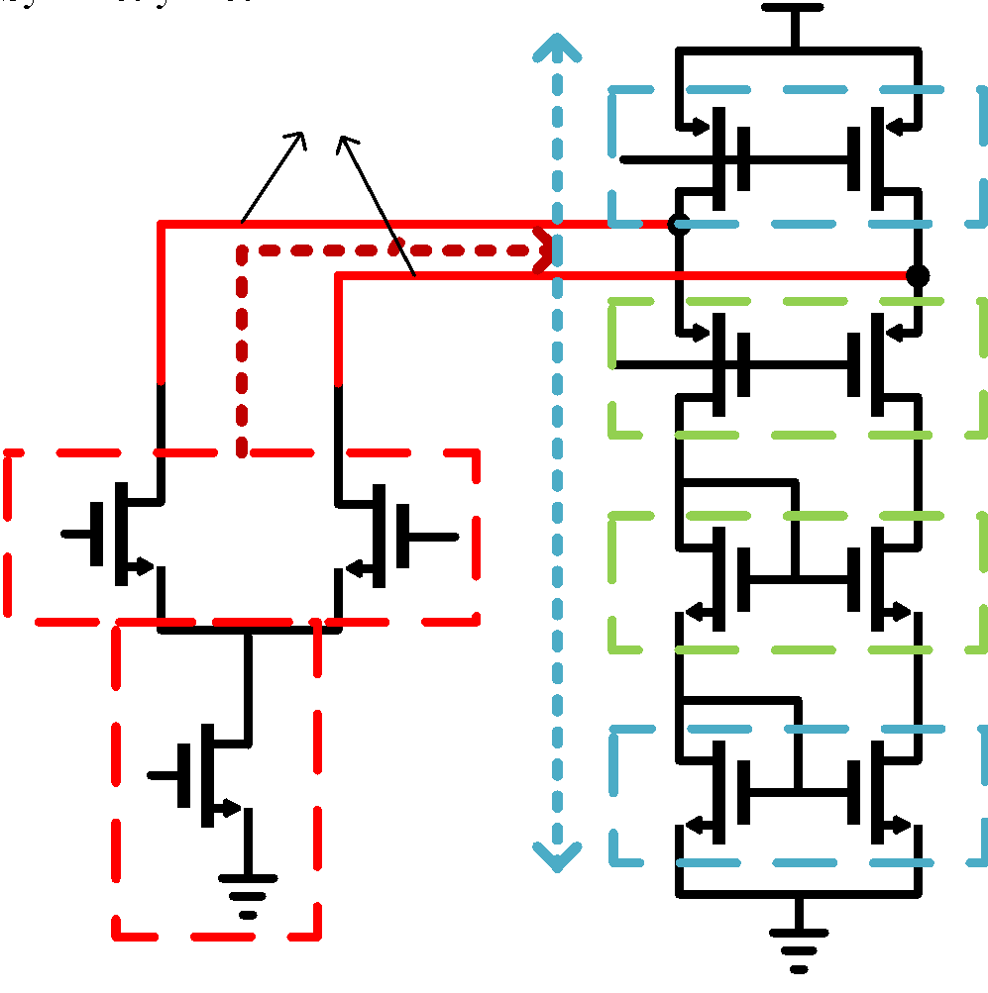
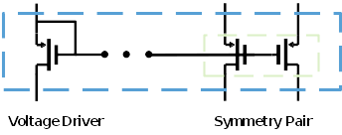
Analog Layout Constraint Extraction
Signal flow based graph traversal
Analogous to following the differential current in small-signal analysis
Start from seed patterns, and ends when the flow paths meet at seed patterns
Visited subgraph from the same seed pattern form a symmetric group and symmetric nets
Also consider matching between passive devices
Constraints post-processing
Identify additional self-symmetric nets and bias circuit symmetry
Constraints pruning to allow a device to be in at most one symmetry constraint for placement feasibility
Small Signal Analysis
Bias Circuit Symmetry Detection

Slide 12
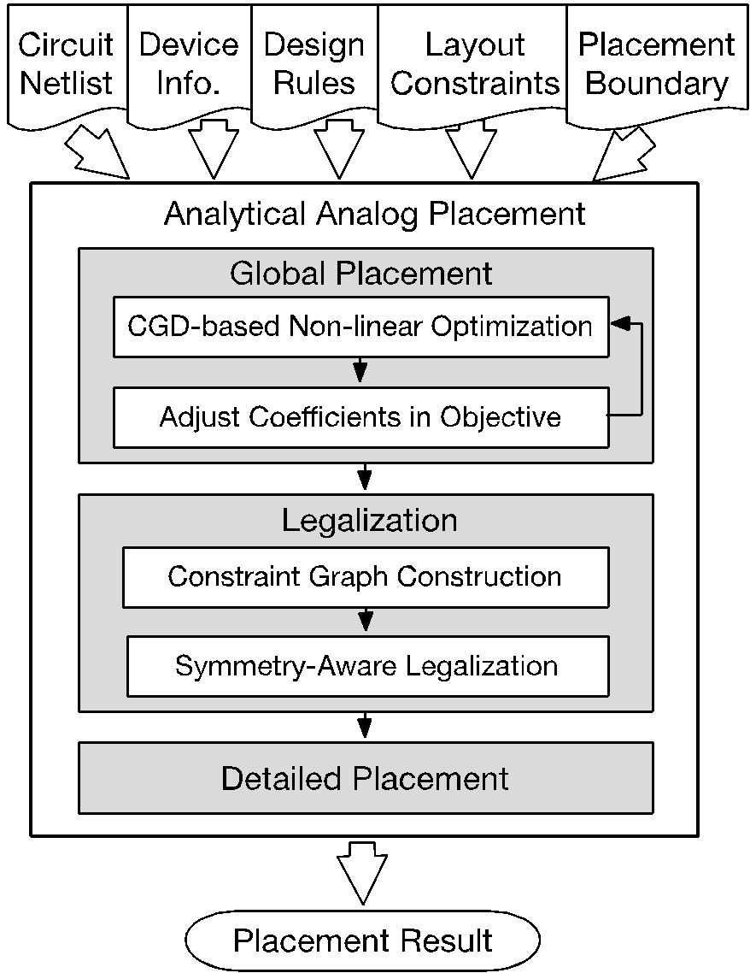
Analog Placement
Input:
Circuit netlist
Device information
Design rules
Layout constraints…
Output: a legal placement solution
Constraints:
Symmetric device groups share a common symmetric axis in the placement
Objectives:
Area, wirelength, …

Slide 13
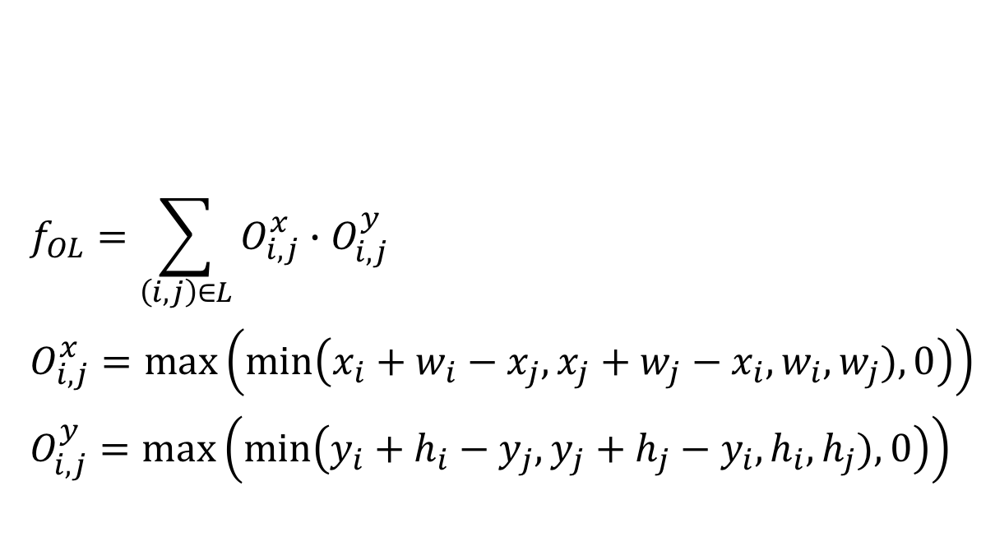
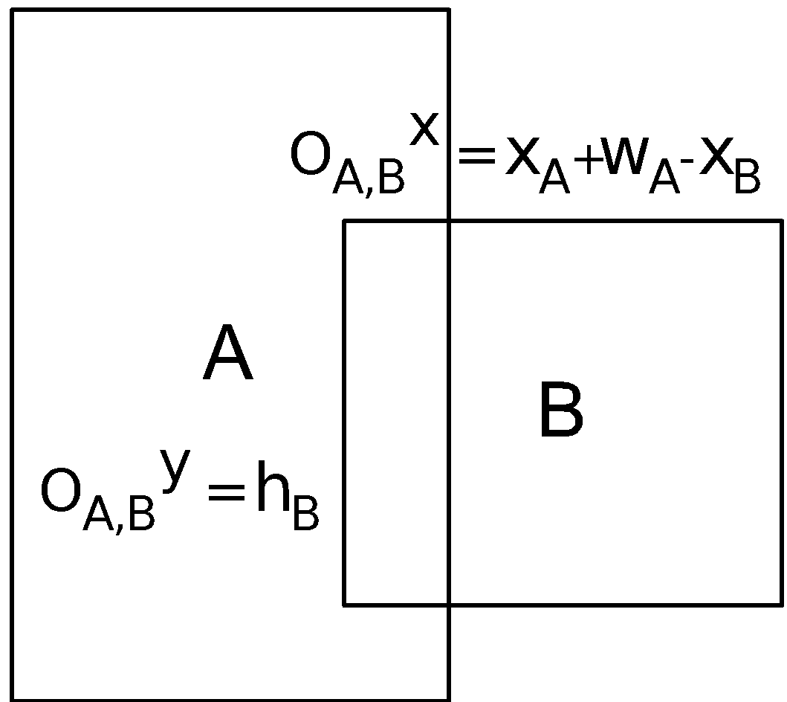
Analytical Global Placement
We relax the constraints into penalties in the objective, and transform the problem into an unconstrained nonlinear optimization problem
Objective:
Wirelength term (half-perimeter wirelength):
Overlap penalty:

Slide 14
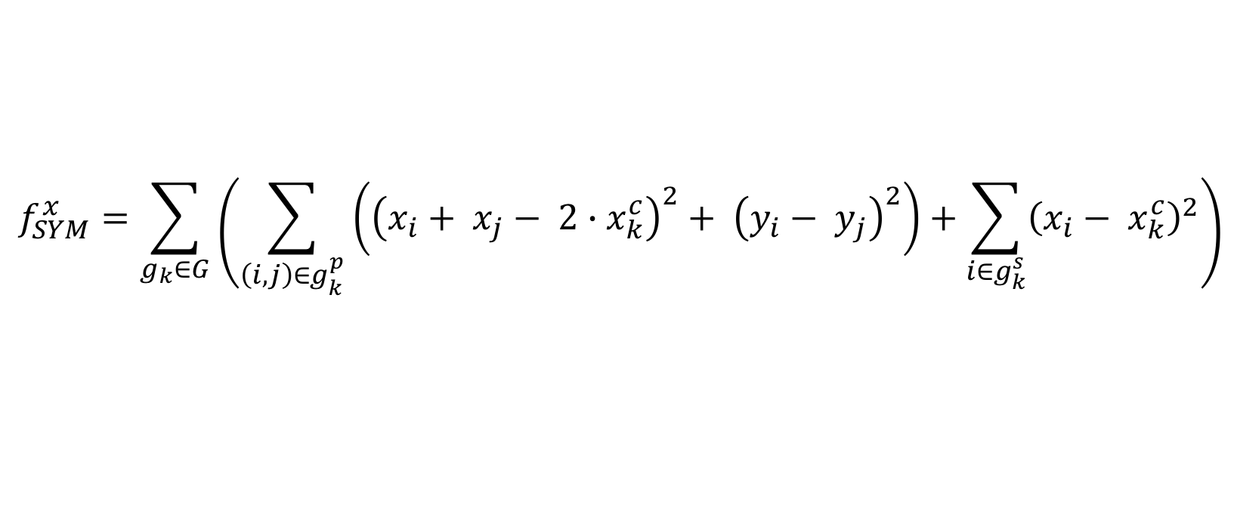
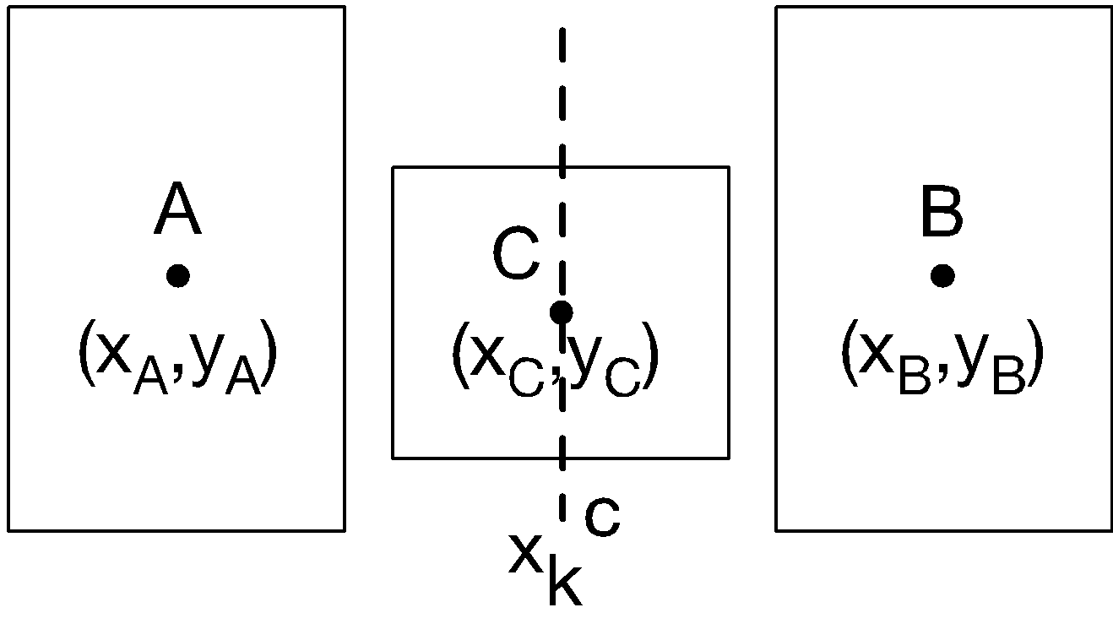
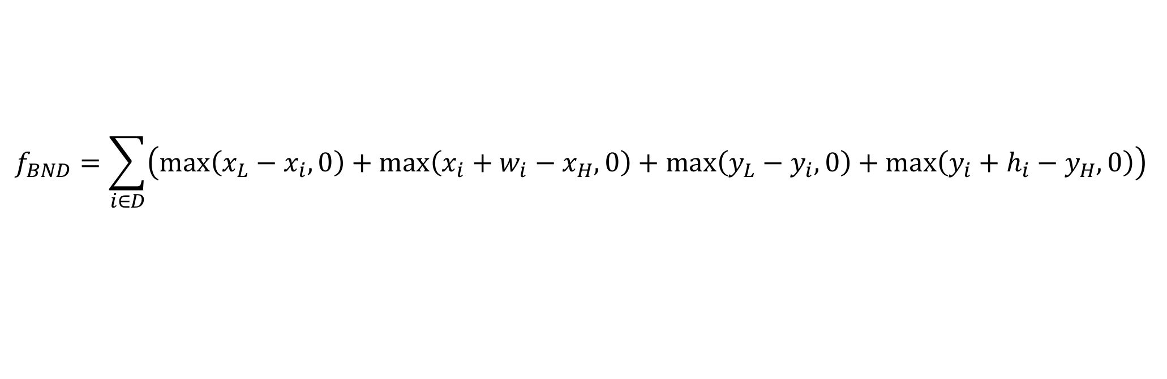
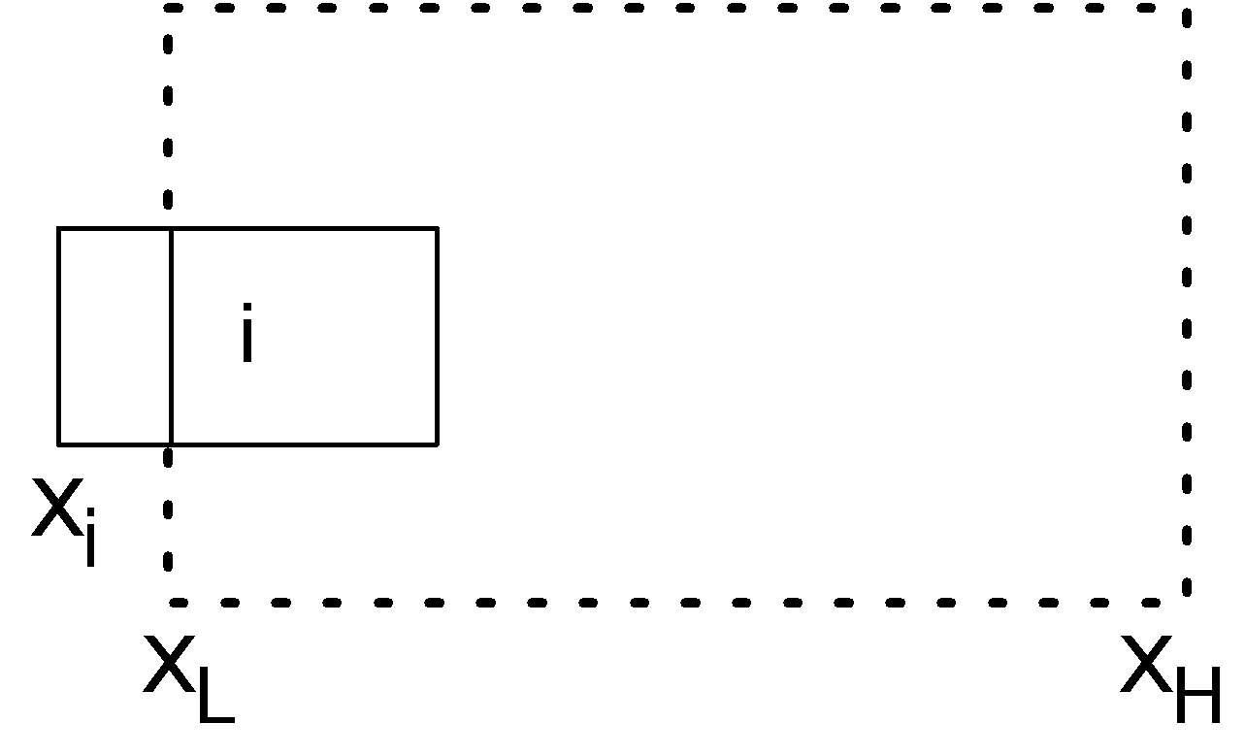
Analytical Global Placement
Asymmetry penalty:
Out of boundary penalty:

Slide 15
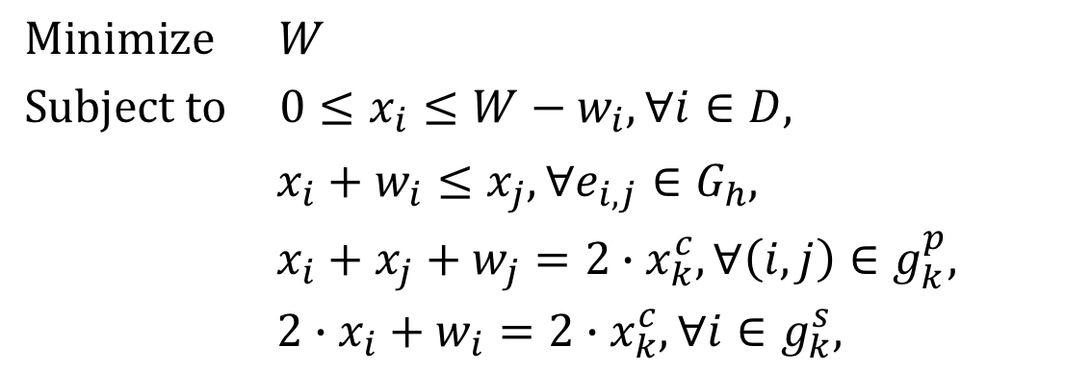

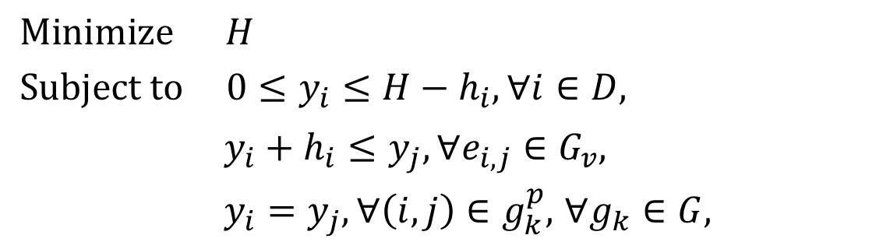
Legalization by Linear Programming
Linear programming (LP) based legalization according to the constraint graphs to minimize area and satisfy constraints
Decomposed into x- and y- direction sub-problems and solved independently
Boundary constraints
Topology order constraints
Symmetry constraints
Boundary constraints
Topology order constraints
Symmetry constraints

Slide 16
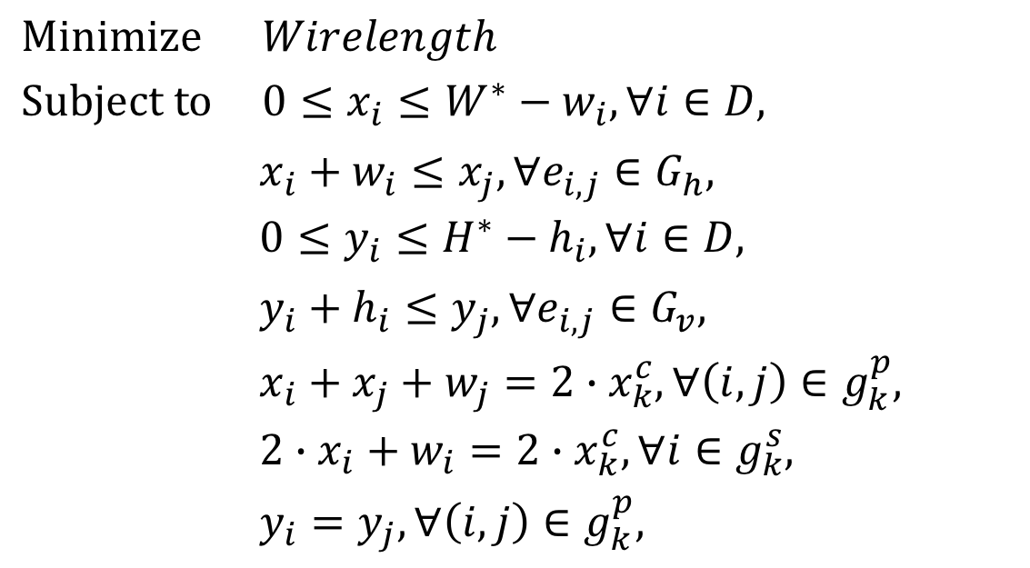

Detailed Placement
LP-based wirelength refinement and design rules handling
Fixed boundary and topology order constraints
Symmetry constraints
Notes:
Wirelength now is the exact wirelength.

Slide 17
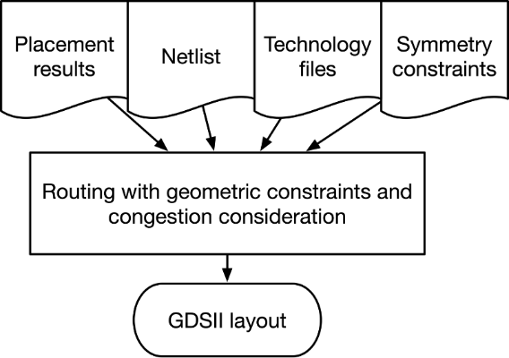
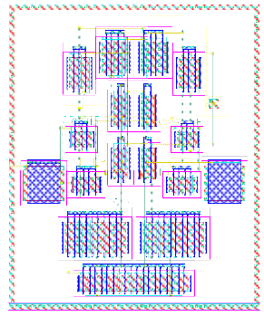
Analog Routing
Inputs:
Routing constraints
Placement results
Design rules (from PDK)
Output:
LVS cleaned GDSII layout
Methods:
A* search based global and detailed routing with geometric constraints

Slide 18
Global Routing
Symmetry-aware grid-based A* search routing engine
First divide the placement into uniform grids
Calculate routing capacity on 2D grid edges
Analog layout pins could be polygons varied in size and shape, which are decomposed into searching points in the path search scheme
Split multi-pin net into two-pin nets based on minimum spanning tree with HPWL as the edge costs, considering symmetric net pairs
Symmetric net pairs and self-symmetric nets are routed on the 3D global routing grid with exact symmetry
A rip-up and reroute scheme is applied when failing to achieve a feasible solution in the early iterations

Slide 19
Detailed Routing
Similar to the global routing, an A* search based scheme is applied
Only need to align to the manufacturing grid specified in the process technology design rules
Design rules are checked during the A* search
When routing the symmetric net pairs or self-symmetric nets, both sides along the symmetry axis are routed at the same time
The resulting routing solution is symmetric-feasible by construction
Other analog circuit-specific routing considerations will also be incorporated to improve the post-layout circuit performance

Slide 20
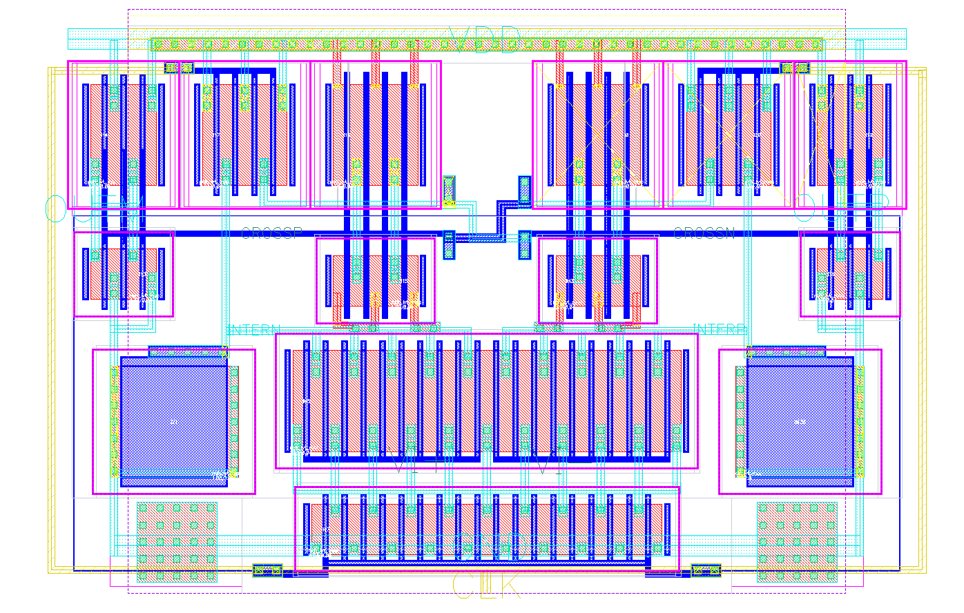
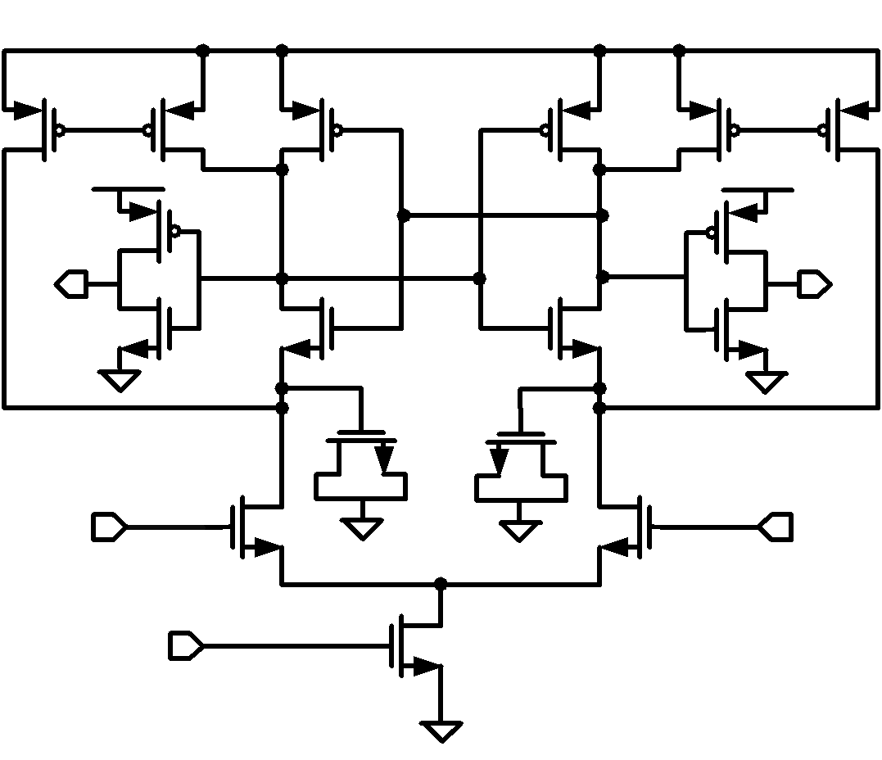
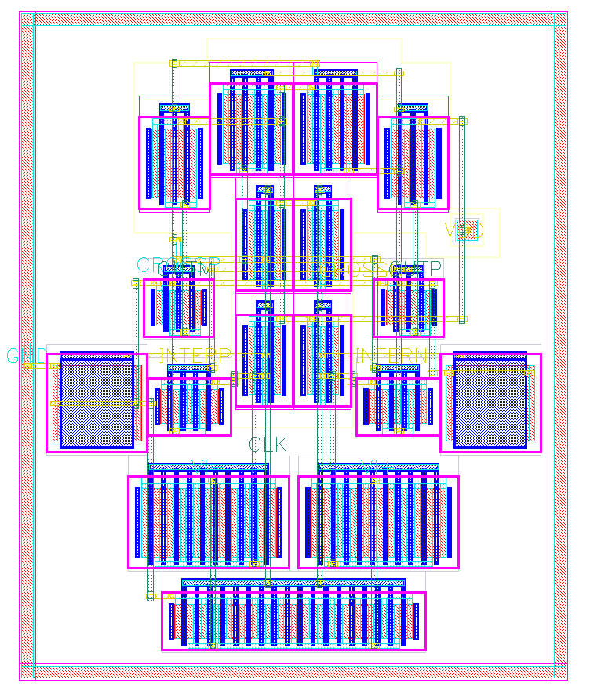
MAGICAL Preliminary Results
A comparator design
Manual Layout
MAGICAL Layout

Slide 21
MAGICAL Preliminary Results
A comparator design
Post-Layout Performance Simulations
 | Manual | MAGICAL
Power (uW) | 16.8 | 18.7
Output Delay (ps) | 150 | 152
Input-referred Noise (uVrms) | 380 | 334
Input-referred Offset (mV) | 0.15 | 0.50
Symmetry-related
Parasitic or compactness related

Slide 22
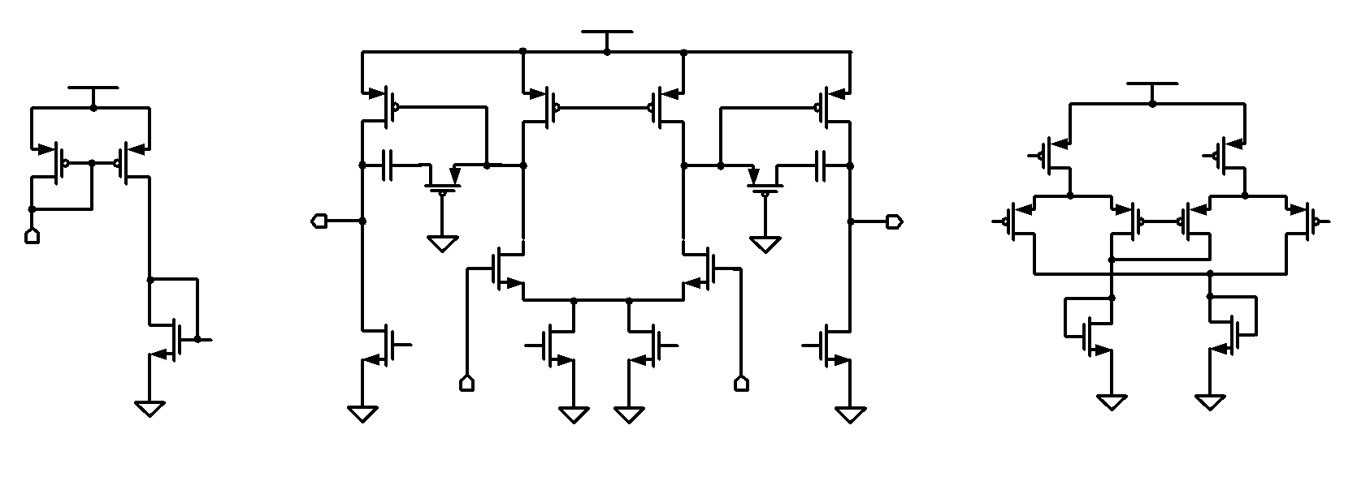
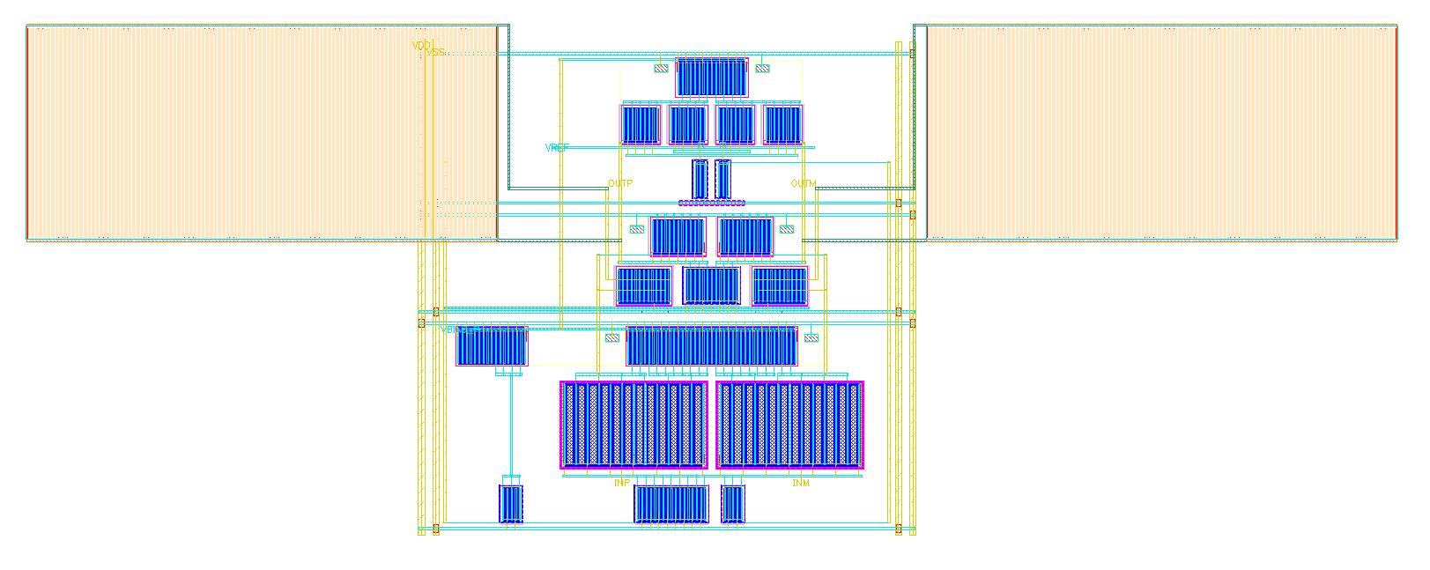
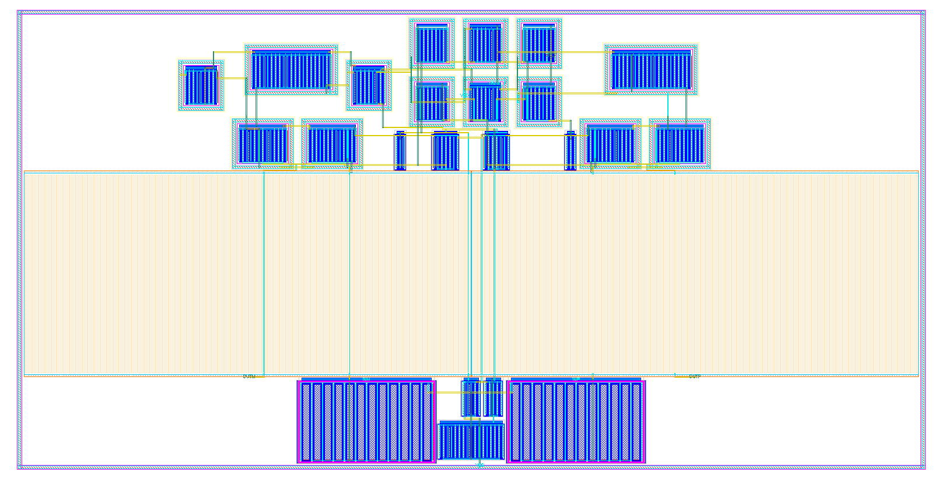
MAGICAL Preliminary Results
A 2-stage miller-compensated OTA design
Manual Layout
MAGICAL Layout

Slide 23
MAGICAL Preliminary Results
A 2-stage miller-compensated OTA design
Post-Layout Performance Simulation
 | Manual | MAGICAL
DC Gain (dB) | 37.7 | 38.0
Unity-gain Bandwidth (MHz) | 110 | 107.5
Phase Margin (degree) | 67.8 | 62.3
Input-referred Noise (uVrms) | 219 | 221.5
CMRR (dB) | 103 | 92.5
Input-referred Offset (mV) | 0.2 | 0.48
Symmetry-related
Parasitic or compactness related

Slide 24
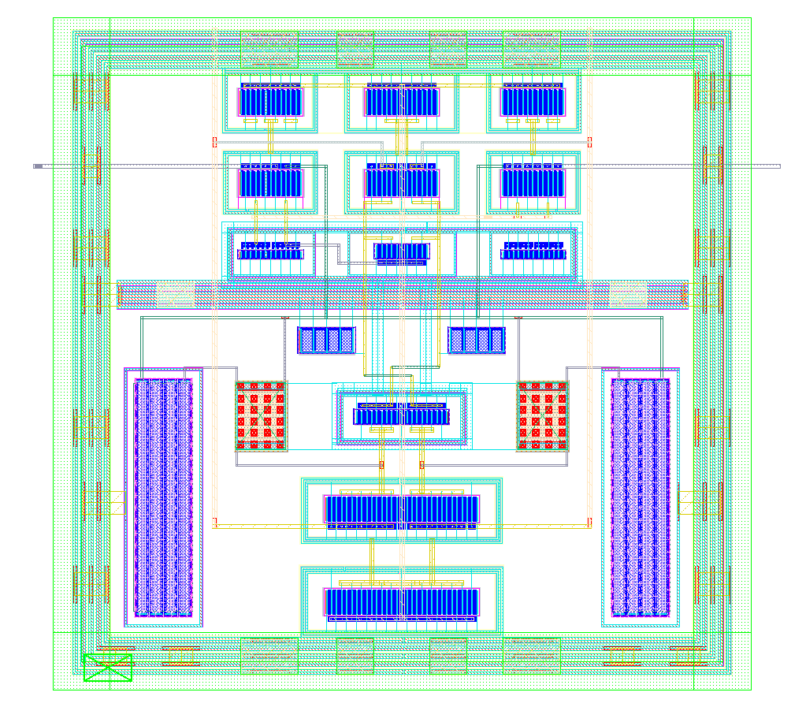
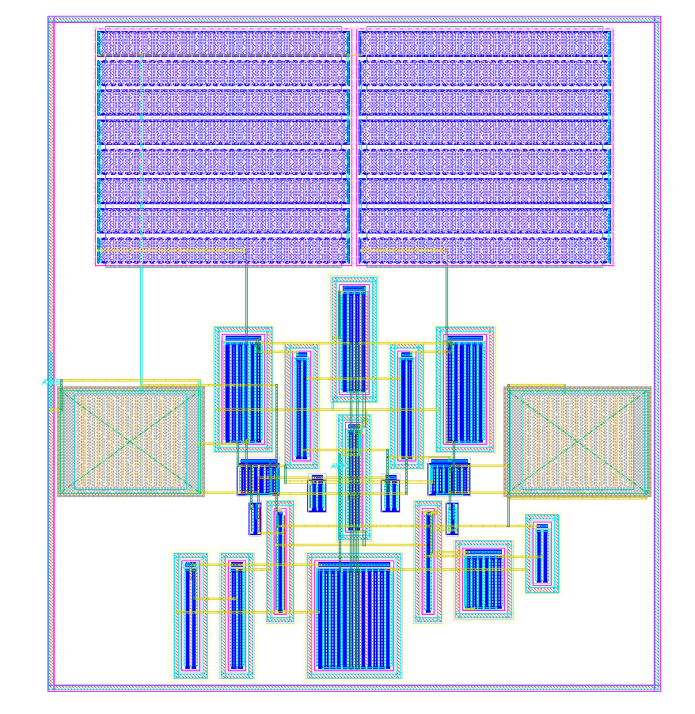
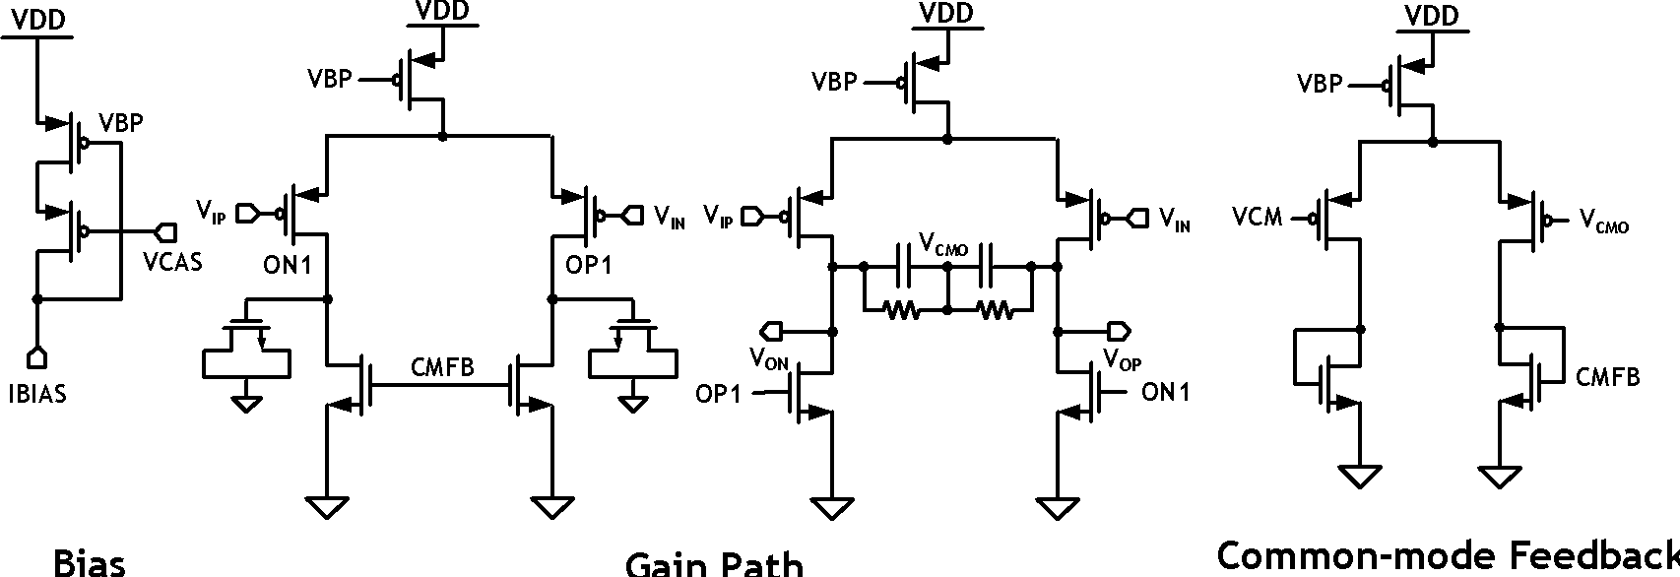
MAGICAL Preliminary Results
A 2-stage feedforward-compensated OTA design
Manual Layout
MAGICAL Layout
Notes:
The finger

Slide 25
MAGICAL Preliminary Results
A 2-stage feedforward-compensated OTA design
Post-Layout Performance Simulation
 | Manual | MAGICAL
DC Gain (dB) | 35.3 | 35.3
Unity-gain Bandwidth (MHz) | 2200 | 2200
Phase Margin (degree) | 77.6 | 77.9
CMRR (dB) | 126.1 | 88.9
Input-referred Offset (mV) | <0.01 | 0.161
Symmetry-related
Parasitic or compactness related

Slide 26
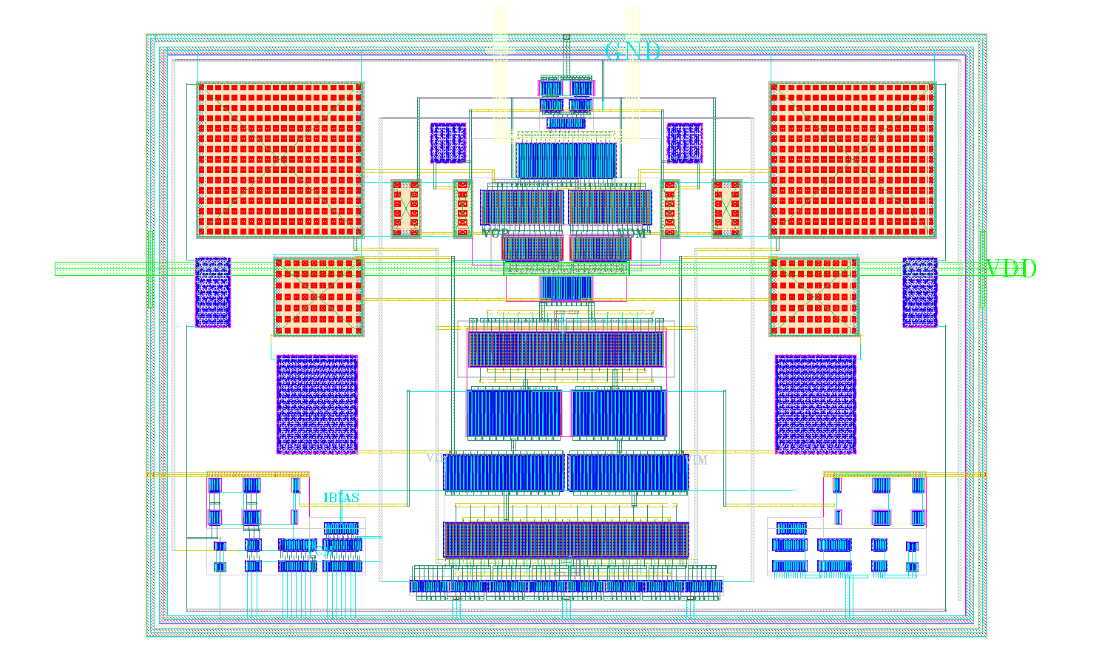
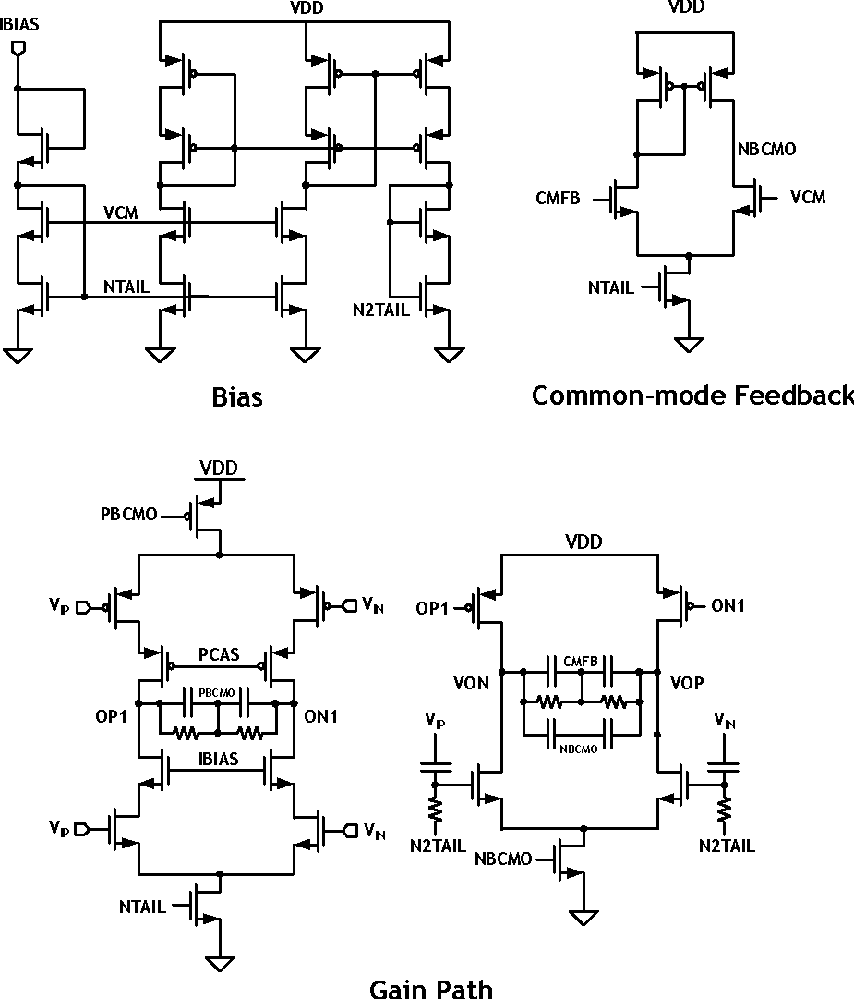
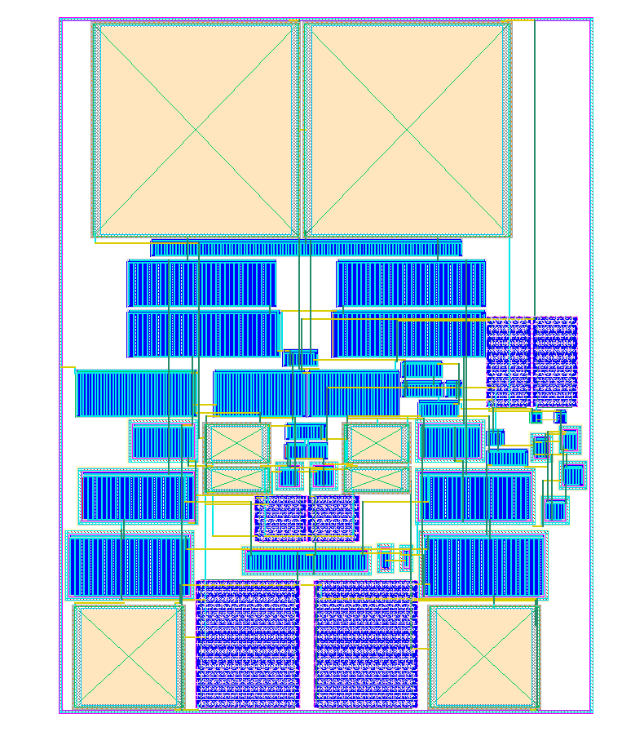
MAGICAL Preliminary Results
An inverter-based OTA design
Manual Layout
MAGICAL Layout

Slide 27
MAGICAL Preliminary Results
An inverter-based OTA design
Post-Layout Performance Simulation
 | Manual | MAGICAL
DC Gain (dB) | 69 | 69
Unity-gain Bandwidth (MHz) | 1300 | 1130
Phase Margin (degree) | 58 | 56.5
CMRR (dB) | 94.5 | 110
Input-referred Offset (mV) | 0.016 | 0.001
Symmetry-related
Parasitic or compactness related

Slide 28
Conclusion
Preview of MAGICAL - a fully automated (no-human-in-the-loop), machine-generated analog IC layout system
Key components: parametric device generation, automatic constraint generation, placement, and routing
Guided by various analytical, heuristic, and machine learning algorithms
Obtained promising initial results cf. manual design (tapeout)
Results are still preliminary
MAGICAL has been made open source in mid-2019 (under BSD-3 license)
GitHub: https://github.com/magical-eda/MAGICAL

Slide 29

Thanks!
Q & A?

Slide 30
Comparisons with BAG
MAGICAL
BAG
Optimization based generator
No template needed
No human in the loop
Embedded constraint extraction
Fully automated P&R
Procedural layout generator
Require template designs
Require additional human input
Relative placement location
Routing metal track selection

