Slide 1


Flight price prediction and deployment
Name : Lathiya Jay Sureshbhai
Roll no. : 20
Subject : Project
Course : AIML
School of emerging science and technology

Slide 2
About the Project
In this project, we will be analyzing the flight fare prediction using Machine Learning dataset using essential exploratory data analysis techniques then will draw some predictions about the price of the flight based on some features such as what type of airline it is, what is the arrival time, what is the departure time, what is the duration of the flight, source, destination and more.
Expected outcome: A user friendly project that give ticket value prediction for traveling in airline based on input given by user like date , time , airlines company, number of shops etc.
Why this project?
Problem Validation & Market Research
Technical Aspects

Slide 3
Why this project?
Anyone who has booked a flight ticket knows how unexpectedly the prices vary. Airlines use using sophisticated quasi-academic tactics which they call "revenue management" or "yield management". The cheapest available ticket on a given flight gets more and less expensive over time. This usually happens as an attempt to maximize revenue based on –
Time of purchase patterns (making sure last-minute purchases are expensive)
Keeping the flight as full as they want it (raising prices on a flight which is filling up in order to reduce sales and hold back inventory for those expensive last-minute expensive purchases)

Slide 4
Problem Validation & Market Research
According to a report, India’s civil aviation industry is on a high-growth trajectory. India aims to become the third-largest aviation market by 2020 and the largest by 2030. Indian domestic air traffic is expected to cross 100 million passengers by FY2017, compared to 81 million passengers in 2015, as per Centre for Asia Pacific Aviation (CAPA).
According to Google Trends, the search term - "Cheap Air Tickets" is most searched in India. Moreover, as the middle-class of India is exposed to air travel, consumers hunting for cheap prices increases.

Slide 5
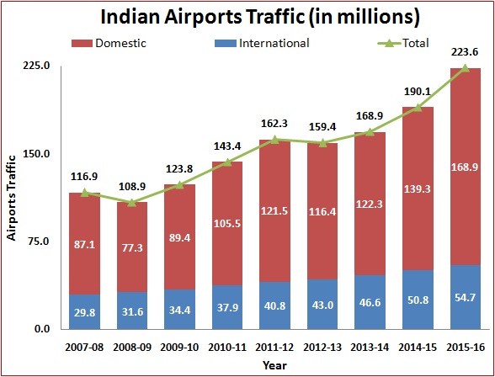

Slide 6
Technical Aspects
The project is basically machine learning & statistic intensive. I used Python for the implementation of the models.
Cleaning & Preparing Data
After we have the data, we need to clean & prepare the data according to the model's requirements. In any machine learning problem, this is the step that is the most important and the most time consuming. We used various statistical techniques & logics and implemented them using built-in R packages.
2. Analyzing & Building Models
Data preparation is followed by analyzing the data, uncovering hidden trends and then applying various predictive & classification models on the training set.

Slide 7
3. Merging Models & Accuracy Calculation
Having built various models, we now have to test the models on our testing set and come up with the most suitable metric to calculate the accuracy. Moreover, many a times, merging models and predicting a cumulative target variable proves to be more accurate.

Slide 8
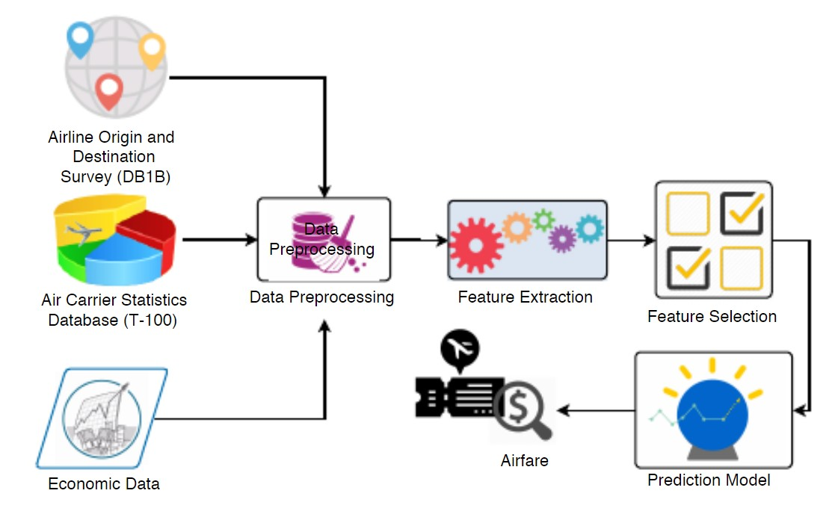
WORK FLOW

Slide 9
About the dataset
EDA: Learn the complete process of EDA
Data analysis: Learn to withdraw some insights from the dataset both mathematically and visualize it.
Data visualization: Visualizing the data to get better insight from it.
Feature engineering: We will also see what kind of stuff we can do in the feature engineering part.

Slide 10
Airline: So this column will have all the types of airlines like Indigo, Jet Airways, Air India, and many more.
Date_of_Journey: This column will let us know about the date on which the passenger’s journey will start.
Source: This column holds the name of the place from where the passenger’s journey will start.
Destination: This column holds the name of the place to where passengers wanted to travel.
Route: Here we can know about that what is the route through which passengers have opted to travel from his/her source to their destination.

Slide 11
6. Arrival_Time: Arrival time is when the passenger will reach his/her destination.
7. Duration: Duration is the whole period that a flight will take to complete its journey from source to destination.
8. Total_Stops: This will let us know in how many places flights will stop there for the flight in the whole journey.
9. Additional_Info: In this column, we will get information about food, kind of food, and other amenities.
10.Price: Price of the flight for a complete journey including all the expenses before onboarding.

Slide 12
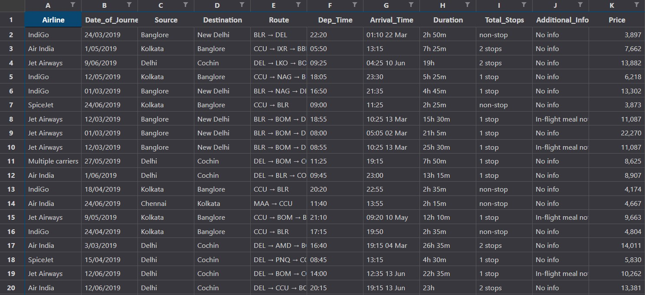
Row Data :
24-03-2019 to 09-05-2019

Slide 13
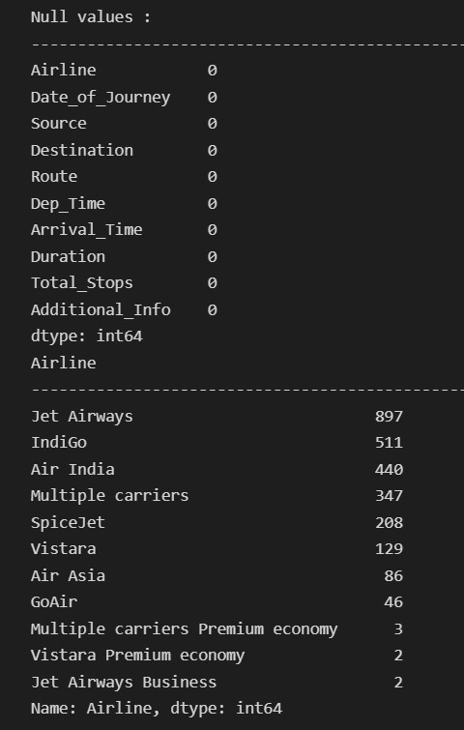
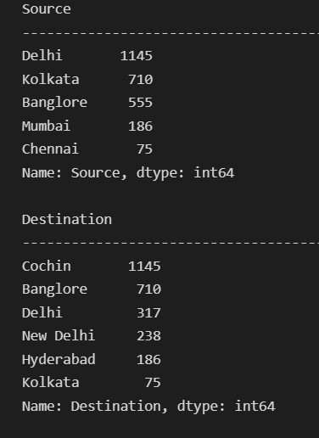
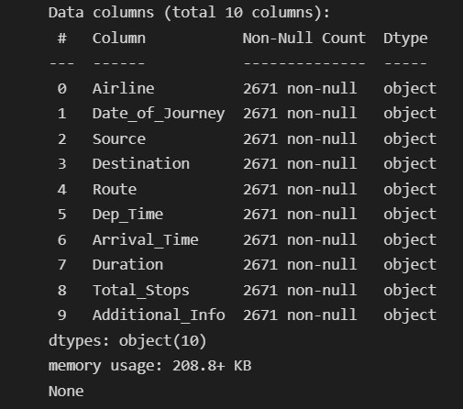

Slide 14
Data Preparation
Data Cleaning
Remove Duplicates
There were not many, but a few repetitions in the data collected.
Find outliers and remove
We are focusing on minimizing the flight prices, hence we considered only the economy class with the following conditions: a) The minimum value of total fare for all days for a particular flight id is less than the mean fare of all the flights
b) The duration of the journey is less than 3 times the mean duration

Slide 15
2. Data prepossessing
Convert object to numeric
In this dataset mostly values in a objective form , so in data prepossessing first we convert object to numeric type
Feature Engineering
We will also see what kind of stuff we can do in the feature engineering part

Slide 16
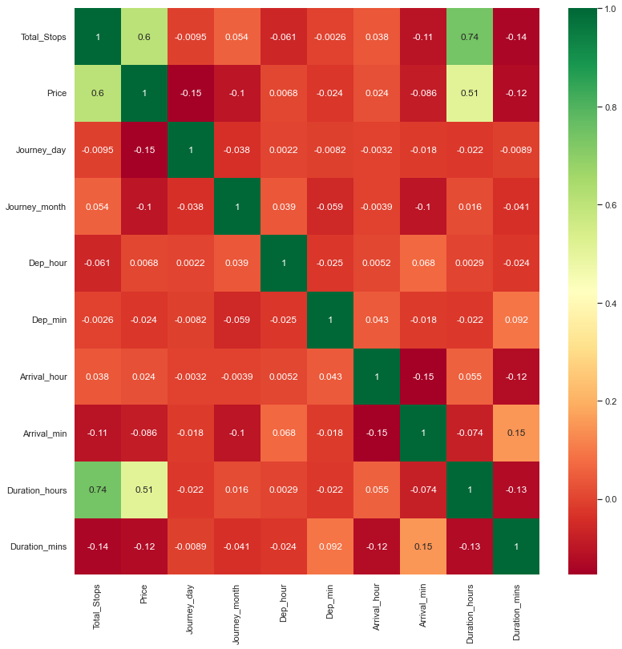
3. Data Visualization
Heatmap

Slide 17
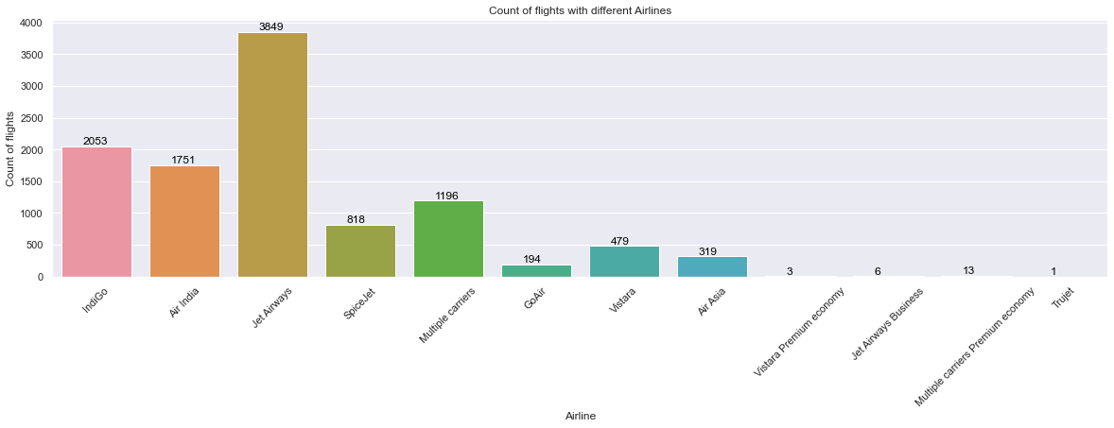
countplot
This chart gives count of different Airlines to flights.
Jet-Airways is most preferable flight.

Slide 18
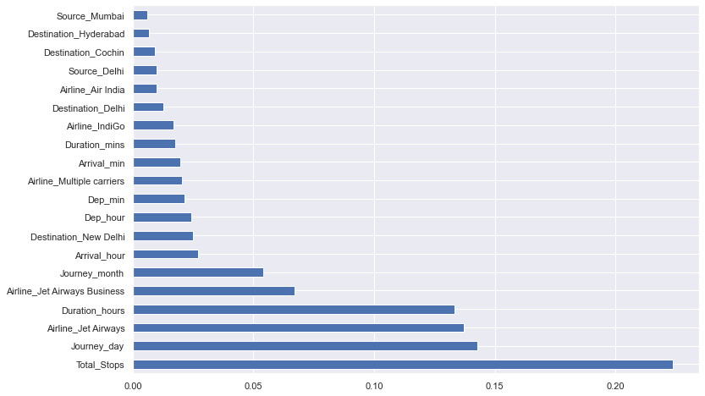
Bar plot
In this graph we find / visualize which factor most important and effective.

Slide 19
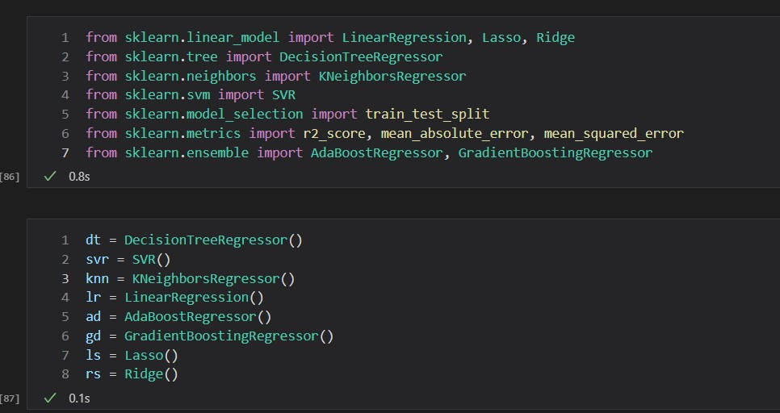
Model
DecisionTreeRegressor
SVR
KNeighborsRegressor
LinearRegression
AdaBoostRegressor
GradientBoostingRegressor
Lasso
Ridge
Output :
R^2
MAE
MSE
RMSE

Slide 20
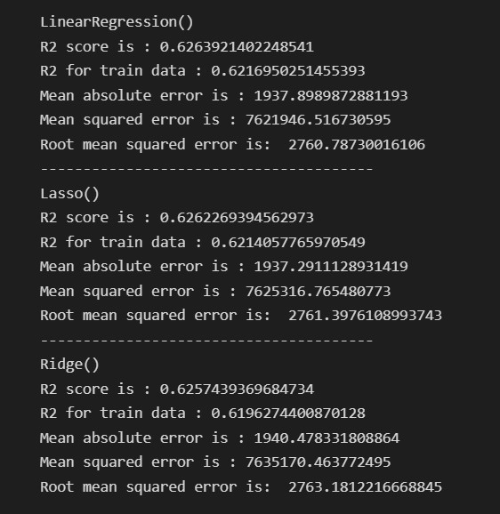
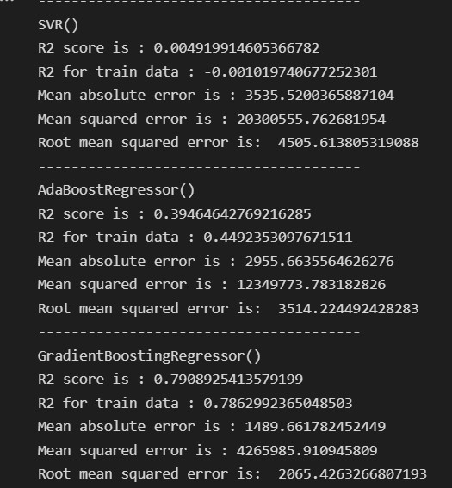

Slide 21
Random Forest
1. Split dataset into train and test set in order to prediction w.r.t X_test
2. If needed do scaling of data
Scaling is not done in Random forest
3. Import model
4. Fit the data
5. Predict w.r.t X_test
6. In regression check RSME Score
7. Plot graph

Slide 22
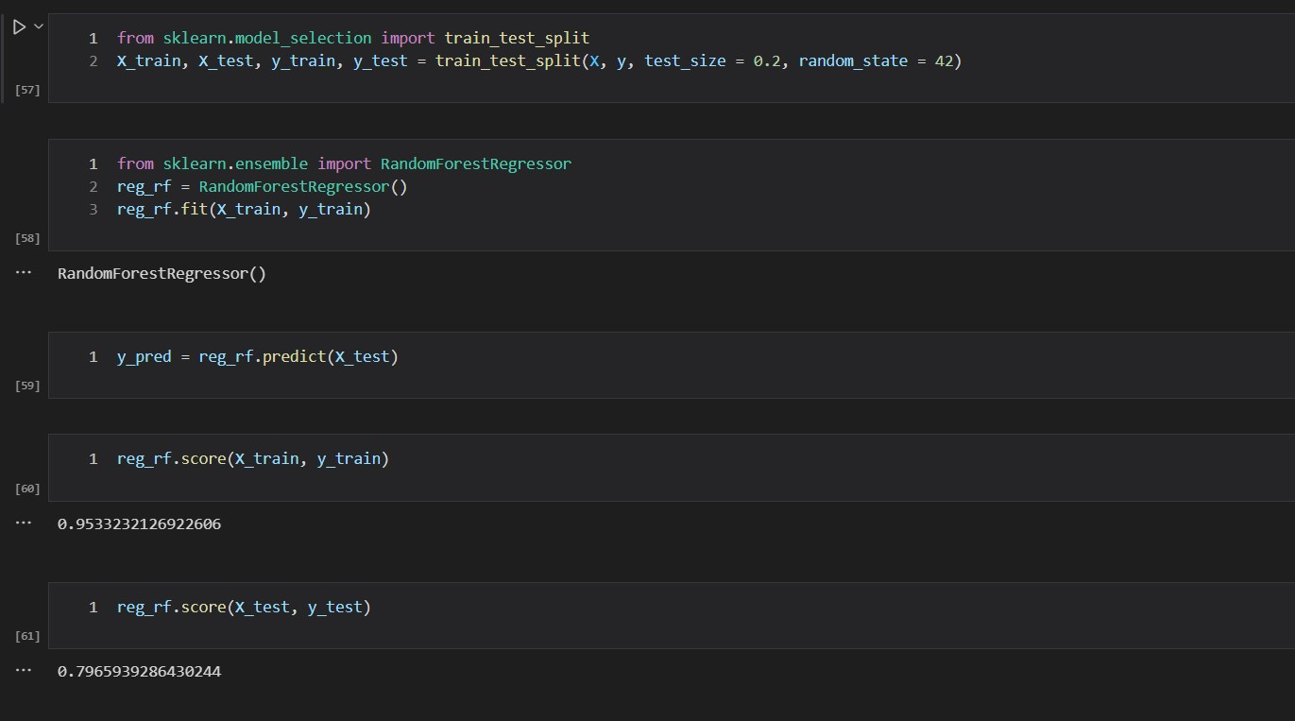
Train data accuracy 95.33%
Test data accuracy 79.65%

Slide 23
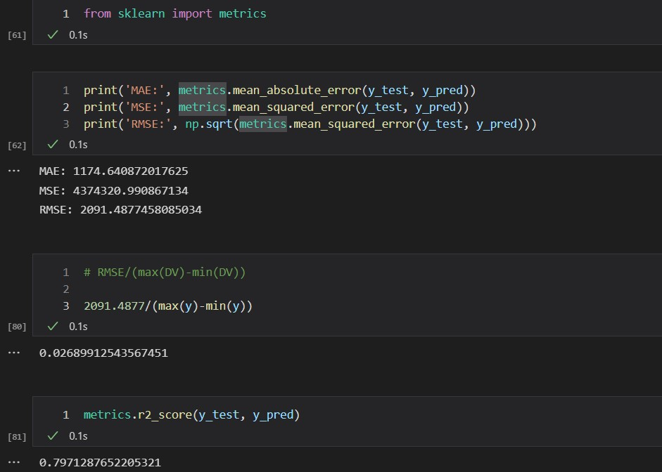
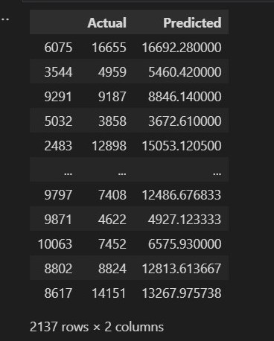

Slide 24
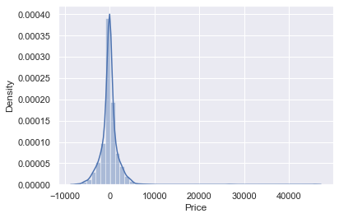
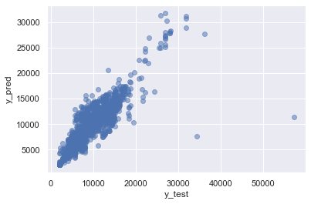
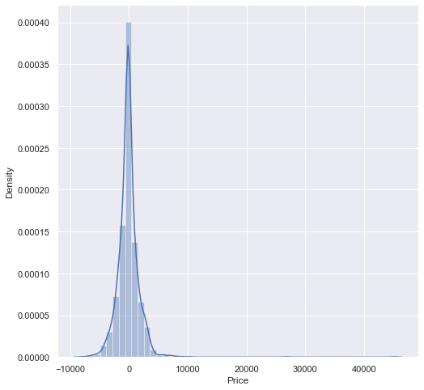
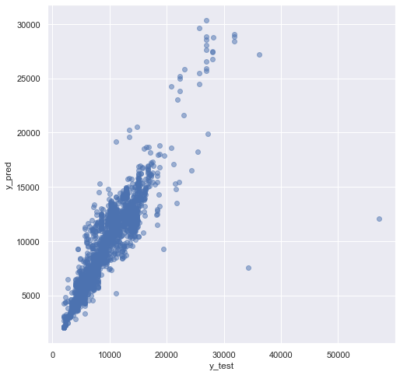
Random Forest
Hyperparameter
Tuning

Slide 25
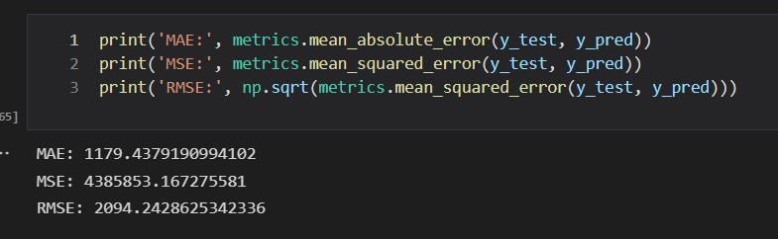
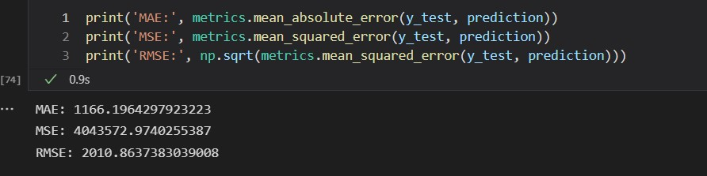
Random Forest
Accuracy :
79.71%
Hyperparameter
Tuning
Accuracy : 79.71%

Slide 26
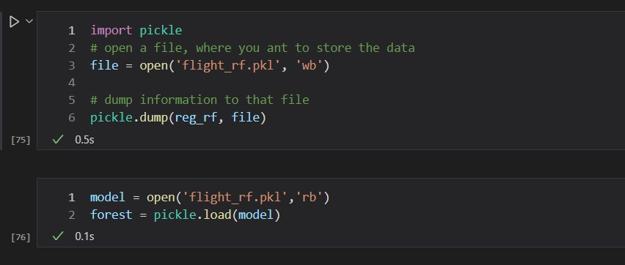
Save the model to reuse it again

Slide 27
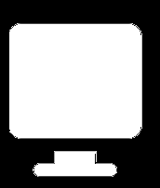
DESKTOP APPLICATION WORKING
Desktop User Interface
I/O process Interface
Model
User Interface
Scaled Data
Output
Prediction

Slide 28
LOGICAL DATA FLOW (WEB INTERFACE)
Input: Source, Destination, Date
Select: Airlines, Duration, Stops
Content
Prediction Flight Tickets Fare

Slide 29
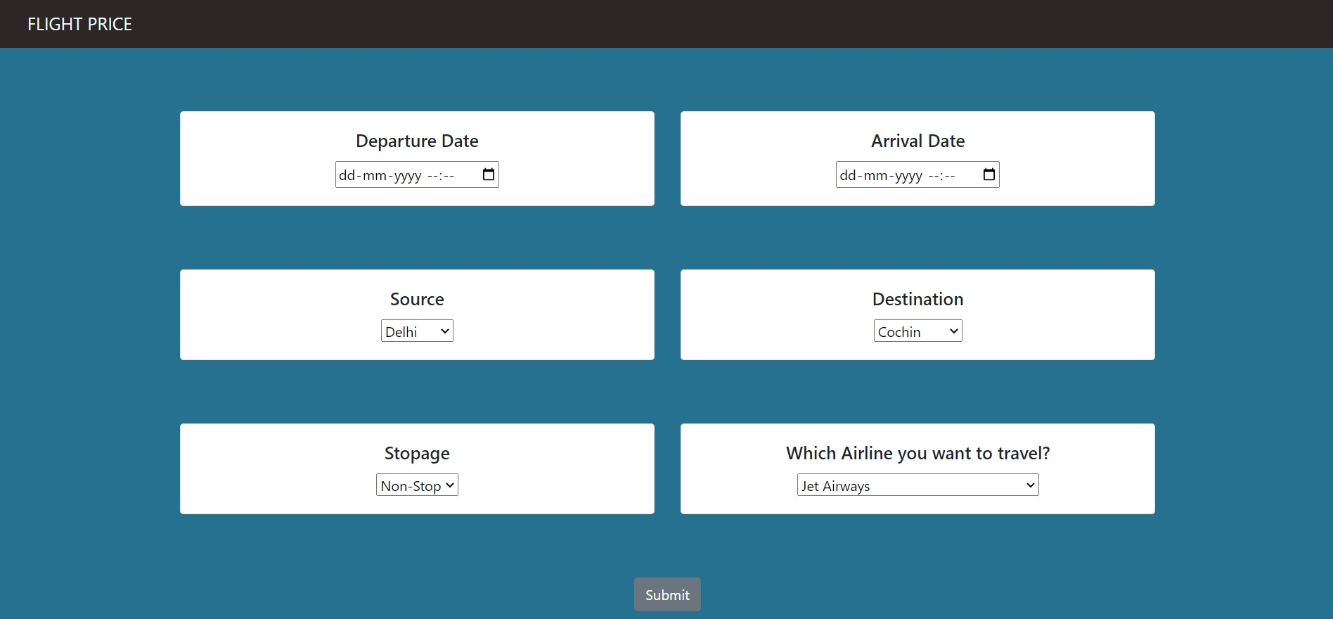
Deployment Part (Backend)
I create a web page on local host for deploy my project.
In this part I use html , CSS for creating web home page.
In html part I also use JavaScript for jQuery.

Slide 30
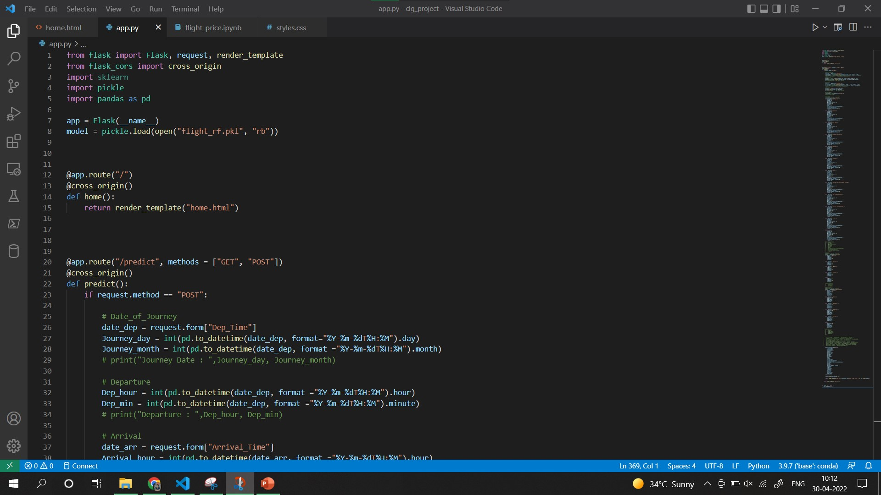
Using flask connect html and modal.
In this part I use request module for collecting data from user input.
use for one-hot encoding.

