Slide 1

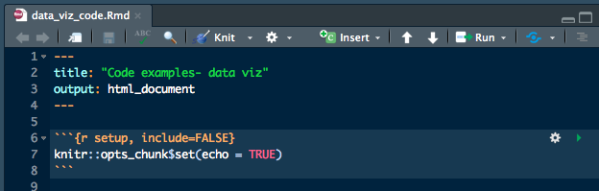
Reproducibility with
Saving yourself in the long term
(and also all the other terms)
Jay Lee
Paideia 2018
Notes:
Unfortunately this class doesn’t have pretty pictures like the data viz one ://///

Slide 2
Prereqs
Use the desktops, rstudio.reed.edu, or on your own machine:
Install R from cran.r-project.org
Install RStudio from www.rstudio.com
If you don’t like RStudio, run
install.packages(‘rmarkdown’)

Slide 3
Today’s
Big
Questions
What is it?
How do I use it?
Why should I use it?
For what should I be using it?

Slide 4
Today’s
Big
Questions
What is it?
How do I use it?
Why should I use it?
For what should I be using it?
Your homework
Your reports
Your book
(Your thesis)

Slide 5
What is
R Markdown?
Type of document created by RStudio
Plain text file that produces more complex output (HTML, PDF, and Word)
Mixes code, code output, text, and images
Has similarities to computational notebooks like jupyter
Compatible with LaTeX, HTML formatting, and Markdown syntax
Focused around document output
Notes:
After this, have them open up a RMD file

Slide 6
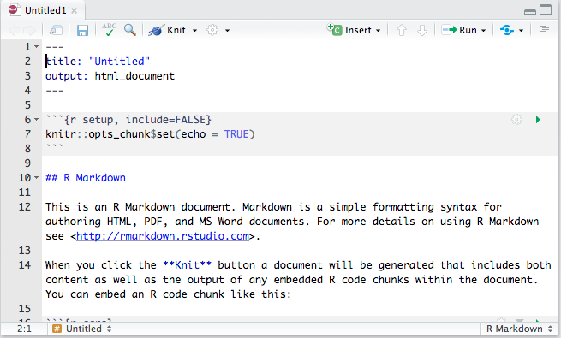
Notes:
This is the RStudio template, you can also use a regular text file and save it with the .Rmd extension.
Note the header, the setup chunk (this sets all future chunks to print by default), and the plain text.
This won’t be what the output looks like, it’s just the source file (instructions).

Slide 7
How do I use R Markdown?
Comes in three main parts:
YAML header
Code
Plain text

Slide 8
YAML Header
Stands for “YAML ain’t markup language” or “Yet Another Markup Language”
Contains data, not document markup like HTML tags
Method of standardizing data about documents
Common data included:
Title, date, author
Output type (HTML, PDF, Word)
Table of contents settings
Themes or custom CSS

Slide 9
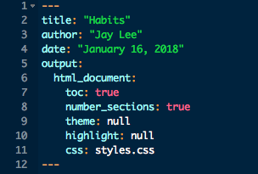

Slide 10
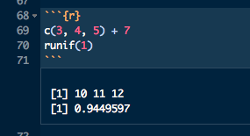
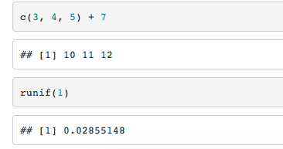
Code chunks

Slide 11
Inline code
Inline code looks like this: `r 3+5`.
Inline code looks like this: 8.

Slide 12
Plain text
Uses Pandoc’s markdown-style text formatting:
More inline functionality than a word processor
Shallower learning curve than LaTeX

Slide 13
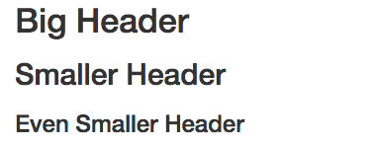
Plain text -
Headers
# Big Header
## Smaller Header
### Even Smaller Header

Slide 14
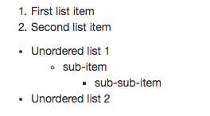
Plain text -
Lists
1. First list item
2. Second list item
* Unordered list 1
+ sub-item
- sub-sub-item
* Unordered list 2
Notes:
Need a double tab (or four spaces) before the sub-items!

Slide 15

Plain text -
LaTeX
Inline math looks like $y = 4x + 7$.
Formula mode looks like:
\[
y = 4x + 7.
\]
Notes:
You can also open/close formula mode with $$
Fomula mode is centered on the page by default

Slide 16

Plain text -
Links
You can link to websites like [Reed College](reed.edu).
You can link to files like [this one](../Workshop.Rmd).
Notes:
You can also link to anchors on the page as long as you name them

Slide 17
Plain text -
Other
![Image name](file/site link).
*bold text*
**italics**
`print code`
Superscript^2^
Subscript~2~
Backslash to actually display special characters like \_ \* \\

Slide 18
Putting it all together:
Knitting
Knitting (or rendering) turns your input text file into the output it produces.
Click the “Knit” button at the top of the file window in RStudio
Run `rmarkdown::render(“file”)`

Slide 19
Putting it all together:
Knitting
Knitting (or rendering) turns your input text file into the output it produces.
Click the “Knit” button at the top of the file window in RStudio
Run `rmarkdown::render(“file”)`
NOTE: By default, this will print (echo) and run (evaluate) all of your code chunks. These settings can be changed for each chunk or all of them.

Slide 20
Why should
I use
R Markdown?
More formatting control than Word, but easier to learn than HTML or LaTeX
Good for semi-casual publication (blogs, homework, final projects).
Solves (some of) the problem of
“well, it works on my computer!”
Follows the ethos of open access and reproducibility in the R community
Plays nice with version control (Git)
Notes:
Saves some of the tedium of LaTeX formatting, but there aren’t any shortcuts on the math typesetting.
I do my homework in RMD!

Slide 21
For what should I use R Markdown?
Applications include:
Interactive webpages (Shiny)
Web-compatible books (bookdown)
Presentations (ioslides, Beamer)
Websites (GitHub pages, e.g.)
Senior thesis (thesisdown)

Slide 22
thesisdown
thesisdown is an R markdown template for the Reed senior thesis, written by Chester Ismay.

Slide 23
This is the interactive part of the slideshow
Wow!

Slide 24
Resources
rmarkdown.rstudio.com
github.com/ismayc/thesisdown
rstudio.com/resources/cheatsheets/
Notes:
Cheatsheets can also be found under “help” in the RStudio interface

Slide 25
That’s all, folks
You can reach me for any further questions at
jaylee@reed.edu,
but I probably won’t answer until I’m at work in
ETC 226
9:30a-12p MWF,
so just come ask me then if you can :))))))

