Slide 1

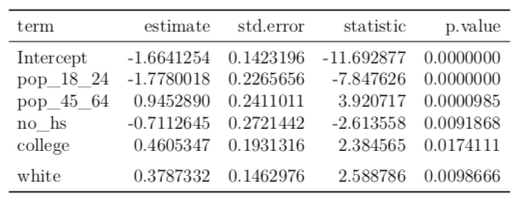
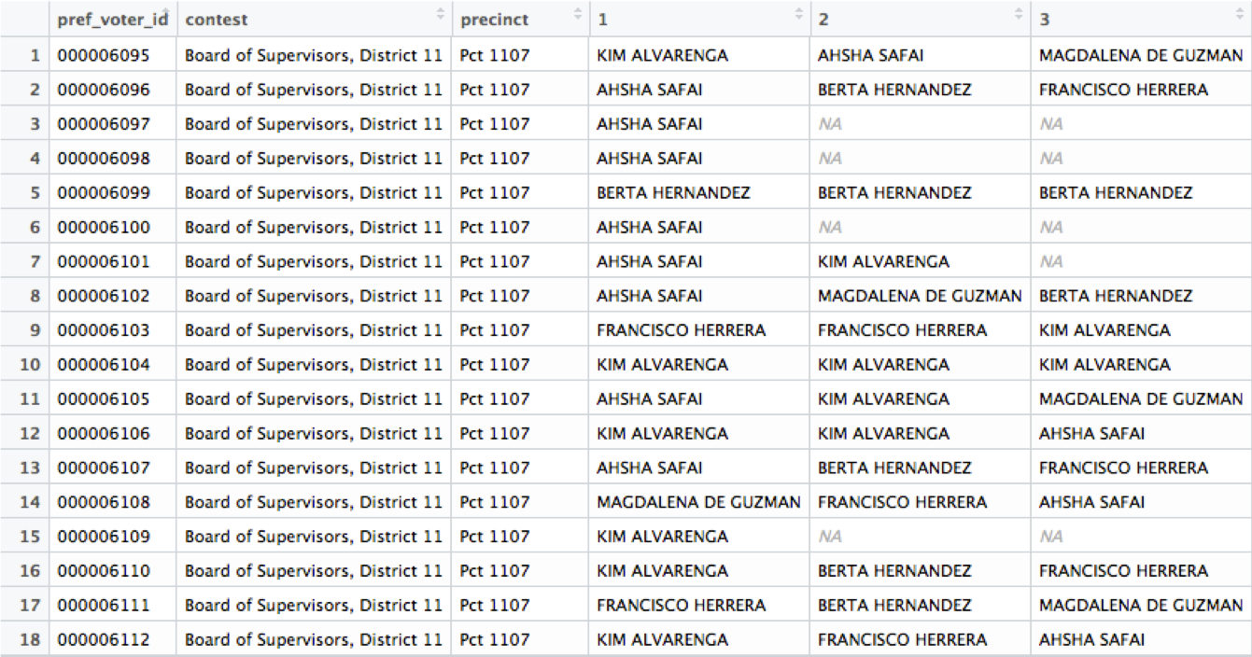
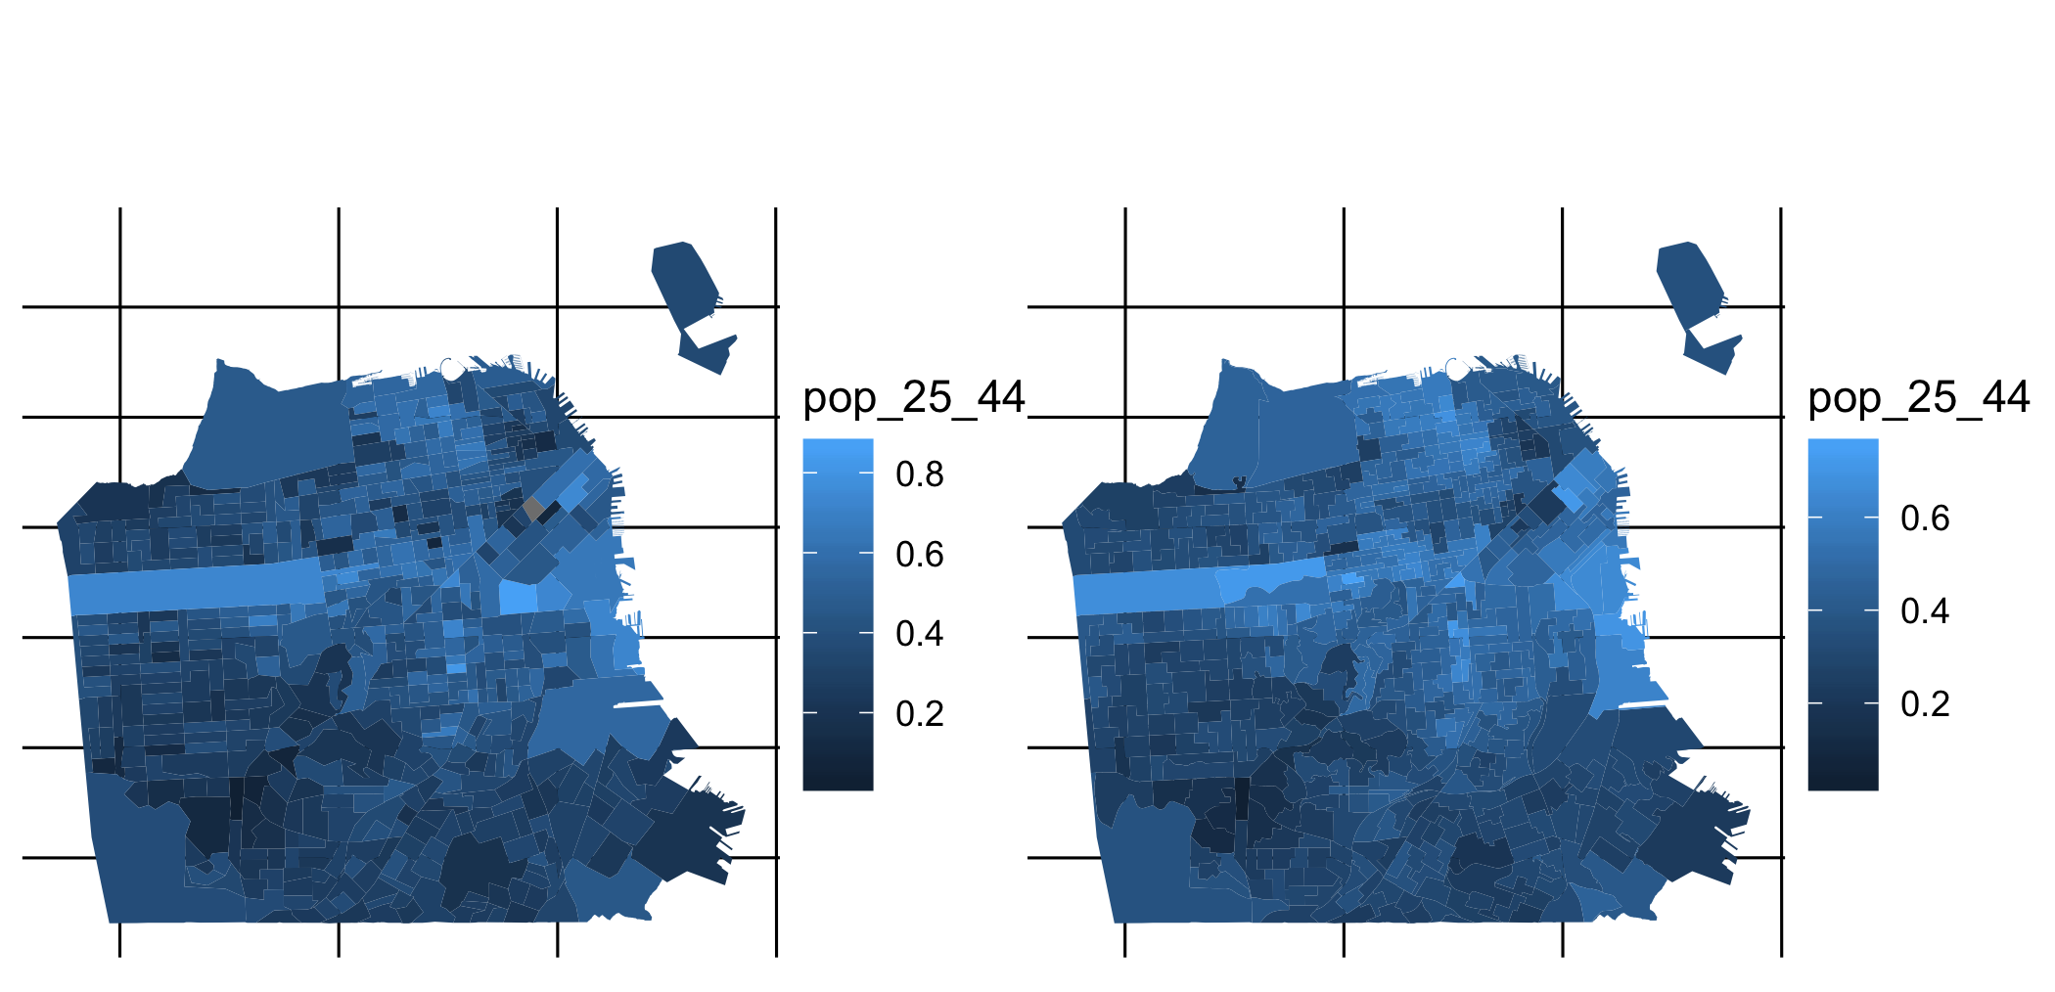
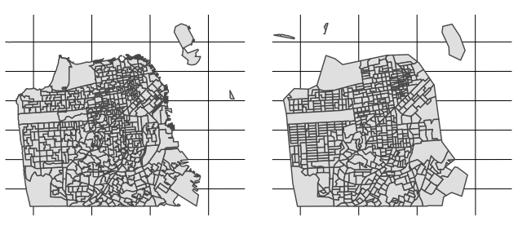
Exploring Demographics of Voter Errors and
Incomplete Ballots in Ranked Choice Voting
Jay Lee, Reed College
Introduction
Data Structure
Areal Interpolation
Conclusions
Ranked choice voting (RCV) is an alternative voting method to the plurality method used more commonly in the US. Voters rank multiple candidates in order of preference, instead of selecting their most preferred option. The tabulation process counts first choice votes, then eliminates the lowest candidate and retabulates with the second choice of those who voted for the now-eliminated candidate. This process continues until one candidate has a majority of the votes.
There are two RCV phenomena that we’re interested in:
Overvoting, where a voter ranks multiple candidates in the same slot
Undervoting, where a voter ranks fewer unique candidates than allotted (e.g. rows 3 and 4, below)
Both of these are underutilizations of the ballot, and lead to ballot exhaustion: if a voter expressed no preference among the candidates in the final round of tabulation, then their vote is not counted in this final round. This is analogous to voting in a general election, but not in a subsequent runoff election.
Our data comes from two sources:
Electoral information about a 2018 mayoral election, from the San Francisco Department of Elections
Demographic data, from the 2012-2016 American Community Surveys (U.S. Census Bureau)
We’re interested in demographic information that we can link to our electoral information. Since individual voters are anonymized, we cannot obtain individual-level demographic information. As such, we aggregate up to the election precinct level and instead examine the rates of overvoting and undervoting in each precinct.
This leaves us with a problem: we have demographic data about Census block groups, but electoral data about election precincts. These zoning systems come from two different levels of government, and generally do not align cleanly. In our particular case (see the maps below), it is clear that the precincts and block groups are not aligned. To build any sort of model that could provide insight into these phenomena, we’ll need to have demographic and electoral information about the same units.
Put more generally, our question is as such: given some known parameter about regions within a zoning system (source), how do we obtain an estimate of that parameter for the regions inside an alternate and overlapping zoning system (target)?
Areal interpolation is a method of addressing this mismatch in zoning systems. To obtain an estimate of the parameter distribution over the target zones, we calculate a weighted mean of the known parameters in the source zones. These weights can be calculated using additional data about the regions, but our method (areal weighting) involves a sum weighted by the amount of overlapping area between the source and target zones.
Initially assuming that population is distributed uniformly, the source zones are intersected by the target zones and their parameters are divided among the partial zones according to how much area each contains. These partial zones are then combined into the corresponding target zones, and the sub-estimates are added together to obtain an estimate of the true parameter in the target zone.
This uniform population distribution assumption is not entirely accurate, but it is useful (particularly in a heavily urbanized area like San Francisco). We can evaluate our interpolation method by visually comparing the distribution of a variable, such as percentage of people aged 25-44.
The results of our regressions show that demographic variables including age, race, and education impact overvoting and undervoting. The coefficients on these variables are similar in direction and magnitude to models predicting turnout more generally, indicating that the same things which predict low turnout (larger minority populations, lower education levels, and more young people, as indicated in the below table) also predict higher rates of our RCV phenomena. This agrees with previous literature about demographics and voter turnout.
Further Research
Future research on this topic could extend to more elections and jurisdictions, to see how general our results are. Additionally, we could improve both our areal interpolation methods and the models fit to this data. Using more auxiliary information such as street locations and parcel data would improve on our uniform population distribution assumption, and give us a more accurate estimate of demographic values in our precincts. There are a number of precincts with zero overvotes in this election, which throws a wrench into both the linear and logistic models. A zero-inflated model might be a more appropriate model choice for this situation.
Percent aged 25-44, pre- and post-interpolation
Goals
Regression Methods
One of the arguments against RCV is that it is harder for voters to participate in, because of a more complicated ballot and the increased effort in forming a more complete preference among candidates. By examining rates of overvoting and undervoting, we can consider more effective methods of targeting voter education efforts.
We use linear and logistic regression models to model the rates of overvoting and undervoting based on our census data. We use normalized estimates of census variables (proportions) as our independent variable, and precinct-level overvoting and undervoting rates as our dependent variable.
Acknowledgements
The research presented here was advised by Dr. Heather Kitada Smalley at Reed College. This study was supported in part by the Richter Funds and the Moore Funds.

