Slide 1


Dataflow-Aware Fault Resilience Analysis for DNN Accelerators
Jaylen Wang, Abdulrahman Mahmoud, David Brooks, Gu-Yeon Wei
YArch’22 Lightning Talk
March 1, 2022
Notes:
Hi everyone – I’m Jaylen and I’ll be presenting my work on Dataflow-Aware Fault Resilience Analysis for DNN Accelerators

Slide 2

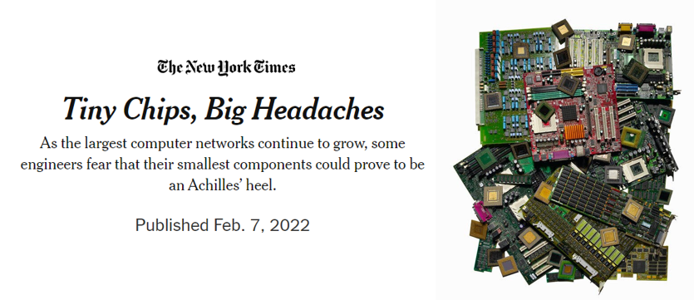
How do we currently handle resilience?
High-level design choices affecting resilience are fixed by RTL/tapeout
Processors are not designed w/ resilience as a 1st-order design-point
Notes:
To give some background – as we design hardware today, the way we handle resilience is by leaving analysis to after many important design choices have been made – not treating it as a first order concern. When in reality – more are realizing – as you can see from the headlines, that this is a large issue for which we need to take a more active approach.

Slide 3
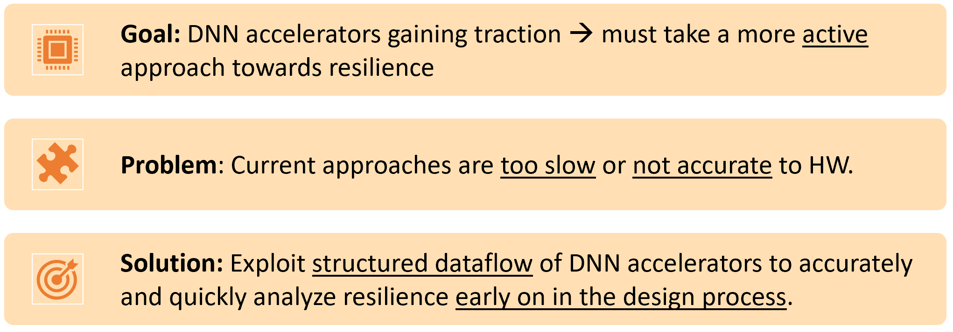
Notes:
If we are to avoid the same mistakes for our DNN accelerator designs, we need better resilience analysis tools than are currently available, which are either too slow for design space exploration or not accurate to actual hardware

Slide 4
Notes:
Our solution is to exploit the structured dataflow of accelerators – and use this constrained space to our advantage

Slide 5

An enlightening analogy…
Notes:
To explain how we do this – I’ll use an analogy…

Slide 6
HW DATAFLOW
ON
ON
HW DATAFLOW
Notes:
Let’s represent the output of a DNN operation as the (lights of rooms in the house on the right)

Slide 7
HW DATAFLOW
ON
ON
HW DATAFLOW
Output matrix
(light=neuron)
Notes:
lights of rooms in the house on the right

Slide 8
HW DATAFLOW
ON
ON
HW DATAFLOW
SW-visible state
(inputs/weights)
Output matrix
(light=neuron)
Notes:
The switch box on the left can then represent software visible state

Slide 9
#----- DRAM --------------------#
for m1=[0:M1]:
#----- weight/input buffer -----#
pfor m0=[0:M0]: # parallel
for p0=[0:P0]:
for r0=[0:R0]:
#----- PE weight/input regs -----#
m = m1*M0+m0; r = r0; p = p0
o[m,p] += i[p+r] * w[m,r]
HW DATAFLOW
ON
ON
HW DATAFLOW
SW-visible state
(inputs/weights)
Output matrix
(light=neuron)
Notes:
In the middle is the HW-dependent dataflow – which can be represented by a loop nest like so

Slide 10
i[1,0] = X
#----- DRAM --------------------#
for m1=[0:M1]:
#----- weight/input buffer -----#
pfor m0=[0:M0]: # parallel
for p0=[0:P0]:
for r0=[0:R0]:
#----- PE weight/input regs -----#
m = m1*M0+m0; r = r0; p = p0
o[m,p] += i[p+r] * w[m,r]
HW DATAFLOW
ON
OFF
HW DATAFLOW
SW-visible state
(inputs/weights)
Output matrix
(light=neuron)
Notes:
We can model an error in software as turning off a switch – and we can see that it affects a certain region of the output – in this case a single floor

Slide 11
i[1,0] = X
#----- DRAM --------------------#
for m1=[0:M1]:
#----- weight/input buffer -----#
pfor m0=[0:M0]: # parallel
for p0=[0:P0]:
for r0=[0:R0]:
#----- PE weight/input regs -----#
m = m1*M0+m0; r = r0; p = p0
o[m,p] += i[p+r] * w[m,r]
HW DATAFLOW
ON
OFF
HW DATAFLOW
SW-visible state
(inputs/weights)
Output matrix
(light=neuron)
What happens if an error occurs in here?
Notes:
However – with just software visible state we have no way of telling what how an error in the hardware will affect the output

Slide 12
#----- DRAM --------------------#
for m1=[0:M1]:
#----- weight/input buffer -----#
pfor m0=[0:M0]: # parallel
for p0=[0:P0]:
for r0=[0:R0]:
#----- PE weight/input regs -----#
m = m1*M0+m0; r = r0; p = p0
o[m,p] += i[p+r] * w[m,r]
HW DATAFLOW
ON
HW-dataflow state
ON
SW-visible state
(inputs/weights)
= HW reuse
Output matrix
(light=neuron)
From dataflow analysis!
Notes:
Our framework uses dataflow analysis to illuminate the underlying reuse and error propagation of the hardware from the loop nest

Slide 13
#----- DRAM --------------------#
for m1=[0:M1]:
#----- weight/input buffer -----#
pfor m0=[0:M0]: # parallel
i[1,0]=X
for p0=[0:P0]:
for r0=[0:R0]:
#----- PE weight/input regs -----#
m = m1*M0+m0; r = r0; p = p0
o[m,p] += i[p+r] * w[m,r]
HW DATAFLOW
ON
HW-dataflow state
ON
SW-visible state
(inputs/weights)
= HW reuse
Output matrix
(light=neuron)
From dataflow analysis!
Notes:
Which allows us to model errors in a more accurate and fine-grained manner

Slide 14
#----- DRAM --------------------#
for m1=[0:M1]:
#----- weight/input buffer -----#
pfor m0=[0:M0]: # parallel
i[1,0]=X
for p0=[0:P0]:
for r0=[0:R0]:
#----- PE weight/input regs -----#
m = m1*M0+m0; r = r0; p = p0
o[m,p] += i[p+r] * w[m,r]
HW DATAFLOW
ON
HW-dataflow state
ON
DATAFLOW ERROR SITES
SW-visible state
(inputs/weights)
= HW reuse
Output matrix
(light=neuron)
From dataflow analysis!
Notes:
Where we can determine the dataflow-aware error sites

Slide 15
What can we do now?…
Using dataflow analysis, can consider resilience during accelerator design
Improve runtime compared to RTL/low-level fault injections by keeping analysis at the dataflow level
Allows for more seamless HW resilience experiments for future research…
Notes:
Using this insight, we can elevate resilience as a first-order design constraint for accelerator design, while also improving runtime compared to traditional RTL/low-level fault injections – which can lead to more seamless resilience experiments for future research

Slide 16
What can we do now?…
Using dataflow analysis, can consider resilience during accelerator design
Improve runtime compared to RTL/low-level fault injections by keeping analysis at the dataflow level
Allows for more seamless HW resilience experiments for future research…
Stop by for more details!
Thanks for listening!
Notes:
For more details, please stop by my poster. Thanks for listening.

