Slide 1
Fin 2008 Investment
Group Project
Fall 2023
National Taiwan University

Slide 2
ESG
Environmental, social, and corporate governance (ESG) investing focuses on companies that support environmental protection, social justice, and ethical management practices.
Like all investors, ESG investors value returns. However, they do not prioritize profits above supporting companies that fit into their ethical frameworks.
Environment.
What kind of impact does a company have on the environment? This can include a company’s carbon footprint, toxic chemicals involved in its manufacturing processes and sustainability efforts that make up its supply chain.

Slide 3
ESG
Social
How does the company improve its social impact, both within the company and in the broader community? Social factors include everything from LGBTQ+ equality, racial diversity in both the executive suite and staff overall, and inclusion programs and hiring practices. It even looks at how a company advocates for social good in the wider world, beyond its limited sphere of business.
Governance
How does the company’s board and management drive positive change? Governance includes everything from issues surrounding executive pay to diversity in leadership as well as how well that leadership responds to and interacts with shareholders.

Slide 4
ESG Rating
An ESG rating measures a company's exposure to long-term environmental, social, and governance risks.
These risks -- involving issues such as energy efficiency, worker safety, and board independence -- have financial implications.
Investors who use ESG ratings to supplement financial analysis can gain a broader view of a company's long-term potential.
Good vs. Poor ESG rating
A good ESG rating means a company is managing its environment, social, and governance risks well relative to its peers.
A poor ESG rating is the opposite -- the company has relatively higher unmanaged exposure to ESG risks.
Notes:
You don’t need to print it out for your exam.

Slide 5
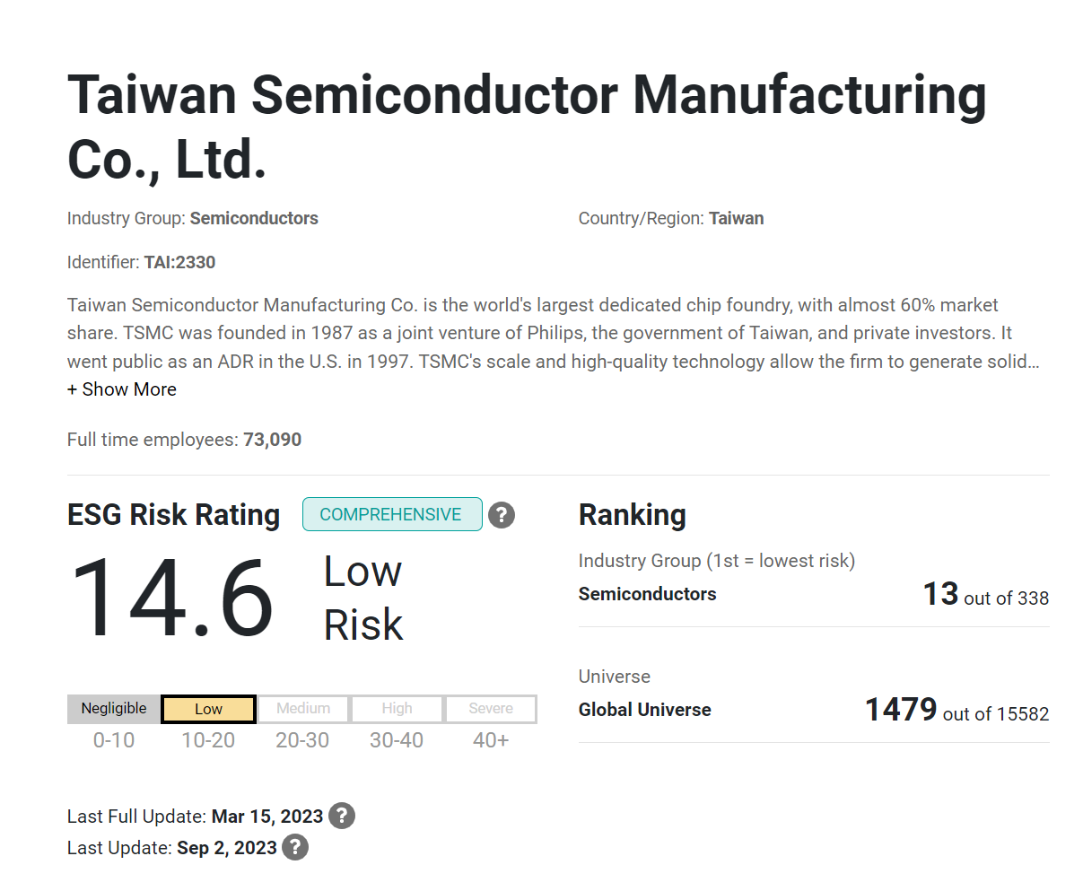
ESG Rating
Good ESG ratings
Negligible
Low
Bad ESG ratings
High
Severe
https://www.sustainalytics.com/esg-ratings

Slide 6
Group Project
Select 5 stocks with good ESG ratings and 5 stocks with poor ESG ratings, respectively.
Good ESG rating group vs. Poor ESG rating group
ESG rating search : https://www.sustainalytics.com/esg-ratings
Calculate monthly returns for past 60 months for each company
Calculate expected return (mean) and standard deviation for each stock
Constructing portfolios for good and poor ESG ratings
Calculate covariance between selected stocks => create covariance matrix
Create 10,000 possible portfolios for each group.
Locate the global minimum variance portfolio for two groups
Find weights of each stocks
Calculate expected returns and standard deviation of the global minimum variance portfolio.

Slide 7
Group Project
Locate the optimal risky portfolio P for two groups
Find weights of each stock for the optimal risky portfolio
Calculate expected returns and standard deviation of P
Assume rf = 3 %
Draw minimum variance frontiers for two groups
Plot CAL and indifference curve(utility function) tangent to mean-variance frontier using P and rf ( = 3 %) for two groups
Assume risk aversion = 4
Construct complete portfolios for two groups.
Calculate expected returns and standard deviation of complete portfolios for two groups

Slide 8
How to Submit
Submit .ipynb , html of python code, and a short report by Nov/26th, 11:59 PM (Sunday) on NTU COOL.
In a short report,
List firms with good ESG ratings and poor ESG ratings and their ESG score/ratings.
Compare expected returns and standard deviation of optimal portfolios for good ESG to poor ESG.
Compare expected returns and standard deviation of complete portfolios for good ESG to poor ESG.

Slide 9
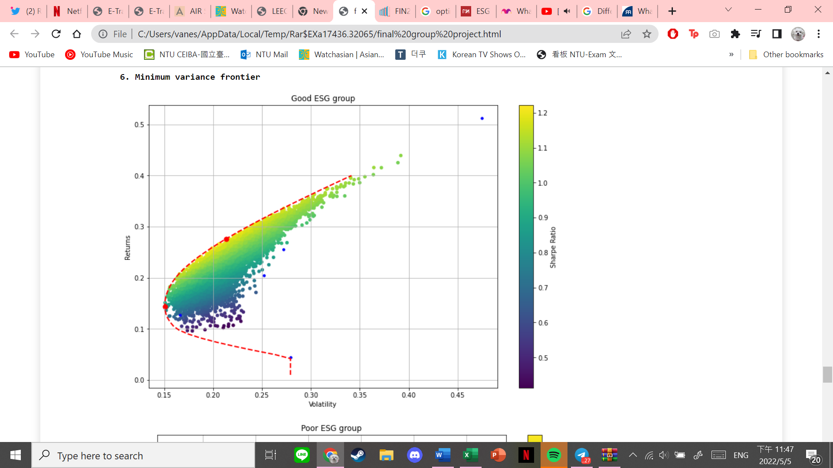
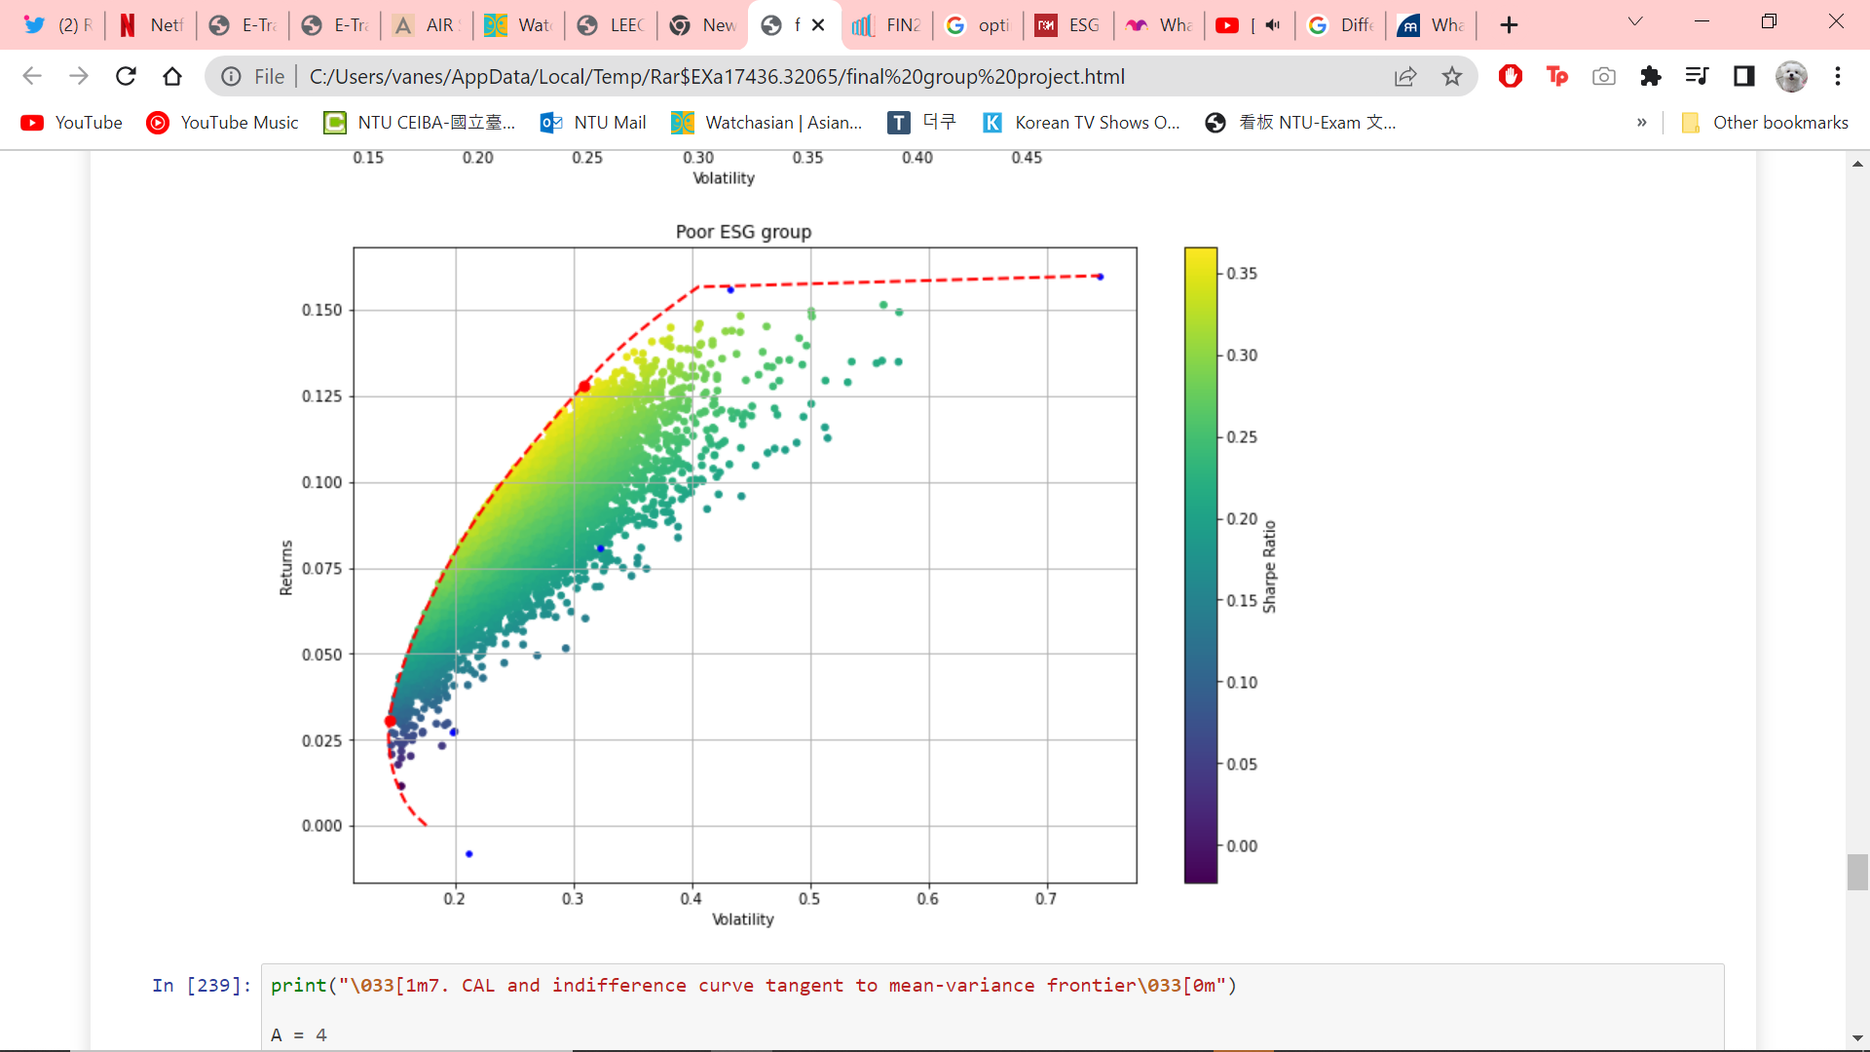
How to Submit
Include two figures for return and standard deviation of randomly generated 10,000 possible portfolios for good and poor ESG groups.

Slide 10
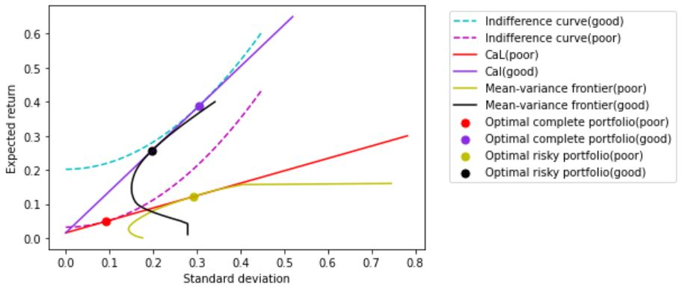
How to Submit
Include one figure with (1) indifference curve tangent( (2)Capital Allocation Line) to (3) mean-variance frontier for two groups
Pedersen et al. (JFE, 2021)

