Slide 1
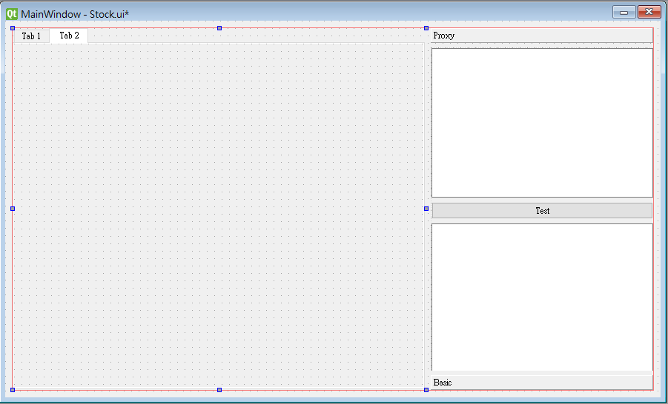
TabWidget
Height/Width can auto resize by enlarge or shrink windows
QToolBox
Height can autoresize
Width not

Slide 2
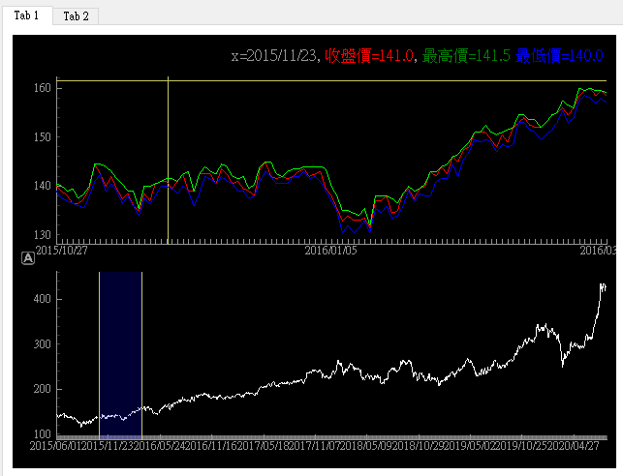
According to time region, show the information of price
Time Region
Can be drag
Can be enlarge and shrink
GraphicsLayoutWidget
PlotItem 1
PlotDataItem
PlotItem 2
https://pyqtgraph.readthedocs.io/en/latest/widgets/graphicslayoutwidget.html

Slide 3
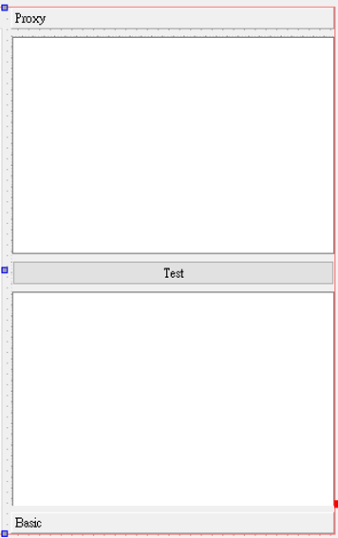
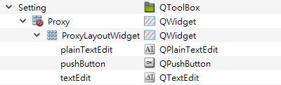
Proxy Panel
Add to gridlayout to manage widget
pyuic5.bat -o stockUI.py .\Stock.ui
Autogened python will not be auto resize by enlarge or shrink windows

Slide 4
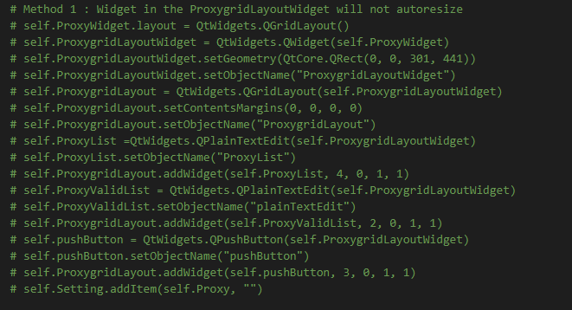
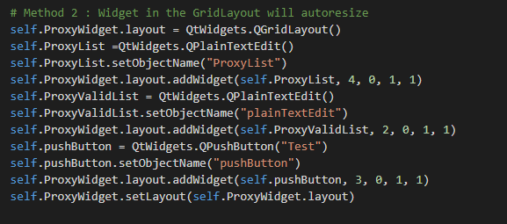
AutoGened
Modified

Slide 5

Width : QtWidgets.QSizePolicy.Fixed (prevent from expanding)
Height: QtWidgets.QSizePolicy.Preferred
A list of proxy server ip
Test Proxy
Test Result

Slide 6
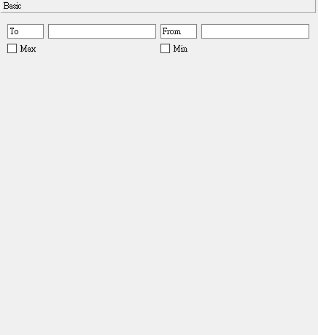
Change the graph
PlotItem.removeItem
PlotItem.addItem
Change the viewbox

