Slide 1
PRESENTATION
INTERNSHIP – WEEK 2
15 Sep 2023

Slide 2


1
1
Introduction
2
Tokenization
CONTENT
3
Word Embeddings
4
Next week: Encoder-Decoder
© Copyright FPT Software – Level of Confidentiality

Slide 3
01. Introduction

Slide 4
1
1
Introduction
2
Tokenization
CONTENT
3
Word Embeddings
4
Next week: Encoder-Decoder
© Copyright FPT Software – Level of Confidentiality

Slide 5

TOKENIZATION
1
2
3
4
Word based
‘cat is cute’
[‘cat’, ‘is’, ‘cute’]
Character based
‘cat is cute’
[‘c’, ‘a’, ‘t’, ‘i’, ‘s’, ‘c’, ‘u’, ‘t’, ‘e’]
Byte Pair Encoding
‘played’
['play', 'e', 'd']
Word Piece
‘playing’
['pl', '##a', '##y', '##i', '##ng']

Slide 6
TOKENIZATION
Word based
‘cat is cute’
[‘cat’, ‘is’, ‘cute’]
Character based
‘cat is cute’
[‘c’, ‘a’, ‘t’, ‘i’, ‘s’, ‘c’, ‘u’, ‘t’, ‘e’]
Byte Pair Encoding
‘played’
['play', 'e', 'd']
Word Piece
‘playing’
['pl', '##a', '##y', '##i', '##ng']
Simple & easy
Fine-grained Analysis
Context meaning
Context meaning
OOV

Slide 7
TOKENIZATION
4 methods comparison
Word based
Character based
BPE
Word piece
played’
{'pla+y', 'p+l', 'wi+t', 'pl+a', 'w+i'}
['play', 'e', 'd']
‘cat is cute’
[‘cat’, ‘is’, ‘cute’]
cat is cute’
[‘c’, ‘a’, ‘t’, ‘i’, ‘s’, ‘c’, ‘u’, ‘t’, ‘e’]
playing’
['pl', '##a', '##y', '##i', '##ng']
Text understanding
Statistical Analysis
Context meaning
OOV
Specific Language
Fine-Grained Analysis
Rare words
Context meaning
High dimension
Semantic Information
Adaptive Vocabulary
Handle OOV
Context meaning
Vocabularies Size
Token length
Reduce ambiguity
Longword
Not fully semantic
Require Memory

Slide 8
1
1
Introduction
2
Tokenization
CONTENT
3
Word Embeddings
4
Next week: Encoder-Decoder
© Copyright FPT Software – Level of Confidentiality

Slide 9


WORD EMBEDDINGS
1
2
Count based method
Prediction Based Method

Slide 10
WORD EMBEDDINGS
1
1
One hot encoding
cat : [0. 1. 0.]
is : [0. 0. 1.]
cute : [1. 0. 0.]
Count based method
Do not capture meaning

Slide 11

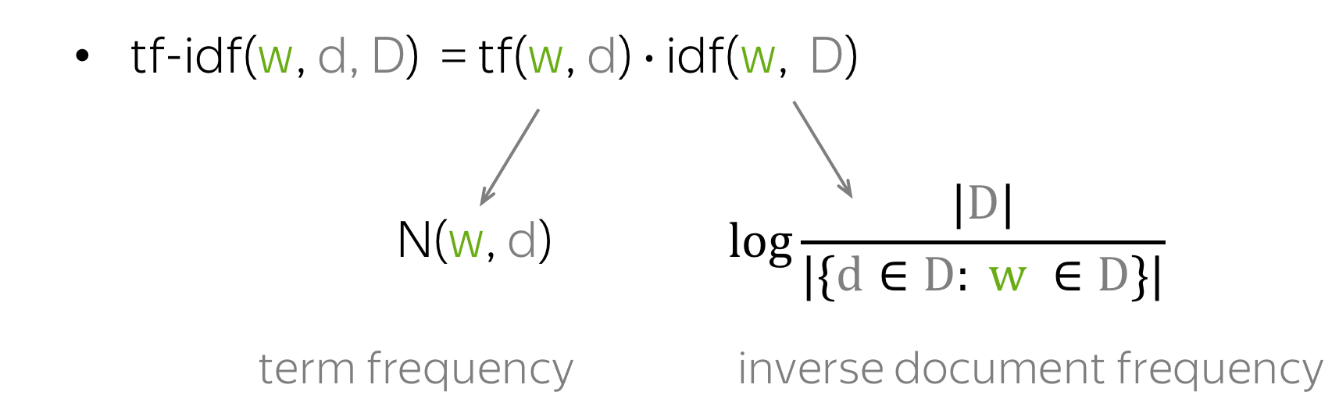
WORD EMBEDDINGS
Bag of words
"cat is cute"
vocabs = ['cat', 'dog', 'is', 'are', 'cute', 'ugly']
1
[1, 0, 1, 0, 1, 0]
Term Frequency –
Inverse Document Frequency
Count based method

Slide 12
WORD EMBEDDINGS
1
2
Count based method
Prediction Based Method

Slide 13

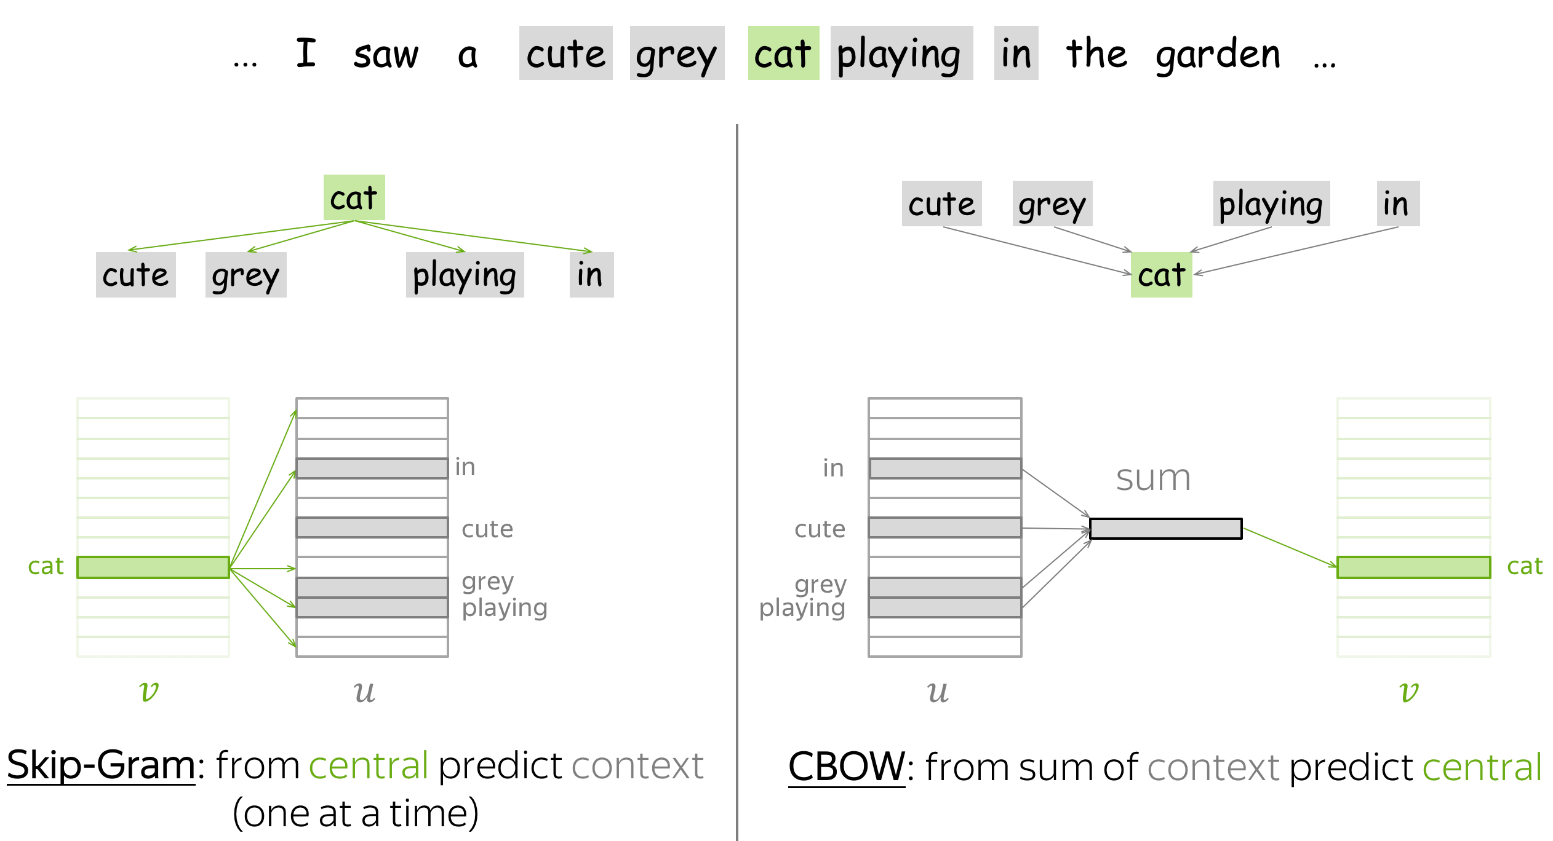
WORD EMBEDDINGS
Word2Vec
2
Prediction Based Method

Slide 14
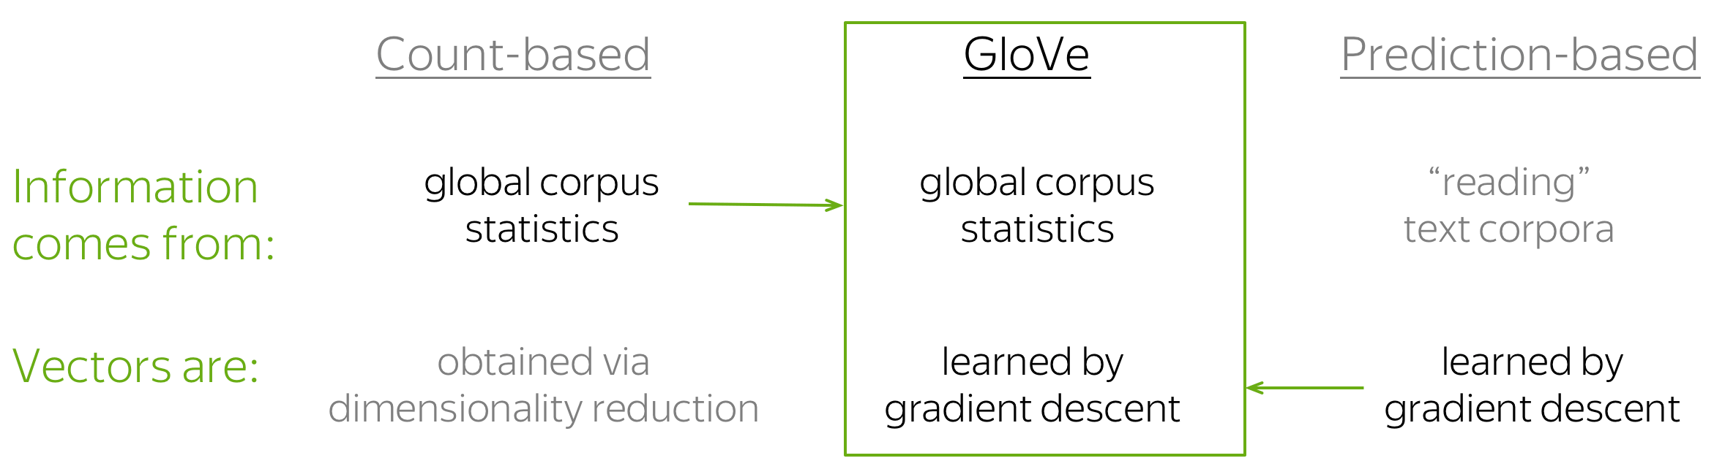
WORD EMBEDDINGS
GloVe
2
Prediction Based Method

Slide 15
WORD EMBEDDINGS
4 methods comparison
Bag of words
TF-IDF
Word2Vec
GloVe
‘cat is cute’
['cat', 'dog', 'is', 'are', 'cute', 'ugly’]
[1, 0, 1, 0, 1, 0]
Semantic Meaning
Global Context
Language Dependency
Rare words
Large model size
Simple
Context meaning
OOV
High dimension
Term important
Semantic Understanding
Open vocabulary
Context Window Size
Synonyms

Slide 16
01. Next week: Encoder - decoder

