Slide 1
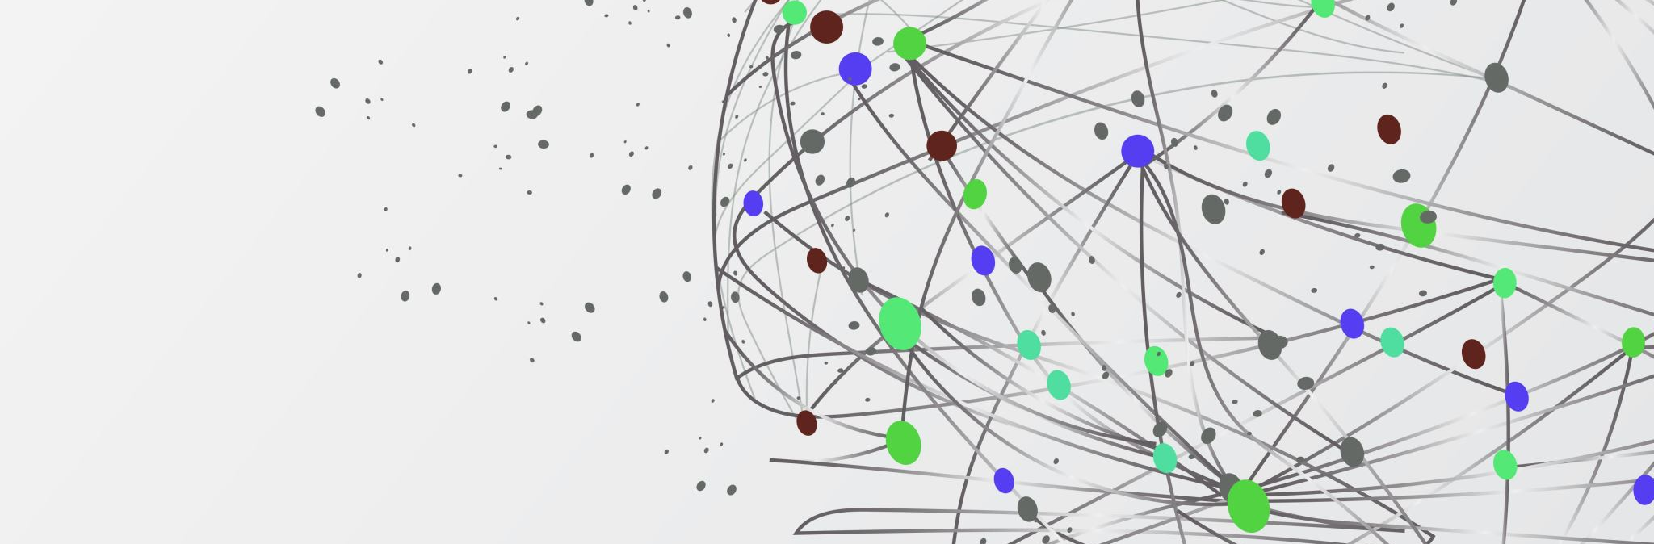
MNIST character recognition
By: Jean-Marc Rugomboka-Mahoro

Slide 2
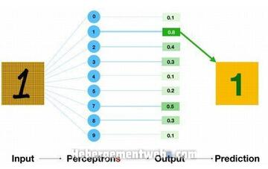
The multilayer feed-forward neural network
- Visible layer (input)
- Perception (options of 0-9)
- Percentage of the perception’s pixels matching the input pixels
- Number predicted (the perception with the highest probability)

Slide 3
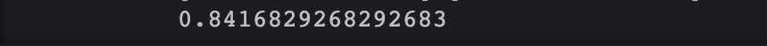
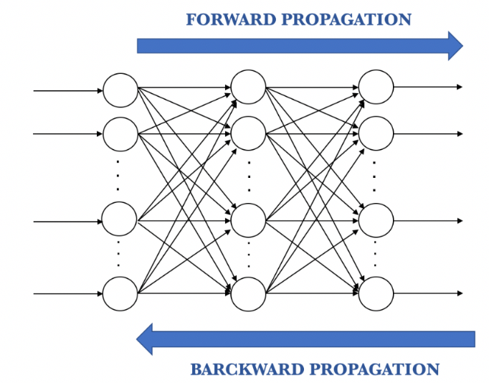
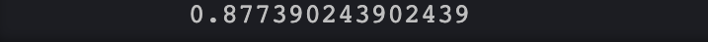
More training
From 55.29 seconds
to
1 minute and 51.34 seconds

Slide 4
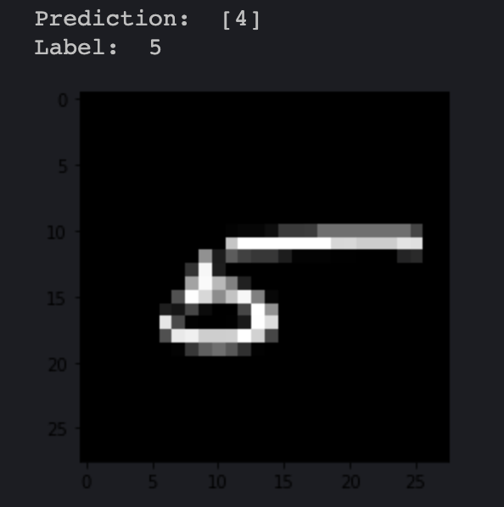
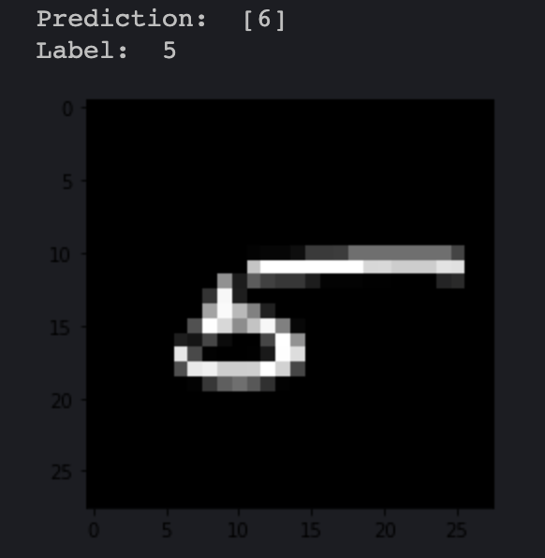
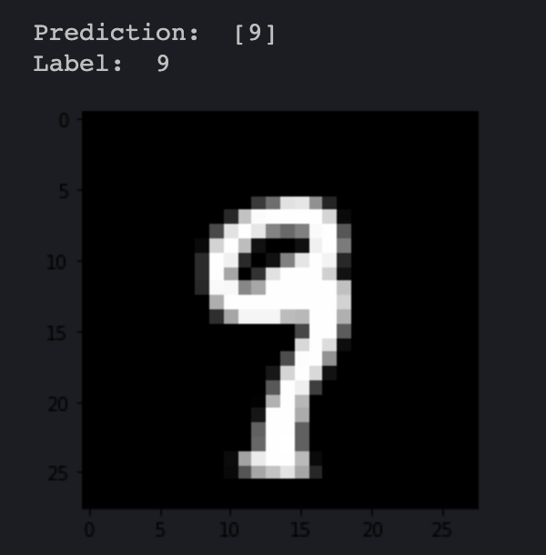
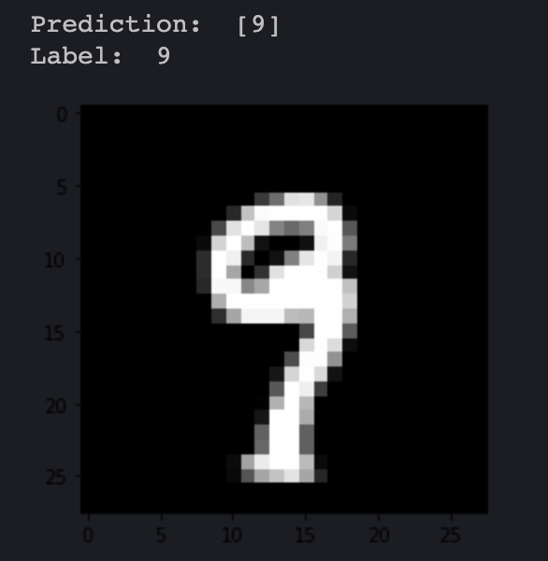
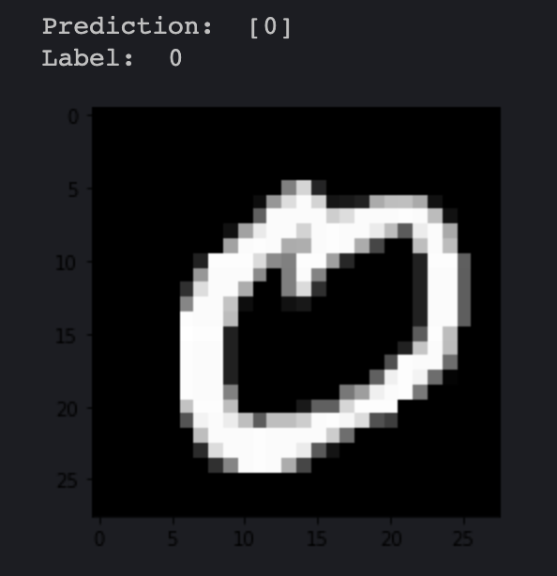
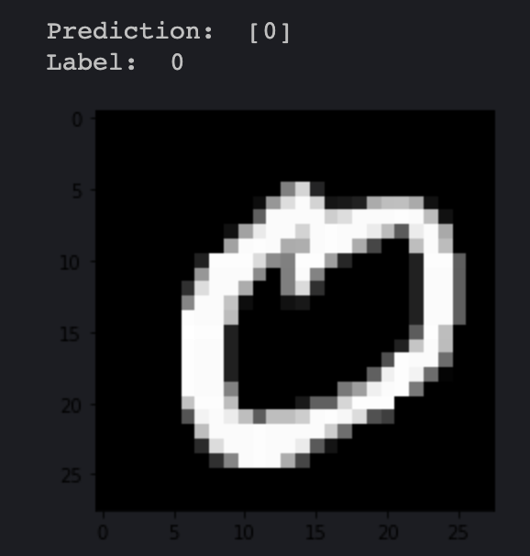
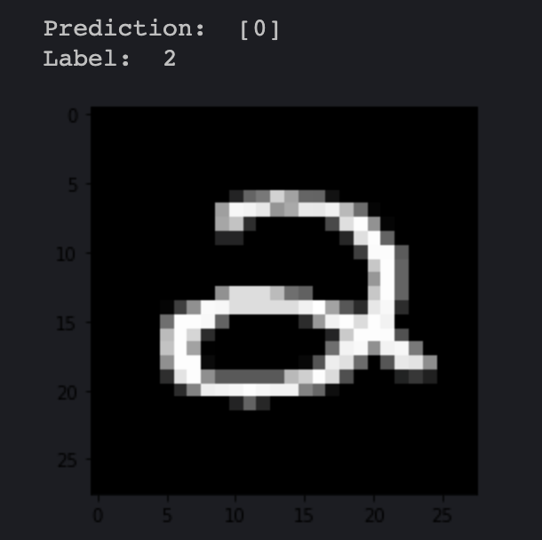
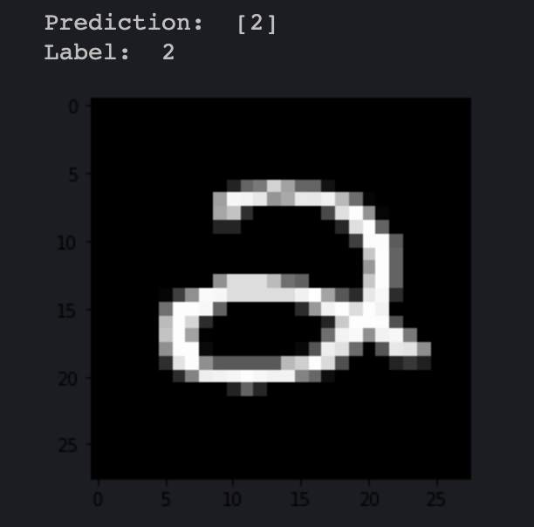
Results[1]
84% accuracy on the left side of the arrow, and 87% accuracy on the right side

Slide 5
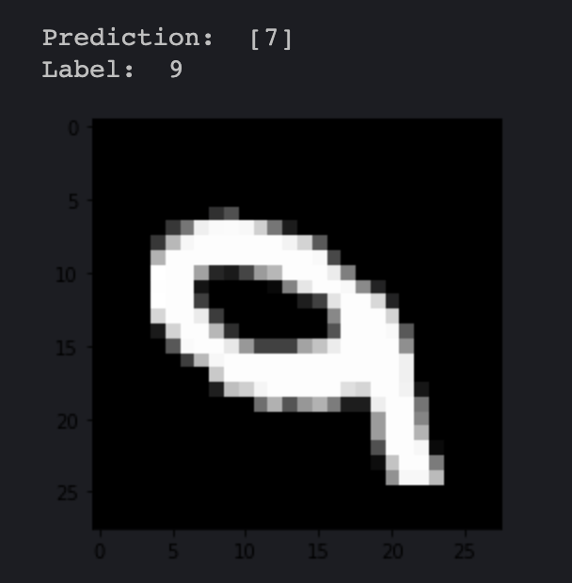
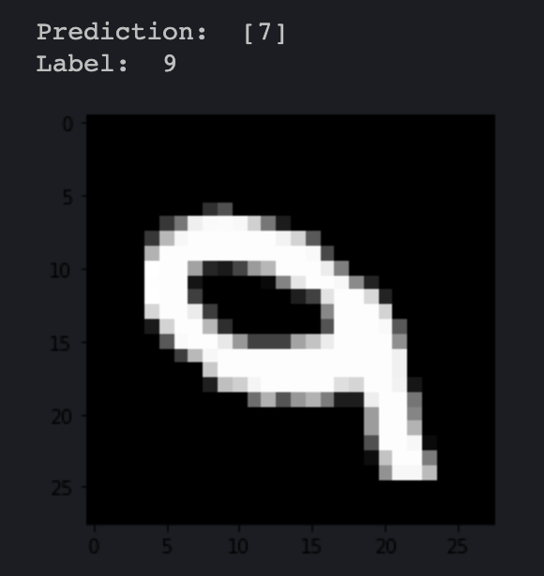
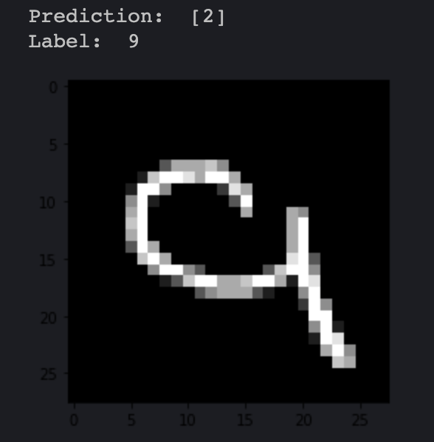
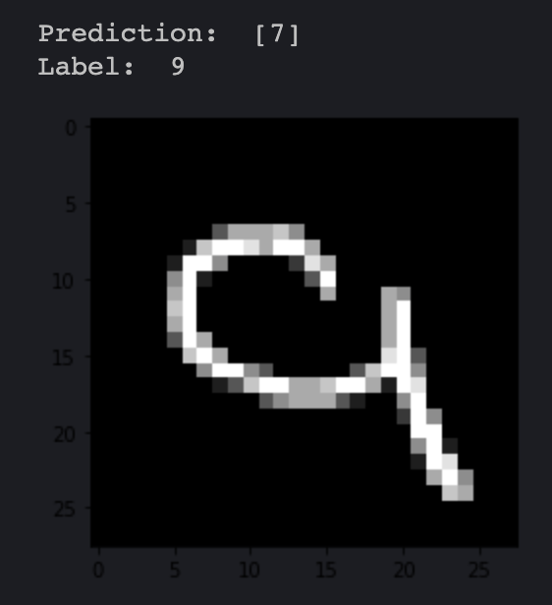
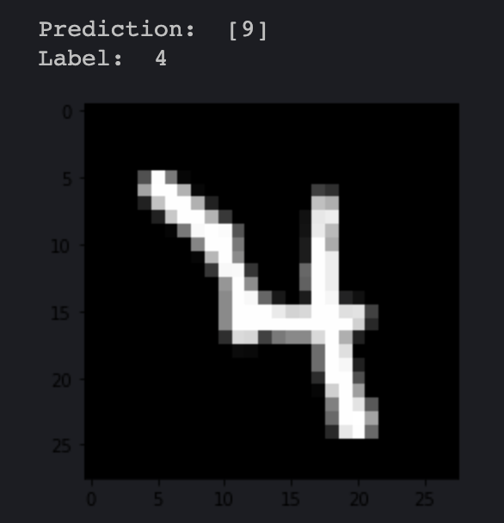
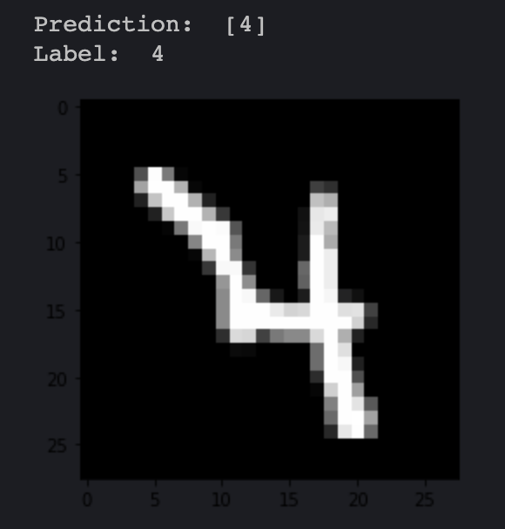
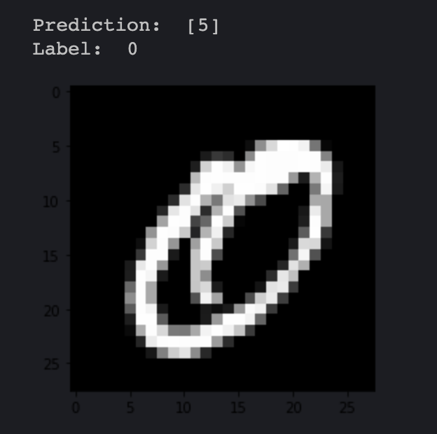
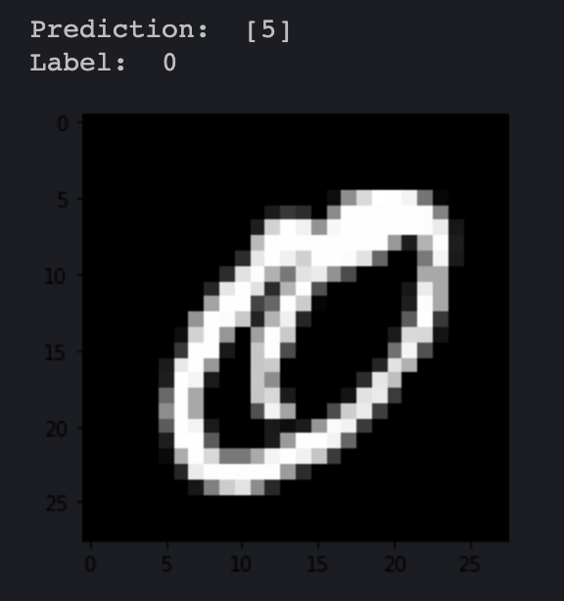
Results[2]
84% accuracy on the left side of the arrow, and 87% accuracy on the right side

Slide 6
Advantage vs disadvantage
Advantages
Accuracy increase by 3%
Simple
Disadvantages
Took almost a whole minute to increase accuracy by 3%
Flawed dataset makes increase in iterations inefficient

Slide 7
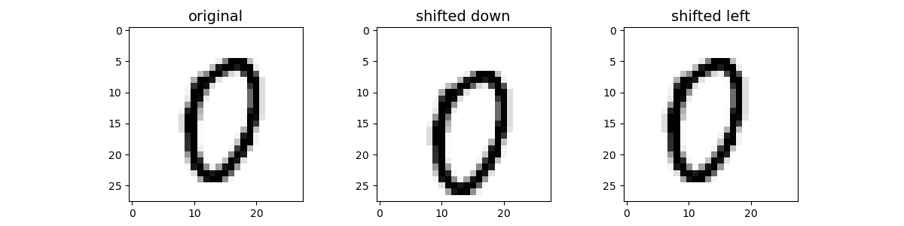
My implementation of the idea
Added more iterations for accuracy
Add more variety to training data set

Slide 8
Conclusion
Explanation of the multilayer feed-forward neural network
Increase accuracy
Images of results
Expanding the dataset with shifted digits and diagonal digits may have made a significant difference

