Slide 1
the University Registration Management System
Negar Hosseini 3619746 Haoliang Xu 3591976
Shehryar Baig 3668126 Jean-Marc Mahoro 3561706

Slide 2
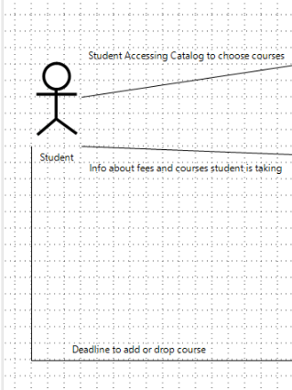
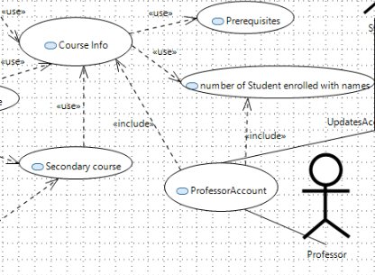
USER GUIDE
The University Registration Management System can be accessed by two types of users:
Students.
Add/Drop courses (before semester deadline)
Get semester schedule
Get semester billing
Professors.
Chooses the courses to teaching
Check courses’ information (enrolled students, etc)

Slide 3
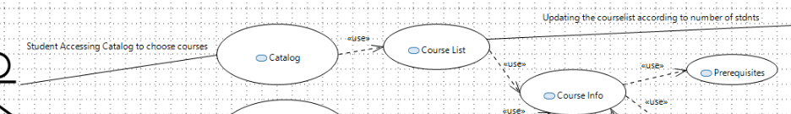
Request for Catalog
This can only be accessed by the Student User at the beginning of the semester.
The system can provide the names of the professor that is teaching that course.
This option will provide the user with detailed list of Courses, opting one course will redirect the user to another window showing more detailed information like Topics covered in that course, what prerequisite courses, he/she must have to attempt any course.
User can filter through the catalog to search for specific department courses

Slide 4
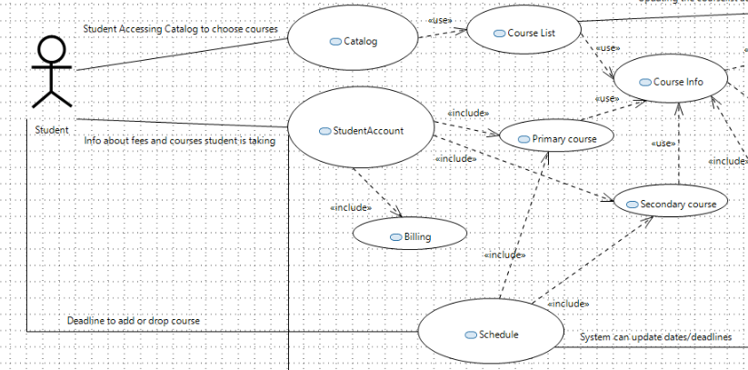
Register/Drop course
This can only be accessed by Student User.
Once the Student user is sure of what he/she will study they can use this option to register for this course and System will automatically update the Users account of what and how many courses they have taken*.
Student will be asked for the secondary courses in case if one of the primary courses gets cancelled**.
*Note: Students can take up to maximum of 4 courses as primary choices.
*Note: Students can take up to maximum of 2 courses as secondary choices.
*Note: For each course, the course will be canceled if enrolled students are more than ten or less than three students this is because the university focuses on the students' progress (less students = more focus from Professors)

Slide 5
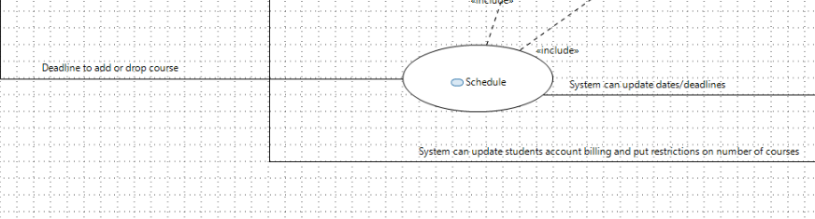
Schedule
This option is also only accessible by Student User.
It will provide the User with a Deadline to drop and register for a course*.
The student student will also be able to see the date the semester starts and ends.
Events will be shown (Holidays etc.).
*Note: Students cannot drop or register courses after deadline.

Slide 6
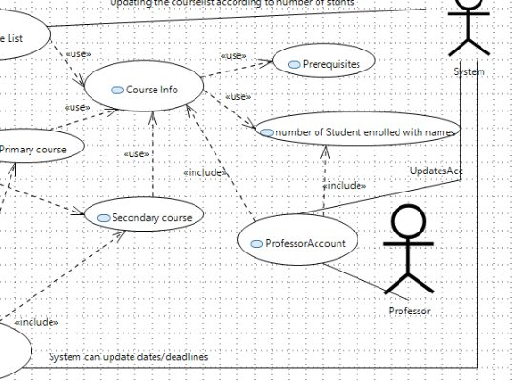
Course Information
This feature can be accessed by Professor User only*.
This will be provided if a professor asks for it.
This will just show the number of students registered for that specific course.
*Note: The course information will be updated with the professors’ information including name, department, etc.

Slide 7
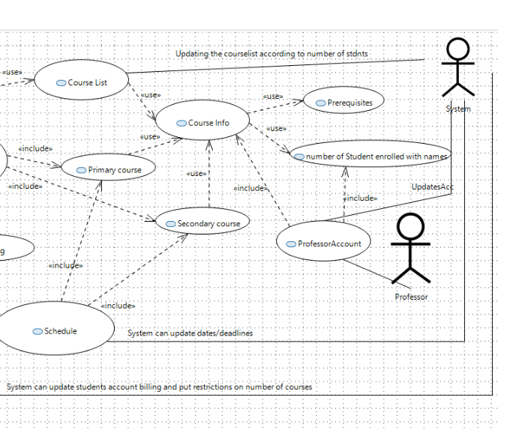
UPDATES TO ACCOUNTS
This is an automated controlled feature which is used to update both the Student and Professor account.
This can never be accessed by any user.
For student users this will update the billing once the courses are registered.
For Professor User this will update the courses they will be teaching, and the number of students in their class.
To keep information confidential this automated system only reaches to some specific extent in both user accounts.

Slide 8



overview
This system will help students to register and drop courses offered by University.
Professors will be pre-informed of how many students are in their class and what courses they will be teaching during this semester.
This will provide more manageable options for both users.

Slide 9
THANK YOU FOR LISTENING

