Slide 1
LOKA FLEET
MANAGEMENT SYSTEM — DICT REGION 2
DRIVERS' BRIEFING
How your four daily processes work in the app — and how to get every alert on your phone.
Vehicle Requests
OB Pass Slips
Gas Vouchers
Trip Records & Extract
Telegram Alerts
lokafleet.dictr2.cloud · October 2026
Notes:
Welcome drivers. Today: the four processes they will touch in LOKA Fleet — vehicle requests, OB pass slips, gas vouchers, and their trip records — then the Telegram integration so alerts reach their phones. Keep it practical: for each process, what the system does and what THEY do.

Slide 2
TODAY'S ROUTE
Six stops, one system
All the paper you used to sign by hand is now a digital record — and after every stop, a 15-minute hands-on workshop.
1
2
3
4
5
6
Vehicle Request
OB Pass Slip
Gas Voucher
Trip Records
Telegram
Experimental
Request, approve,
dispatch, complete
Gate pass + Certificate
of Appearance
Fuel authorization with
3 approval gates + QR
Your trip ticket +
driver trip extract
Alerts pushed to
your phone
GPS tracking and
the AI assistant
One login: lokastage.dictr2.cloud — same account, same password, works on phone and computer.
LOKA Fleet — Drivers' Briefing
02
Notes:
Set expectations: nothing is removed from the rules — approvals still happen, guards still log trips — but every piece of paper becomes a tracked digital record. The five stops: four processes plus Telegram at the end.

Slide 3
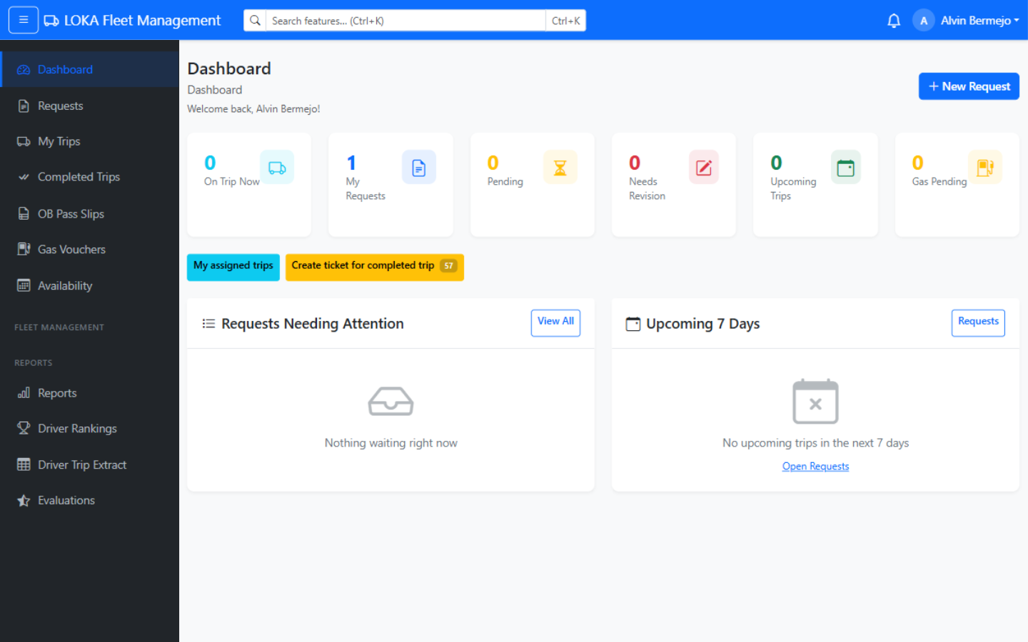
STAYING INFORMED
One login — every alert finds you
The system notifies you at every step. Four channels, so an alert always reaches you.
Bell
In-app — Instant — with a badge count on your menu.
@
Email — Full details, threaded by control number.
SMS
Text — Short message to your registered mobile.
TG
Telegram — Push to your phone — connect once (stop 5).
Alerts a driver gets: Requested as driver · Assigned as driver · Trip started · Trip completed · Changed or cancelled
Your driver dashboard — trips, pending tickets and requests at a glance.
Alerts are queued, never blocking the system — expect them within about 2 minutes of the event.
LOKA Fleet — Drivers' Briefing
03
Notes:
Drivers get: 'You Have Been Requested as Driver', 'You Have Been Assigned as Driver', 'Trip Started', 'Trip Completed', plus cancel/edit notices. In-app is instant; email/SMS/Telegram drain from a queue every 2 minutes. Telegram is opt-in — covered in the last section.

Slide 4
STOP 1 · VEHICLE REQUEST
From request to completed trip
The requester files online; approvers and motorpool act in the app; the guard's stamps close the loop.
Request filed
Pending approval
Motorpool review
Approved
submit
pending
pending_motorpool
approved
Requester confirms
Guard: dispatch + odometer
On the road
Trip completed
email · Proceed
dispatched
in_use · on_trip
completed
The small line inside each step is the exact status the app shows. Before the trip, the requester gets a confirmation email — one click and the trip is a go.
File early
Trips cap at 72 hours
Conflict-checked
The system enforces a booking window and minimum lead time before departure.
Longer trips are split — the app rejects over-length bookings automatically.
Motorpool sees schedule clashes before assigning a vehicle and driver.
LOKA Fleet — Drivers' Briefing
04
Notes:
Exact statuses: pending -> pending_motorpool -> approved -> completed (plus rejected / revision / cancelled). Requester files with destinations, passengers, preferred driver. Approval assigns vehicle + driver and notifies everyone. Guard dispatch/arrival with odometer readings flips the trip to completed and frees the vehicle and driver instantly.

Slide 5
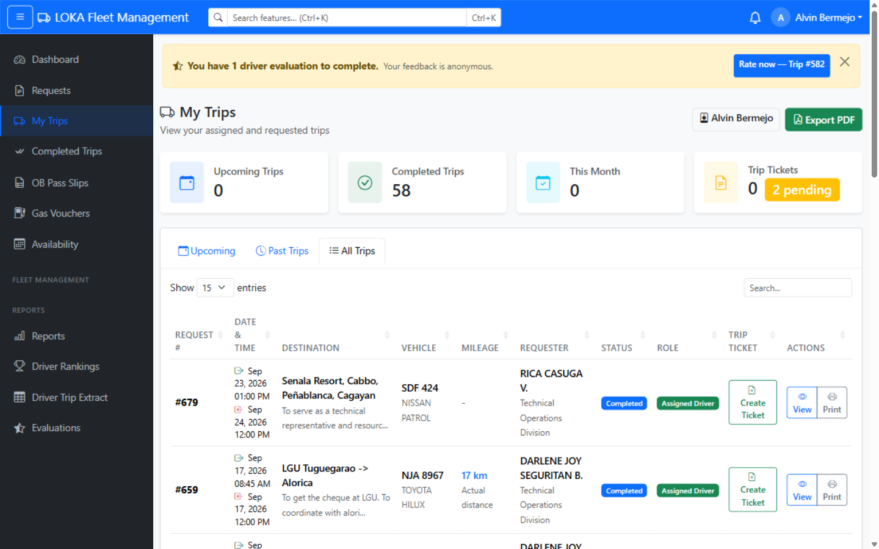
STOP 1 · YOUR PART
What you do, step by step
Six touchpoints — the system does the paperwork, you do the driving.
1
Assignment alert arrives
“You Have Been Assigned as Driver” — bell, email, SMS, Telegram.
2
Open My Trips
Your schedule: trips, destinations, passengers, assigned vehicle.
3
Gate: dispatch stamp
Guard records dispatch + odometer. Vehicle In Use, you On Trip.
4
Drive the trip
Stick to the approved destination and schedule.
5
Gate: arrival stamp
Guard records return + odometer — trip flips to Completed.
6
Get rated
Riders rate you anonymously: cleanliness, behavior, appearance, safety.
My Trips — assigned trips with Create Ticket and Print actions.
REMEMBER “Requested as driver” is not a confirmed trip — wait for the ASSIGNMENT alert before preparing the vehicle.
LOKA Fleet — Drivers' Briefing
05
Notes:
Walk through the notification names exactly as the app sends them. My Trips is driver-only in the sidebar. The evaluation invites go to passengers after arrival; results appear in the driver's own reports. If the vehicle breaks down mid-trip, call motorpool — admins can adjust the record.

Slide 6
WORKSHOP · STOP 1 · VEHICLE REQUEST
Hands-on: read your own schedule
Do it now on the practice account — or on your own phone if you already have a login.
15
SCENARIO
MINUTES
solo or in pairs · one phone or laptop per pair
Motorpool just assigned you to drive to Bayombong tomorrow, 8:00 AM. Nobody has called you yet — everything you need is in the app.
YOUR TASKS
1
Open My Trips
YOU'RE DONE WHEN
Sidebar → My Trips → All Trips. Find the Bayombong trip.
You can state tomorrow's schedule — time, destination, vehicle — without asking anyone.
2
Read the trip row
Say the date, time, destination, vehicle and plate out loud.
3
Export your schedule
Tap Export PDF — your trips list opens ready to print.
LOKA Fleet — Drivers' Briefing
06
Notes:
Run this live: the practice account (requester persona) is on the projector; drivers with accounts follow on their phones. Point at the Assigned Driver badge and the Completed status on the real rows. Common question: 'Requested vs Assigned' — answer with the slide 5 REMEMBER rule.

Slide 7
STOP 2 · OB PASS SLIP
The gate pass that follows you out the door
Official Business outside the office: numbered slip, supervisor approval, gate stamps, and a client-confirmed Certificate of Appearance.
Apply — 4 short sections
Supervisor approves
Motorpool approves *
Guard: DEPART stamp
pending_supervisor
approve button
pending_motorpool
departed
Guard: ARRIVE stamp
Client confirms CoA
Requester finalizes
Completed
arrival
coa_received
finalize
completed
* Official DICT vehicle only — a private-vehicle slip skips Motorpool and is approved right after the supervisor. Small lines = the exact status the app shows.
Needs changes? Supervisor or motorpool returns it for revision — you fix and resubmit. Cancel is final.
Bound to a trip? If the slip is tied to a vehicle request, the guard's dispatch/arrival stamps the slip automatically.
LOKA Fleet — Drivers' Briefing
07
Notes:
Revised flow: approvals are one-click buttons (no more e-signature canvases); the guard presses DEPART/ARRIVE with their login and a timestamp; the client confirms the Certificate of Appearance through a one-time link — a tick-box plus contact details — instead of a signature. Statuses: pending_supervisor -> pending_motorpool (official only) -> approved -> departed -> coa_received -> completed. NOTE: this revised flow is on staging; live prod still shows the e-signature version until rollout.

Slide 8
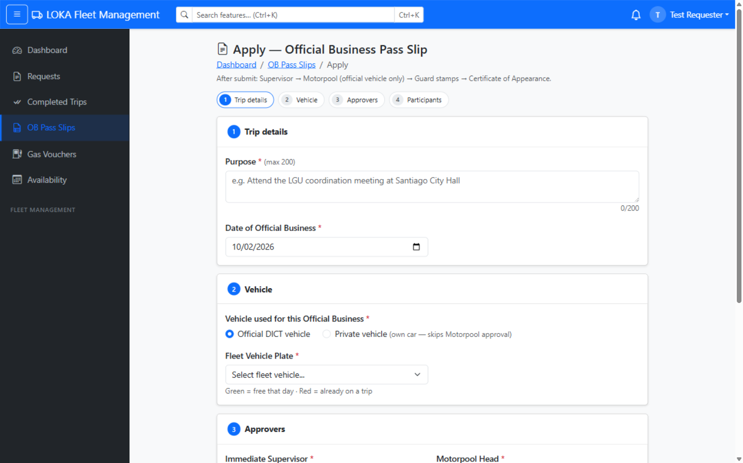
STOP 2 · YOUR PART
Filing an OB pass slip
One form, four short sections — then the slip travels while you do.
1
Apply — Steps 1 & 2
Trip details (purpose + date); vehicle: official DICT plate or private.
2
Apply — Steps 3 & 4
Pick supervisor (+ motorpool head for official); optional companions.
3
Print the approved slip
Every slip carries its own pass slip number.
4
Gate stamps
Guard taps DEPART / ARRIVE — your time-stamped gate record.
5
Client confirmation
The office visited ticks proof-of-service, leaves name + contact.
6
Finalize
You close the slip — its QR verifies it as genuine on any phone.
The apply form — four guided sections, one submission.
REMEMBER Driving for someone's OB? The slip, the stamps and the client confirmation are one connected record — no more lost paper.
LOKA Fleet — Drivers' Briefing
08
Notes:
The apply form is sectioned into 4 steps: Trip details, Vehicle, Approvers, Participants. Private vehicle = no motorpool step. The CoA kiosk needs at least one contact (mobile or official email) — motorpool spot-checks a few numbers monthly, so the visit must be real. The QR opens a public verify page with the contact masked.

Slide 9
WORKSHOP · STOP 2 · OB PASS SLIP
Hands-on: encode a paper pass slip
Do it now on the practice account — or on your own phone if you already have a login.
15
SCENARIO
MINUTES
solo or in pairs · one phone or laptop per pair
You are handed yesterday's paper pass slip: employee J. Cruz, Santiago City Hall meeting, this Friday, official DICT vehicle, one companion.
YOUR TASKS
1
Apply — Steps 1 & 2
YOU'RE DONE WHEN
Encode purpose and Friday's date; pick Official DICT vehicle.
You can name the 4 sections and who approves: official = supervisor + motorpool, private = supervisor only.
2
Apply — Steps 3 & 4
Choose the supervisor, add the companion, check the print preview.
3
Trace the approvals
Open an approved sample slip — find the guard DEPART stamp and the QR.
LOKA Fleet — Drivers' Briefing
09
Notes:
Bring 2-3 real (old) paper pass slips for the encode drill — it is the fastest way to make the form familiar. Do NOT submit in bulk: one live submission is enough, then walk the group through an approved slip's view page (guard times card + QR). Mention the 200-character purpose counter.

Slide 10
STOP 3 · GAS VOUCHER
No fuel moves without three pairs of eyes
A numbered fuel authorization with three approval gates — and a QR code that proves it is real at the pump.
File — draft or submit
Gate 1 · Motorpool review
Gate 2 · Budget Officer certifies funds
draft
pending_review
pending_budget
Gate 3 · Chief Admin & Finance approves
Approved — print the QR voucher
pending_approval
approved
Fuel up at an accredited station
Payment tracked
present the voucher
unpaid → paid
Any gate can reject
Only accredited stations
Finance closes the loop
A rejection comes back with the reason — fix it and file again.
Pick from the official station list; the voucher states vehicle, fuel and liters.
Payment status is tracked until the station is paid — no mystery balances.
LOKA Fleet — Drivers' Briefing
10
Notes:
Exact statuses: draft -> pending_review -> pending_budget -> pending_approval -> approved (or rejected / cancelled). Gate 2 is new: a flagged Budget Officer must certify funds before the Chief of Admin & Finance gives final approval. The requester can nominate a preferred budget officer. Payments move unpaid -> paid/processed.

Slide 11
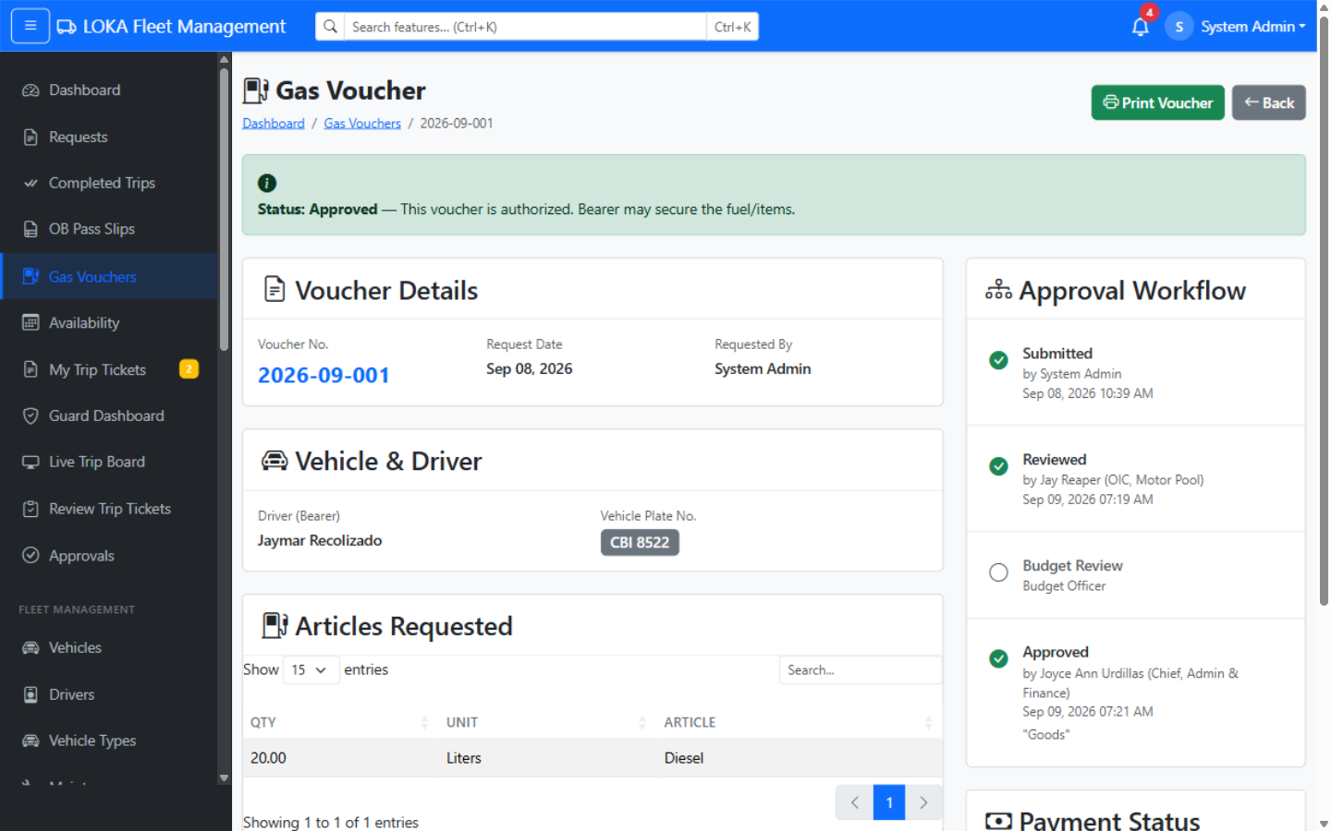
STOP 3 · YOUR PART
Getting fuel the digital way
Five steps from request to a full tank.
1
File the voucher
Vehicle, fuel type, liters, accredited station — draft or submit.
2
Track the 3 gates
Motorpool review → Budget certification → final approval.
3
Print once approved
The printable voucher carries a QR code.
4
Present at the pump
Station staff scan the QR — a public page proves it is genuine.
5
Payment status
Finance marks it paid — you see where the voucher stands.
An approved voucher — status banner, approval workflow and articles.
REMEMBER The QR code is the anti-fake check — station staff verify it on any phone, no login needed.
LOKA Fleet — Drivers' Briefing
11
Notes:
Vouchers are filed under the filer's own account; the driver name field is free text with suggestions from the driver roster. Only approved vouchers should be presented — the verify page shows the approval status, so an unapproved or tampered printout fails the scan.

Slide 12
WORKSHOP · STOP 3 · GAS VOUCHER
Hands-on: file it, then prove it
Do it now on the practice account — or on your own phone if you already have a login.
15
SCENARIO
MINUTES
solo or in pairs · one phone or laptop per pair
The patrol vehicle needs 20 liters of diesel before a long trip. The station is on the accredited list.
YOUR TASKS
1
File a voucher
YOU'RE DONE WHEN
Gas Vouchers → New. Vehicle, diesel, 20 liters, station → Save as draft.
You can explain why a pending voucher cannot fuel a trip, and what the QR proves at the pump.
2
Submit it
Open the draft → Submit. Watch the status become Pending Review.
3
Verify a real voucher
Open the approved sample on screen and scan its QR with your phone.
LOKA Fleet — Drivers' Briefing
12
Notes:
The QR scan is the wow moment — project the approved voucher (2026-09-001) and have everyone scan it; the public verify page opens without a login. Stress the three gates: nothing moves until all three are green. If asked who files: staff with gas access, including tagged drivers.

Slide 13
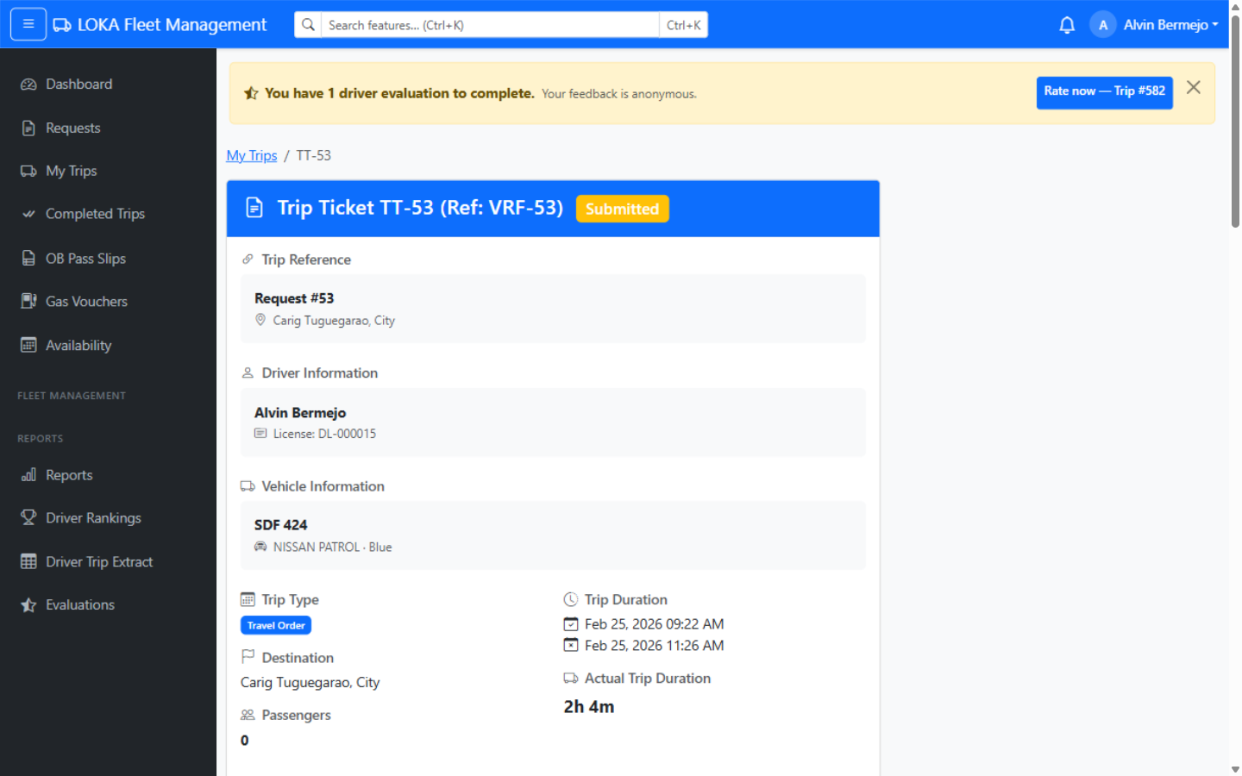
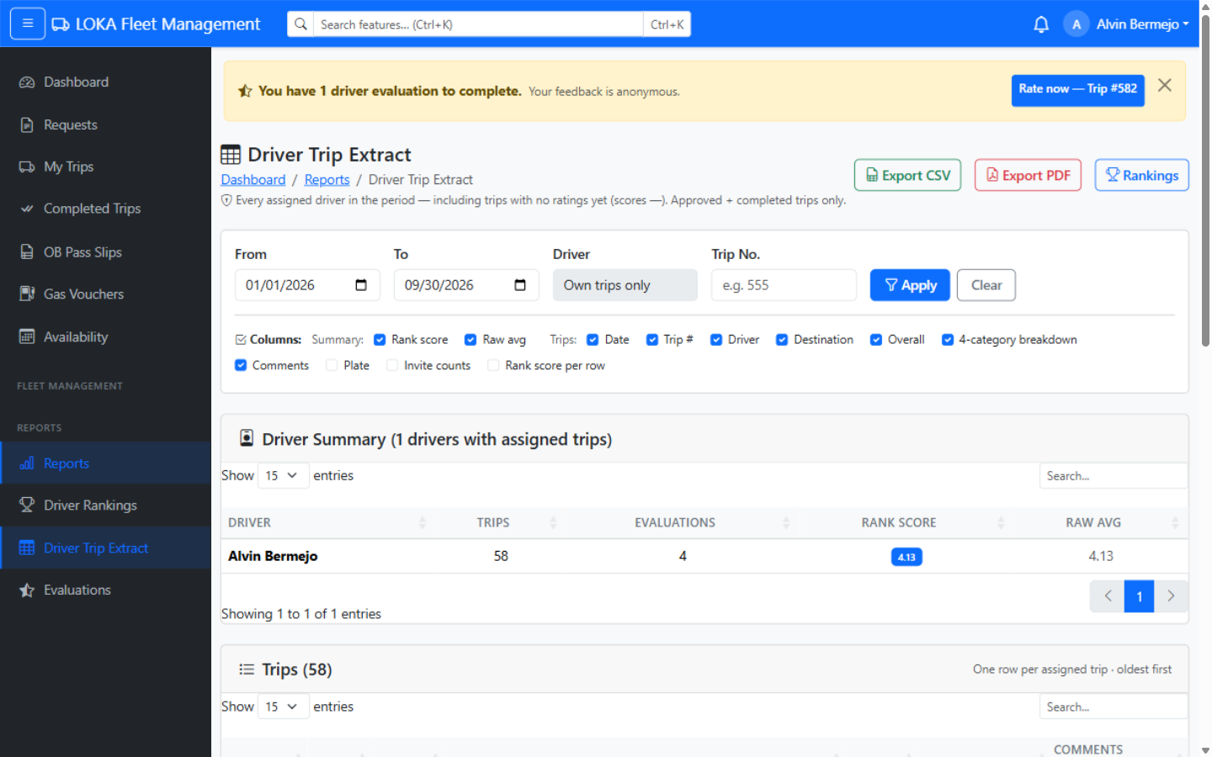
STOP 4 · TRIP RECORDS
Your ticket, your numbers
Every completed trip becomes an official record — and every trip you drove is extractable on demand.
The trip ticket — one trip's official record
The driver trip extract — all your trips
Created from My Trips after arrival — pre-filled with times and odometer.
Every assigned trip in a date range + your ratings — export CSV / PDF.
LOKA Fleet — Drivers' Briefing
13
Notes:
Drivers create tickets for their own completed trips (My Trips -> Create ticket; admins can assist). The dashboard nags until a completed trip has its ticket. The extract counts trips with status approved or completed where you were the assigned driver, inside the date range. Ratings shown come from passenger evaluations.

Slide 14
STOP 4 · YOUR PART
Pulling your own trip record
Sixty seconds, any date range, print-ready.
1
Open the report
2
Set the range
Reports, then Driver Trip Extract — as a driver you automatically see only your own trips.
Choose From / To dates. Filters for vehicle and control number are there too.
3
Read the summary
4
Scan the trips
Trip count, evaluations received, and your fair rank score for the period.
One row per trip: date, control no., destination, overall rating and the 4 rating categories.
5
Choose columns
6
Export
Tick what you need — plate number, invite counts, comments — the screen is the export.
Download as CSV (for encoding) or PDF (for printing and filing).
REMEMBER Raters stay anonymous — comments always print as “Anonymous passenger”. Trips with no ratings yet show a dash.
LOKA Fleet — Drivers' Briefing
14
Notes:
Self-scoped drivers only see their own data (My Driver Report). Rankings use a Bayesian fair score so a driver with 2 ratings cannot outrank one with 40 on a lucky average — m=5 prior toward the fleet mean. Unranked drivers appear in a separate 'too few evaluations' table.

Slide 15
WORKSHOP · STOP 4 · TRIP RECORDS
Hands-on: ticket it, then extract it
Do it now on the practice account — or on your own phone if you already have a login.
15
SCENARIO
MINUTES
solo or in pairs · one phone or laptop per pair
You have just returned from a completed trip. The office needs the record for the file — today, while details are fresh.
YOUR TASKS
1
Create the ticket
YOU'RE DONE WHEN
My Trips → a completed trip → Create Ticket. Check times and odometer.
You created a ticket and exported your own extract — no logbook, no handwriting.
2
Save and open it
Save, then view the ticket — control no., route, passengers all pre-filled.
3
Pull your extract
Reports → Driver Trip Extract → set this month → Export PDF.
LOKA Fleet — Drivers' Briefing
15
Notes:
Use the driver persona's real completed trips (58 available locally). Emphasize checking the odometer against the dashboard before saving — corrections later need an admin. The extract's rank score will come up; one sentence: it balances few vs many ratings fairly, raters stay anonymous.

Slide 16
STOP 5 · TELEGRAM
Your alerts, in your pocket
LOKA Fleet can push the same alerts to the Telegram app on your phone — free, fast, and it works anywhere.
1
Never miss an assignment
The driver-assignment ping reaches you even when you are away from the office desk.
LOKA Fleet Bot
[Vehicle] You have been assigned as Driver — Control No. 1042, Oct 5 8:00 AM, Tuguegarao to Bayombong.
2
Same events you already get
Every alert that hits your bell and inbox can also land in Telegram — tagged per process.
[OB] OB Pass Slip #12 approved. Print it before your trip.
3
Private and opt-in
Only you can link your account. No link, no messages — nothing is broadcast.
[Gas Voucher] Voucher #9 approved — print the QR voucher.
The [tag] matches the email colors — you know the process at a glance.
LOKA Fleet — Drivers' Briefing
16
Notes:
Telegram-only: Viber was dropped (commercial paywall). Alerts are queued and delivered within ~2 minutes; sending never blocks the app. Messages are short texts with the process tag — the same tags and colors used in email: blue Vehicle, teal OB, orange Gas Voucher.

Slide 17
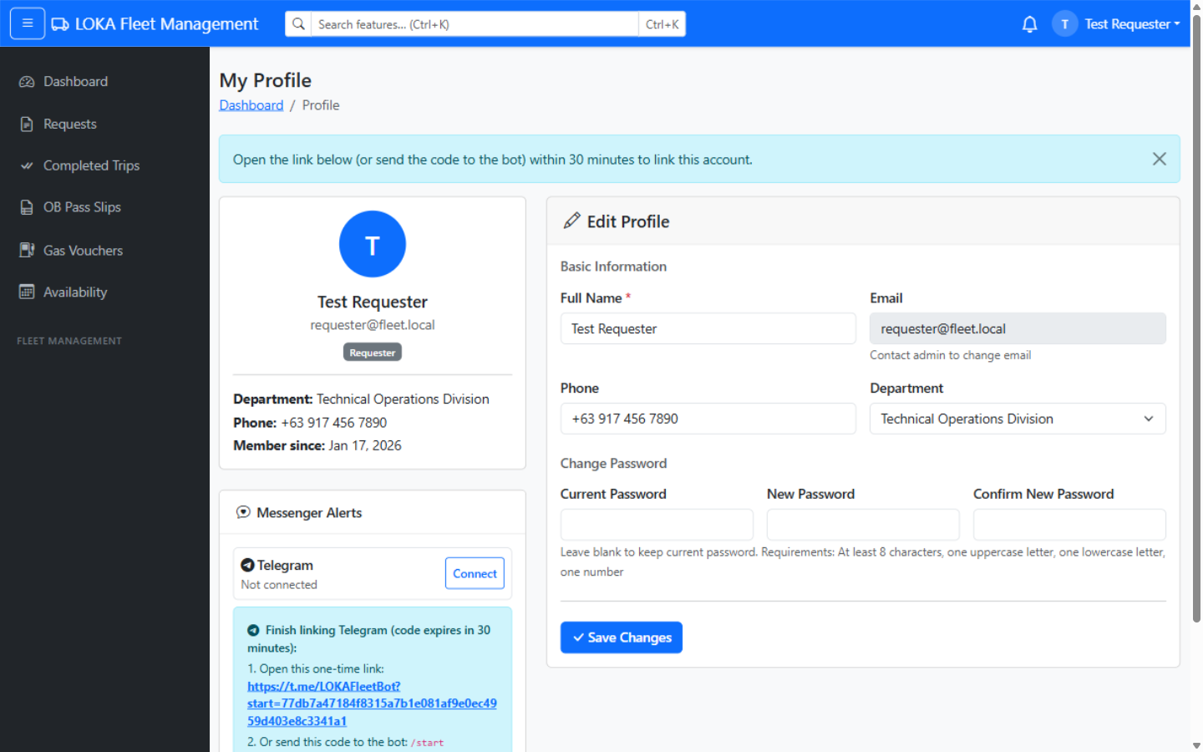
STOP 5 · ONE-TIME SETUP
Connect Telegram in two minutes
Do this once today — every alert after that arrives on its own.
1
Install Telegram
Free app — register with your mobile number.
2
Open your profile
Log in, click your name, Profile, Messenger Alerts.
3
Click Connect
The system shows a one-time link and a short code.
4
Open the link
Telegram opens with the LOKA Fleet bot — press START.
5
See Connected
A green Connected badge appears. You are done.
6
Anytime: Disconnect
One click in the same card — or ask an admin.
Profile → Messenger Alerts — the one-time link and /start code.
REMEMBER The link is one-time and expires after 30 minutes — if it lapses, just click Connect again for a new one.
LOKA Fleet — Drivers' Briefing
17
Notes:
Flow: Profile -> Messenger Alerts -> Connect -> one-time deep link https://t.me/<bot>?start=<token> (or send '/start <token>' to the bot). Token TTL is 30 minutes, single use. Disconnect clears the binding. Admins can set the chat ID from User Management instead. No binding = no Telegram messages, but bell + email + SMS continue.

Slide 18
WORKSHOP · STOP 5 · TELEGRAM
Hands-on: connect before you leave
Do it now on the practice account — or on your own phone if you already have a login.
15
SCENARIO
MINUTES
solo or in pairs · one phone or laptop per pair
Your next assignment could come while you are on the road. Set up the alert channel on your own phone — now, not later.
YOUR TASKS
1
Install Telegram
YOU'RE DONE WHEN
Play Store / App Store → register with your mobile number.
Your profile shows a green Connected badge — the next assignment will ring on your phone.
2
Connect in LOKA
Profile → Messenger Alerts → Connect → open the one-time link.
3
Press START
The LOKA Fleet bot replies — your profile shows Connected.
LOKA Fleet — Drivers' Briefing
18
Notes:
This is the take-home action of the whole briefing — leave real time for it. Helper tip for the room: the link expires after 30 minutes, so click Connect only when you are ready to open Telegram. Anyone stuck can be linked by an admin instead (User Management → chat ID).

Slide 19
STOP 6 · EXPERIMENTAL
Fresh from the workshop: what's next
Four new tools are built and being tested. Each ships switched OFF until the region is ready — expect them soon.
GPS Trip Tracking
for drivers
See the vehicle live during a trip — from the driver's phone. Starts at the guard's dispatch, stops at arrival.
Why “experimental”?
1
Off by default
AI Assistant
for everyone
Nothing changes until the region switches it on in System Control.
Ask in plain words — “What is the status of my trip?” It shows what it is checking, then answers with a link.
2
Tested first
Vehicle Repair History
for motorpool
Fully built and QA'd locally; staging next — production only after sign-off.
Every repair with parts and cost, one record per plate — searchable and printable, imported from the old Excel workbooks.
3
You will be told
Deeper Rollback View
for admins
Drivers get a heads-up (like this one) before GPS or the assistant go live.
Admins can step a request back to any earlier approval stage — with the complete trail kept for audit.
LOKA Fleet — Drivers' Briefing
19
Notes:
Plans #38-41 on branch plans-38-41-experimental: Repair History (#38), Rollback full stages (#39), AI assistant (#40), GPS tracking (#41). All implemented + QA'd on localhost, default OFF behind System Control flags. Today is awareness only — no training needed until each goes live. The next two slides demo the two drivers will touch: GPS tracking and the AI assistant.

Slide 20
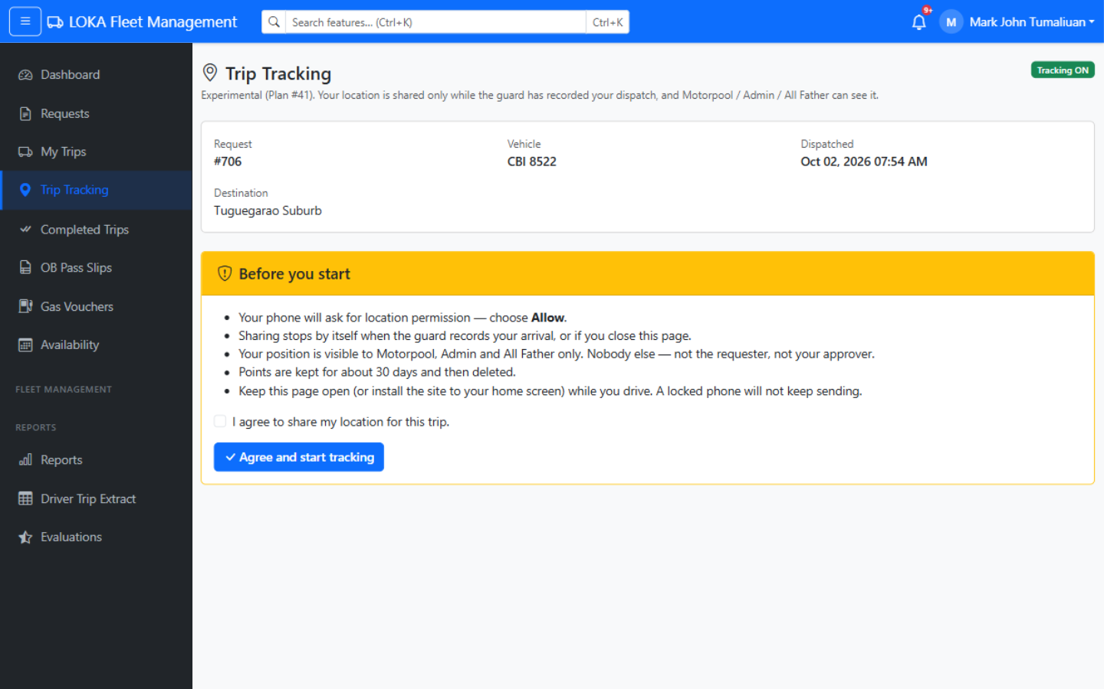
EXPERIMENTAL · GPS TRACKING
Your phone becomes the trip tracker
While you drive a dispatched DICT vehicle, motorpool can see where you are — no extra device, no app store.
1
Starts and stops by itself
Guard DISPATCH starts sharing; ARRIVAL stops it. No buttons for you.
2
One-time consent
First trip: tick “I agree to share my location” — it is always your choice.
3
Keep the page open
Add it to your home screen. A locked phone pauses sharing — trail just stops.
4
Gentle on battery
One location ping about every 45 seconds while you move; weak fixes are dropped.
5
Private by design
Only Motorpool, Admin and All Father ever see it — never the requester or approver.
6
Nothing kept forever
Points auto-delete after 30 days.
The driver's Trip Tracking page — trip, vehicle and the consent box.
REMEMBER Experimental and off right now — when the region switches it on, you will get the same walkthrough live.
LOKA Fleet — Drivers' Briefing
20
Notes:
Plan #41. Tracking window = approved + dispatched + no arrival; scope v1 is DICT fleet vehicles only (not private-vehicle OB). The ops Live Board shows exact lat/lng + an SVG trail to Motorpool/Admin/All Father only; no third-party map tiles. Pings every 45s, fixes worse than 200 m dropped; 30-day retention purge. Real browser QA: consent, ping, live board trail all verified.

Slide 21
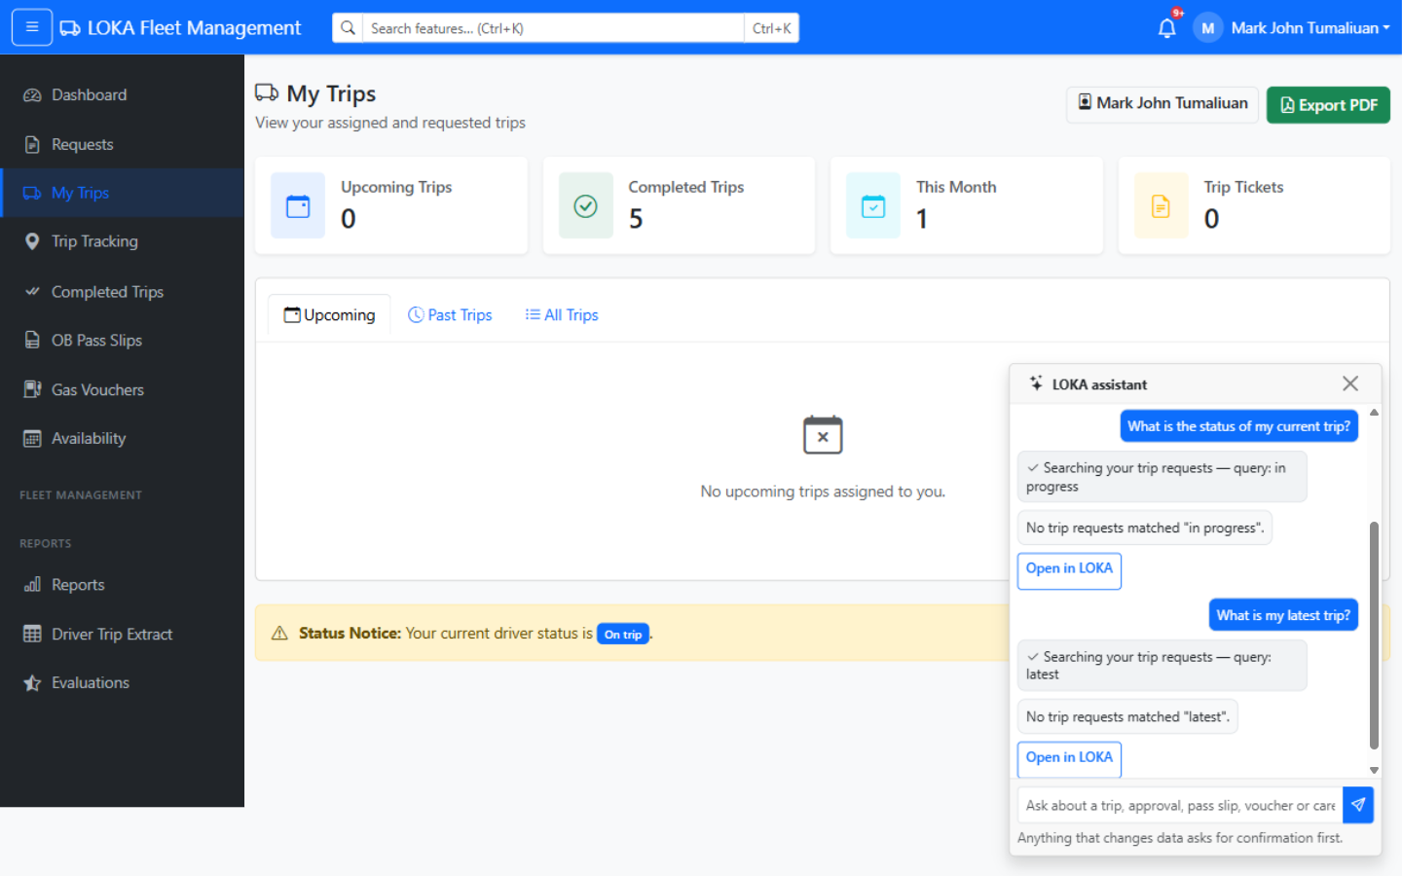
EXPERIMENTAL · AI ASSISTANT
Ask the fleet assistant in plain words
A chat bubble on every page — ask about your trips, pass slips, vouchers or approvals instead of digging through menus.
1
Just ask
“What is the status of my current trip?” — it understands and looks it up.
2
It shows its work
Every lookup appears as a trace line (“Searching your trip requests…”) before the answer.
3
Answer + deep link
Results come with an “Open in LOKA” button straight to the record.
4
It cannot click buttons
Approvals stay human — the assistant at most opens the right screen for you.
5
Safe by default
Writes ask for Confirm first; rate-limited per user; fully logged in the audit trail.
Real session — the trace line shows the lookup, then “Open in LOKA”.
REMEMBER Experimental and off right now — switched on per region once the free AI model pool is proven reliable.
LOKA Fleet — Drivers' Briefing
21
Notes:
Plan #40. OpenRouter-backed, free-model catalogue, key stored server-side. 9 tools; 8 read-only, the only write creates a pending care item an approver must still approve. Role-scoped: a driver's chat can only ever touch the driver's own records; View-as uses the effective role. Every tool call audited (ai_tool_executed). Default model qwen/qwen3.8-27b:free; ~30 prompts/user/hour app-side on top of provider limits.

Slide 22
BEFORE YOU GO
Six golden rules in LOKA Fleet
Small habits that keep your records clean and your trips smooth.
1
File early
2
Mind the gate
Requests and pass slips need lead time — the booking window is enforced automatically.
Departure and arrival stamps make the official record — no stamp, no completed trip.
3
Odometer honest
4
Ticket right away
Readings are checked against vehicle history — log the real numbers.
Create the trip ticket as soon as the trip is completed, while details are fresh.
5
Your login = your name
6
Connect Telegram
Every approval, stamp and ticket is logged under your account. Never share it.
One-time setup so the next assignment finds you on your phone, not on a bulletin board.
LOKA Fleet — Drivers' Briefing
22
Notes:
Rule 2 is the big one for drivers: the guard's dispatch and arrival stamps drive everything — trip completion, vehicle release, OB slip stamps, and the trip ticket. If the guard misses a stamp, report it to motorpool immediately so the record can be corrected.

Slide 23
Thank you!
Questions? Anything unclear on any of the five stops — ask now, or find us at the motorpool office.
Connect Telegram today
Bookmark the site
Ask for help early
Profile, Messenger Alerts, Connect — two minutes.
lokafleet.dictr2.cloud — works on your phone browser.
Motorpool office or the System Admin can walk you through any step.
LOKA Fleet Management System · DICT Region 2
Notes:
Close with the single action you want from them today: connect Telegram before leaving the room. Help desk: motorpool office / system admin.

