Slide 1

Scratch
Why we need it
What it does
How you can save the world with it

Slide 2
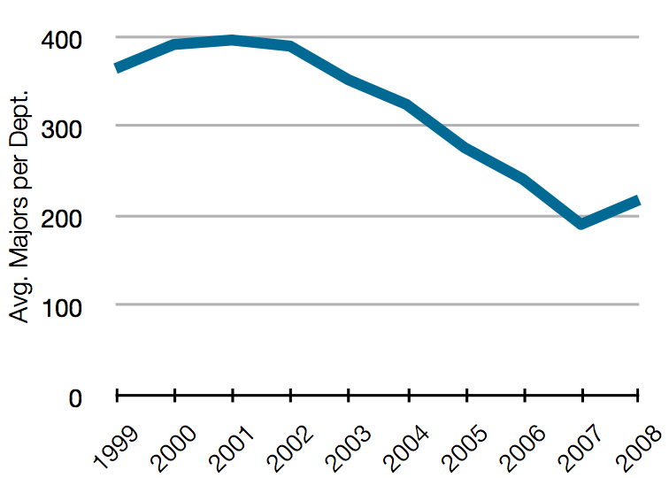
Discovering Scratch
Problem: Computer Science majors down 50% this decade
CRA Taulbee Survey, http://www.cra.org/statistics/

Slide 3
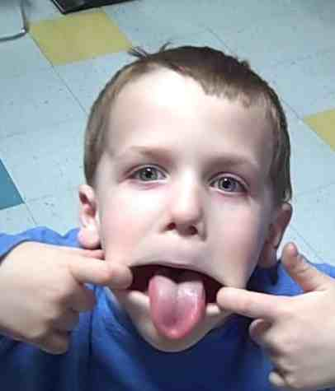
Doing My Part
Wanted to teach son programming
Did some Googling...
Lenny

Slide 4
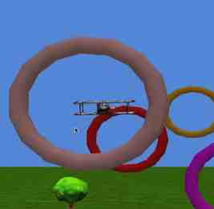
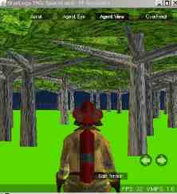
There are other programs...
Alice
StarLogo TNG

Slide 5

...Scratch is just better
user-friendliest
most polished
easiest to share
most popular

Slide 6
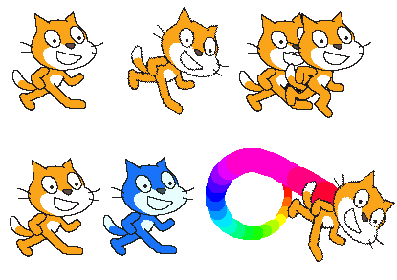
Sprites

Slide 7
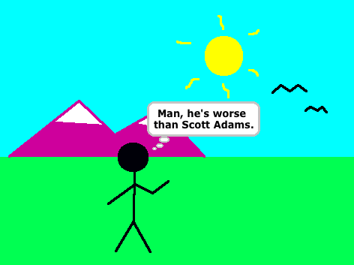

Wait, there's more!
Draw backgrounds and sprites!
Record sounds!

Slide 8
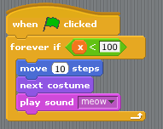
Oh, yeah...

Slide 9
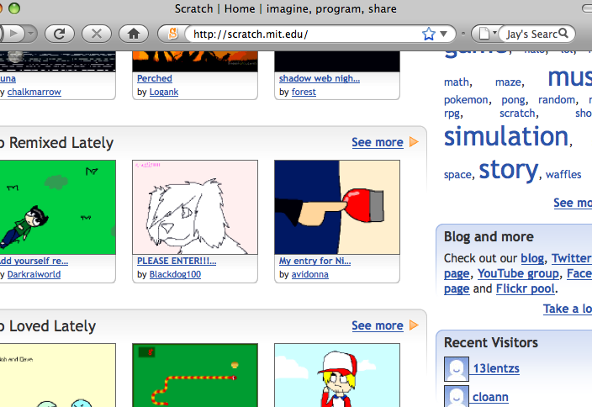
scratch.mit.edu

Slide 10


Slide 11
Setup
Install (easy!)
Promote (Twitter and Upcoming.org)

Slide 12
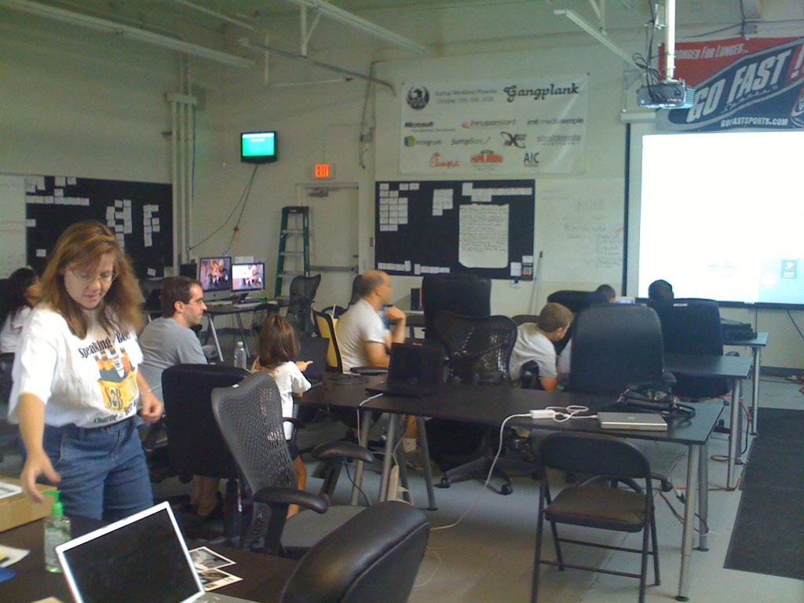
The Event
Photo:
@gangplankjr

Slide 13
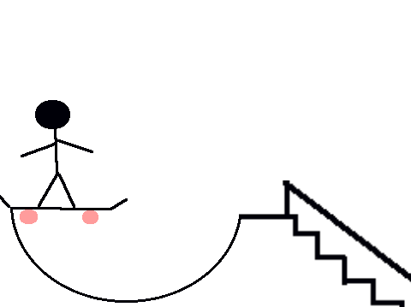
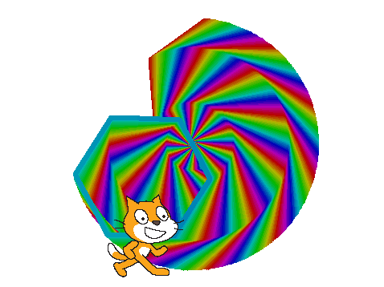
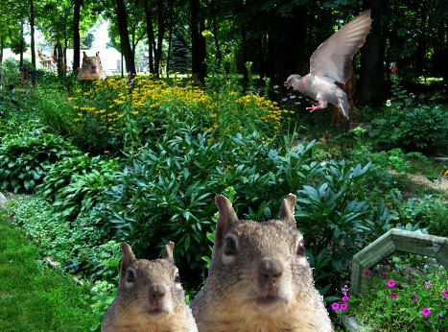
Projects
scratch.mit.edu/users/brianF
scratch.mit.edu/users/chier01
scratch.mit.edu/users/lennyandmom

Slide 14
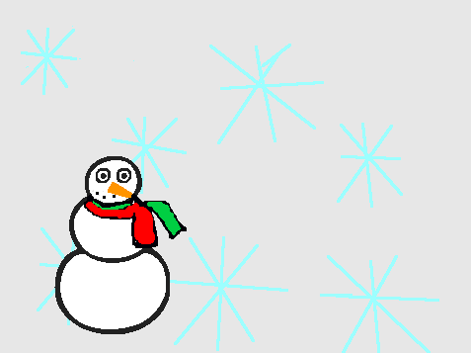
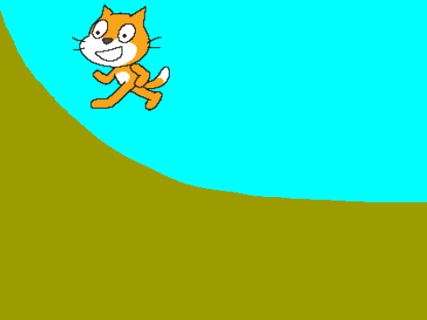
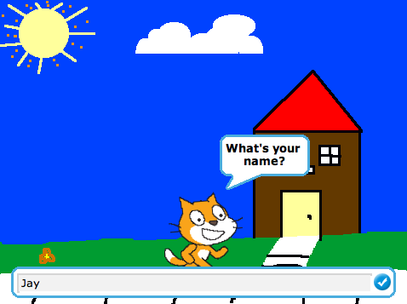
Projects
scratch.mit.edu/users/katykat7925
scratch.mit.edu/users/cassinator
scratch.mit.edu/users/WOnetClan

Slide 15
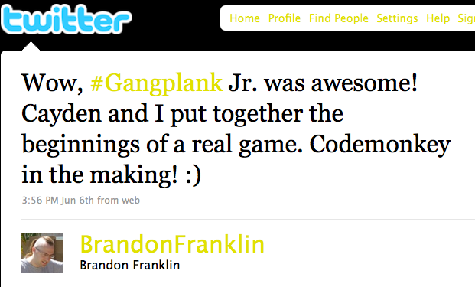
Reviews

Slide 16
Aftermath
@alandd's 12-year-old shares with a friend
Angelina B. links to her project on her blog

Slide 17
Let's Keep it Going
@tomeast's Cub Scout den
Mike at Arcadia Neighborhood Learning Center

Slide 18
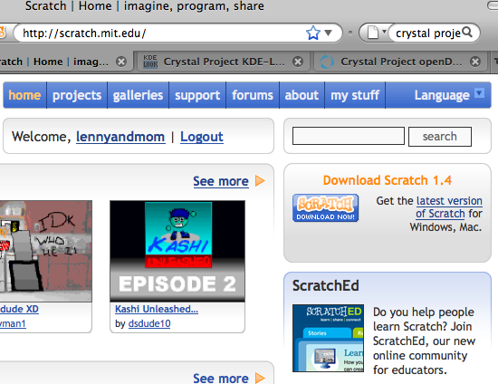
Get It!

Slide 19
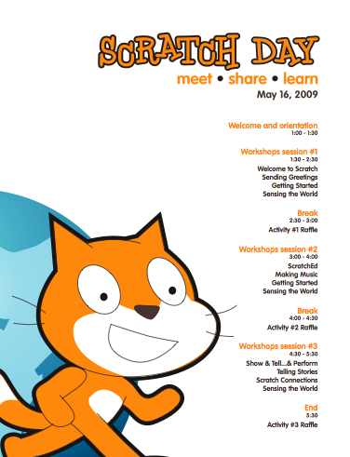
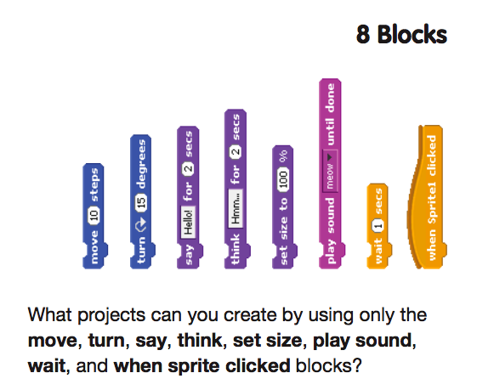
On the site

Slide 20
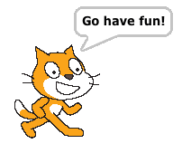
scratch.mit.edu

