Slide 1
The relationship between female labor force participation and fertility rate in Brazil (1960-2013)
Jayme Anchante

Slide 2
Dataset
Which dataset did you use of the following:
World Development Indicators. The dataset from the World Bank contains over a thousand annual indicators of economic development from hundreds of countries around the world.
Source: https://www.kaggle.com/worldbank/world-development-indicators

Slide 3
Motivation
Over the last 50 years, we have witnessed an increase in female labor force participation and a decrease in the fertility rate in most countries. We know that usually women need to pause their professional life in order to have a baby and also that non-working females tend to be domestic workers and have more time to become a mother. But we need to know how both are related in order to better understand the female labor market dynamics and the parenthood decision in the country-level.

Slide 4
Research Question(s)
What is the relationship between female labor force participation and fertility rate in Brazil? How Brazil compares to other Mercosur full-member countries regarding these two indicators over time?

Slide 5
Main Findings
Decline in the fertility rate among the Mercosur countries, especially for Brazil, Paraguay and Venezuela.
Rise in the female labor force participation.
Strong linear inverse relationship between the fertility rate and the female labor force participation in Brazil.

Slide 6
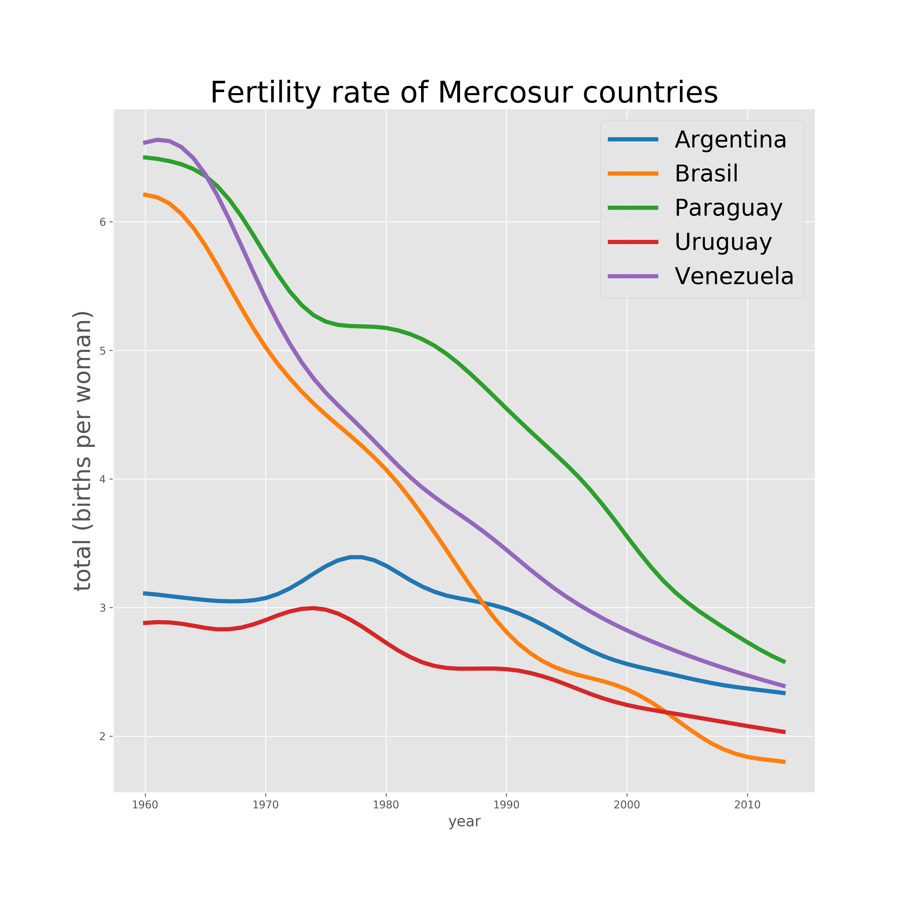

Slide 7
We can see a smooth decline in the fertility rate among all Mercosur countries. Brazil, Paraguay and Venezuela had rates over 6 children per female, whereas Argentina and Uruguay had rates around 3 in 1980. In 2013, all rates are between 1.8 and 2.8 children per female, Brazil has the lowest and Paraguay has the highest rate. Interestingly, Argentina and Uruguay both experienced some increase in their rate between 1970 and 1980.

Slide 8
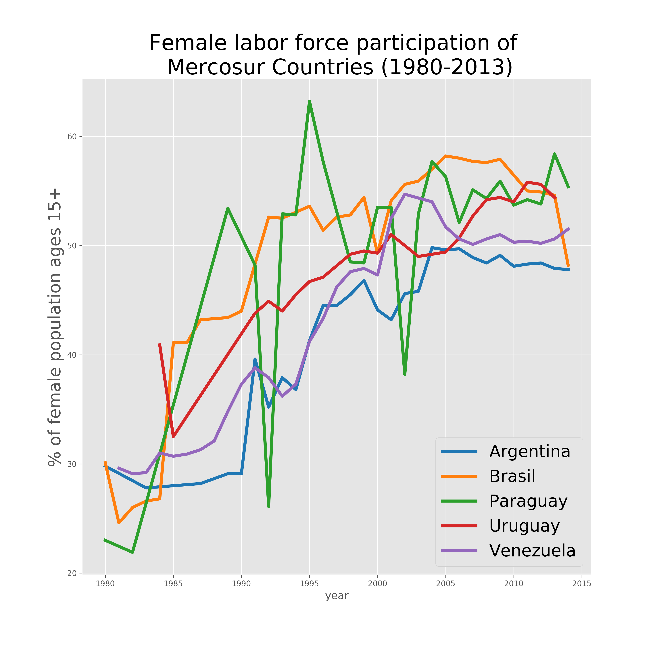

Slide 9
There is a lot more variation in the female labor force participation than in the fertility rate, probably because of the own labor market dynamics. We can also see that the first record is only in 1980 (contrary to the fertility rate, which is 1960). Most countries began with 30% of the female working, but this percentage rised to around 50% in 2013.

Slide 10
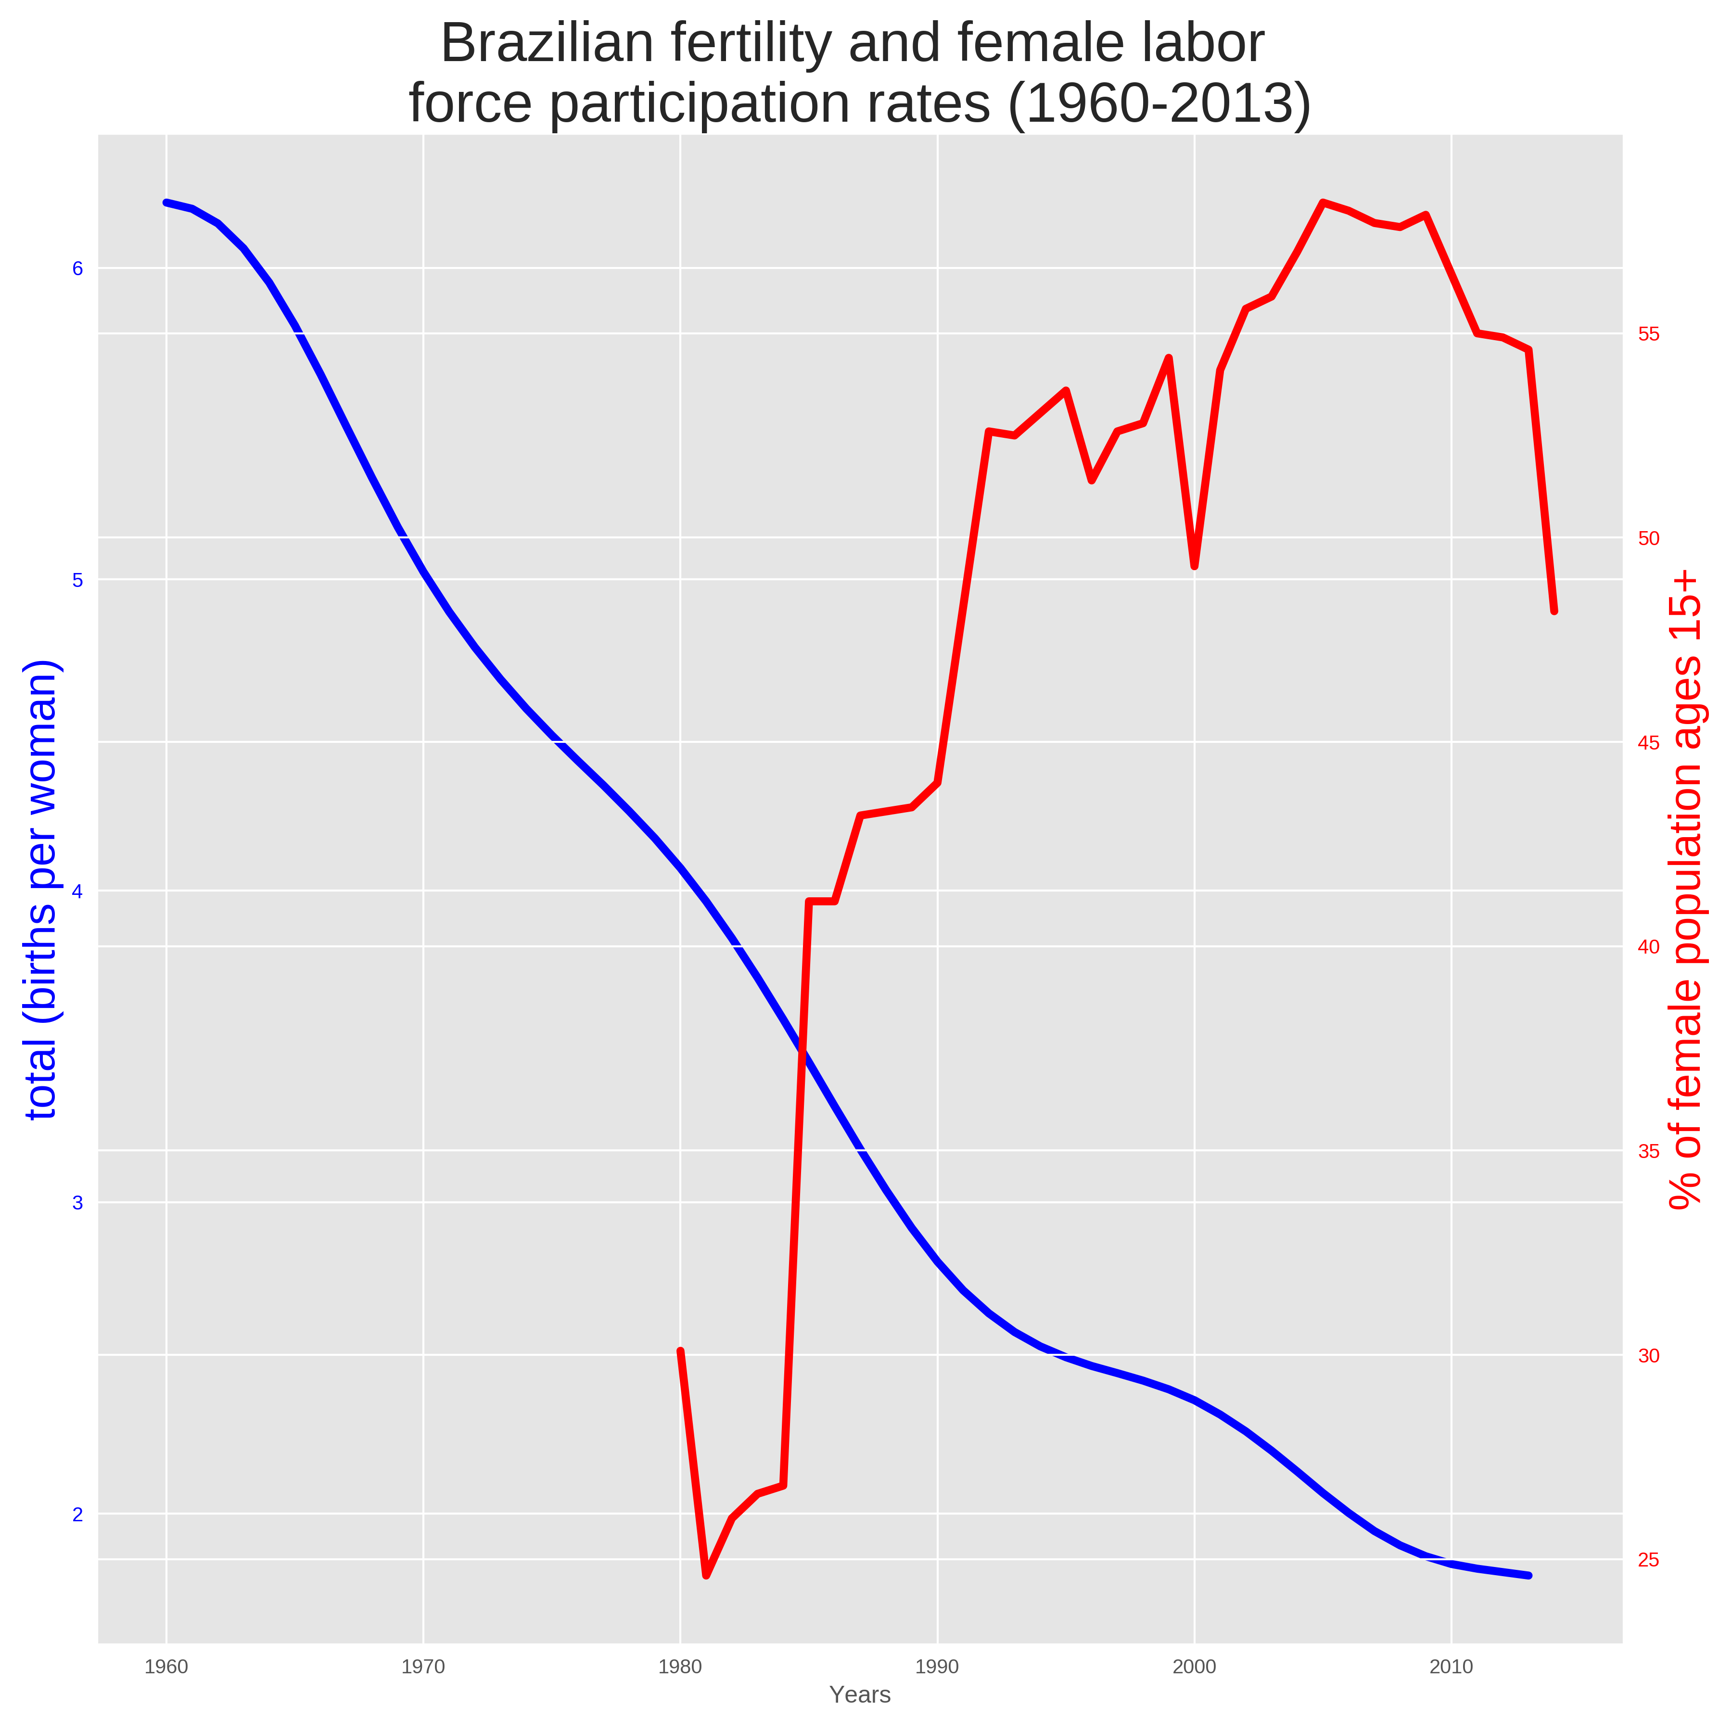

Slide 11
Plotted together as a line plot at different scales, we can see a clear inverse relationship between the fertility rate and the female labor force participation in Brazil. Most of the rise in the female participation happened between the mid-80’s and the mid-90’s.

Slide 12
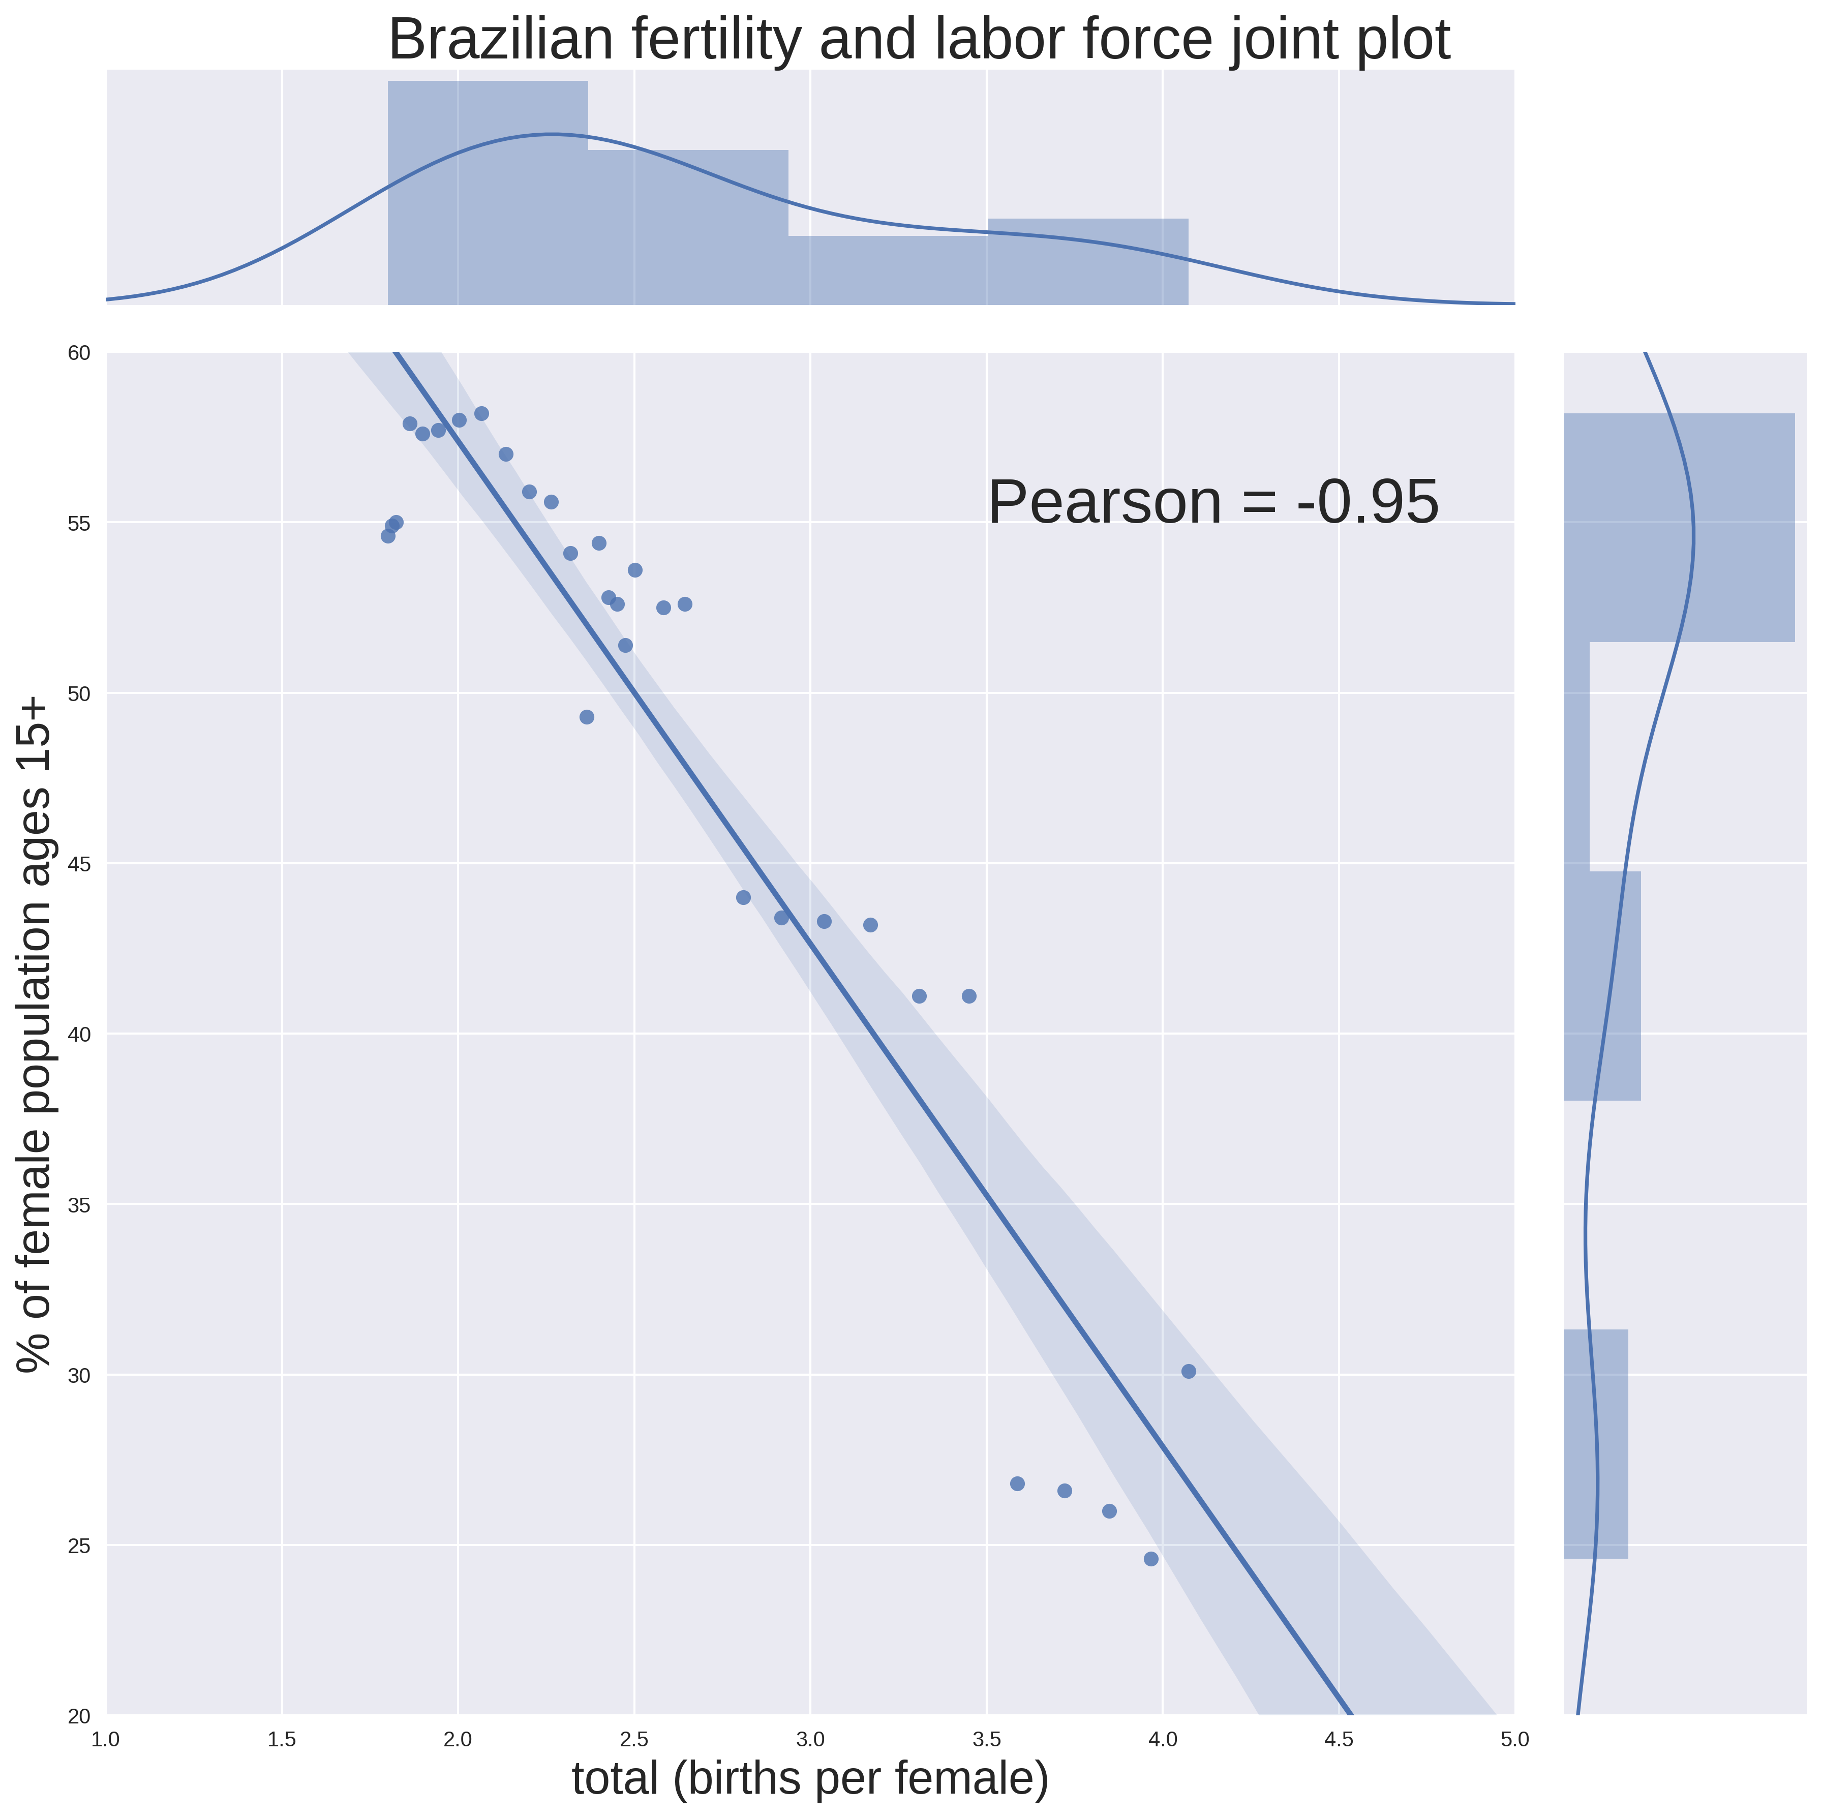

Slide 13
Plotted together as a scatter plot, we can confirm the inverse relationship between the fertility rate and the female labor force participation in Brazil. We also draw a fitted a linear curve to the data that shows the steep negative angular coefficient. The Pearson correlation coefficient of – 0.95 shows a strong negative linear relationship between the two variables.

Slide 14
Acknowledgements
I would like to thanks the Python for Data Science professors Ilkay Altintas and Leo Porter for the insightful classes.

Slide 15
References
- Lj Miranda. Philippines: Energy Use. Source: https://www.kaggle.com/ljvmiranda/philippines-energy-use/notebook
- Slater Stich. Data Visualization in Python: Advanced Functionality in Seaborn. Source: http://blog.insightdatalabs.com/advanced-functionality-in-seaborn/
- Pyplot tutorial. Source: https://matplotlib.org/users/pyplot_tutorial.html
- Seaborn tutorial. Source: https://seaborn.pydata.org/tutorial.html

