Slide 1
baton rouge Neighborhoods
Applied Data Science Capstone – Coursera by IBM – July 2021

Slide 2
Background
Use Foursquare’s location-based data to explore the neighborhoods in Louisiana’s capital city
Provide my colleagues with a comprehensive look at ideal areas to look for housing based on the venues available

Slide 3


Data Exploration
Neighborhood names obtained from Wikipedia
Manually added latitude & longitude (Geocoder did not work)
Resulting dataframe has 3 columns & 30 rows

Slide 4
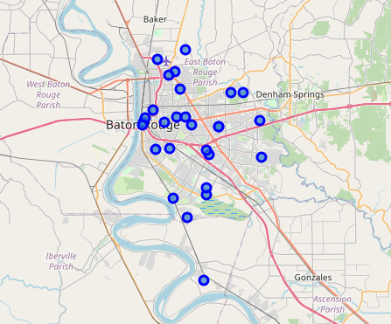
Neighborhoods in baton rouge
Downtown
Spanish Town
Beauregard Town
Garden District
Old South Baton Rouge
LSU/Lakeshore
Mid-City
McDonald Land
Brookstown
Melrose Place
Melrose East
Inniswold
Goodwood
Hundred Oaks Addition
Southdowns
Gardere
Westminster
Oak Hills Place
Scotlandville
Shenandoah
Sherwood Forest
Brownfields
Zion City
Monticello
Park Forest
Glen Oaks
University Club
Centurion Place
Northdale
Broadmoor

Slide 5
Venue details from foursquare
Asked for top 100 venues categories for each neighborhood
Highest count was Downtown (42), then Garden District (41), Beauregard Town (32) and Spanish Town (17)
Remaining neighborhoods had less than 10 venue types
93 unique venue type categories among all neighborhoods

Slide 6
Top venue categories (among all neighborhoods)
Home Service
American Restaurant
Intersection
Trail
Flower Shop
Construction and Landscaping
Convenience Store
Dance Studio
Discount Store
Distillery
Donut Shop

Slide 7
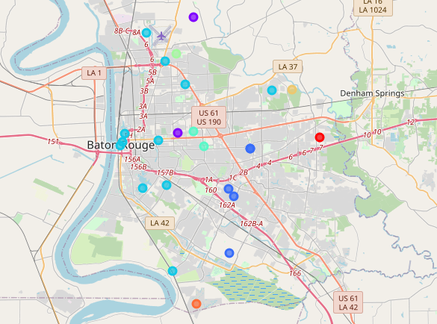
Clustering the neighborhoods
Used Kmeans() to build 8 clusters
Top Clusters:
Cluster 3: 12 neighborhoods
Cluster 2: 5 neighborhoods
Cluster 4 & 1: 2 neighborhoods each
Remaining clusters had 1 neighborhood each

Slide 8
Results

Slide 9
Largest Cluster - #3
Cluster 3 Neighborhoods (12)
Top Venues in Cluster 3
Downtown
Spanish Town
Beauregard Town
Garden District
LSU/Lakeshore
Mid-City
Brookstown
Southdowns
Gardere
Scotlandville
Monticello
Glen Oaks
Focused on food and active pursuits
Sandwich Place
American Restaurant
Park, Trail, College, Gym, Pool
Food
Fishing Store, Music Venue, College Gym

Slide 10
Second Largest Cluster - #2
Cluster 2 Neighborhoods (5)
Top Venues in Cluster 2
Inniswold
Oak Hills Place
Broadmoor
Sherwood Forest
Westminster
Focused on large box stores and proximity to interstate or major highways
Home Service (Shops & Service)
Intersection (Travel & Transportation)
Trail
Flower Shop
Construction & Landscaping

Slide 11
discussion
Neighborhoods in Cluster 3 are best for those looking for a variety of activities & services
Various options with mix of food venues and activity-related venues
Neighborhoods in Cluster 2 are best for those who want to be surrounded by larger box stores (i.e. Home Depot); or those who need easy access to the interstate (or major highways) for a commute or frequent travel

Slide 12
conclusion
Before relocating to Baton Rouge, think about one’s personal interests
Some neighborhoods offer variety of venue types whereas others are dominated by a select 1-2 specific venue types.
Personal Choice: neighborhoods in Cluster 3
Important Note: additional factors such as housing availability and proximity to favorite venue types should also be considered before making the final choice on a neighborhood

Slide 13
references
Neighborhood data pulled from Wikipedia - https://en.wikipedia.org/wiki/Neighborhoods_in_Baton_Rouge,_Louisiana

