Slide 1
Predicting a Job post as real or fake
Jayme Kirchner – CSC535 – Deep Learning

Slide 2
problem definition and project goals

Slide 3
Problem to address
Predict whether a job posting is real or fake based on the posting’s text, categorical variables, and the salary range
Data downloaded from a csv file on Kaggle
https://www.kaggle.com/shivamb/real-or-fake-fake-jobposting-prediction
17,880 total job postings
18 variables in total
Imbalanced dataset with roughly 5% of fake postings (866 of 17,880)

Slide 4
data exploration and pre-processing

Slide 5
Text variables (unique values)
Title: title of the job ad entry (11,231)
Location: geographical location of the job ad (3105)
Department: corporate department (1337)
Company Profile: brief company description (1709)
Description: details description of the job ad (14,801)
Requirements: enlisted requirements for the job opening (11,968)
Benefits: enlisted benefits offered by the employer (6205)
Salary Range*: indicative salary range (874)
*Note: this value is a string in the original dataset but will be split into two numeric values during pre-processing

Slide 6
Categorical variables (Unique values)
Employment Type: full-time, part-time, etc. (5)
Required Experience: entry-level, etc. (7)
Required Education: Bachelor, etc. (13)
Industry: automotive, IT, etc. (131)
Function: consulting, research, etc. (37)
All of these variables will be one-hot-encoded for the initial baseline RNN model

Slide 7
Numeric variables
Job Id: identification number for the job posting (17,880)
Telecommuting: indicates whether posting mentions telecommuting (2)
Has Company Logo: indicates whether company logo is present (2)
Has Questions: indicates whether screening questions are present (2)
Fraudulent: indicates whether posting is fake (2)

Slide 8
Exploring the text Data
Maximum length of characters in each text column:
'title': 142
'location': 161
'department': 255
'company_profile': 6178
'description': 14,907
'requirements': 10,864
'benefits': 4429
There is only 1 row where description is blank
There are 19 rows where all text variables except title and description are blank
12 of these are fake

Slide 9
Cleaning the data
Replace missing values in categorical columns with a new ‘No Data’ label
Distinguish between the absence of data and existing ‘Not Applicable’ or ‘Other’ labels
Combine all text columns into one called ‘full_text’ and drop the relevant columns
Minimum length of full_text is 33 characters
Maximum length of full_text is 14,964 characters
Split the string variable salary_range into two columns: salary_low and salary_high
If string value was converted to a month, update cell to be the month’s corresponding numeric value (i.e., ‘Oct’ becomes ‘10’)
Replace NA values with integer -1 to add columns into main data frame, then replace -1 by NaN and cast into Int64 datatype
Update instances of ‘US’ to ‘USA’ so it is distinct country and not word ‘us’
Separate combined words with a space (i.e., PinterestLoves → Pinterest Loves)
Move the fraudulent column to the end of the dataframe

Slide 10
Replace na/missing values in Salary columns
Strategy
Steps
Using only the training data, the mean low and high salary for each employment type will replace missing values in the respective salary column
Split data frame into train/test and then train/val – 80/20 split for both
Create dictionary with employment type as key, and respective mean values for salary_low and salary_high
For each employment type,
Create a temp data frame
Fill missing values with relevant mean
Update original data frame
Cast into Int64 datatype

Slide 11
Visualizing the data

Slide 12
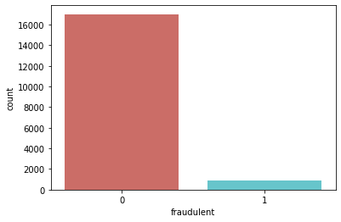
Distribution of fraudulent postings
There are 17,880 real postings and 866 fake postings
Fake postings do not start until index 98 and the last is found at index 17,831
The data is very imbalanced with 95% as real posts and only 5% as fake

Slide 13
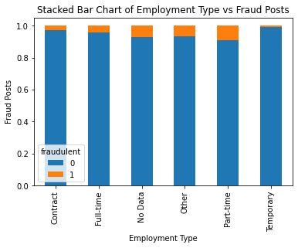
Employment type
Full-time: 11,620
No Data: 3471
Contract: 1524
Part-time: 797
Temporary: 241
Other: 227

Slide 14
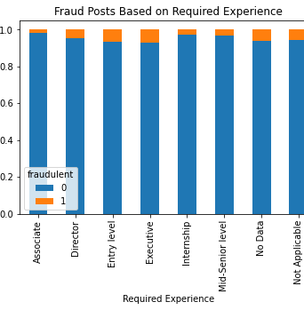
Required experience
No Data: 7050
Mid-Senior level: 3809
Entry level: 2697
Associate: 2297
Not Applicable: 1116
Director: 389
Internship: 381
Executive: 141

Slide 15
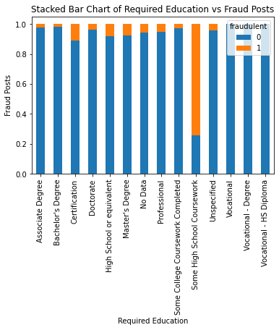
Required education
No Data: 8105
Bachelor's Degree: 5145
High School or equivalent: 2080
Unspecified: 1397
Master's Degree: 416
Associate Degree: 274
Certification: 170
Some College Coursework Completed: 102
Professional: 74
Vocational: 49
Some High School Coursework: 27
Doctorate: 26
Vocational - HS Diploma: 9
Vocational - Degree: 6

Slide 16
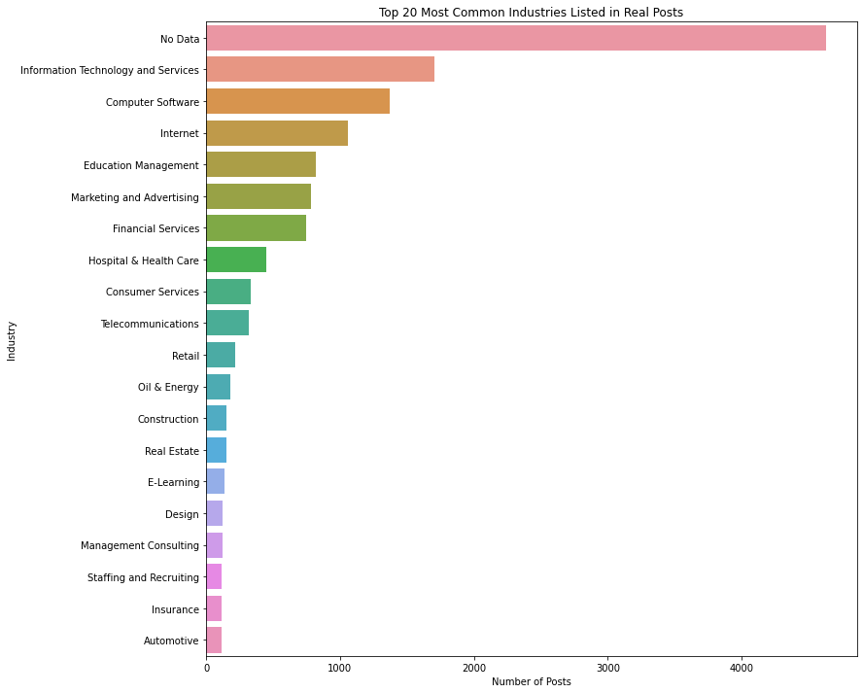
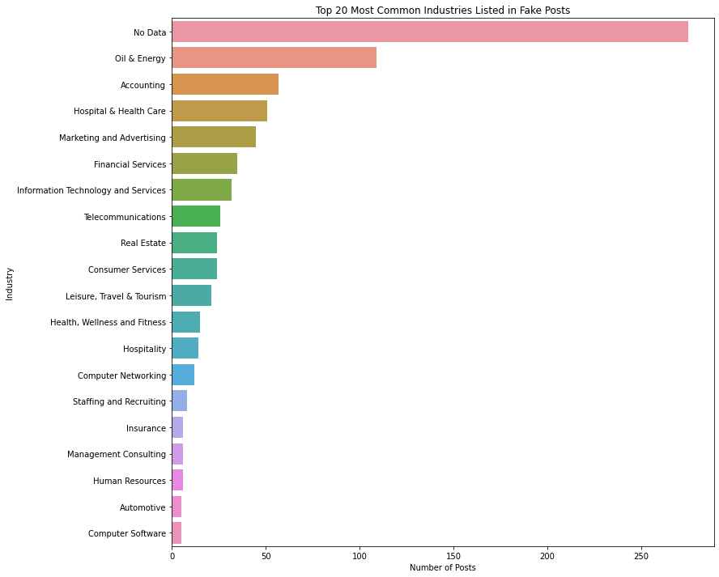

Top 20 most common industries

Slide 17
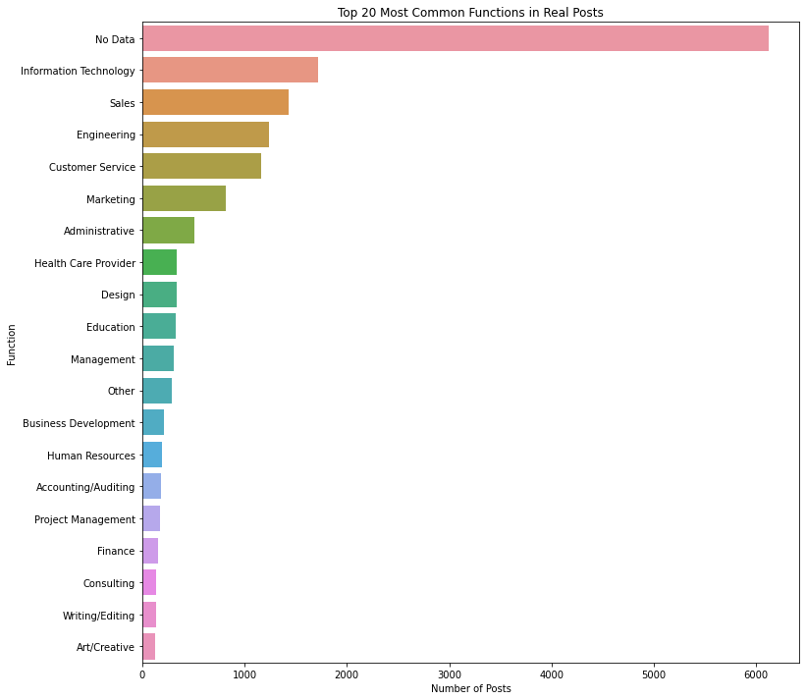
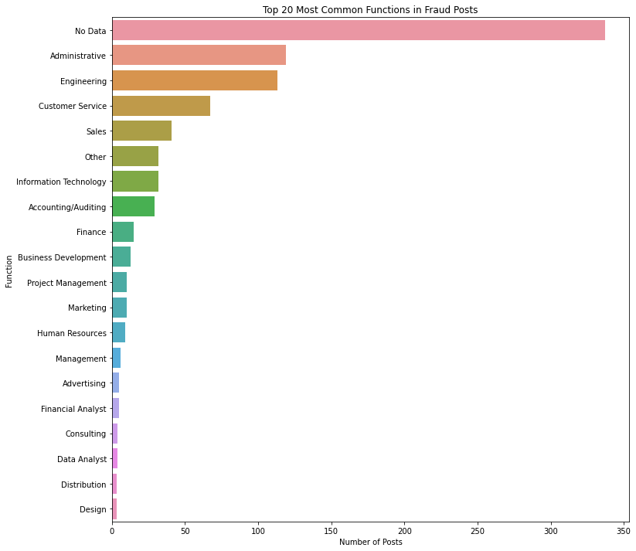
Top 20 most common functions

Slide 18
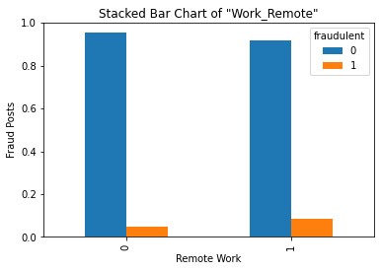
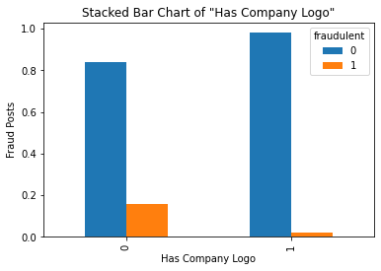
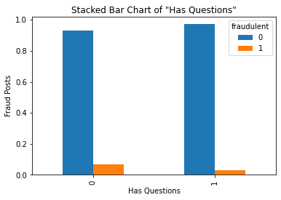


binary variables (all job postings)
Work Remotely
Has Company Logo
Has Questions

Slide 19

Observations from the graphs
Employment Type
Fewest fraudulent job postings are found for ‘Temporary’
Most fraudulent postings appear to be found for ‘No Data’, ‘Other’, and ‘Part-time’
Required Experience
Largest amount of fraud postings are for ‘Entry Level’, ‘Executive’, ‘No Data’ or ‘Not Applicable’
Required Education
No fraudulent postings for any vocational category
Most fraudulent postings for ‘Some High School Coursework’ (20 out of 27)
Large number of fraudulent postings also found for ‘Certification’, ‘Hight School or equivalent’, and ‘Master’s Degree’

Slide 20
Observations from the graphs
Most Common Label
The lack of an industry or function listed in the job posting was the most frequent among all graphs
Other Top Industries
Fake Posts: Oil & Energy, Accounting, Hospital & Healthcare, Marketing and Advertising
Other Top Functions
Fake Posts: Administrative, Engineering, Customer Service, Sales
Real Posts: Information Technology and Services, Computer Software, Internet, Education Management
Real Posts: Information Technology, Sales, Engineering, Customer Service, Marketing

Slide 21
Observations from the graphs
Work Remotely
More fraudulent posts when job posting offered remote work
Has Company Logo
More fraudulent posts when job posting did not include a company logo
Has Questions
More fraudulent posts when job posting did not contain screening questions

Slide 22
One-hot-encoding and splitting the dataset

Slide 23
One-hot-encode categorical variables
Columns to be one-hot-encoded:
Employment Type
Required Experience
Required Education
Industry
Function
Original data frame had 12 columns
One-hot-encoding expanded it to 205 columns

Slide 24
Train/val/test split
Data was already split into train/val/test to calculate salary means
Split was done again now that all data is processed satisfactorily
Train/Test and Train/Val were split based on 80/20 ratio
Same random state was used for all splits
Train_x had 10,889 real posts and 554 fraud posts
Shape of each data frame:
Original dataframe shape: (17880, 205)
train_x shape: (11443, 205)
val_x shape: (2861, 205)
test_x shape: (3576, 205)
There are 5 industry levels where training data only has real postings:
Libraries, Military, Package/Freight Delivery, Shipbuilding, Wine and Spirits
Models will not learn to predict fraudulent postings for these levels

Slide 25
Deep learning models

Slide 26
Models and metrics
Models:
RNN with TextVectorization, Embedding, and Bidirectional layers
BERT with modified preprocessing function
Metrics:
False Positives (fp)
False Negatives (fn)
Binary Accuracy (accuracy)
AUC (auc)
Loss Function:
Binary Crossentropy
Optimizer:
Adam (RNN)
AdamW (BERT)

Slide 27
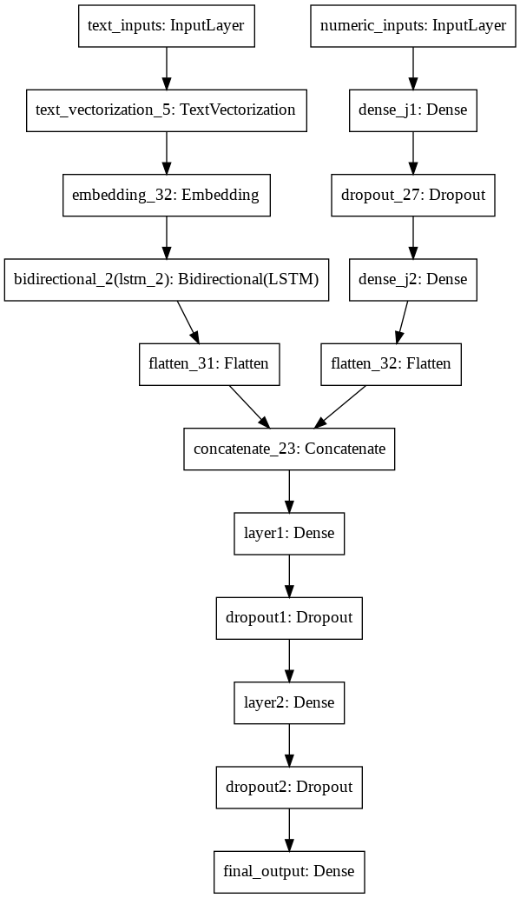
rnn model architecture
Text and numeric data

Slide 28
Training and Testing with all variables
Inputs (train / validation):
Full text vectorized to 128 tokens
Numeric variables
Inputs (train+validation / test):
Full text combining with train and validation combined
Numeric variables with train and validation combined
Ran models for 5 epochs each

Slide 29
metrics Results and observations
Training
Problems with results
AUC: 0.5109 (increase)
False Negatives: 515.0 (varied)
False Positives: 492.0 (decrease)
Data imbalance caused the initial models (text + numeric data) to have high accuracy but a low AUC score of 50%
Under-sampling the real postings in the training data did not significantly improve results
Second RNN model will only use the text columns to see if the AUC score improves
TextVectorization, Embedding, and Bidirectional(LSTM) layers applied to each text column
Validation
AUC: 0.5054 (varied)
False Negatives: 137.0 (increase)
False Positives: 10.0 (decrease)

Slide 30
Text-only data columns
The text columns were split into 5 groups:
Title, Location, Description
Department, Employment type, Required Experience, Required Education, Industry, Function
Company Profile
Requirements
Benefits
The text-only dataset was split again into train/validation/test and each column group was saved into its own Numpy array
Each text group was vectorized into 128 tokens
This amount matches the default number of tokens with BERT preprocessing models
Next slide shows top 20 and bottom 20 tokens in each text group

Slide 31
the most and least frequent tokens
Title + Location + Description
Top 20 words in vocab: ['', '[UNK]', 'and', 'the', 'to', 'of', 'a', 'in', 'for', 'with', 'our', 'is', 'you', 'are', 'will', 'be', 'as', 'we', 'on', 'team’]
Last 20 words in vocab: ['media', 'into', 'growing', 'knowledge', 'engineer', 'build', 'systems', 'required', 'office', 'information', 'if', 'has', 'training', 'one', 'lead', 'social', 'do', 'communication', 'ca', 'years']
Department + Employment type + Required Experience + Required Education + Industry + Function
Top 20 words in vocab: ['', '[UNK]', 'data', 'no', 'fulltime', 'level', 'degree', 'bachelors', 'midsenior', 'technology', 'information', 'services', 'and', 'entry', 'associate', 'marketing', 'sales', 'or', 'school', 'high’]
Last 20 words in vocab: ['security', 'building', 'materials', 'general', 'communications', 'travel', 'nonprofit', 'tourism', 'leisure', 'social', 'entertainment', 'electricalelectronic', 'client', 'beverages', 'support', 'goods', 'creative', 'team', 'cosmetics', 'vocational']
Company Profile
Top 20 words in vocab: ['', '[UNK]', 'and', 'the', 'to', 'of', 'a', 'in', 'we', 'our', 'is', 'for', 'with', 'are', 'that', 'you', 'on', 'as', 'their', 'have’]
Last 20 words in vocab: ['growing', 'we’re', 'online', 'what', 'marketing', 'home', 'across', 'mission', 'jobs', 'believe', 'job', 'improve', 'candidates', 'many', 'high', 'up', 'platform', 'focus', 'been', 'creative’]
Requirements
Top 20 words in vocab: ['', '[UNK]', 'and', 'to', 'of', 'in', 'a', 'the', 'with', 'experience', 'or', 'skills', 'for', 'ability', 'be', 'work', 'you', 'is', 'as', 'years’]
Last 20 words in vocab: ['support', 'level', 'if', 'technology', 'about', 'microsoft', 'company', 'detail', 'proven', 'technologies', 'attention', 'applications', 'information', 'who', 'position', 'writing', 'mobile', 'school', 'role', '–’]
Benefits
Top 20 words in vocab: ['', '[UNK]', 'and', 'to', 'the', 'a', 'of', 'in', 'we', 'with', 'you', 'for', 'our', 'work', 'is', 'your', 'benefits', 'on', 'an', 'as’]
Last 20 words in vocab: ['bonus', '–', 'position', 'their', 'startup', 'do', 'per', 'international', 'want', 'offers', 'personal', 'excellent', 'exciting', 'solutions', 'creative', 'sick', 'world', 'sales', 'provide', 'day'

Slide 32
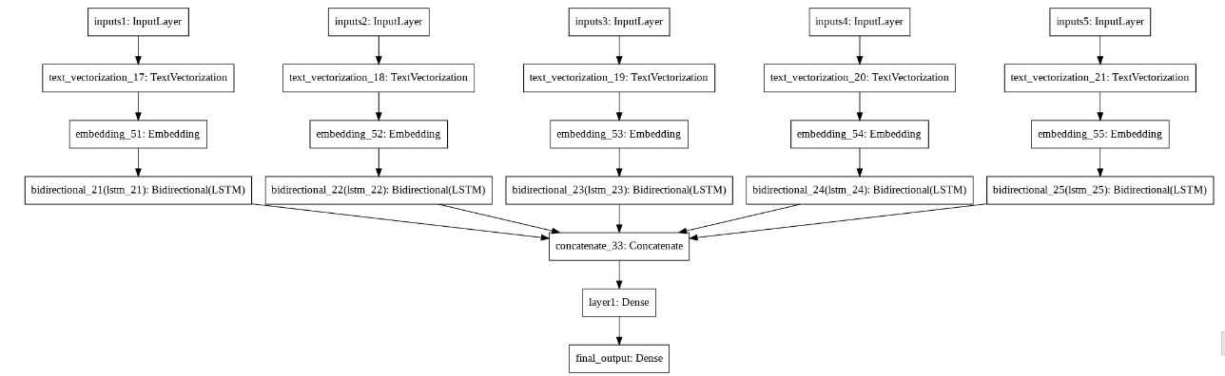
Text-only rnn model architecture
Each column group is fed as input to the model, passing through three layers – TextVectorization, Embedding, and Bidirectional LSTM
All inputs are combined and passed into a Dense Layer
Final output layer has 1 neuron with sigmoid activation function

Slide 33
Metrics Results
Training
Training + Validation
AUC: 0.7930 (increase)
False Negatives: 554 (increase)
False Positives: 0.0 (decrease)
AUC: 0.8009 (increase)
False Negatives: 693.0 (decrease)
False Positives: 0.0 (decrease)
Validation
Testing
AUC: 0.7972 (increase)
False Negatives: 139.0 (no change)
False Positives: 0.0 (no change)
AUC: 0.7864 (increase)
False Negatives: 173.0 (no change)
False Positives: 0.0 (no change)

Slide 34
Nlp model: bert

Slide 35
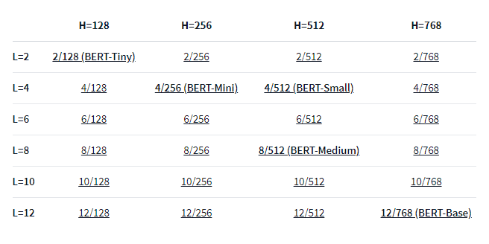
Bert models
Image found at: https://huggingface.co/google/bert_uncased_L-4_H-512_A-8

Slide 36
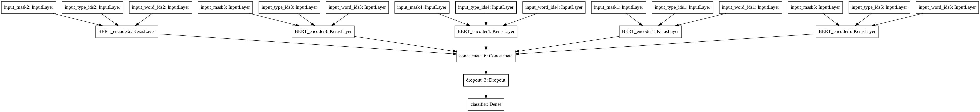
Text-only BERT model architecture
BERT-Small (L=4, H=512, A=4)
Token Length: 128
Each input passes through a Tokenizer layer and a Packing layer for preprocessing
Preprocessing inputs to each encoder: input_mask, input_word_ids, and input_type_ids

Slide 37
Metrics Results
Training
Testing
AUC: 0.8055
False Negatives: 520.0
False Positives: 27.0
AUC: 0.9637
False Negatives: 119.0
False Positives: 4.0
Validation
AUC: 0.9625
False Negatives: 109.0
False Positives: 1.0

Slide 38
Comparing the models and results

Slide 39
Comparing the text-only Models
RNN
Small-BERT
Epochs: 5
Fixed learning rate with Adam optimizer
Final Metrics Results:
AUC: 0.7864
False Negatives: 173.0
False Positives: 0.0
Epochs: 1
Warm-up learning rate scheduler with AdamW optimizer
Final Metrics Results:
AUC: 0.9637
False Negatives: 119.0
False Positives: 4.0
Small-BERT is the better model to predict fraudulent job postings from a highly imbalanced dataset using only the text components of the posting

Slide 40
Expanding the project
Ideas to apply with more time and/or resources

Slide 41
Augmenting data with back translation
What is Back Translation?
Translating a text from a source language and back via a second language
Python Package: BackTranslation on PyPl
Implements googletrans
Languages to be used: French, Spanish, Chinese, Russian
Back translation is only applied on fraudulent data posts
Steps:
Create data frame to save all augmented fraudulent posts (i.e., df_augmented)
Apply translate() function from BackTranslation package to the original 866 fraudulent posts in English using one of the above languages
Append results to df_augmented
Repeat steps 2-3 with a new language, applying translate() to all posts found in df_augmented
When finished, append df_aug to original data frame
Final data frame would have 13,856 fraudulent posts (approx. 45% of the total data)

Slide 42
Generating fake job post with gpt-2
After RNN and BERT, I would like to train a GPT-2 model to create a realistic fake job posting
This idea was inspired by a Coursera Guided Project, ‘Generating New Recipes using GPT-2’ https://www.coursera.org/projects/generating-new-recipes-python

Slide 43
Combine numeric inputs with 5 text inputs
Both models performed well on the text-only data that was split into 5 separate inputs
Add the numeric variables (Work Remote, Has Questions, Has Company Profile, Salary Low, Salary High) to these text inputs
Compare the performance on each model on this combined data versus the text-only data

Slide 44
Classic bert (bert-base)
This project could only run the data through a Small-BERT model due to a lack of resources in Colab
I would like to explore whether Classic BERT would provide better AUC scores than Small-BERT and then run the final testing data on the best-performing model

Slide 45
Increase tokens to 512
BERT allows a maximum of 512 tokens
Current model used 128 because Colab resources were not sufficient for inputs with 512 tokens
I would like to see whether a model with 512 tokens for each input would improve on the results of this project

Slide 46
hyper-parameter tuning
Model Training Times (per epoch):
RNN Baseline Model: 25 to 36 minutes
Small-BERT: 3.5 to 4 hours
The models did not overfit during training but also the available resources in Colab were not conducive to extensive parameter tuning
I would like to see if these results could be further improved by tuning the hyper-parameters

Slide 47
conclusions

Slide 48
Problem with false negatives
The model predicted 109 real job postings in the test data as being fake
The details (or lack thereof) provided in these real job postings share many characteristics with fraudulent posts
Advice to Job Posters:
Include as much information as possible about the position’s requirements and responsibilities so the post is not a “yellow flag” to the job seeker
Make sure the company has an active online presence to support its authenticity as a legitimate company and provide working links in the job posting
If provided, salary range should be realistic and clear

Slide 49
Problem with false positives
The model predicted 4 fraudulent postings in the test data as being real
Authentic-looking fake job postings attract the job seeker to submit a resume, providing the scammer with their personal job history and contact details
Future requests for additional personal information or money to “speed up the application process” may be more believable to the job seeker if thought to be from a legitimate company, resulting in possible identity or financial theft.
Advice to Job Seekers:
A lack of information in the job posting makes it more likely to be fraudulent
An emphasis on remote work and lack of an interview process are more likely to be in fraudulent posts
The company should have an online presence
Check out their website and the contact details provided
Look for past and current activity on their social media account(s)
Oftentimes, the company has its own career site with the same job posting – apply there
If in doubt, err on the side of caution and do not apply

Slide 50
Questions?

