Slide 1

Supply Chain analysis of on time deliveries

Slide 2

Objective: Predicting if a delivery will arrive on time
E-commerce sales and shipments of products rather then Brick and mortar sales
grew 14.2% in 2021

Slide 3
E-commerce sales and shipments Data Set
10999 entries in the Data set
5 Warehouse blocks utilized
3 different modes of shipment
Cost factors and prior purchases knowledge

Slide 4
Data Evaluation and Modeling
Logistic Regression
Random Forest
Support Vector Machines
Random and Grid Search
xgBoost modeling

Slide 5
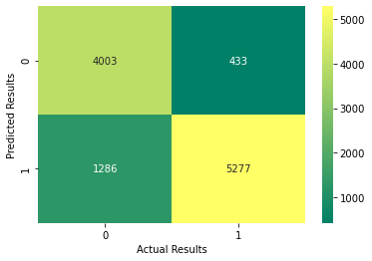
Results
Goal is to reduce false positive and false negative

Slide 6
Results
Model Accuracy
Ability to predict
Possibility of Error

Slide 7
Next Steps
Data Sampling
Predictive analysis
Time series data
Increase the amount of samples and focus the data on more qualitative features
Increasing the accuracy of the of the predictive model
Include time series data into the data set to determine whether different times of the year have an effect

Slide 8
Questions?

Slide 9
Thank YOU
Jason Hart
Contact info:
jasonmhart76@gmail.com
(718)213-9060 (Cell)

