Slide 1

Supply Chain analysis of on time deliveries

Slide 2

Objective: Predicting if a delivery will arrive on time
E-commerce sales and shipments of products rather then Brick and mortar sales
grew 14.2% in 2021

Slide 3
E-commerce sales and shipments Data Set
10999 entries in the Data set
Warehouse blocks A,B,C,D,E
Land
Sea and
Air Shipments
Cost factors and prior purchases knowledge

Slide 4
Data Evaluation and Modeling
Data Discovery
Data Preperation
Intitial Model
Model Tuning and evaluation
xgBoost modeling

Slide 5
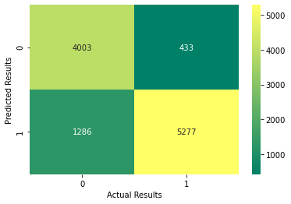
Final Results
False Negatives
Goal is to reduce false positive and false negative
False Positives

Slide 6
Results
Model Accuracy
Ability to predict
Possibility of Error

Slide 7
Next Steps
Data Sampling
Predictive analysis
Time series data
Increase the number of samples and focus the data on more qualitative features
Increasing the accuracy of the predictive model
Include time series data into the data set to determine whether different times of the year have an effect

Slide 8
Recommendations
Discount Offered
Product Weight
Cost of the produce
Prepare for when a product is going to be discounted by creating a space in the warehouse for those product
Create a warehouse Block which handles all larger products with train staff to handle more efficientl
Segregate the product of higher cost and set up a rapid deployment process for these goods

Slide 9
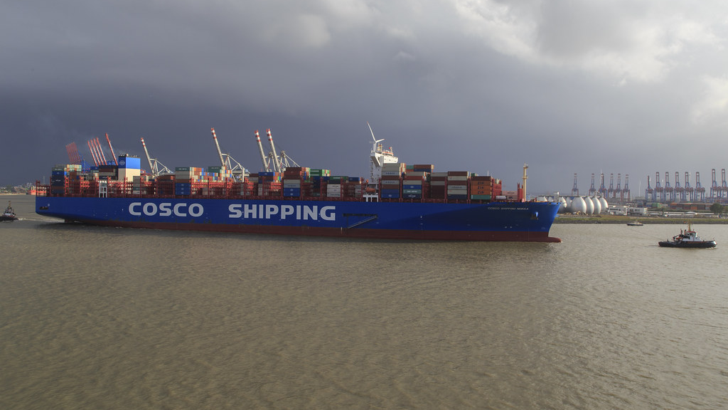
Questions?
This Photo by Unknown Author is licensed under CC BY-NC

Slide 10

Thank YOU
Jason Hart
Contact info:
jasonmhart76@gmail.com
(718)213-9060 (Cell)

