Slide 1

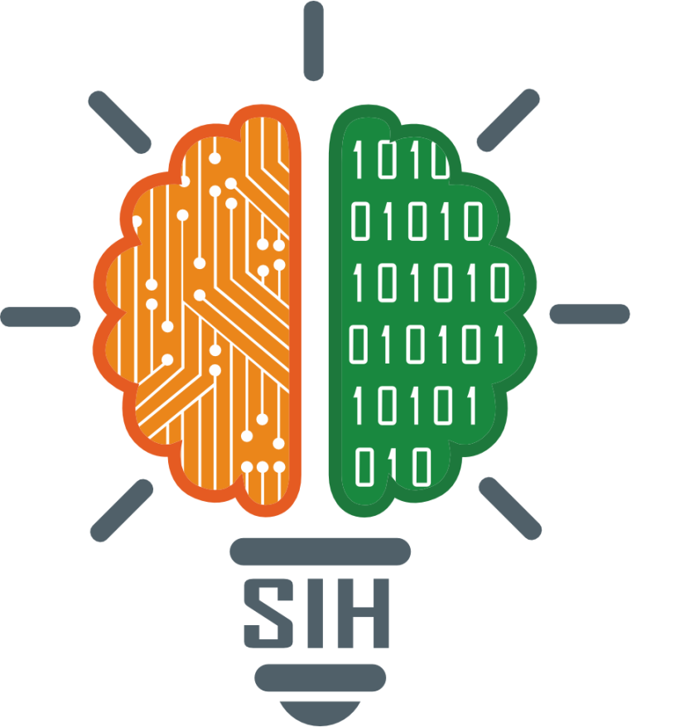
SMART INDIA HACKATHON 2024
TITLE PAGE
Problem Statement ID – SIH1598
Problem Statement Title- Student Innovation
Theme- Heritage & Culture
PS Category- Software
Team ID-
Team Name (Registered on portal)- Achiever

Slide 2
IDEA TITLE: Digital Heritage Showcase Platform
Achiever
Proposed Solution:
The "Incredible India" website showcases India's rich cultural heritage through detailed tours of regions, states, and themed experiences like adventure, festivals, and cuisines. It highlights famous attractions, cities, and personalized travel packages, aiming to immerse tourists in India's diverse landscapes and traditions. The platform offers curated itineraries, travel quotes, and insights into India's unique destinations, backed by award-winning services recognized by the Ministry of Tourism. The website emphasizes memorable travel experiences, catering to various preferences and ensuring safe, luxurious journeys across India.

Slide 3
TECHNICAL APPROACH
Achiever
To build a website similar to Incredible India, a combination of technologies can be used:
Frontend Technologies:
1. HTML, CSS, JavaScript: For structuring content, styling, and interactive elements.
2. React.js / Angular / Vue.js: For dynamic user interfaces and component-based design.
3. Bootstrap / Tailwind CSS: For responsive design.

Slide 4
FEASIBILITY AND VIABILITY
Achiever
Feasibility: The proposed solution leverages widely adopted and scalable technologies, ensuring ease of implementation and maintenance. The use of established web and cloud platforms allows for efficient deployment and scaling to handle growing user demands.
Viability: The project aligns with the growing interest in cultural tourism and has strong market potential due to India's rich heritage. With proper marketing, SEO strategies, and user-friendly features, the platform can attract a broad audience, making it financially viable and sustainable in the long term.

Slide 5
IMPACT AND BENEFITS
Achiever
Impact: The platform will promote India’s cultural heritage on a global scale, encouraging tourism and increasing awareness of India's traditions, history, and art forms. This will help preserve cultural identities while boosting local economies.
Benefits:
Enhanced Tourism Experience: Offers personalized travel recommendations, enriching visitors' experiences.
Economic Growth: Increases revenue for local artisans, businesses, and communities.
Cultural Preservation: Digitally documents and promotes lesser-known traditions and cultural assets.
Global Reach: Connects international tourists with India’s diverse cultural heritage, fostering cross-cultural exchanges.

Slide 6
RESEARCH AND REFERENCES
Achiever
https://www.indiaculture.gov.in/world-heritage
https://indianculture.gov.in/
https://www.incredibleindia.org/content/incredible-india-v2/en.html
https://www.sih.gov.in/sih2024PS?technology_bucket=QWxs&category=U29mdHdhcmU=&organization=QUlDVEUsIE1JQy1TdHVkZW50IElubm92YXRpb24=&organization_type=QWxs

