Slide 1
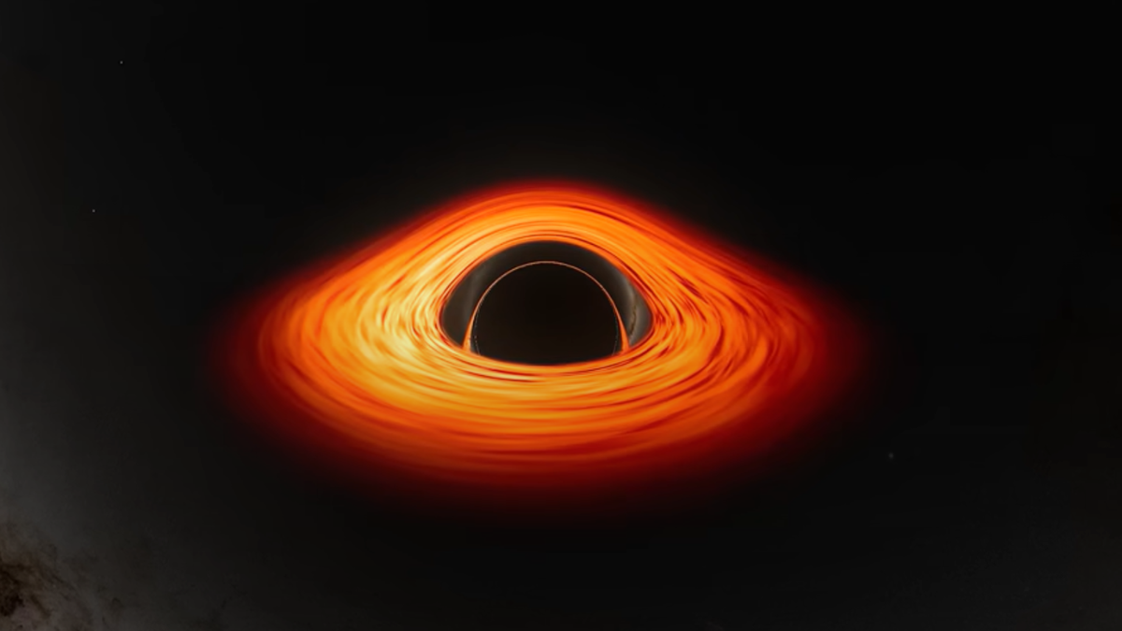
Extremal Black Hole Simulations: 3+1 Formalism
Jay Motka
Photo Credits: NASA
1

Slide 2
Outline
Motivation
Literature: 3+1 Formalism & Near Kerr-limit BH Simulation
My Insight: Near-extremal Charged BH Simulation
Summary
2

Slide 3


Weak Cosmic Censorship Conjecture (WCCC):
Kerr metric event horizons:
Reissner-Nordström (RN) metric event horizons:
WCCC:
“A spacetime singularity is always hidden inside of a black hole’s event horizon.”
3

Slide 4

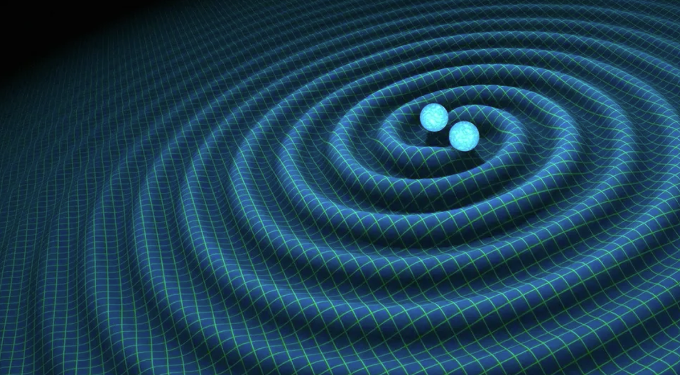
Motivation:
We can test it using simulations!
One scenario: Merger of two near-extremal charged black holes
Credits: space.com
4

Slide 5
Motivation
Furthermore, near-extremal BH are interesting cases of physics in themselves.
Near-extremal charged BH has high-gravity & high-electromagnetic regime!
Simulations could be used as a background to test interesting physics.
5

Slide 6

3+1 Formalism (Baumgarte & Shapiro, 2010)
Numerical relativity is traditional initial condition (Cauchy) problem!
Einstein equation: 2nd order PDEs
Initial Conditions:
Formulating Cauchy problem in GR:
3-spatial dimension and 1-temporal dimension can be separated
6

Slide 7
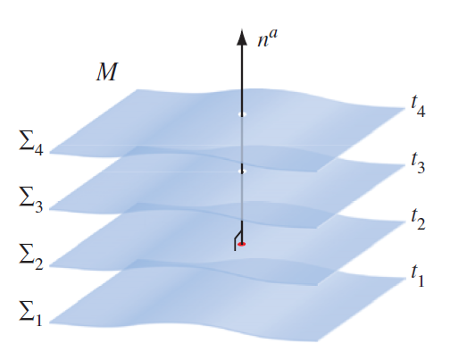
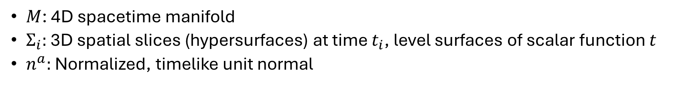
Foliations of Spacetime
Credits: Baumgarte & Shapiro, 2010
$M$: 4D spacetime manifold
$Σ_{i}:$ 3D spatial slices (hypersurfaces) at time $t_{i}$, level surfaces of scalar function $t$
$n^{a}:$ Normalized, timelike unit normal
7

Slide 8


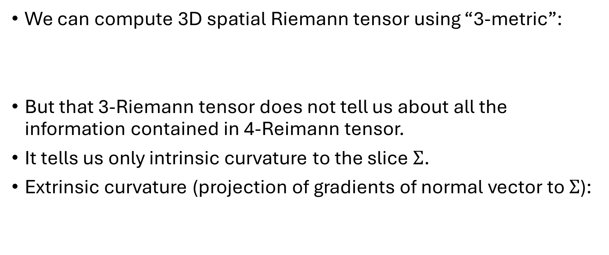

Initial Conditions
We can compute 3D spatial Riemann tensor using “3-metric”:
But that 3-Riemann tensor does not tell us about all the information contained in 4-Reimann tensor.
It tells us only intrinsic curvature to the slice $Σ$.
Extrinsic curvature (projection of gradients of normal vector to $Σ$):
1st Initial Condition
2nd Initial Condition
(Related to $∂_{t}γ_{ab}$)
8

Slide 9




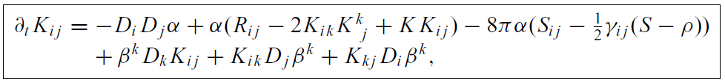

Constraint & Evolution Equations
Hamiltonian Constraint:
Momentum Constraint:
Evolution Equations:
(energy density)
(momentum density)
9

Slide 10


Simulation of Near Kerr-limit BH (Liu et al., 2019)
Liu et al. (2019) simulated spinning BH near the Kerr-limit:
They used 3+1 formalism & recipe called moving puncture method.
They used a correction to the traditional quasi-isotropic coordinates to avoid simulation errors.
Results:
10

Slide 11


My thoughts: Simulation of Near-extremal Charged BH?
Traditionally used quasi-isotropic coordinates:
At extremal limit, these quasi-isotropic coordinates vanishes to 0.
This could lead to simulation errors since it is extremally hard to resolve near zero scale.
Same problem occurred in Liu et al. (2019).
11

Slide 12

Tweaking the coordinates
They resolved it by multiplying a correction term to the quasi-isotropic coordinates.
We can take an analogous term and do the same!
Multiply with:
12

Slide 13
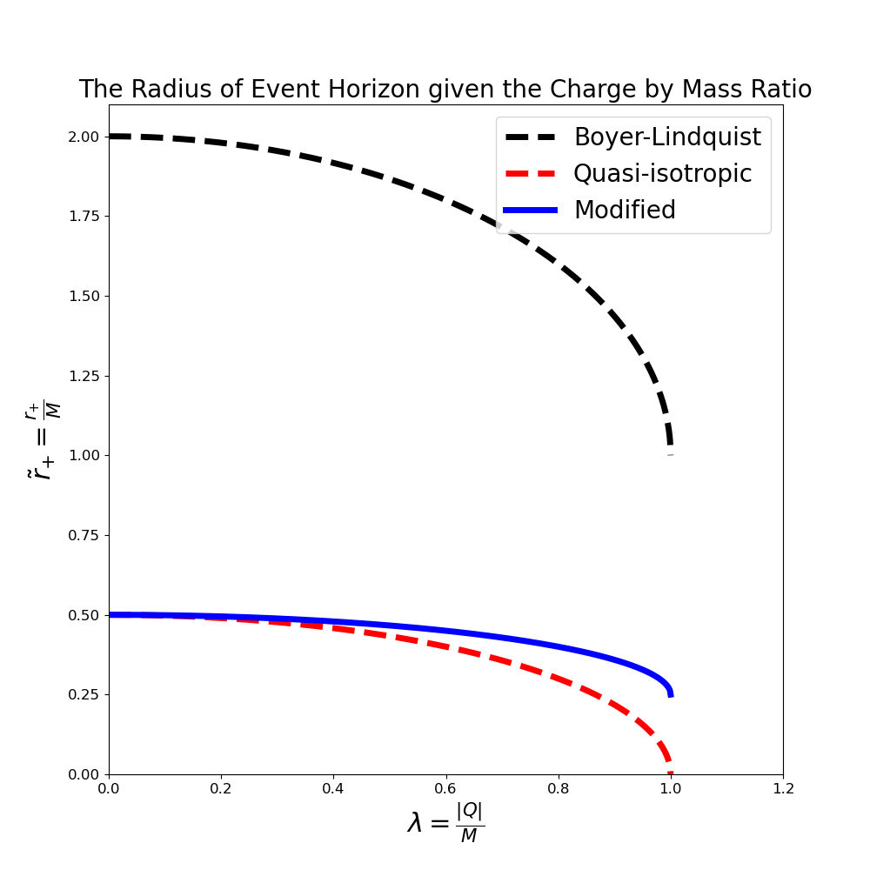
Modified Event Horizon Radial Coordinates
13

Slide 14
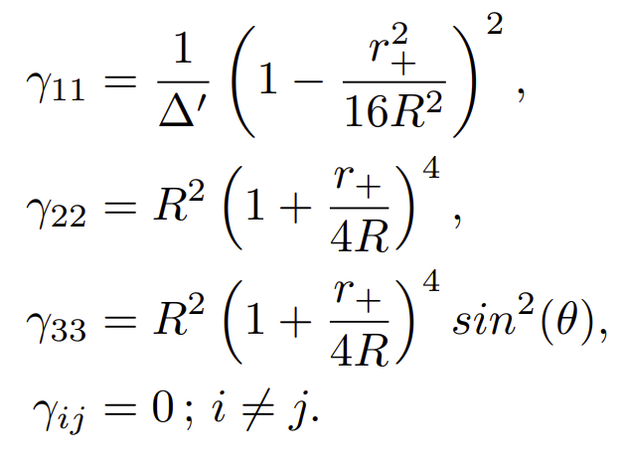

Initial Conditions
Spatial metric:
Extrinsic Curvature:
They satisfy both the Hamiltonian and the momentum constraint.
14

Slide 15
Summary
3+1 formalism is an excellent and easier way for numerical simulation of spacetime.
We found the initial conditions satisfying both constraints using the modified coordinates (to avoid inaccuracies).
By applying the evolution equations, we can, in future, simulate the near-extremal charged black holes!
15

Slide 16
Thank you!
Back up slides ahead…
16

Slide 17

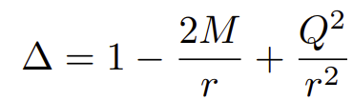

Charged BH
Reissner-Nordström (RN) metric:
RN metric event horizons:
Extremal limit:
17

Slide 18
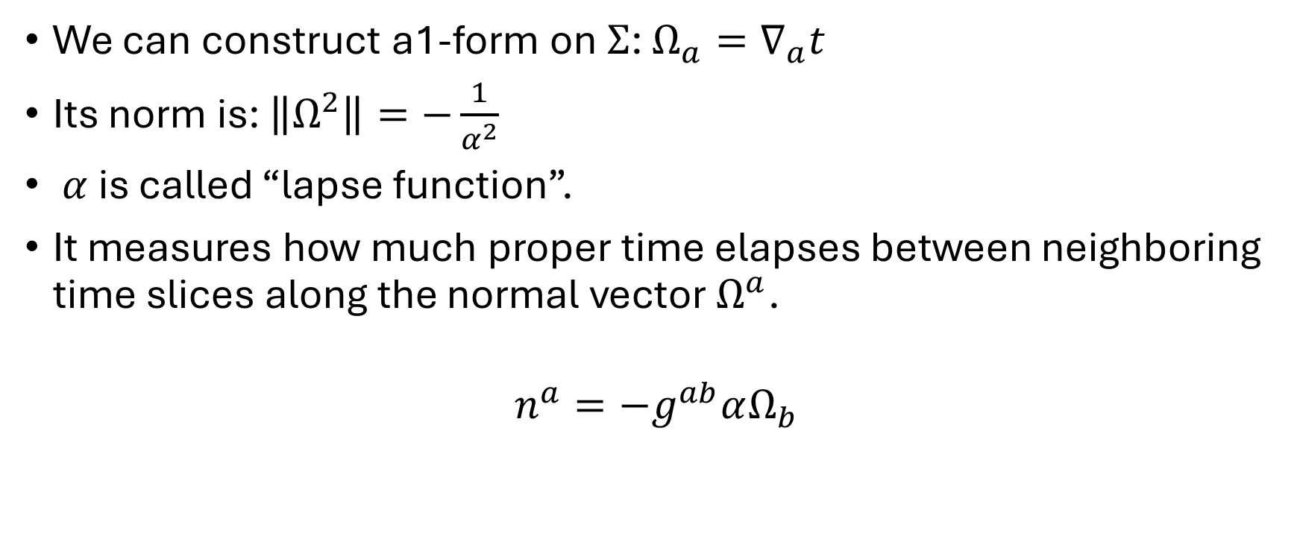
Unit Normal Vector
We can construct a1-form on $Σ$: $Ω_{a}=∇_{a}t$
Its norm is: $\left\|Ω^{2}\right\|=−\frac{1}{α^{2}}$
$α$ is called “lapse function”.
It measures how much proper time elapses between neighboring time slices along the normal vector $Ω^{a}$.
$$n^{a}=−g^{ab}αΩ_{b}$$
18

Slide 19


Projection Tensors
Projection tensor along unit normal:
Projection tensor along the spatial hypersurface:
Using these we can decompose any tensor into 3+1 form.
19

Slide 20
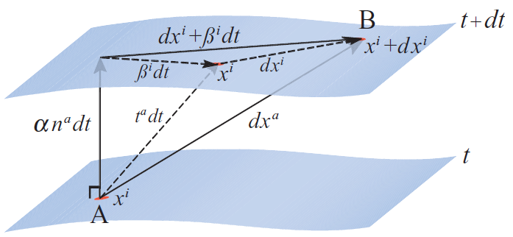

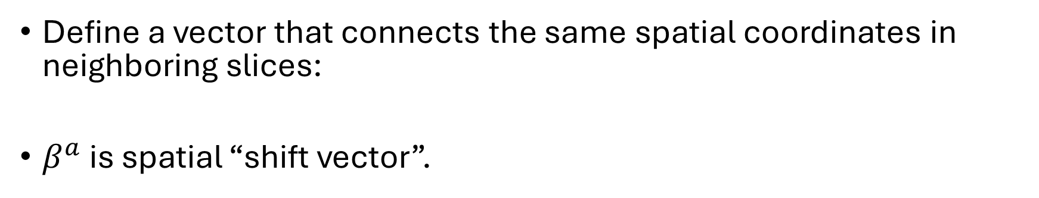
Shift Vector
Credits: Baumgarte & Shapiro, 2010
Define a vector that connects the same spatial coordinates in neighboring slices:
$β^{a}$ is spatial “shift vector”.
20

