Slide 1
Modern Cryptography
Project 2 : Blog Application
Prof. Giovanni Di Crescenzo
Rajat Pawar (N13295898)
Jay Patel (N10541249)

Slide 2
Introduction
Blog Application
User registration
Post blog
View blog

Slide 3
Idea Of Security
Completely secure system is a virtual impossibility.
An approach often used in the security profession is one of balancing risk and usability

Slide 4
Possible Threats To Application
Data modification
Data can be changed in between communication channel
Man in the middle
Data replay
Attacker can resend the same request which was captured previously
Data eavesdropping
Attacker can sniff the traffic between client and server.
Data storage
How data is stored on the server?
Key management
How keys are stored?

Slide 5
Cryptographic Steps
Used HTML5 secure local storage in browser to store the client side keys.
Implemented Asymmetric key algorithm to encrypt the communication between client and server.
Used session variables to mitigate the data replay attacks.
Implemented native methods to store data securely on server.
Notes:
Generally cookies are used to store the local data but we have used html5 secure storage.

Slide 6
Implementation
Server side:
php
C++
Openssl
Client side:
HTML5
Javascript
AJAX
crytoJS

Slide 7
Screenshots

Slide 8
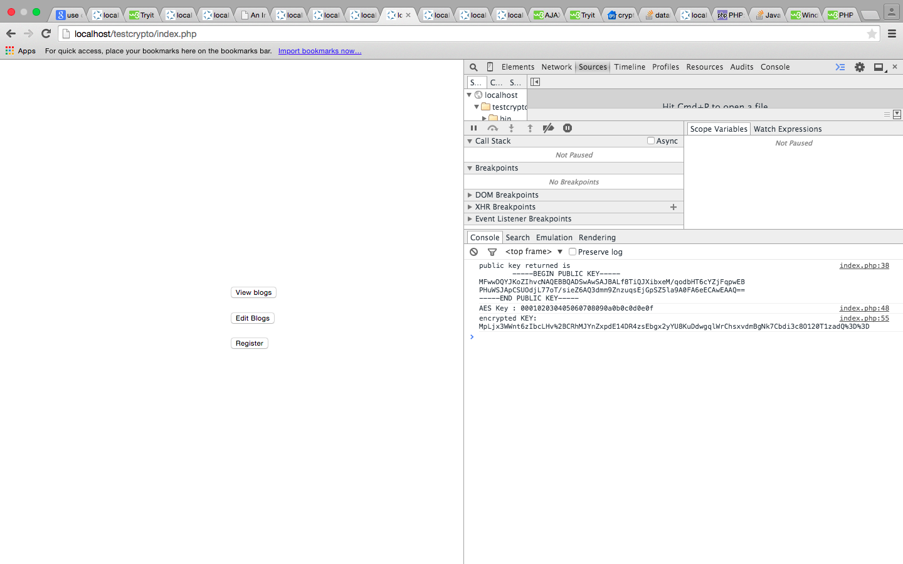

Slide 9
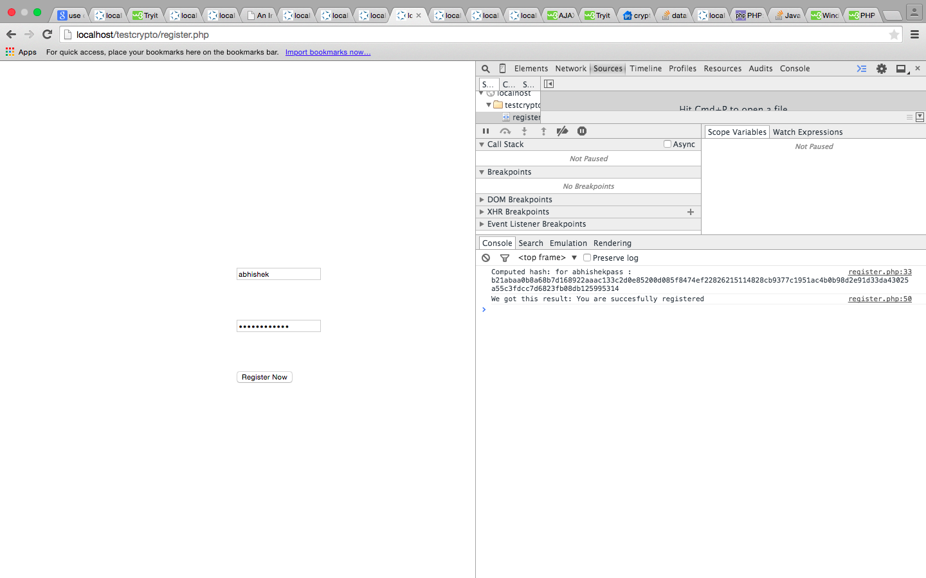

Slide 10
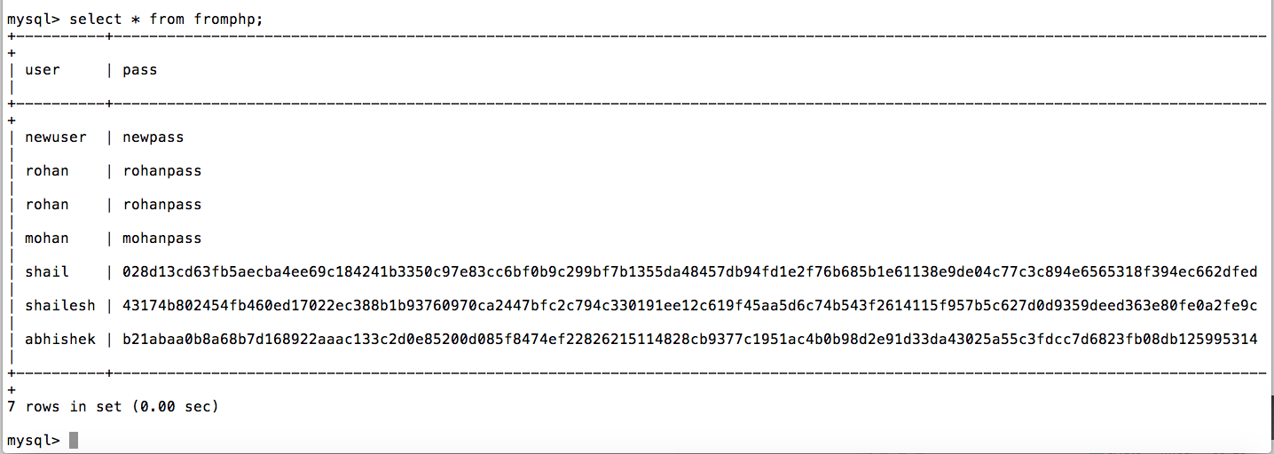

Slide 11
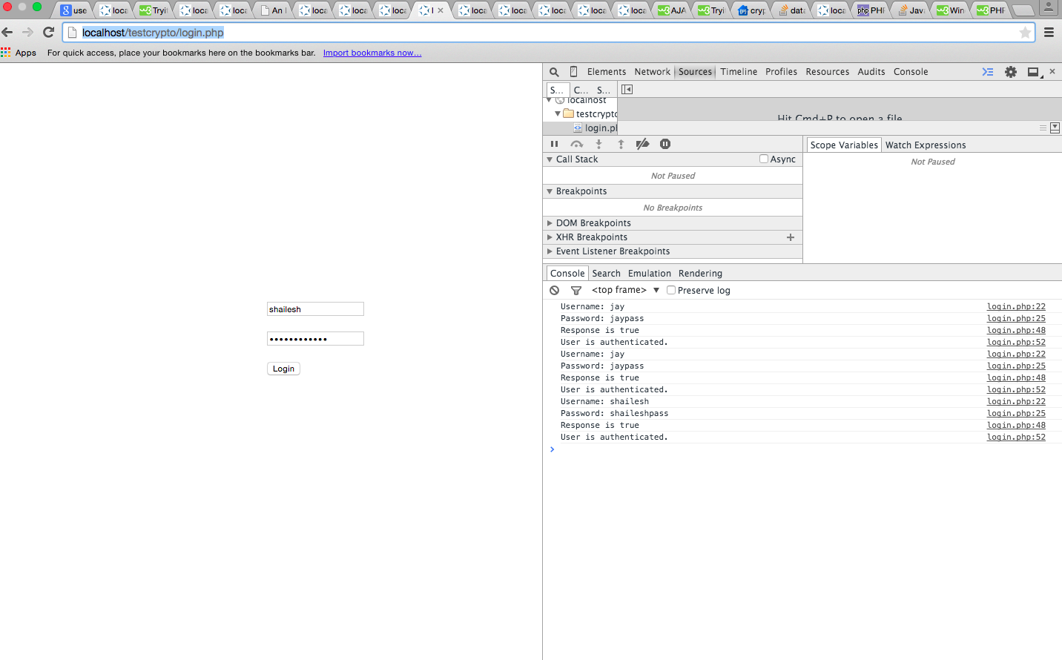

Slide 12
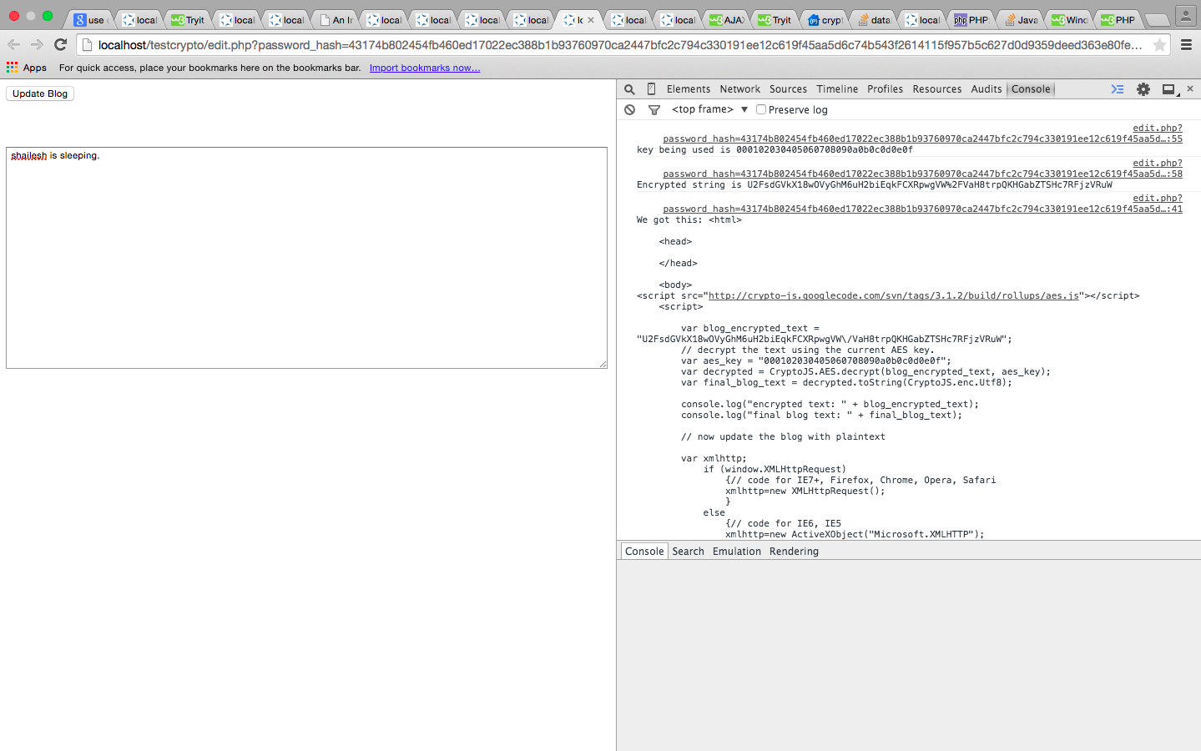

Slide 13
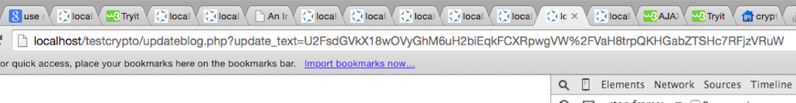

Slide 14
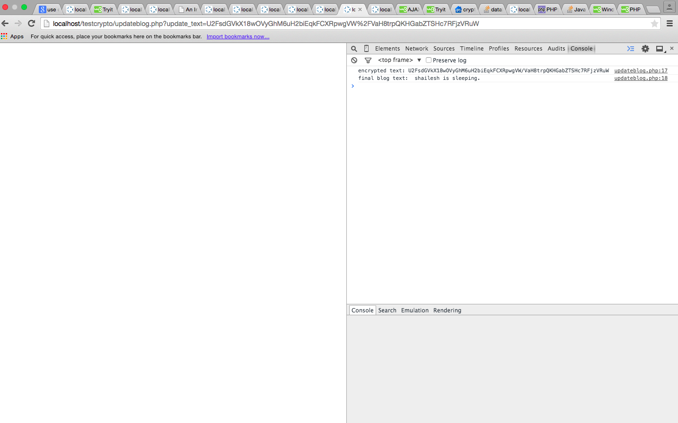

Slide 15
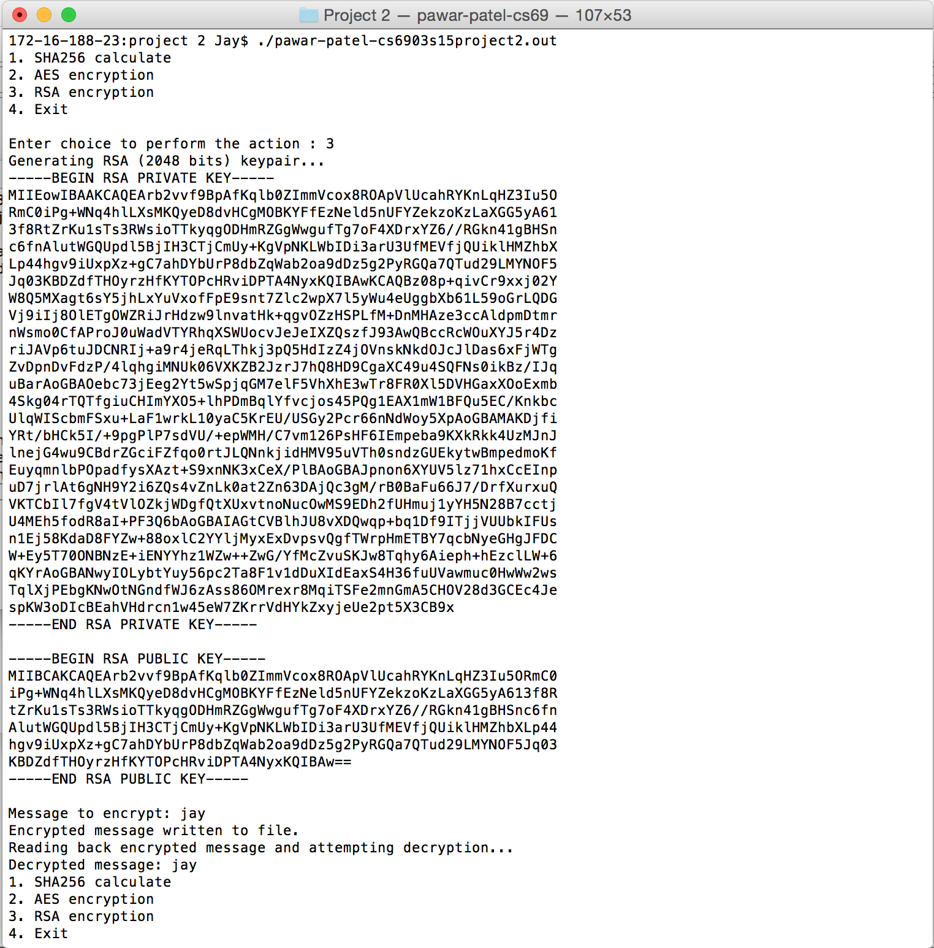

Slide 16
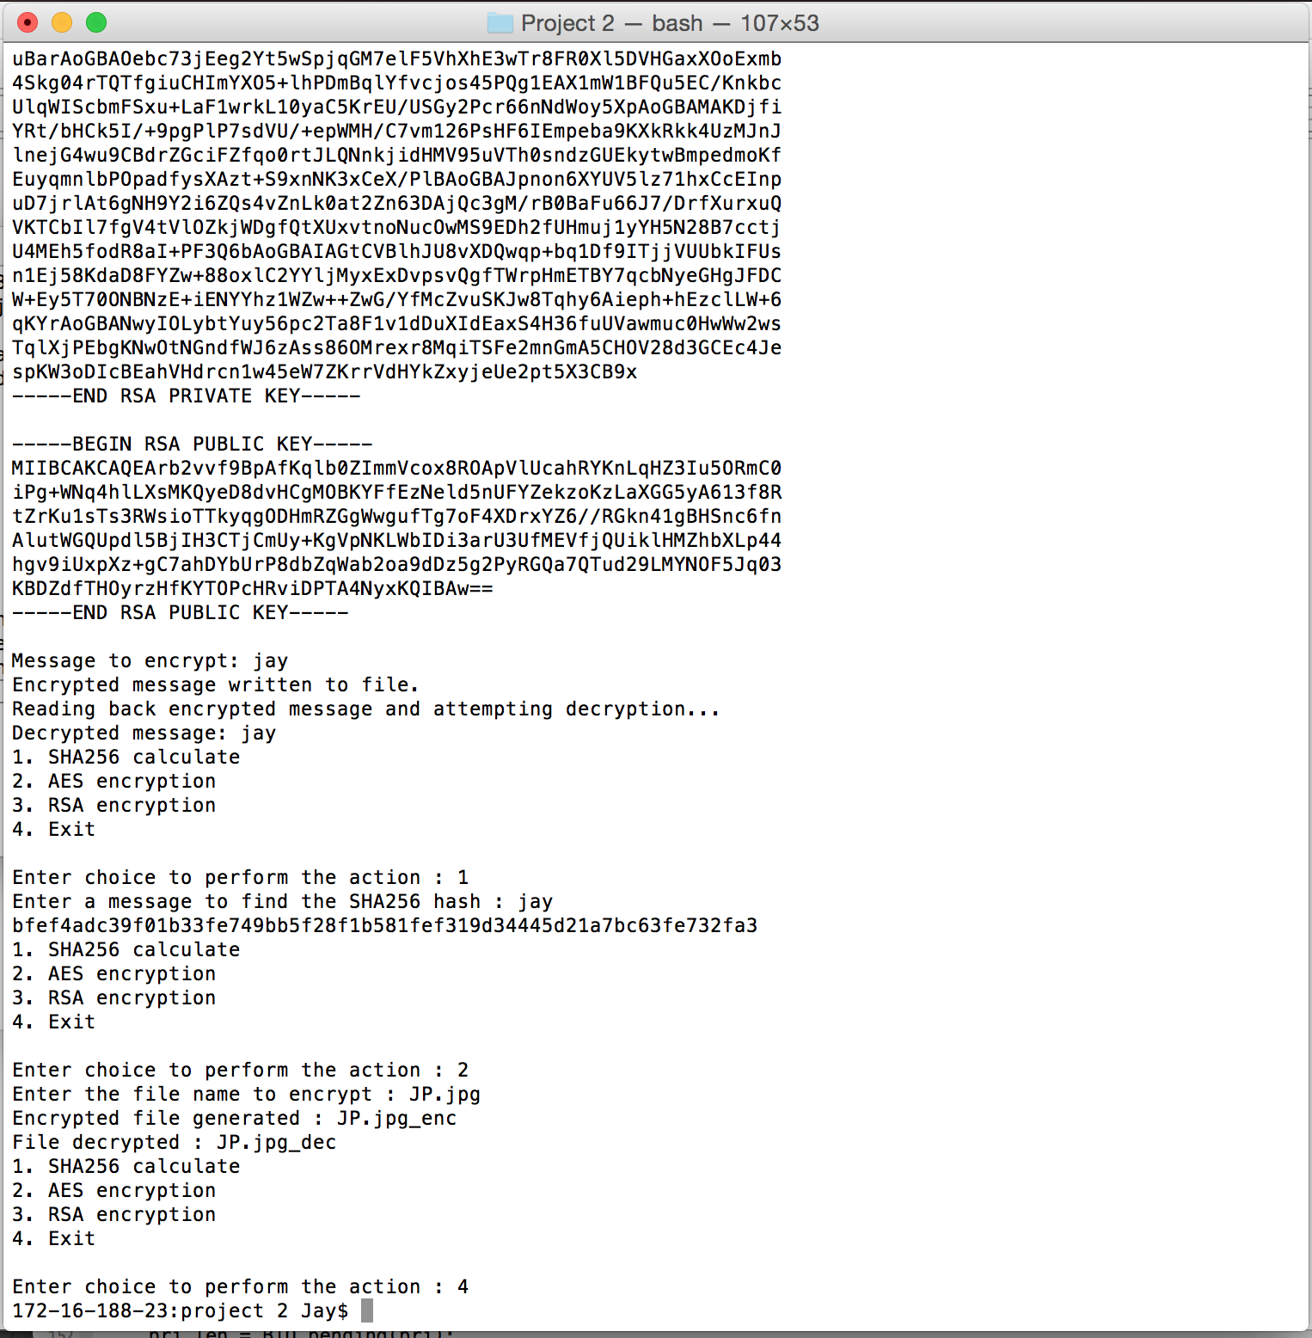

Slide 17
Questions??
Thank You!

