Slide 1
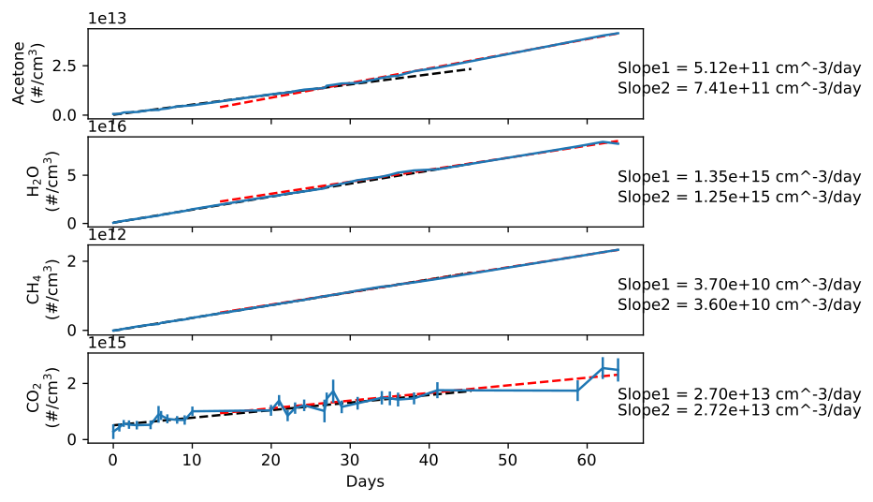
Heating Applied
2
1

